Slide 1
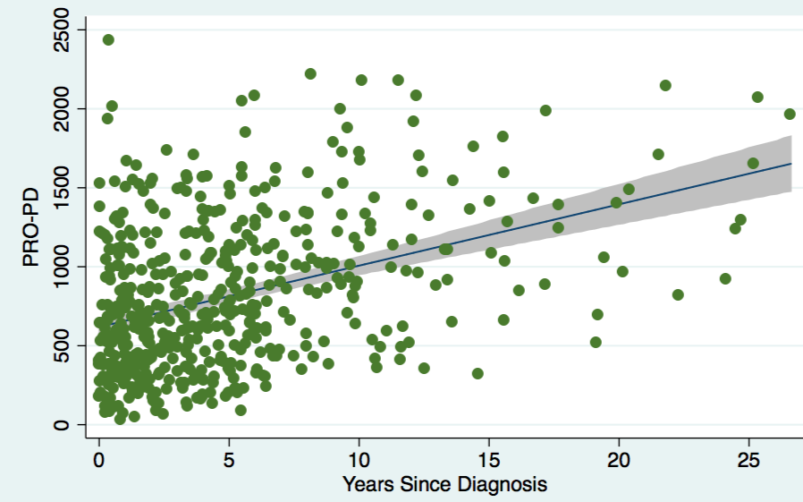
Poor
Fair
Good
Excellent
Quality of Life

