Slide 1
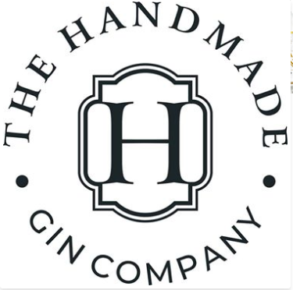
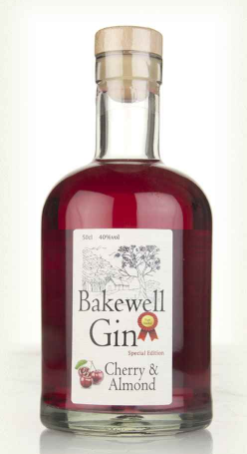



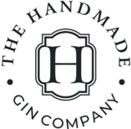
UK'S LOVE AFFAIR WITH GIN SEES SALES HIT AN
ALL-TIME HIGH
19 million more bottles sold compared to 2017 (+40%)
Flavours growing at 751% driving over half of all growth.
Source;- WSTA Market Report 2018
Insert Bakewell Logo Here (from Label)
A big Picture of the Bottle.
Bakewell Gin
Infused with just six botanicals, this is an aromatic craft gin with classic notes of juniper alongside cubeb pepper, cardamom, hibiscus flowers and of course cherry and almond.
40% ABV 6x 50CL
As recommended in;-
A picture of the Case.
Bottle Bar code XXXXXXXX | Case Weight XX Kg | Case Dimensions YYxYYxYY(h) | Case Bar code XXXXX | Cases per pallet 120 |Cases on a layer X

Slide 2
A picture of the Case.
Union Jack Logo
A big Picture of the Bottle.
Union Jack Black Gin
This distinctive black gin is infused with warming aniseed to create a flavour reminiscent of the retro 'Black Jack' sweets. Enclosed in a bespoke matt black embossed bottle. Serve with a splash of blackcurrant juice and top with soda.
Bottle Bar code XXXXXXXX | Case Weight XX Kg | Case Dimensions YYxYYxYY(h) | Case Bar code XXXXX | Cases per pallet 120 |Cases on a layer X
A picture of the Case.
Candy Floss Logo
A big Picture of the Bottle.
Candy Floss Gin
This pink shimmering sweet creation is best served with a premium Tonic Water or Lemonade and sliced Strawberries.
40% ABV 6x 50CL
Bottle Bar code XXXXXXXX | Case Weight XX Kg | Case Dimensions YYxYYxYY(h) | Case Bar code XXXXX | Cases per pallet 120 |Cases on a layer X
A picture of the Case.
Persian Blue Logo
A big Picture of the Bottle.
Persian Blue
This really unusual gin is made using a traditional combination of botanicals i, but the inclusion of Marshmallow Root brings a wonderful sweetness to the overall balance.
Bottle Bar code XXXXXXXX | Case Weight XX Kg | Case Dimensions YYxYYxYY(h) | Case Bar code XXXXX | Cases per pallet 120 |Cases on a layer X
Insert Contact Details here for Handmade Gin – Address and Telephone number.

