Slide 1
ZURITones
Zuri – Swahili language means “beautiful”
Tones – Sounds, Qualities, Vibrations, Atmospheres, Ambiences, Moods, Colours, Shades, Hues
Zuri is all about BEAUTY that NURTURES.
Beauty in terms of a range of high quality decor products for the home and garden that have character as well as craftmanship.
The product range uses and is inspired by the natural energies of Earth, Air, Fire, Water and Spirit.
The product range creates an environment of balance, harmony, healing, and enriches as well as nurtures you and your surroundings.
Sophisticated, Stylish and Luxurious - yet slightly Unusual, Simple, Clean and Minimalist
Classic and Timeless – yet uniquely Contemporary
Powerful and Impactful - yet caringly Gentle
Zuri Tones is a range of wind chimes that are beautifully harmonised and use sound to promote healing and balance. The Air element is the core focus for Zuri Tones.
Keywords / concepts the brand encompasses:
Authentic
Meaningful
Empowering
Enchanted
Mystical
Soulful
Harmony
Balance
Growth
Nurturing
Healing
Energy
Transformation
Possible Colours to include:
Black
White
Silver
Blue
Purple
Green

Slide 2
The Zuri logo will create associations of simple beauty, balance and quality. The addition of the Tones to the Zuri logo will create associations of air, sound vibrations, healing and harmony.
The Zuri Tones logo will illicit feelings of trust in the quality and a sense of overall well-being and pampering.
The core values to be communicated are trust, quality, harmony and beauty.
The target audience:
Mostly female
25-70yrs
Enjoy spending time outdoors in their gardens just relaxing or entertaining
Want to create a cozy, comforting, soothing environment
Are down to earth and genuine and in touch with nature and their surroundings
Appreciate being surrounded by beauty and harmony
Enjoy unique and interesting objects that can add a sense of individuality, luxury, and beauty to their home / garden, or as a gift for those they care about.

Slide 3

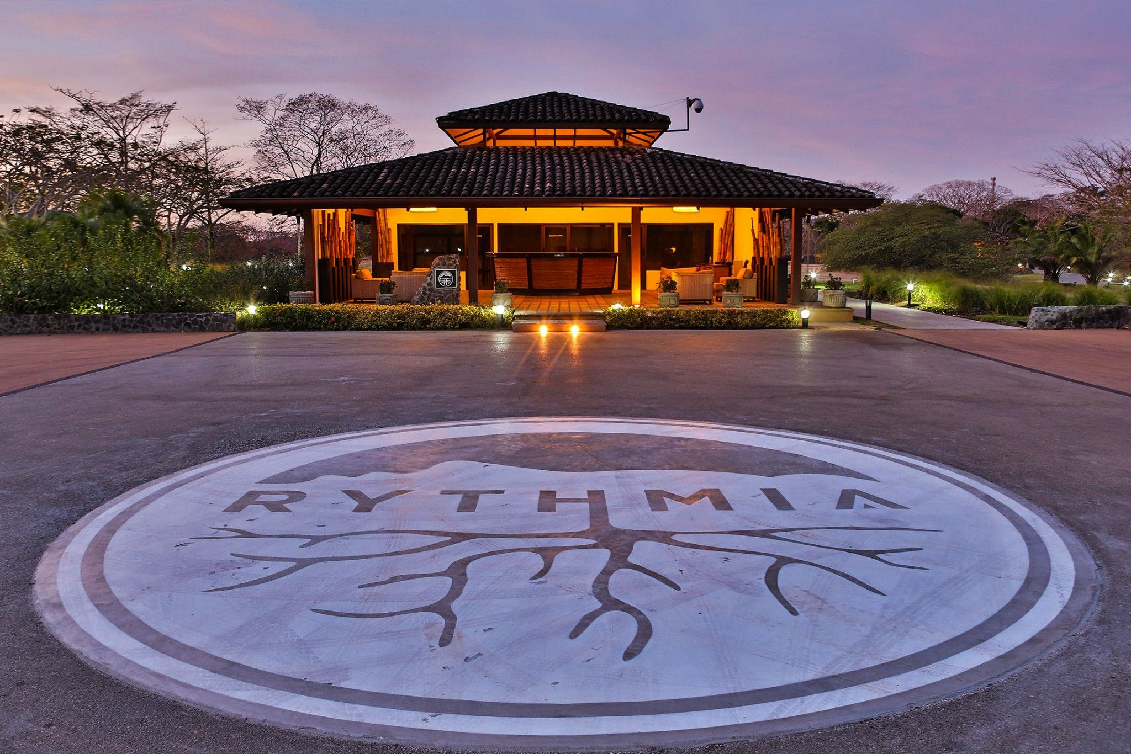

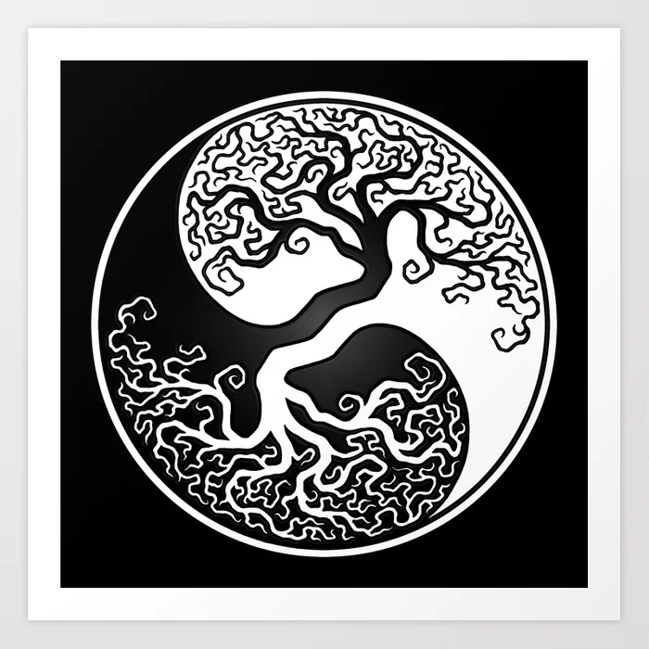
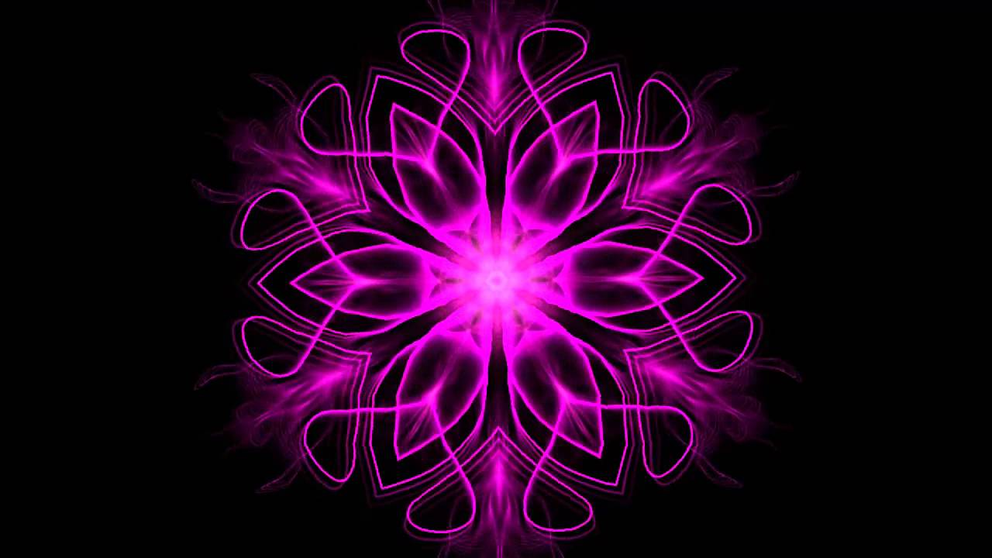
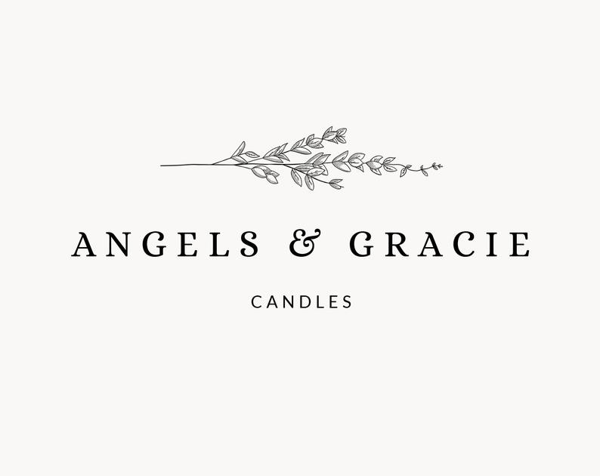
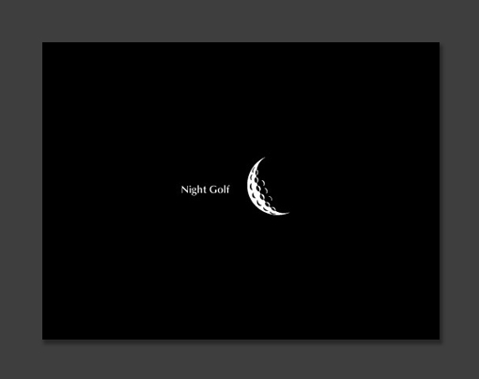


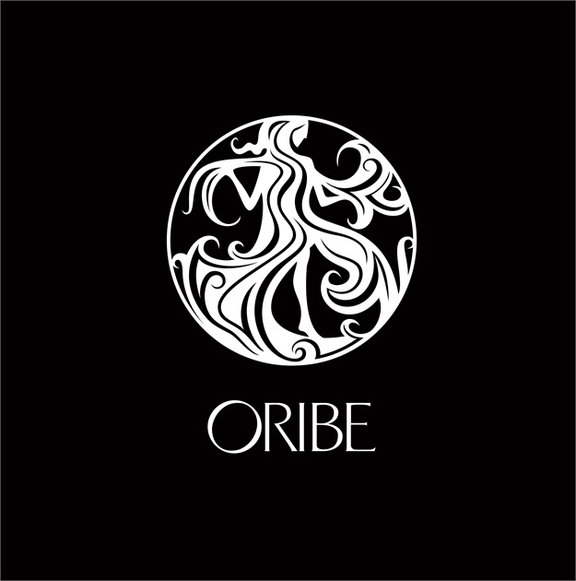
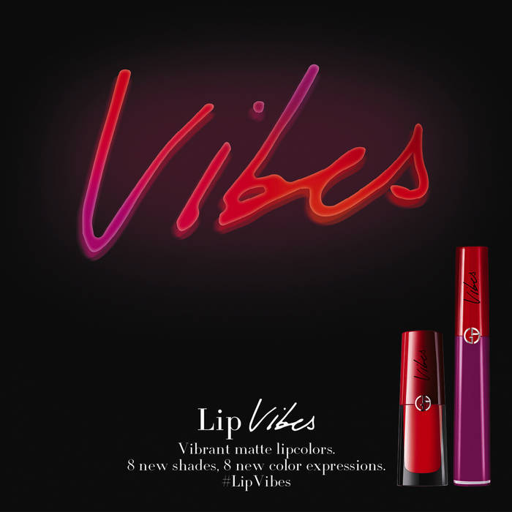
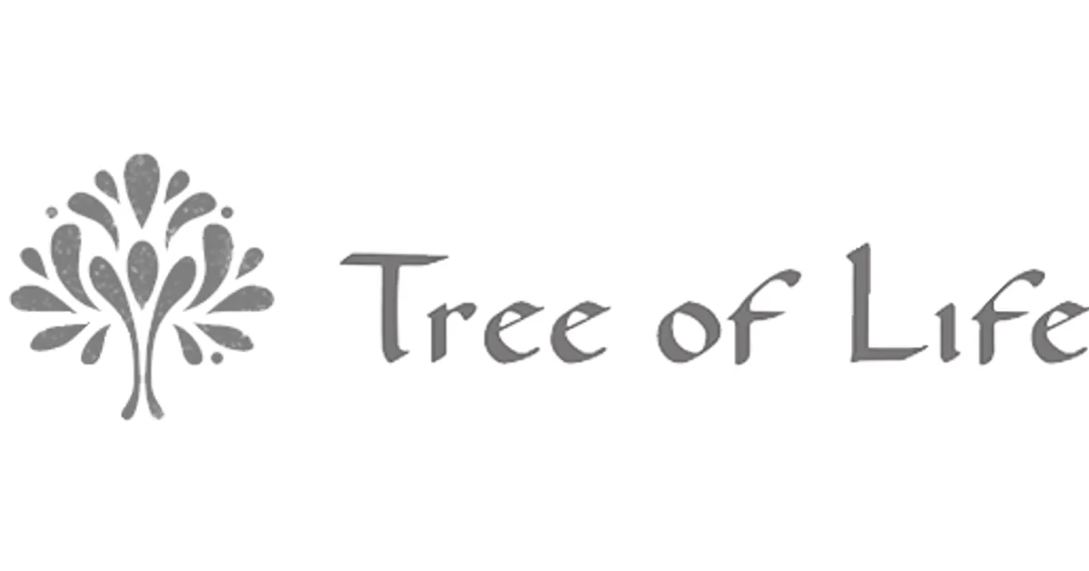

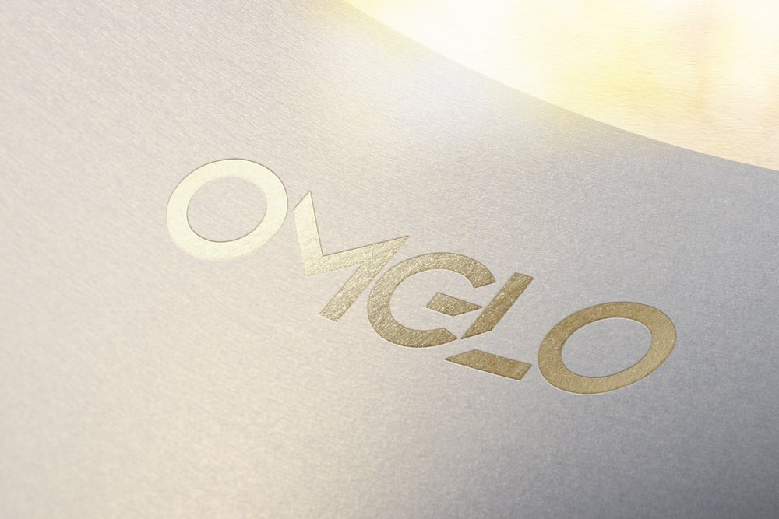

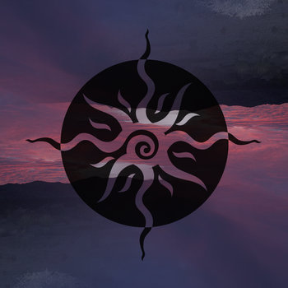

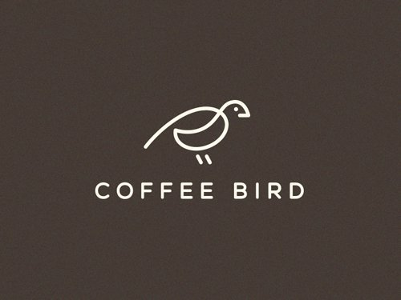


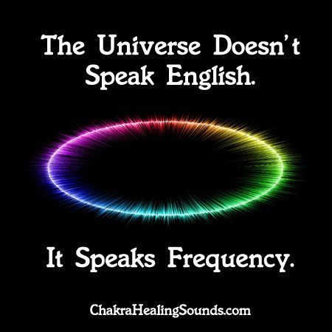
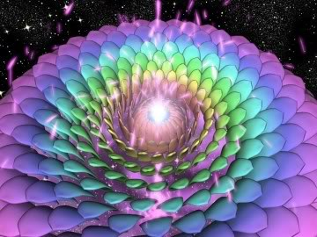
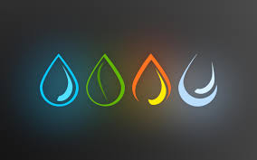

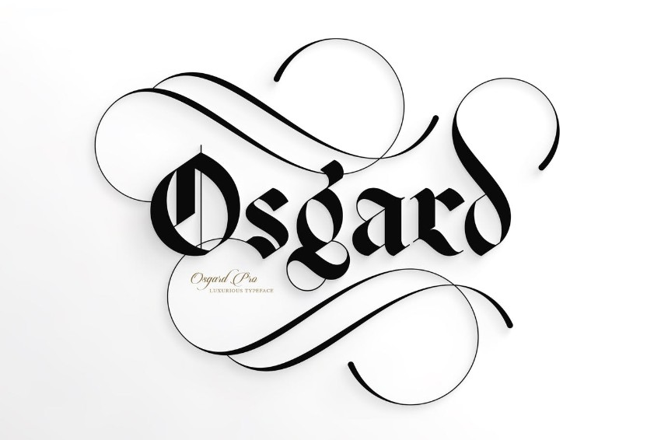

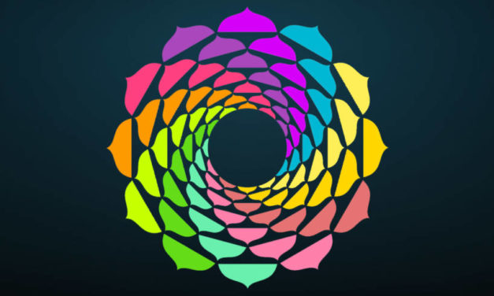

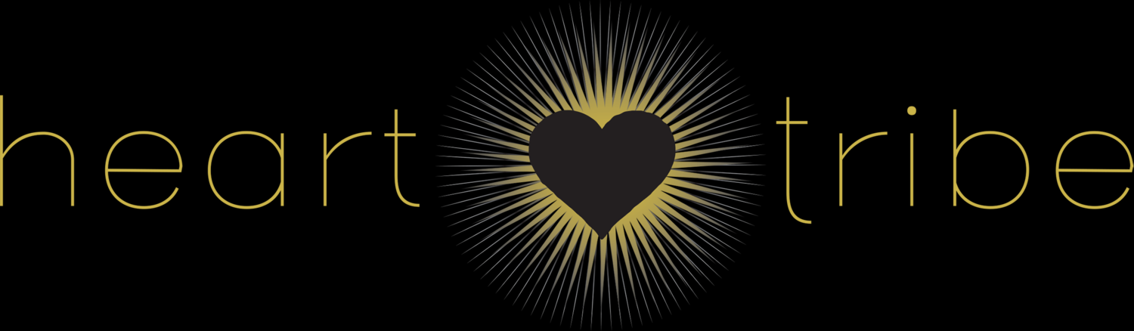
Logos and images that were interesting / resonated for thought and inspiration:

