Slide 1
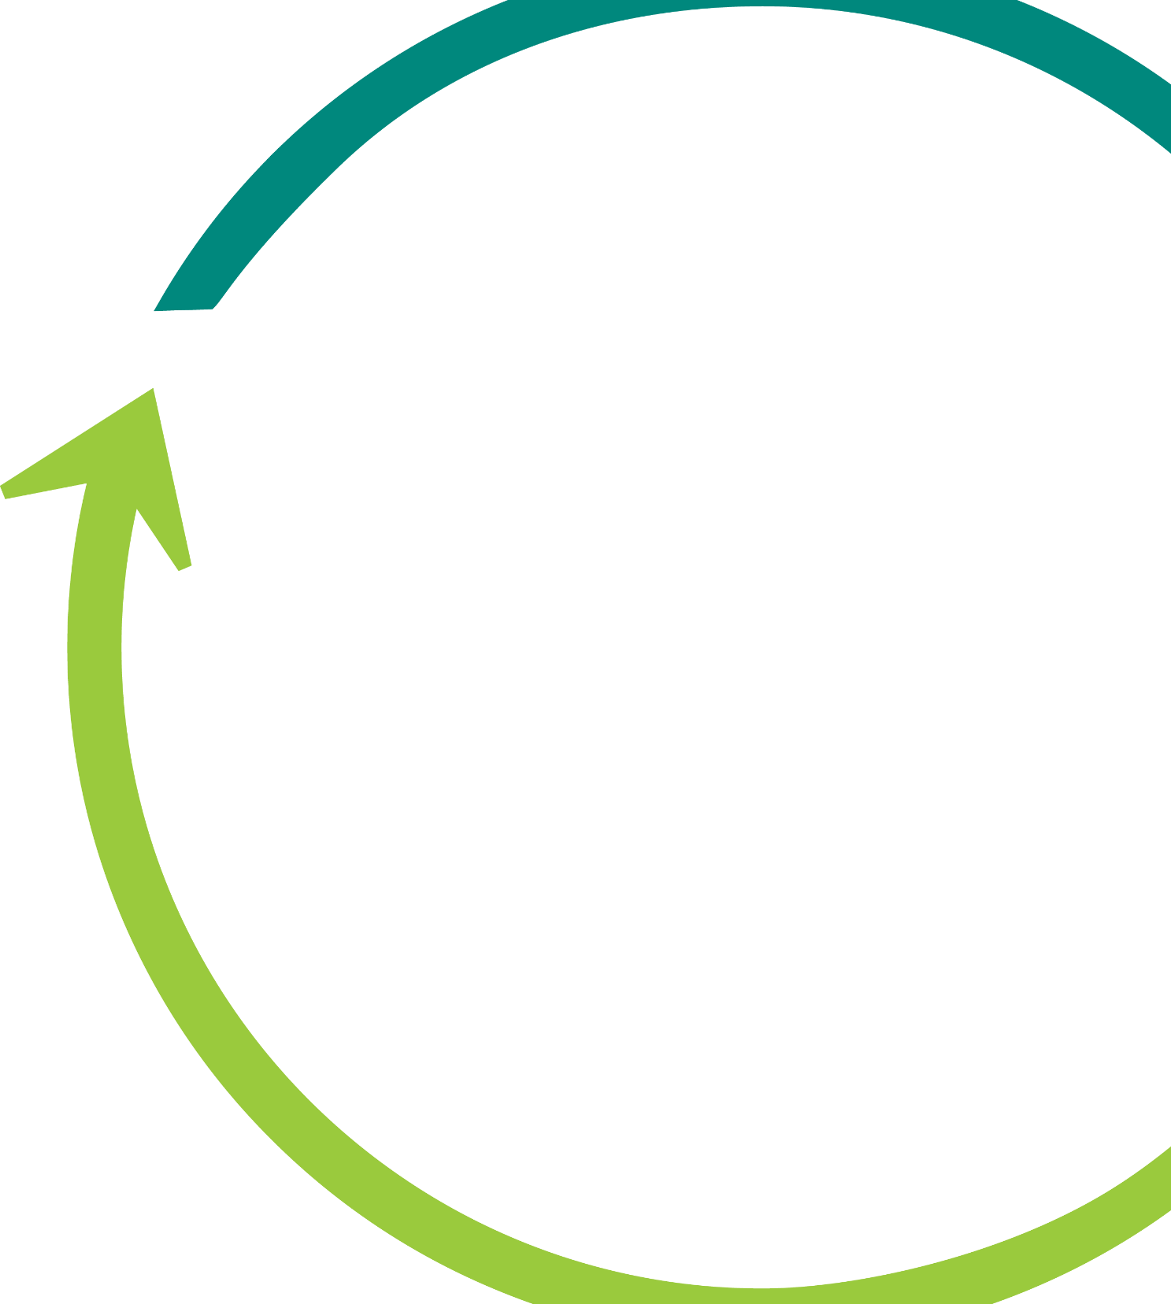





The Life Sciences Marketplace
The Solution to Obsolescence, Marketing, and Procurement
www.rawconn.com

Slide 2




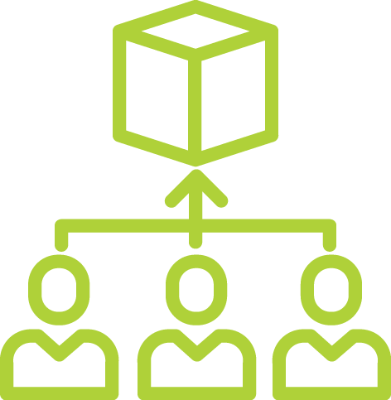




What is RawConnect?
A Virtual Life Sciences Marketplace
Buy and Sell New, Used, & Excess Raw Materials and Equipment
Create a Store in Minutes
Life Science Manufacturers, Researchers, & Suppliers
Vetted Vendors and Buyers
2

Slide 3
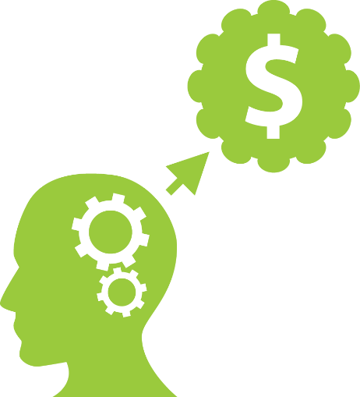

About Us
MISSION
VISION
Greener, more cost efficient, and quality driven supply chains through use of a life sciences marketplace.
Organizations no longer have to transfer waste to patients, the environment, and shareholders.
3
Notes:
Our priorities are twofold:
Help organizations reduce cost to create more access for patients
Reduce the waste that is transferred to the environment

Slide 4






Our Process
Register
Set-up Payment
Flexible payment options for sellers and buyers
List Materials
Buyers and Sellers vetted upon registration. Sign user agreement.
Listings vetted
01
02
03
04
05
Connect
Checkout and Sign
Buyers and Sellers can contact one another to discuss terms
Agree to transaction information and sign when required
4
Notes:
Register- Everyone must be vetted as we ensure only professional scientific or science-like organizations are permitted on the marketplace.
Set-up Payment- This is for vendors only. They have the liberty to customize their store, upload a logo, develop their own terms and conditions, etc. They will set up a merchant account with Stripe and can accept credit payments. Or, they can elect for transitional invoicing on a 30 or 60 day term, and RC will invoice for the vendor for fees.
List Materials- Products can be listed individual or by CSV. Buyers can only buy one products from one vendor at a time. Listings are vetted to ensure they are not APIs, intermediates, narcotic based, etc.
Connect- What makes us special is that our platform encourages connecting and communications. All products can be customized for exclusive purchased after negotiations.
Check out and sign- All transactions are eligible for signature on our part 11 DocuSign. The transaction simply needs to have the “signature requested” checked, and RC will send the PO for signature to both parties.

Slide 5

Why Do This?
1
Reduced Inventory Write-offs
2
Reduced Disposal Costs
3
Collaborate with the Life Science Community
4
Reduce Environmental Waste
5
Immediate Benefits and Practical Solutions
5

Slide 6
Why Do This Explained
Larger
Likely Seller
Size?
Aftermarket
New/Original
Manufacturer
Why Be A Seller? | Why Be a Buyer? | Why Be a Supplier?
Reduce Disposal Costs | Reduce Purchase price of cGMP or Non cGMP products | Expand your marketing base and reach.
Costs of landfill, inactivation, incineration can be high | Purchase Lower Quantities - Many suppliers require large or bulk amounts. Can help with research. | Easily set-u a store and get in business in minutes.
Reduce CoGS by recouping/reducing write off costs | Create more suppliers. Can reduce risk if limited suppliers | No monthly premiums
Reduce Inventory carrying costs. Get obsolesce out of your warehouse, cold room, etc. | Reduce lead time and availability in emergencies. | Flexible fees
Reduce Environmental Impact | Collaborating with other LS organizations | Access to a wide and diverse science based network
Likely Buyer
Smaller
Larger
Likely Supplier
Site Type?
Supplier
Size?
Likely Supplier Likely Buyer
Smaller
Larger
Like Seller
Likely Buyer
Research
Size?
Likely Buyer
Smaller
6

Slide 7
Our Features
1
Quality Aligned User Agreements
2
Part 11 Compliant Signatures as Required
3
Easily Negotiate and Share Information
4
Industry Aligned Product Information
5
No Monthly Fees. No Risk or Commitments
5

Slide 8

Why Us?
Experienced Support and Staff
Quality-driven marketplace - CFR 21
Fast transactions and store set-up
Independently Managed Marketplace
Vetted Vendors and Listings
7

Slide 9
Why Us Explained
Experienced Staff
  R&D, Commercial, Quality Assurance, Supply Chain, and general business and LS experts who understand your business and can help
Quality Driven Marketplace
  We ensure a robust user agreements sets quality standards. We vet all products prior to approval. We regulate the marketplace in a professional manner.
Easy Set-up
  Whether an original supplier or manufacturer recouping write-offs, we can get you set-up with a professional store in minutes with your own terms and conditions, payment methods, and shipping methods.
Independently Managed
  We are not affiliated with any buyers or sellers. Everyone is subject to professional and objective rules and policies of the marketplace to ensure quality.
All Sellers and Buyers Vetted
  Only science based organizations with ties to their jurisdiction and no federal injunctions are permitted to buy and sell.
8

Slide 10
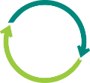
Why Now?
Patients buying waste in an environment with high priced medicines.
Government can create stricter environmental and humanitarian laws that apply retroactively (CERLCA)
Immediate environmental footprint reduction
9

Slide 11
Why Now Explained
Patients Buying Waste
  Political, Societal, and Economic pressures continue to mount on drug prices. More scrutinization of practices will come making it important that patients are not buying waste associated with products.
Changing Federal Tolerance on Waste/Environment
  EPA, FDA, and other government continue to make environmental reporting more strict and enact harsher laws for waste. Better to be ahead of legislation than behind it.
Progressive Companies Winning
  Companies who challenge the status quo and find new ways to reduce costs and impacts on the environment continue to upstage complacent ones.
10

Slide 12




THANK YOU
For Your Time
844-383-7272
info@rawconn.com
www.rawconn.com

