Slide 1


http://www.drsmtc.com
Home
About Us
Services
Good Reads
Contact
Dr Moussavand Tranquility Center
6001 Cochran Road, Suite 111, Solon, OH 44139 (440) 394-8488 dr.Moussavand@drsmtc.com

Slide 2
Home Picture(s)
Logo + Business Name + image of serenity, tranquility, calm...
Home Text
Each individual is unique with unique personality and unique needs. Therefore we provide individual treatment customized for you or your child. Multiculturalism also informs our practice. We are a full service mental health practice with the capacity to serve adults, children, teens and their parents.
We provide high quality evidence based treatment and care including medication management, pharmacogenomic testing, individual psychotherapy, group psychotherapy, art therapy, CBT, DBT and trauma therapy. Our providers are experts in treating variety of illnesses such as depression, anxiety, schizophrenia, ADHD, gender identity concerns and PTSD.
We are experienced in a variety of methods that help people achieve their psychological goals, and we will discuss with you the best ways to attain the health and wellness that you deserve. We are committed to helping you achieve your optimal level of emotional functioning and fulfill a successful life.
Tel & Address
Telephone, email, and address showing on all pages

Slide 3
About Us picture(s)
Showing professional/experts in an yoga/meditation type of environment. Convey a feeling of Happy or elated mood.
About Us Text
You will find a number of highly specialized – experienced and caring therapists and psychiartrists in Tranquility Center. We provide medication management and psychotherapy (counseling) across the lifespan.
– children, teens and adults.
Other than English, we speak the following languages
Spanish
German
Farsi
Hebrew

Slide 4





About Us scroll down, shows providers’ pictures (5 of them)
Each provider picture is associated with a text tag (name + title) and a bio-brief (about one paragraph)

Slide 5
Services picture(s)
Icons/pictures depicting the bullet points below
Services Text
Medication management
Psychotherapy: Individual, group, couples, and family
Art Therapy
Treatment Approach
Treatment Areas
Each bullet point is a link

Slide 6

Service > Medication management
one or two paragraph (to be provided by customer) + pictures

Slide 7

Service > Psychotherapy: Individual, group, couples, and family
one or two paragraph (to be provided by customer) + pictures

Slide 8
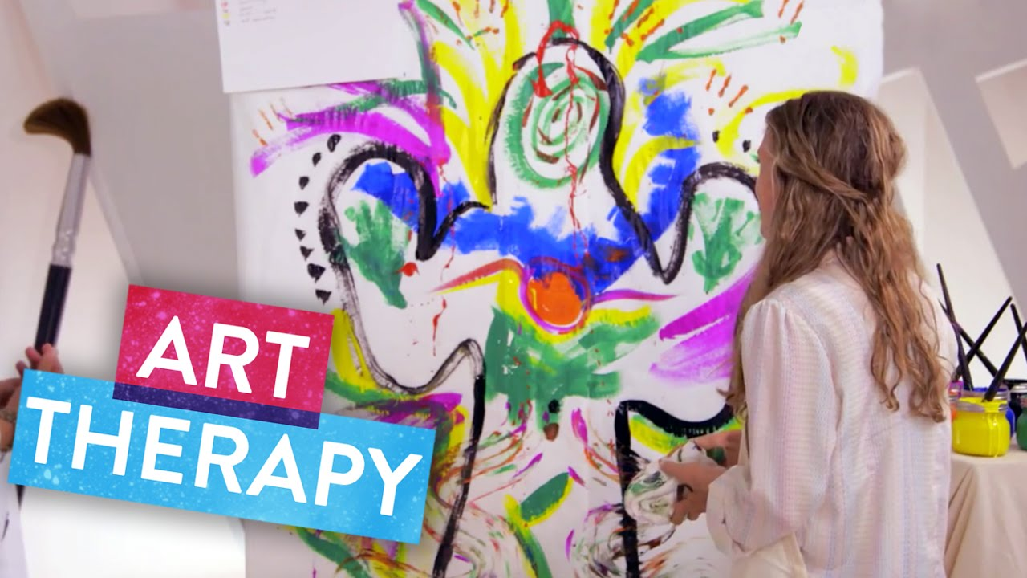
Service > Art Therapy
one or two paragraph (to be provided by customer) + pictures

Slide 9

Service > Treatment Approach
one or two paragraph (to be provided by customer) + pictures

Slide 10

Service > Treatment Areas
  Depressive disorders
  Anxiety disorders
  Attention-deficit/hyperactivity disorder
  Bipolar disorder
  Posttraumatic stress disorder
  Adjustment disorders
  Schizophrenia
  Borderline Personality Disorder
  Trauma
  Anger management
  Bereavement/Grief
  Family conflict
  Parenting
  Women’s issues
  LGBTQ issues
  Relationship issues
  Abusive relationships/domestic abuse
  Life/professional transition issues

Slide 11


Good Reads
Title
Author
description (1 paragraph)
Title
Author
description (1 paragraph)

Slide 12
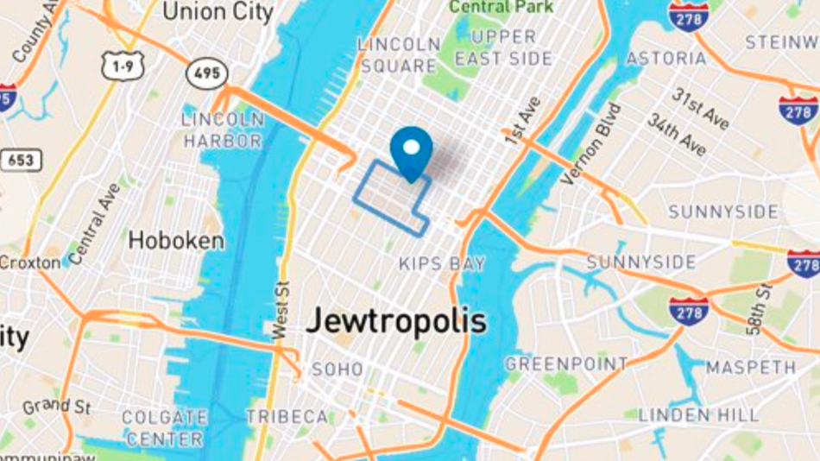
Contact
6001 Cochran Road, Suite 111, Solon, OH 44139
(440) 394-8488
dr.Moussavand@drsmtc.com
Appointment Request
First Name
Last Name
email
Tel
Please contact me for an appointment
Submit

