Slide 2
We make e-commerce fulfilling

Slide 3

WHO ARE WE?
Sprint Logistics – Heston, Middlesex
Aizad Hussain
CEO & Principal
Imran Hussain
Managing Director
Stuart Tudgay
Operations Manager
Mark Smith
Account Director
Sprint Logistics – Peterborough, Cambridgeshire
Helen Anderson
Managing Director
Martin Hewitt
Operations Manager
Nic Price
Head of Logistics
Experts in storage, order processing and fulfilment for e-commerce. Guardians of your brand and delivering your customer promise cost effectively and on-time.
Multiple sales channels but a single warehouse partner, we integrate with own e-store, amazon, E-Bay, Gumtree, Etsy, etc.

Slide 4
WHO ARE WE?
We’re the partner that prevents the ‘roadblocks’ to your growth!
No managing multiple sites, no separate stock inventories.
Simpler communication, single delivery point for stock, consolidated reporting for all sales and and stock movements.
One point of accountability.

Slide 5

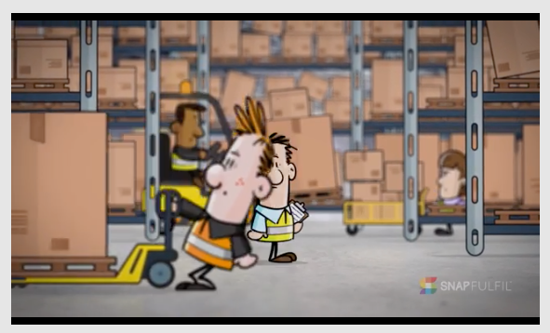
You’ve never heard of us?

Slide 6
These are some of our clients…..

Slide 7
How could we help you?

Slide 8

OK, Lets look at working with Amazon and your own e-store as examples…..

Slide 9
Working with AMAZON FBA

Slide 10
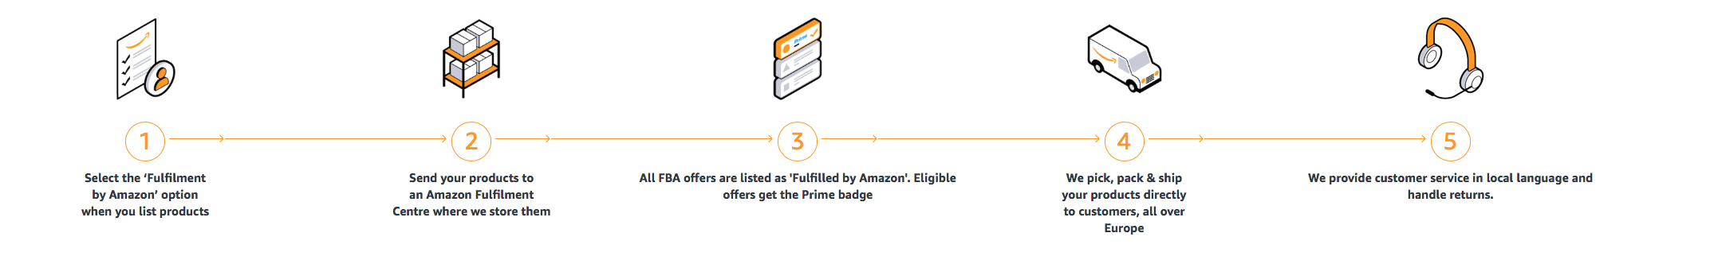

Amazon FBA & 3PL
1
2
3
4
5
You send products to Amazon
Amazon stores your products at their warehouse
Customers purchase your products
Amazon picks and packs products
Amazon picks, packs products & ships to customer
Benefit from ‘association’ with Amazon brand and advertising plus:
  - Free Shipping,
  - Prime Service
  - Customer perception of Amazon service.
Notes:
This is the basic premise of FBA fulfilment
May be best option for your business
Great associational benefits by being integral to the amazon ‘experience’
3PL can still work with you within this model to potentially add value to your business………

Slide 11

Amazon FBA & 3PL
So how can we help?
No need for your own storage are, so reduced cost or better use of current space
No time spent checking items for QC or volume accuracy
No time spent on amazon booking-in or admin processes
A 3PL can prepare product before delivery, production and affixing of barcode labels to products in line with amazon requirements
Greater staff and resource pool on hand to deal with large call-off
Able to use same stock at 3PL for own online order channel
Notes:
- Rather than hold the stock you ship to amazon, let a 3PL do that side of the work. WALK THROUGH SLIDE.

Slide 12
Working with AMAZON FBM

Slide 13
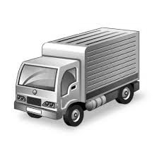
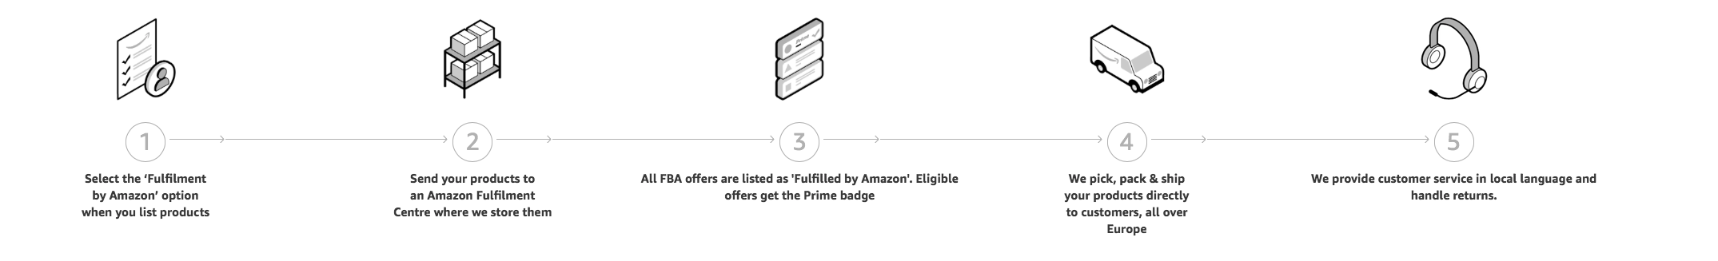
Amazon FBM & 3PL
1
2
3
4
5
You list your products for sale on Amazon
You pick and pack the stock from your own location
You arrange shipment via your own post/carrier contract
Customers purchase your products
Order data is passed you for fulfilment
Allows you more flexibility in controlling inventory and quality control as well as substantially lower seller fees than FBA
Notes:
This is the basic premise of FBM fulfilment
May be best option for your business
Some associational benefits by being integral to the amazon ‘experience’
3PL has a larger role to play in this scenario as they hold and ship the goods.
Basically normal 3pl fulfilment but the sales channel is amazon rather than your own e-commerce store

Slide 14
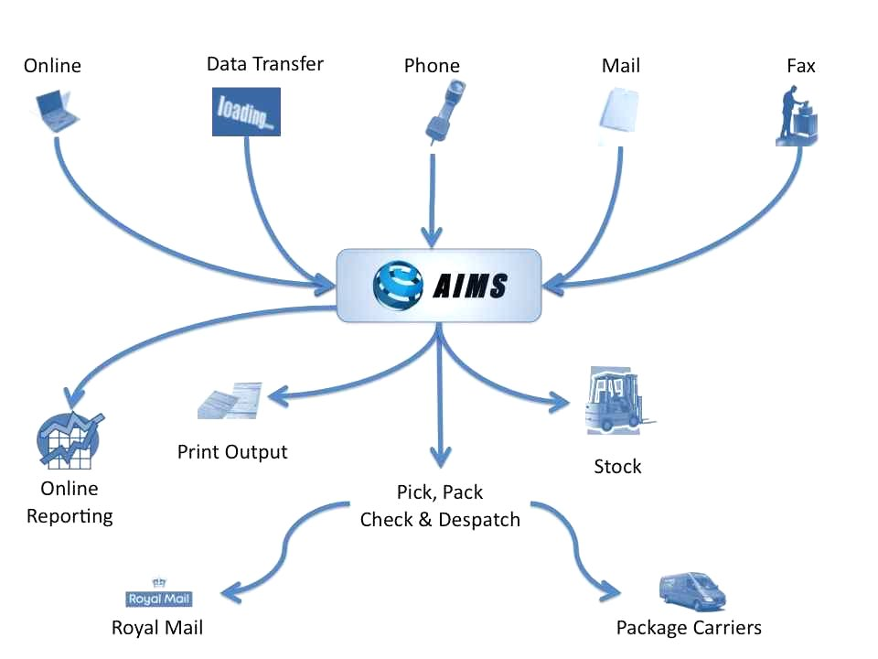


Amazon FBM & Working with Sprint?
Your product at 3PL location so no need to store yourself
No time spent checking items for QC or volume accuracy
Immediate listing of new products you create yourself
Easier stock variance, less commitment (e.g. trial new items)
Full stock visibility, usually in real-time
Economies of scale available based on combined volumes of 3PL activity
Capability to add ‘bounce-back’ leaflets of catalogues to each order
Able to use same stock at 3PL for own online order channel
Notes:
Basic fulfilment. Just a dedicated sales channel via Amazon rather than your own website
WALK THROUGH SLIDE.

Slide 15
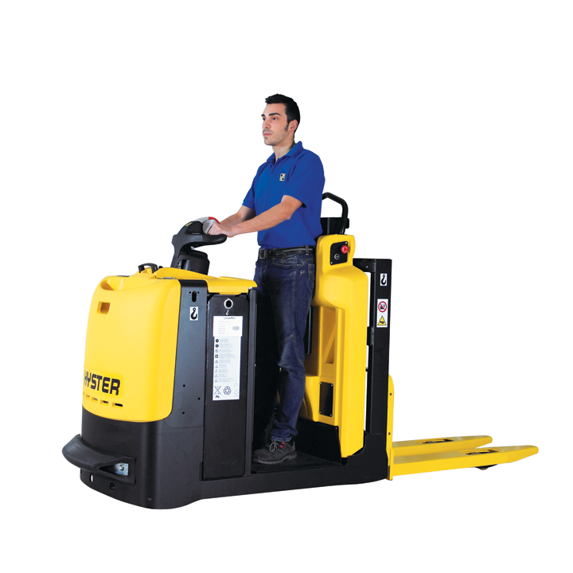
Working with Your own e-store

Slide 16

Your own e-store & 3PL
1
2
3
4
5
Customers purchase your products from your store and other channels of your choice
Items shipped to customer via one of a variety of services of your choice
You send products to 3PL
3PL stores your products at their warehouse
3PL receives orders directly and picks and packs products
Your store, your sales, your revenue!
Multiple sales channels of your choosing (own store, Wowcher, NOTHS, Etsy, Groupon, etc).
Mix and match sales channels as it suits your business, consolidate in one warehouse and logistics partner
Notes:
This all about you! Your store or a range of channels
You hold stock, receive orders directly from the store(s) and arrange shipping
The whole end-to-end service from goods in to order receipt and processing through to pick, pack and shipping can be handled by the 3PL
they can supply reporting on stock levles, best selling items, delivery tracking, and even customer services in some cases.
You pick and mix

Slide 17
Your own e-store & 3PL
Your product at 3PL location so no need to store yourself
No time spent checking items for QC or volume accuracy
You control availability and back order build up from your site
Easier stock variance, less commitment (e.g. limited time offers, etc.)
Full stock visibility, usually in real-time
Economies of scale available based on combined volumes of 3PL activity
Capability to add ‘bounce-back’ leaflets of catalogues to each order
Able to use same stock at 3PL for additional sales channels (Wowcher, Groupon, NOTHS, etc.)
Notes:
- WALK THROUGH SLIDE.

Slide 18
Now you’d like a case study I guess?

Slide 19
Welcome to the world of classic Vinyl and CD music….

Slide 20


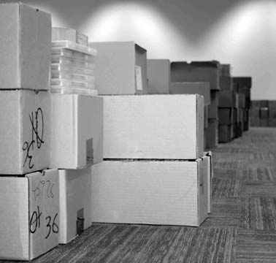

Specialise in Classic and Collectible vinyl
Ends up with a lot of ‘excess’ CD’s when buying
Stock comes in ‘blind’, no idea whats in cartons, no paperwork there than X number of cartons/pallets
We sort into titles and then grade every item by hand into categories for resale
Place sorted goods into stock and list by SKU & title online

Slide 21
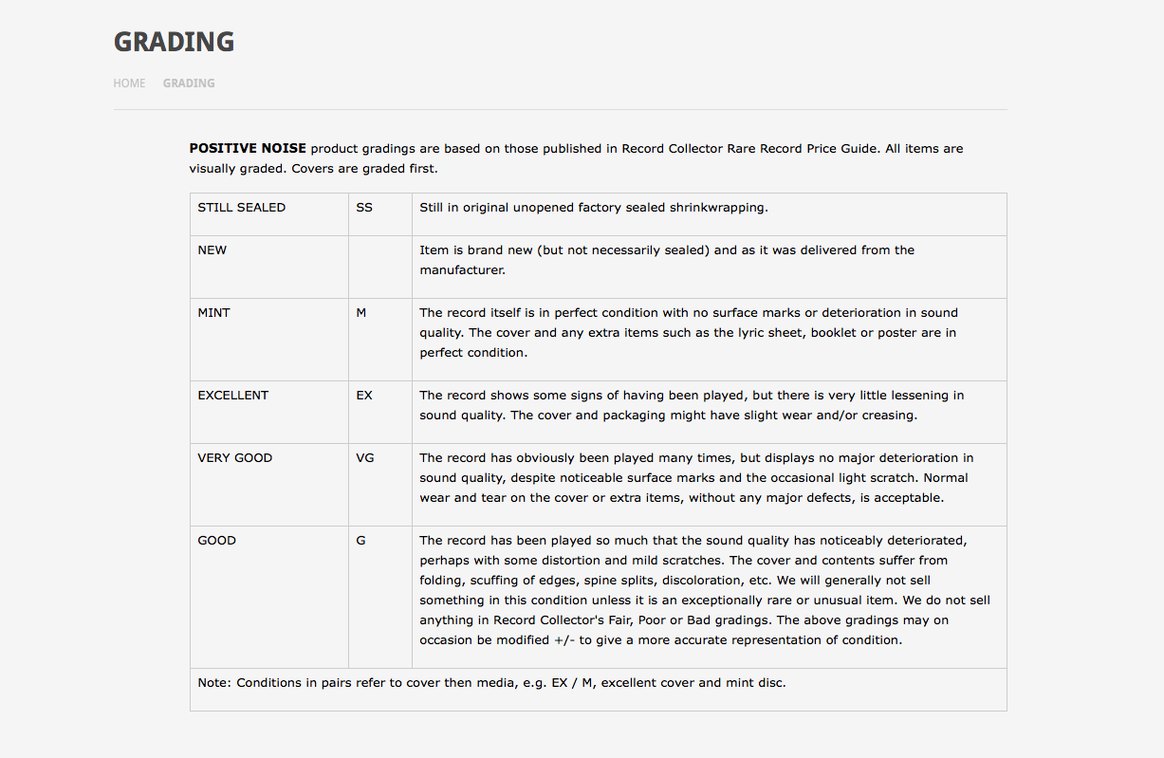

Slide 22
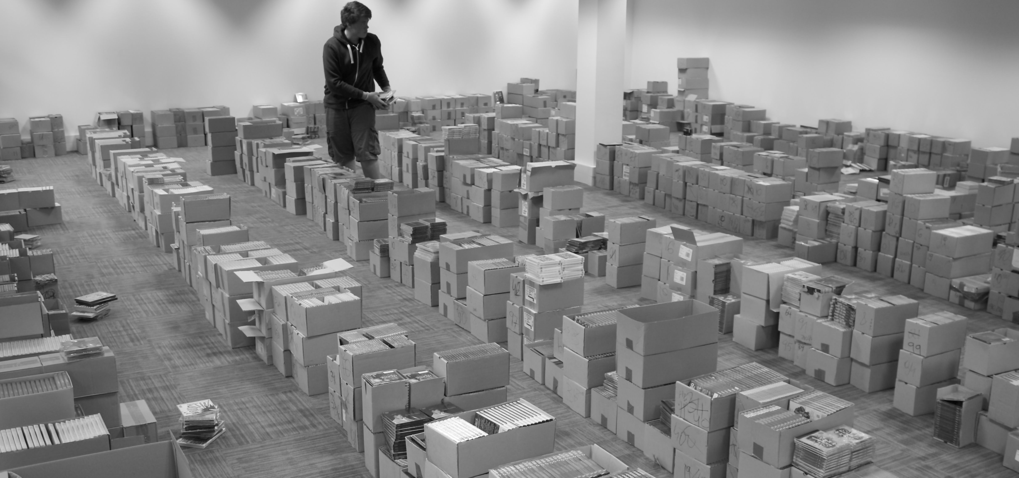
Initial sort process for 3 x pallets of CD’s
No manifest or list of goods provided

Slide 23

Initial sort process for 3 x pallets of CD’s
No manifest or list of goods provided

Slide 24

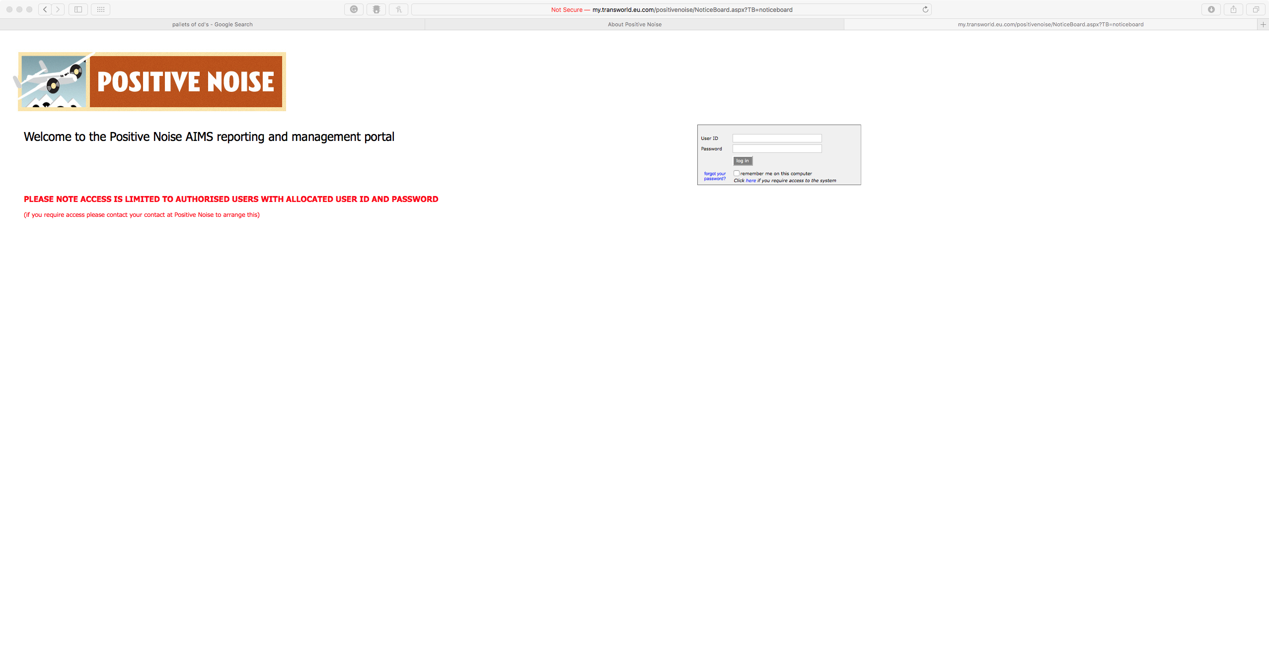
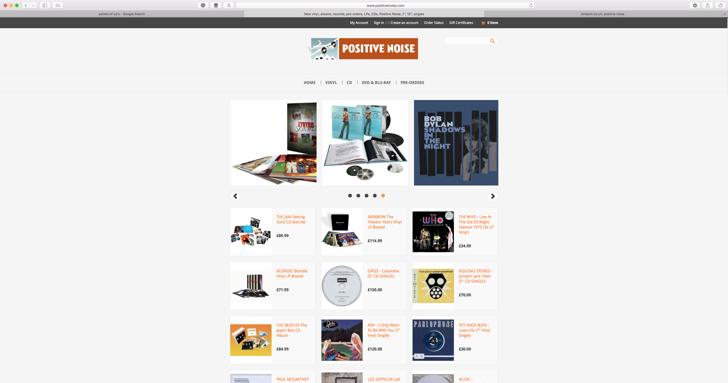
Sales via Own site and Amazon FBA
We make up ‘bulk orders’ for Amazon usually a pallet per month.
  we download order
  produce unit barcode labels
  pick stock and relabel with barcodes
  produce labelling and manage and label cartons and shipping sheets
  Arrange delivery or send on Amazon ‘preferred’ courier

Slide 25
