Slide 1
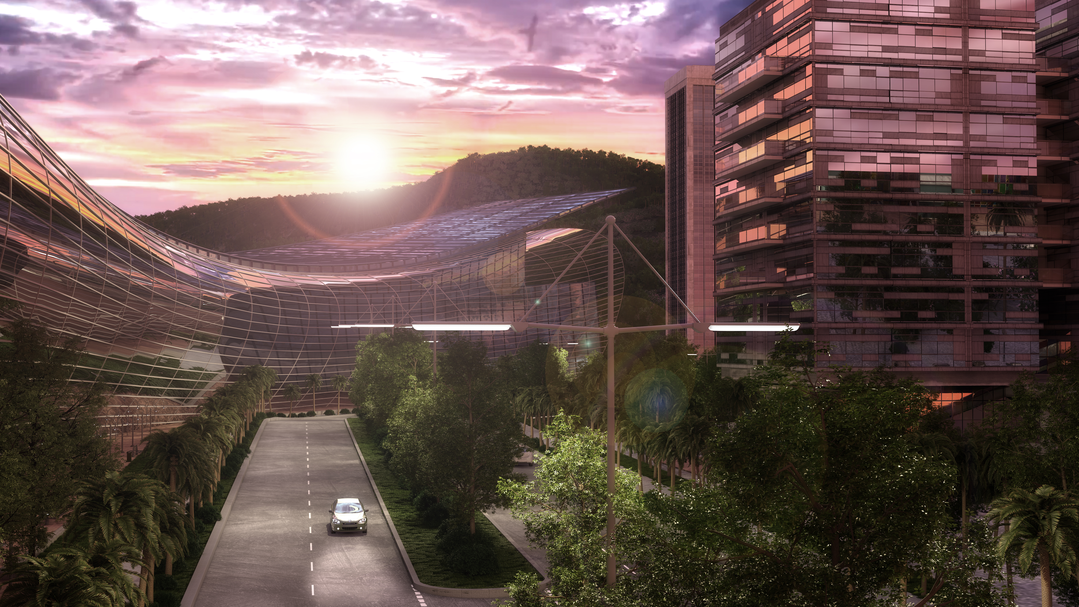

GREEN VALLEY PANAMA REAL
ESTATE PROJECTEXECUTIVE SUMMARY 2019
“The First Smart City in Panama”
PRESENTED BY GREEN VALLEY PANAMÁ & ROYAL EAGLE CAPITAL PARTNERS

Slide 2
Disclaimer
This document has been prepared by Royal Eagle Capital Partners (“RECP”) based on strictly confidential information provided by the Sponsor, Green Valley Panama, S.A., to be used exclusively for planning and equity structuring purposes.
This document is strictly confidential and prohibits the reproduction or dissemination without RECP written consent is forbidden.

Slide 3
INVESTMENT OPPORTUNITY
Royal Eagle Real Estate Company is offering the opportunity to participate in a PRE-IPO equity position to qualified investors to create a Public Real Estate Company and to invest in two real estate projects located in Panama.
Royal Eagle is evaluating a public company in Canada to perform a Reverse-Take Over transaction to acquire, develop and operate real estate business in USA and Latin America.
Capital Requirement: $30,000,000.00

Slide 4
Greenvalley & Bamboo Projects
The first intend transaction is to acquire equity rights in Greenvalley Holdings and Bamboo real estate projects.
Royal Eagle invested and performed full due-diligence for a period of ninety (90) days, which Royal Eagle has reviewed information related to corporate governance, contracts, agreements, financials, permits, properties, taxation, legal and liabilities to create model that will ensures the investment.

Slide 5
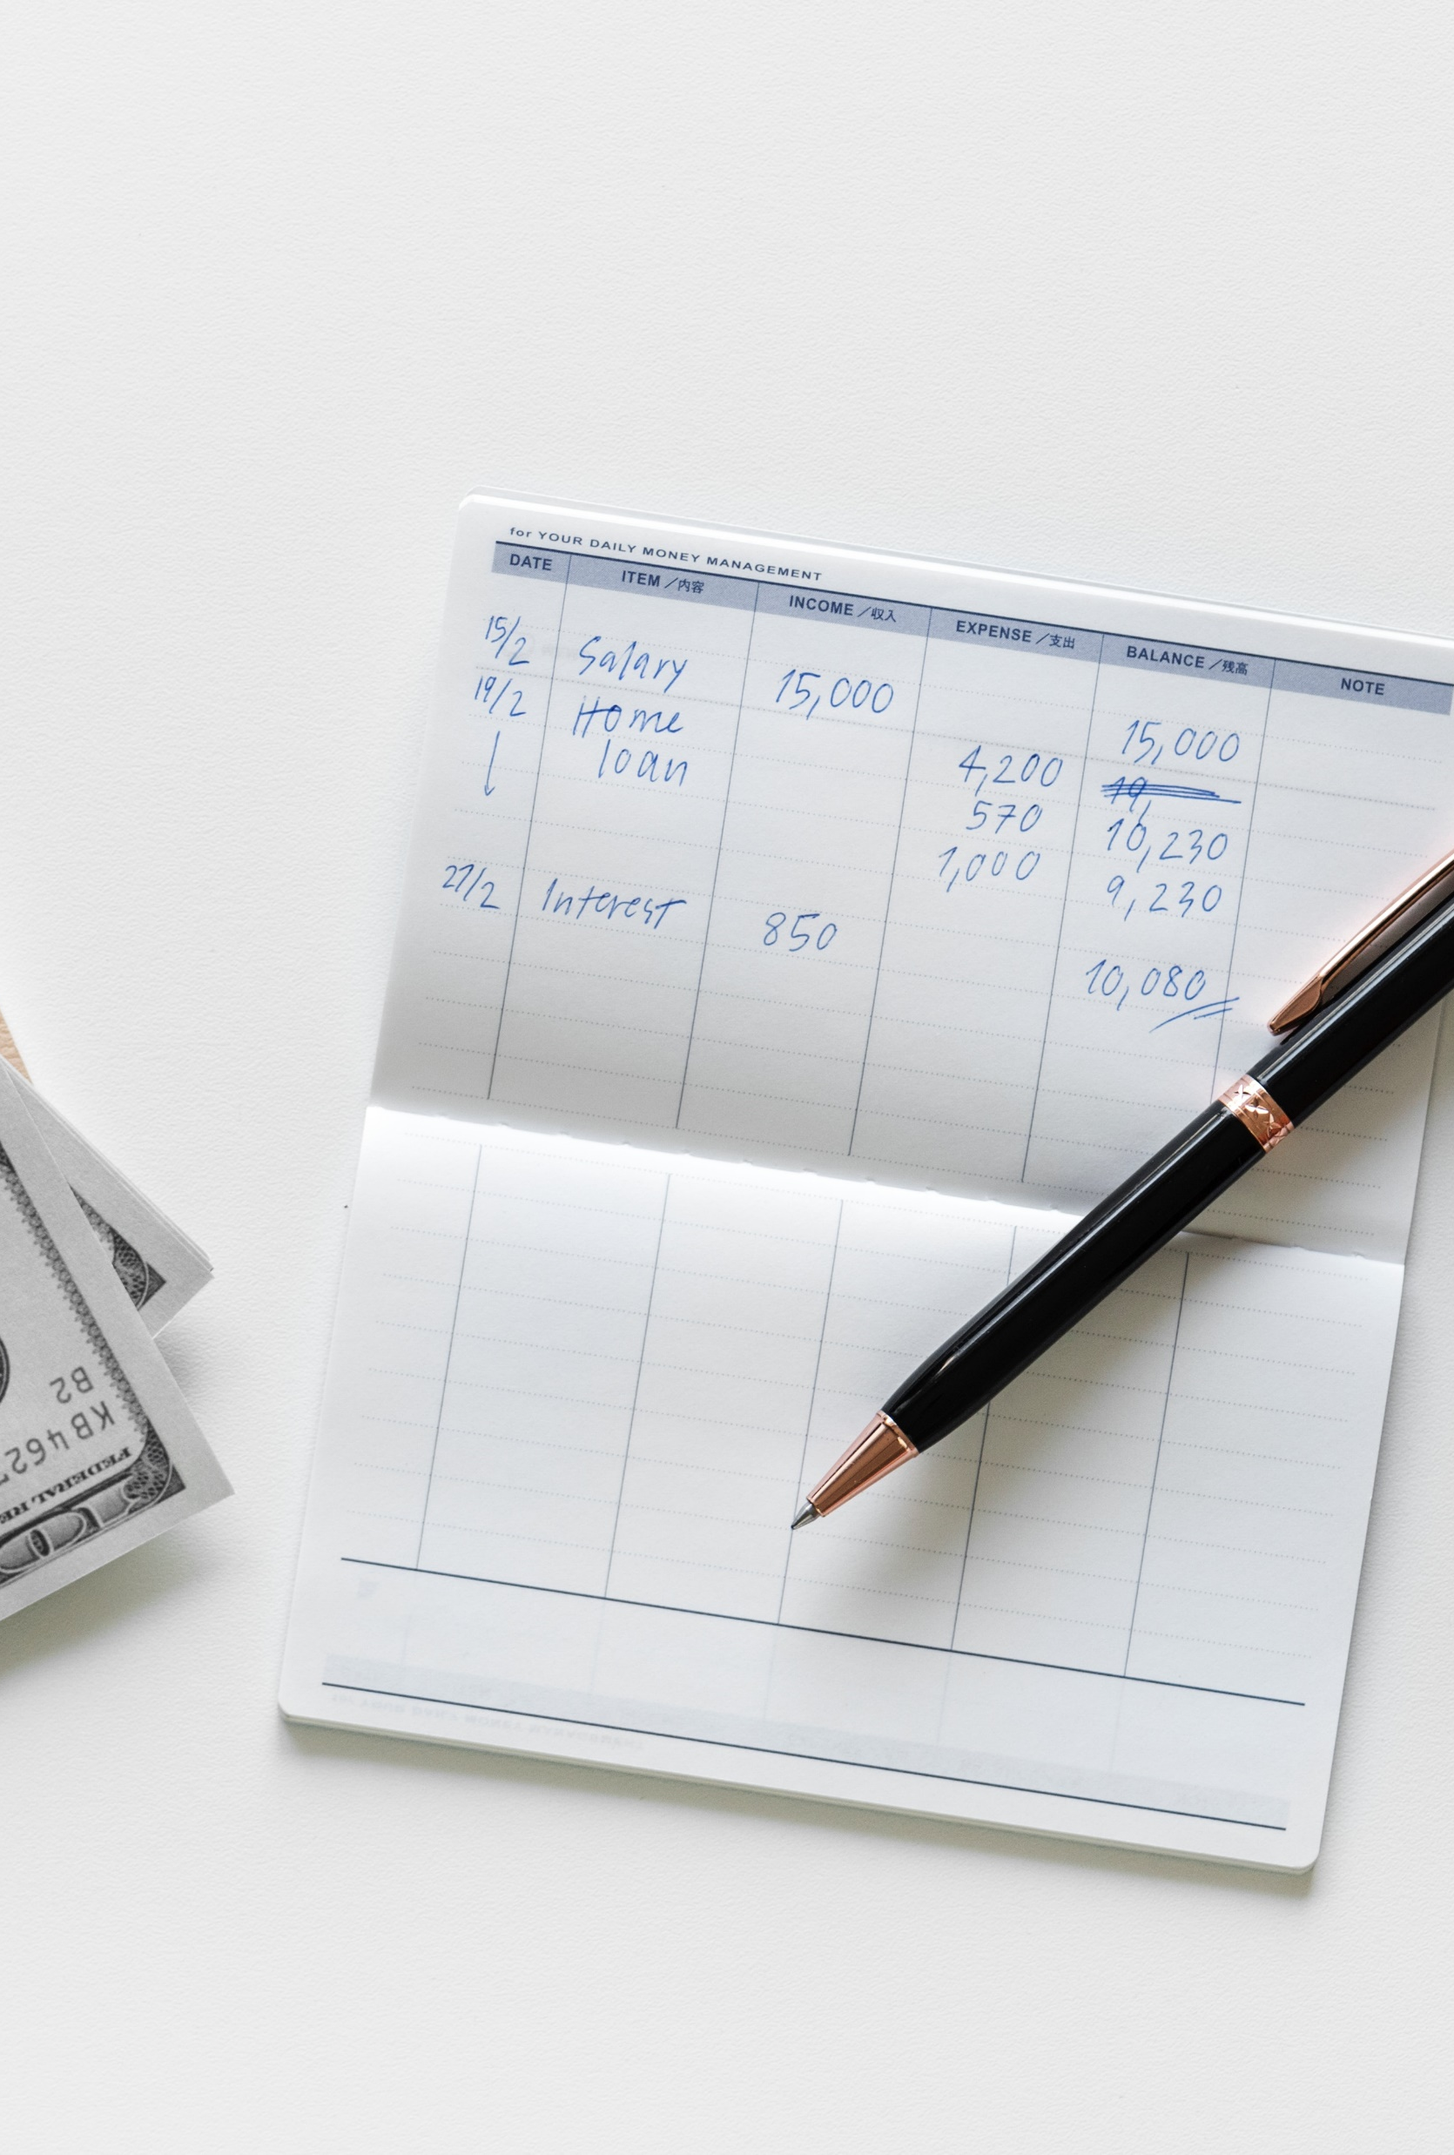
Greenvalley & Bamboo Projects
On January 15, 2019, Royal Eagle signed an LOI with Greenvalley Holdings with the following commitments:
  Due Diligence ends April 15, 2019
  Total Investment Greenvalley Holdings:
  24MM USD for 20% of the Company where:
    500K as down payment 30 days after due diligence is finished with a signing contract
    21.5MM final payment 60 days after signing contract
    2MM to develop Bamboo Project for 50% rights of the project.

Slide 6

Greenvalley & Bamboo Projects –
DATA ROOM
Royal Eagle has created a data room with information available upon request with the due diligence package with the following:
Corporate documents of the company and subsidiaries
Material contracts and agreements
Financial Information
Properties
Taxation rules
Acquisition, partnership and JV agreements
Government regulations and filings
Sales and marketing presentation
Sales contracts and purchase agreements
Panama Real Estate Reports
Financial model, budget, land and lots appraisals.
Capital stack

Slide 7
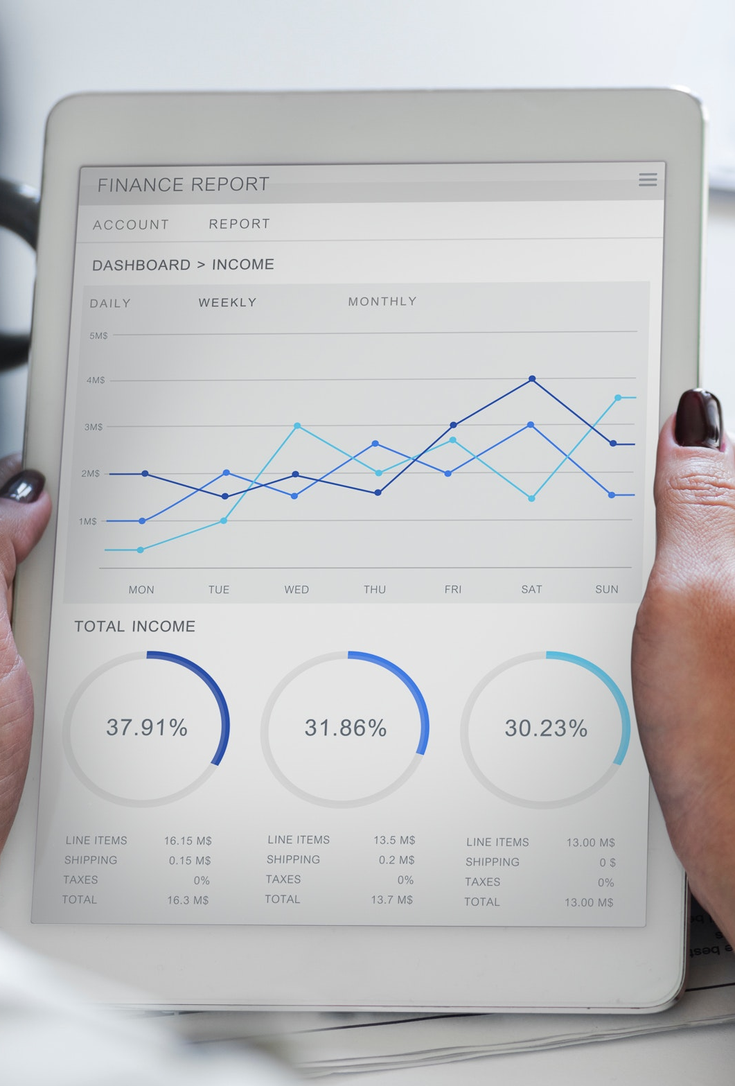
Financial Highlights of the Deal
Investing 24MM USD in the Greenvalley and Bamboo Project will generates 85MM USD of revenue for Royal Eagle in the next 10 years.
In addition of the equity deal:
  We have the first right of refusal to develop residential, commercial and high-rise projects exercising the option to buy land at a prefer acquisition cost of land.
  Royal Eagle is requesting 2:1 collateral in land as guarantee of performance.

Slide 8
Financial Highlights of the Deal
Royal Eagle Real Estate ROI & IRR Greenvalley and Bamboo projects:
Royal Eagle (ROI & IRR) Green Valley & Bamboo Project
Investment | Amount | Ownership | Valuation Pre-Money | Valuation After-Money¹ | Term | ROI RE | ROI RE Times | IRR
Green Valley | $ 22,000,000 | 20.0% | $ 110,000,000 | $ 619,197,253 | 10 years | $ 81,531,305 | 3.71 | 24.70%
Bamboo | $ 2,000,000 | 50.0% | $ 4,000,000 | $ 32,984,221 | 5 years | $ 4,073,758 | 2.04 | 19.79%
Total | $ 24,000,000 | 21.1% | $ 114,000,000 | $ 652,181,474 |  | $ 85,605,063 | 3.57
¹ Green Valley Business Plan

Slide 9
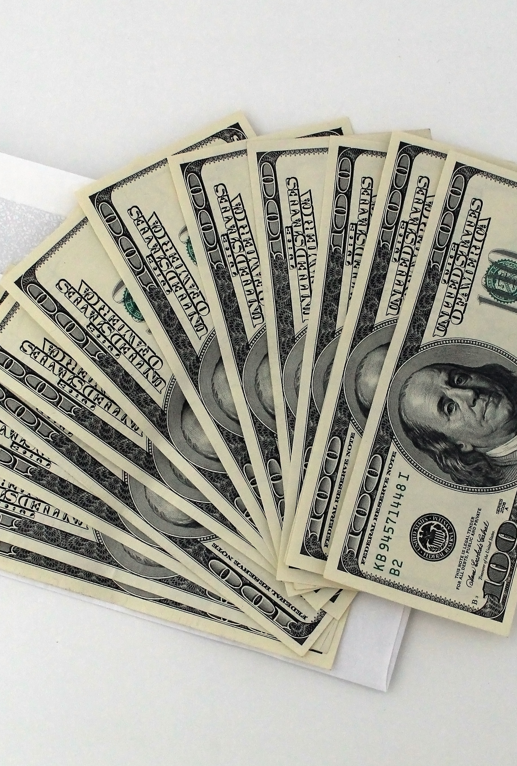
10MM USD Investment Performance
Investing 10MM USD in the Royal Eagle Real Estate Company, based on Greenvalley and Bamboo projects only, will generate 85MM USD of revenue for Royal Eagle in the next 10 years.
In addition of the equity deal:
  10% preferred return annually plus
  33% equity ownership and profits

Slide 10
10MM USD Investment Performance
10MM investment performance Royal Eagle Real Estate Company:
Total Investment | $ 30,000,000.00
Equity Partner Private 10MM | $ 10,000,000.00
Public Company Canada RTO | $ 20,000,000.00
Private Investment Length | 7 years
Currency | USD
Rate | 10%
Upside Investor | 33% | Profits
Portfolio Management | 2.50% | Annual

Slide 11
10MM USD Investment Performance
1st Phase 10MM Investment 10% Preferred Interest
Year | Investment | Interest | Capital | Interest | New Capital | Total ROI 7 year | Capital + Interest
1 | $ 10,000,000.00 | $ 1,000,000.00 | $ - | $ - | $ 11,000,000.00 | 10.00%
2 | $ 11,000,000.00 | $ 1,100,000.00 | $ - | $ - | $ 12,100,000.00 | 10.00%
3 | $ 12,100,000.00 | $ 1,210,000.00 | $ 2,420,000.00 | $ 3,310,000.00 | $ 7,580,000.00 | 10.00% | $ 5,730,000.00
4 | $ 7,580,000.00 | $ 758,000.00 | $ 2,420,000.00 | $ 758,000.00 | $ 5,160,000.00 | 10.00% | $ 3,178,000.00
5 | $ 5,160,000.00 | $ 516,000.00 | $ 2,420,000.00 | $ 516,000.00 | $ 2,740,000.00 | 10.00% | $ 2,936,000.00
6 | $ 2,740,000.00 | $ 274,000.00 | $ 2,420,000.00 | $ 274,000.00 | $ 320,000.00 | 10.00% | $ 2,694,000.00
7 | $ 320,000.00 | $ 32,000.00 | $ 2,420,000.00 | $ 32,000.00 | $ - | 10.00% | $ 2,452,000.00
Totals |  | $ 4,890,000.00 | $ 12,100,000.00 | $ 4,890,000.00 |  |  | $ 16,990,000.00

Slide 12
10MM USD Investment Performance
Total Distribution $ 43,215,063.42
Second Phase Upside Ownership
Income GV & Bamboo | $ 85,605,063.42
Investment | $ 30,000,000.00
Interest Paid | $ 4,890,000.00
Management Fees | $ 7,500,000.00
Subtotal I | $ 43,215,063.42
Investor 33% Ownership | $ 14,260,970.93
67% Royal Eagle | $ 28,954,092.49

Slide 13
10MM USD Investment Performance
Total Distribution $ 43,215,063.42
Second Phase Upside Ownership
Income GV & Bamboo | $ 85,605,063.42
Investment | $ 30,000,000.00
Interest Paid | $ 4,890,000.00
Management Fees | $ 7,500,000.00
Subtotal I | $ 43,215,063.42
Investor 33% Ownership | $ 14,260,970.93
67% Royal Eagle | $ 28,954,092.49

Slide 14
10MM USD Investment Performance
INVESTOR | 2019 | 2020 | 2021 | 2022 | 2023 | 2024 | 2025 | 2026 | 2027 | 2028 | Totals Investor
 | 0 | 1 | 2 | 3 | 4 | 5 | 6 | 7 | 8 | 9
Ct | -$10,000,000 | $0 | $0 | $5,730,000 | $3,178,000 | $2,936,000 | $2,694,000 | $2,452,000 | $7,130,485 | $7,130,485 | $ 21,250,970.93
(1+R)^T | 1.00 | 1.00 | 1.00 | 1.00 | 1.00 | 1.00 | 1.00 | 1.00 | 1.00 | 1.00
Ct/(1+R)^T | -10,000,000 | 0 | 0 | 5,730,000 | 3,178,000 | 2,936,000 | 2,694,000 | 2,452,000 | 7,130,485 | 7,130,485 | $ 21,250,970.93
IRR | 21.42%
ROI Investor $ | $ 21,250,970.93
Annual ROI % | 21.25%

Slide 15
GREENVALLEY AND BAMBOO PROJECTS
SMART CITY DEVELOPMENT & MEDIUM DENSITY RESIDENTIAL PROJECT
PRESENTED BY
GREEN VALLEY PANAMÁ &
ROYAL EAGLE CAPITAL PARTNERS

Slide 16

Green Valley Panama is a project in urban development of 200 hectares of land, a new innovative community that has an Avant-grade infrastructure, unprecedented in the country, combined with a lot of beautiful open landscapes.
Green Valley offers urbanized land to developers and builders who want to create their residential, commercial, institutional or sports projects within Panama's first smart city.
For information visit: www.greenvalleypanama.com

Slide 17
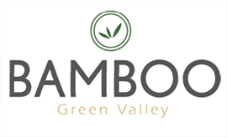
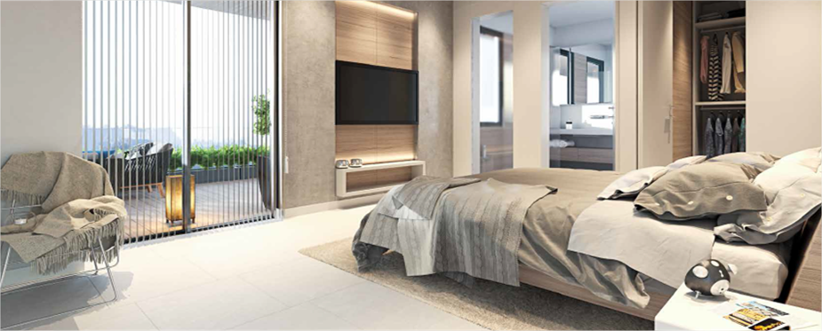
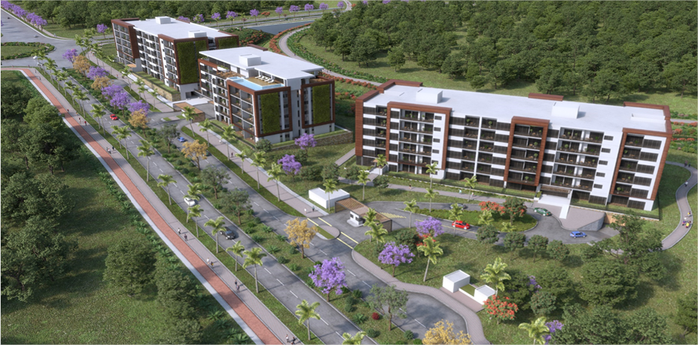
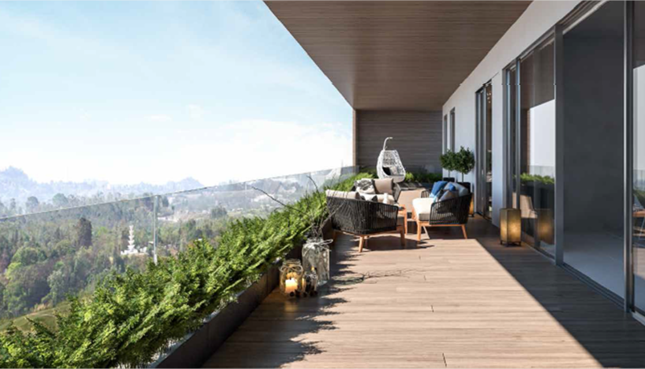
The Bamboo project is the first residential project to start construction in Green Valley Panama
Bamboo is a medium density project with 145 Apartments divided in 3 towers.
Project Revenue is 33MM USD

Slide 18
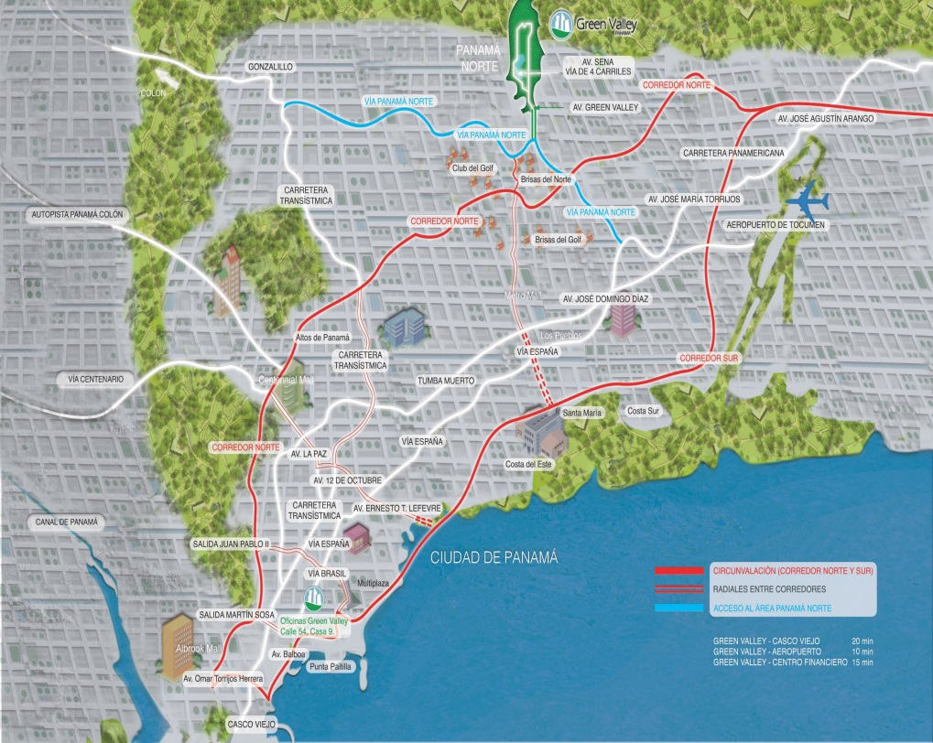
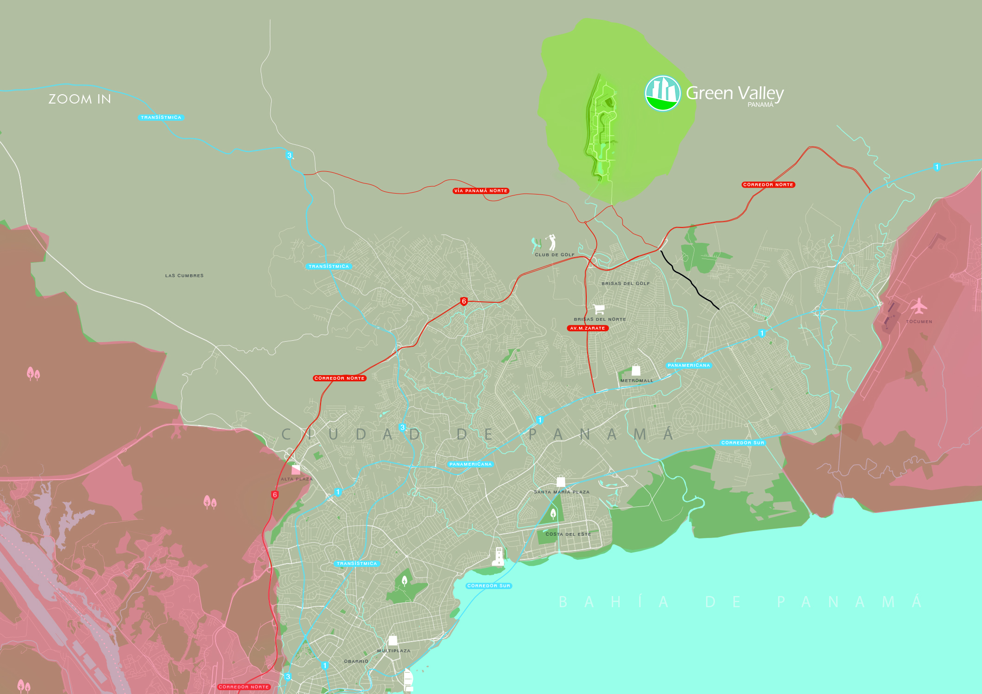
Project Overview
Green Valley Panama is a project in urban development of 200 hectares of land, a new innovative community that has an avant-garde infrastructure, unprecedented in the country, combined with a lot of beautiful open landscapes. Green Valley offers urbanized land to developers and builders who want to create their residential, commercial, institutional or sports projects within Panama's first smart city.
Green Valley Panama is located in the North of Panama City, the only undeveloped area that Panama City has left to expand, and best zone for the future development of the city.
LOCATION
NORTH OF PANAMA CITY

Slide 19
GREEN VALLEY PANAMA TIMELINE
At the beginning of the year, sales of the first high-density commercial lot for the Shopping Center were closed, the sale of several lots of RM3 continued, and the residential lots finished..
Construction work begins on the "Metropolitan School of Panama". The construction of the first single-family home is completed. Sales of lots of land continue, both to developers and end users
Green Valley Panama gets all the permits to start the construction and sale of the project.
Sales of single-family lots are continued in a sustainable manner and most of the low-density C1 lots are sold, as well as several RM3 lots.
2007
2012
2014
2016
2011
2013
2015
2017
The corporation "Green Valley Panamá S.A" is incorporated. Constituted and existing under the laws of the Republic of Panama
Green Valley Panama starts its global management activity of the Green Valley project.
The sale of the first RM3 lands begins.
The sale of institutional land to promoters for the construction of schools, clinics and sports centers is achieved, positioning the project among the most relevant in the Republic of Panama.
The sale of institutional land to promoters for the construction of schools, clinics and sports centers is achieved, positioning the project among the most relevant in the Republic of Panama.

Slide 20
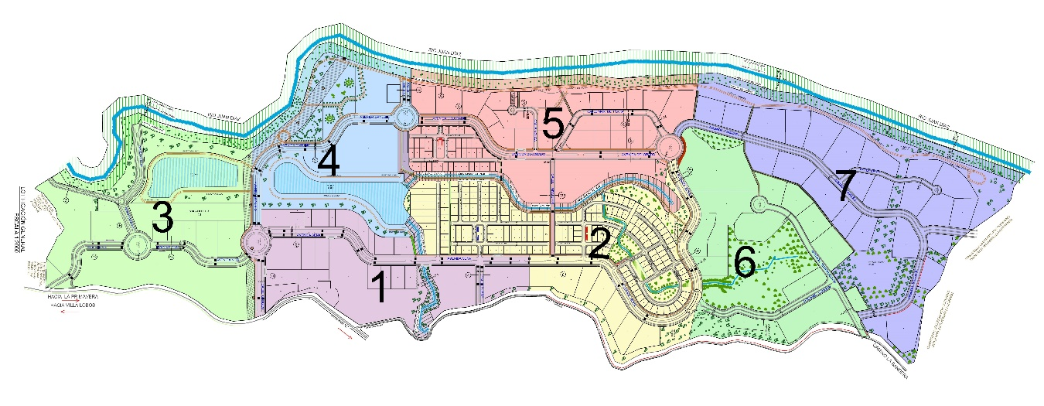
SITE PLANNING
The project of 200 hectares of land is divided into 7 phases of construction.

Slide 21
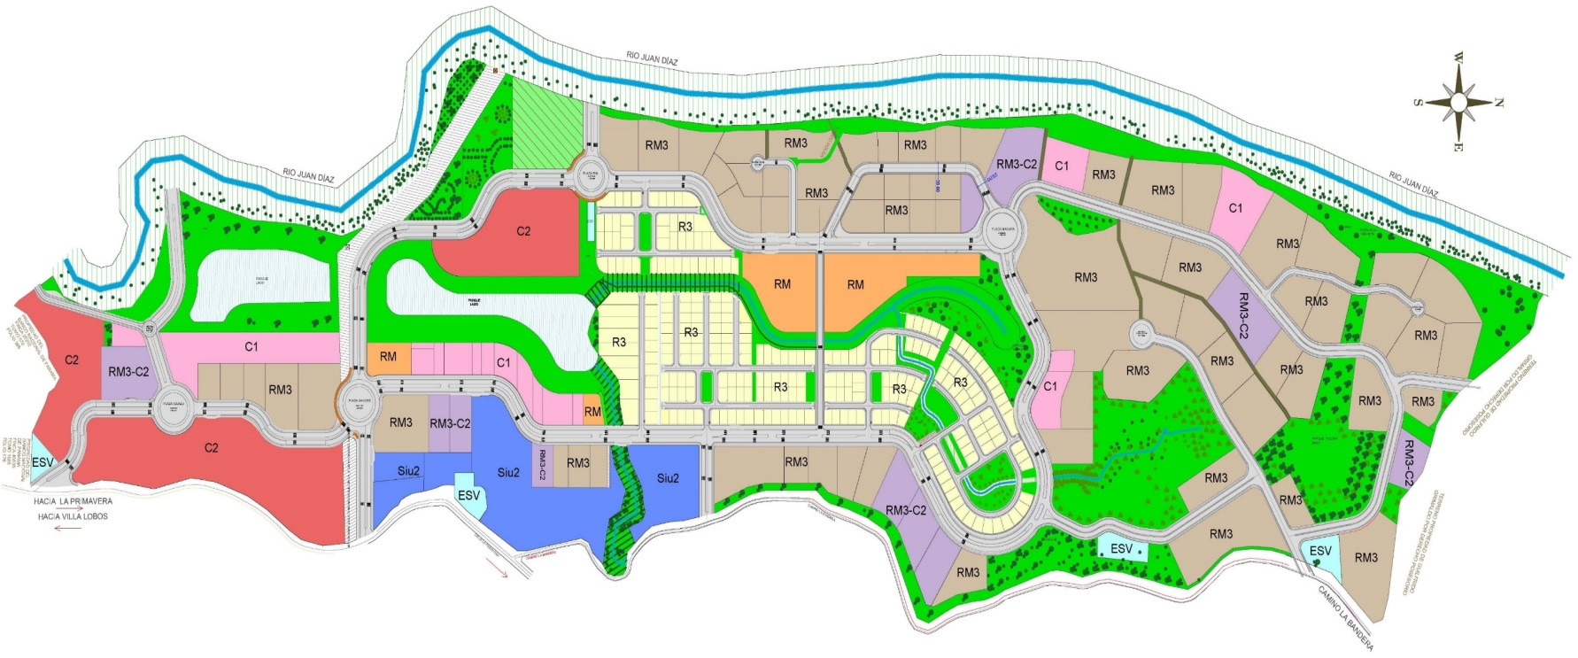
ZONING
R3: LOW DENSITY RESIDENTIAL (HOUSES)
RM: MEDIUM DENSITY RESIDENTIAL (6 STOREY BUILDINGS)
RM3: HIGH DENSITY RESIDENTIAL (SKYSCRAPERS)
C1: LOW DENSITY COMMERCIAL (2 STOREY COMMERCIAL PLAZAS)
C2: HIGH DENSITY COMMERCIAL (MALLS)
C2: COMMERCIAL RECREATIONAL (SPORTS CENTERS)
Siu2: INSTITUTIONAL (SCHOOLS, POLICE STATIONS AND PUBLIC SERVICES)
RM3-C2: MIXED RESIDENTIAL AND HIGH DENSITY COMMERCIAL (MIXED USE SKYSCRAPERS)

Slide 22
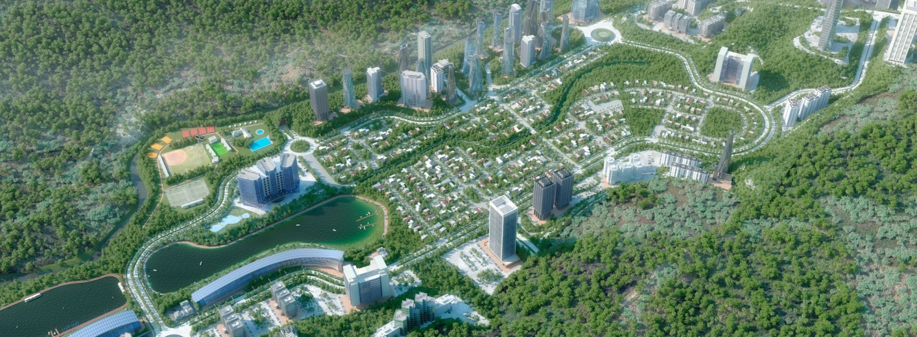
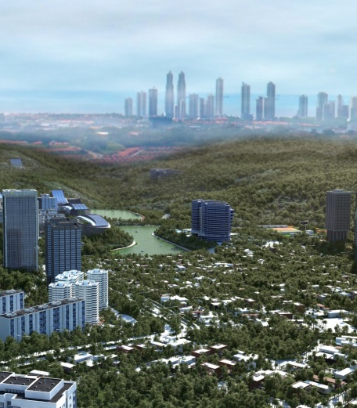
AMENITIES
The project is based on the development of an Eco-city, that is to say, in a design where the criterion of integration and preservation of the environment in which it is located, of enormous beauty and a great wealth of fauna and flora, prevails.

Slide 23
AMENITIES - Infrastructures of the Highest Level
Wide avenues of four lanes.
Sidewalks 2.6 meters.
Underground communication system with 16 tubes for the creation of a Smart City.
Eight large parks that occupy 56 hectares.
A huge lake.
An area with small lakes and walks.
12km of bike lanes.
LED lighting to promote energy saving.
Wastewater treatment plants.
Underground wiring system.
Sports Complex.

Slide 24

Greenvalley distinctive assets:
Strategic location
The project is located in Panama Norte, specifically in a green area that offers views of the city center. Panama Norte has achieved great development interest from the government and private companies, since this is the last remaining area of the city of Panama with potential for urban development.

Slide 25

Greenvalley distinctive assets:
Innovative Concept
Green Valley is a project based on the development of an Eco-City, where the integration and preservation of the environment prevails. It is a balance between urban and natural areas, conserving more than half of the vegetation in the area. It is a model of open urbanization where highlights a cycle-track of 10 km, 8 parks, an artificial lake, sports areas for the enjoyment of the inhabitants.

Slide 26

Greenvalley distinctive assets:
Connectivity
Great connectivity with the city center to inaugurate the second phase of the North Corridor, a section that allows the merger with the South Corridor, to form a circular road that goes around Panama City. Currently the project is also accessible from the Panama Norte highway and additional, in January 2016 the Government of Panama awarded to MECO through public tender the design, rehabilitation and widening project of the Pedregal-Gonzalillo-Transístmica highway, whose name will be Panama North and it is expected that the work will finish in 2018, which will provide another way that would facilitate access to the project.

Slide 27

Greenvalley distinctive assets:
Target market
The target market of the project is the professional middle class and upper middle class, which seek a green and ecological environment with the highest housing standards. According to the 2010 National Census, the total Panamanian population was 3.66 million inhabitants with a GDP per capita of US $ 7,945 and at the end of 2014 it increased to 3.91 million inhabitants with a GDP per capita of US $ 12,158. This indicates a population growth of 6.8% and an increase of GDP per capita of 53.0%, which is contributing to the increase of Panamanian purchasing power, especially the development of a new emerging middle class, with a young, professional profile and delimited in Panama City.

Slide 28

Greenvalley distinctive assets:
Permitology and Zoning
The project will have urban land with maximum RM3 classification, intended for high-density residential construction. Currently, the MIVIOT seeks the implementation of the Metropolitan Plan for sustainable urban development, which will have as goals the urban containment and decentralization, to raise the level of competitiveness and urban, social and economic sustainability in Panama. So the control of territorial expansion is a reality, which could cause restrictions on the authorization of RM3 permits in response to the refusal of public opinion caused by disorderly urban development and noncompliance of regulations by promoters.

Slide 29
GREENVALLEY & BAMBOO
Financial Metrics
PRESENTED BY GREEN VALLEY PANAMÁ & ROYAL EAGLE CAPITAL PARTNERS

Slide 30
Financial Metrics USD
Royal Eagle (ROI & IRR) Green Valley & Bamboo Project
Investment | Amount | Ownership | Valuation Pre-Money | Valuation After-Money¹ | Term | ROI RE | ROI RE Times | IRR
Green Valley | $ 22,000,000 | 20.0% | $ 110,000,000 | $ 619,197,253 | 10 years | $ 81,531,305 | 3.71 | 24.70%
Bamboo | $ 2,000,000 | 50.0% | $ 4,000,000 | $ 32,984,221 | 5 years | $ 4,073,758 | 2.04 | 19.79%
Total | $ 24,000,000 | 21.1% | $ 114,000,000 | $ 652,181,474 |  | $ 85,605,063 | 3.57
¹ Green Valley Business Plan
85MM dollars total revenue = 3.57x times total investment
23.22% accumulated IRR

Slide 31
Financial Metrics USD
Greenvalley Land Development
Total Revenue | $ 619,197,252.80
Cost of the Project | Cost | % vs Revenue
Land | $ 12,698,413.00 | 2.05%
Construction | $ 108,037,364.34 | 17.45%
Project Management 3% | $ 17,503,267.46 | 2.83%
Marketing 2% | $ 13,037,176.18 | 2.11%
Sales Commission 3% | $ 18,792,195.71 | 3.03%
Taxes % | $ 18,575,917.58 | 3.00%
Transfer of Real Estate | $ 12,383,945.06 | 2.00%
Financial Costs* | $ 10,512,447.61 | 1.70%
Total Costs | $ 211,540,726.93 | 34.16%
Profit/Loss | $ 407,656,525.87 | 65.84%
Royal Eagle 20% | $ 81,531,305.17 | 20.00%

Slide 32
Financial Metrics USD
Bamboo Medium Density Apartments
Total Revenue | $ 32,984,221.00 | 100.0%
Cost of the Project | Cost | % vs Revenue
Land | $ 3,225,920.00 | 9.78%
Construction | $18,502,384.00 | 56.09%
Project Management 3% | $ 370,047.68 | 1.12%
Marketing .8% | $ 148,019.07 | 0.45%
Sales Commission 4% | $ 740,095.36 | 2.24%
Taxes % | $ 555,071.52 | 1.68%
Financial Costs* | $ 1,295,166.88 | 3.93%
Total Costs | $ 24,836,704.51 | 75.30%
Profit/Loss | $ 8,147,516.49 | 152.79%
Royal Eagle 20% | $ 4,073,758.24 | 76.40%

Slide 33
Images
PRESENTED BY GREEN VALLEY PANAMÁ AND ROYAL EAGLE CAPITAL PARTNERS

Slide 34
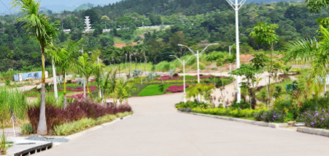
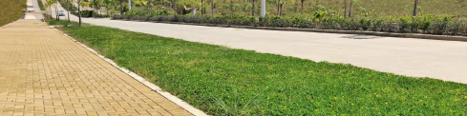
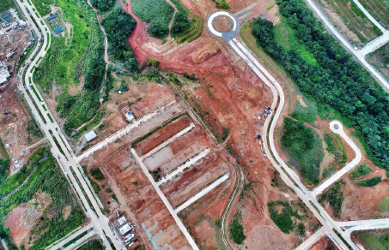
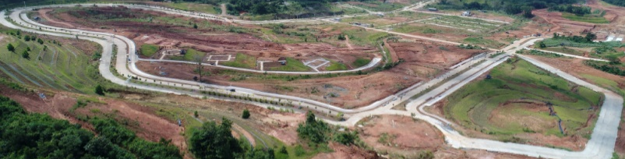
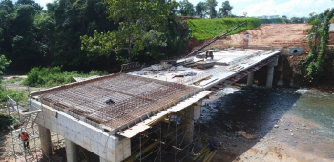
Greenvalley today

Slide 35
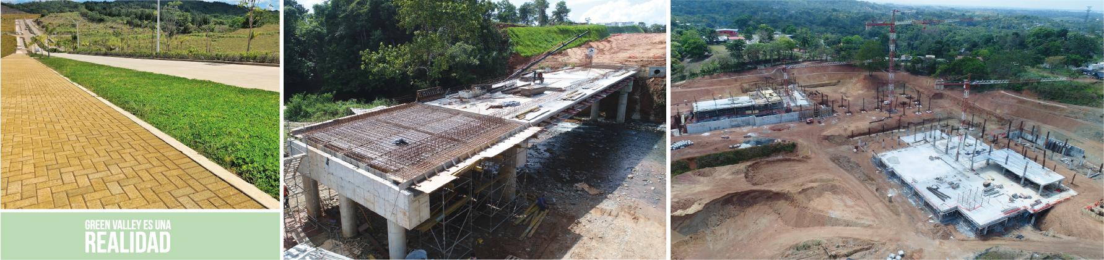
GREEN VALLEY IS A REALITY
Green Valley is more than just a project, Green Valley is a reality, more than 43% of the land sold, 100% of sales in the residential area, 70% sold in commercial lots of low density and 47% in lots of land High-density multifamily guarantee it. Important institutions such as the MET School (Metropolitan School of Panama) have trusted our project and are currently developing their buildings within it.

Slide 36
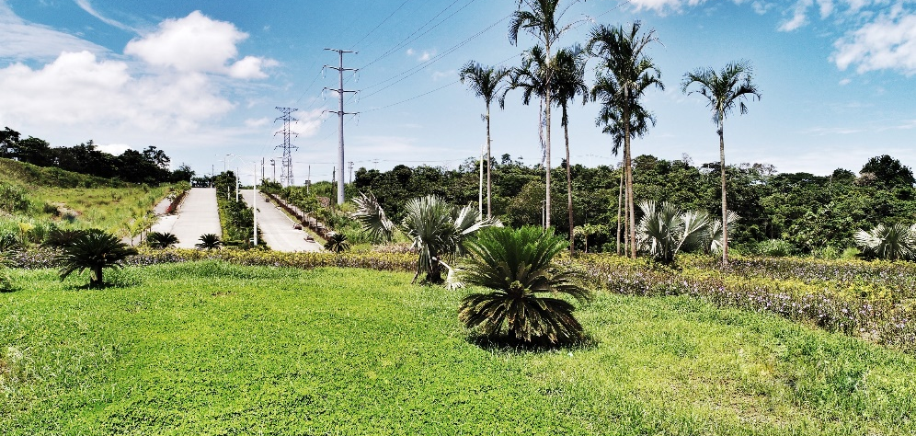
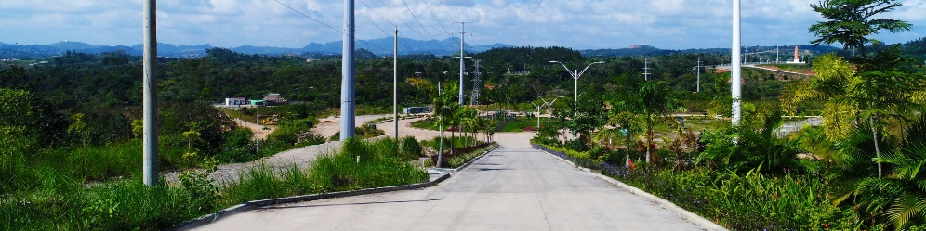
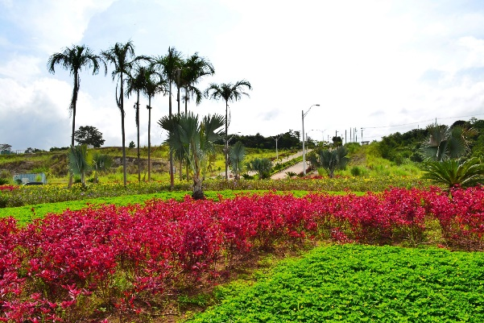
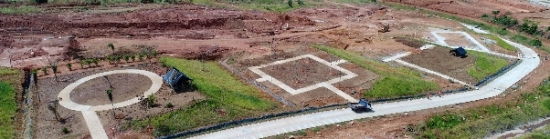
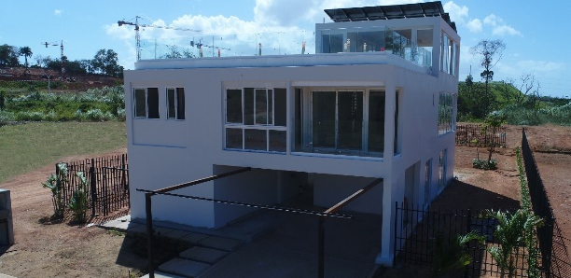
Greenvalley today

Slide 37
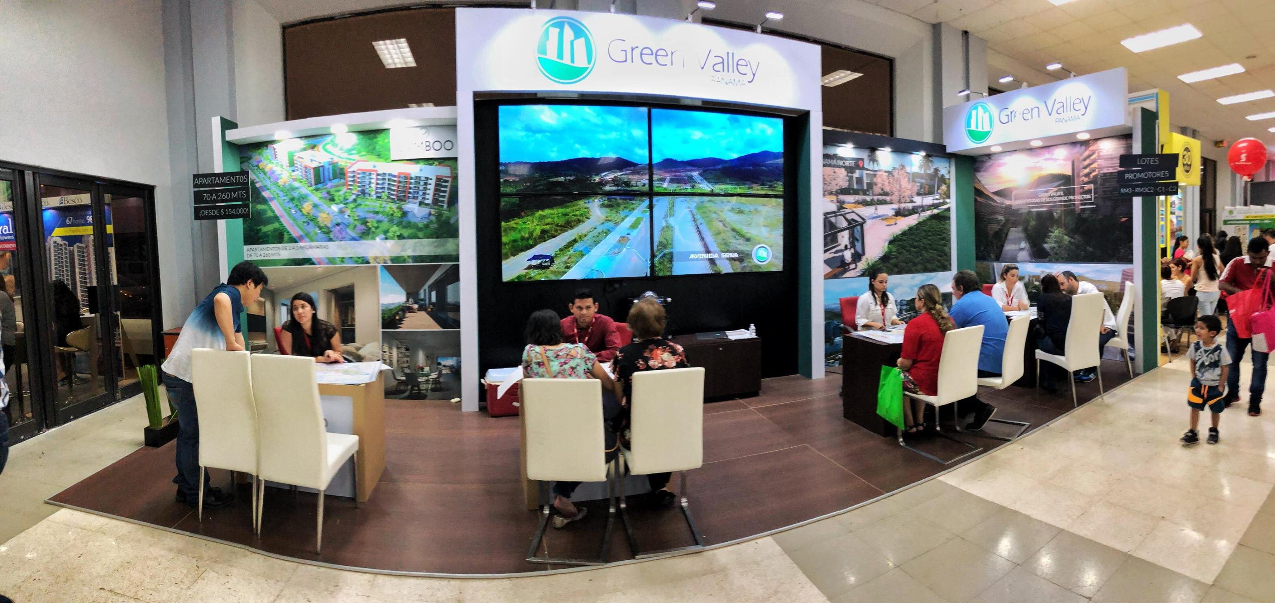

Slide 38

MARKETING MATERIAL
Website: www.greenvalleypanama.com
Video Material >>
Green Valley Panama is a Reality https://www.youtube.com/watch?v=FkZIlqNeFaA
Green Valley Panama Work Progress - September 2018- https://www.youtube.com/watch?v=cWNO7YegbEI
Metropolitan School of Panama Work Progress - May 2018: https://www.youtube.com/watch?v=6syIqAHgqvE
Green Valley Panamá Virtual Tour https://www.youtube.com/watch?v=WnNtvs6A8hE
Via Panama Norte Work Progress - November 2018 https://www.youtube.com/watch?v=Q2CKQPJdLtI
Verdi Park Work Progress – October 2018 https://www.youtube.com/watch?v=6f5-wGvR6bA

Slide 39
ABOUT ROYAL EAGLE
ASSET MANAGEMENT COMPANY

Slide 40
About us
RE CAPITAL PARTNERS USA LLC, (hereinafter "Royal Eagle CAP USA") is an Asset Management Company located in Houston, Texas.
Our team has more than 40 years of combined experience in institutional capital markets, asset management, private equity/debt, equity compensation for publically traded companies, executive benefits, investment banking and operating privately held companies. Royal Eagle raises equity/debt for both public and private companies.
Royal Eagle will own and operate growth businesses in energy, oil and gas, technology and real estate through both equity and debt and syndication.
We are strategically positioned in Houston (USA) and Panama City (PANAMA/LATAM HUB).
Royal Capital Partners has an extensive network across the globe that allow us to create strong relationships and build partners with synergies that can grow the business as a team.

Slide 41
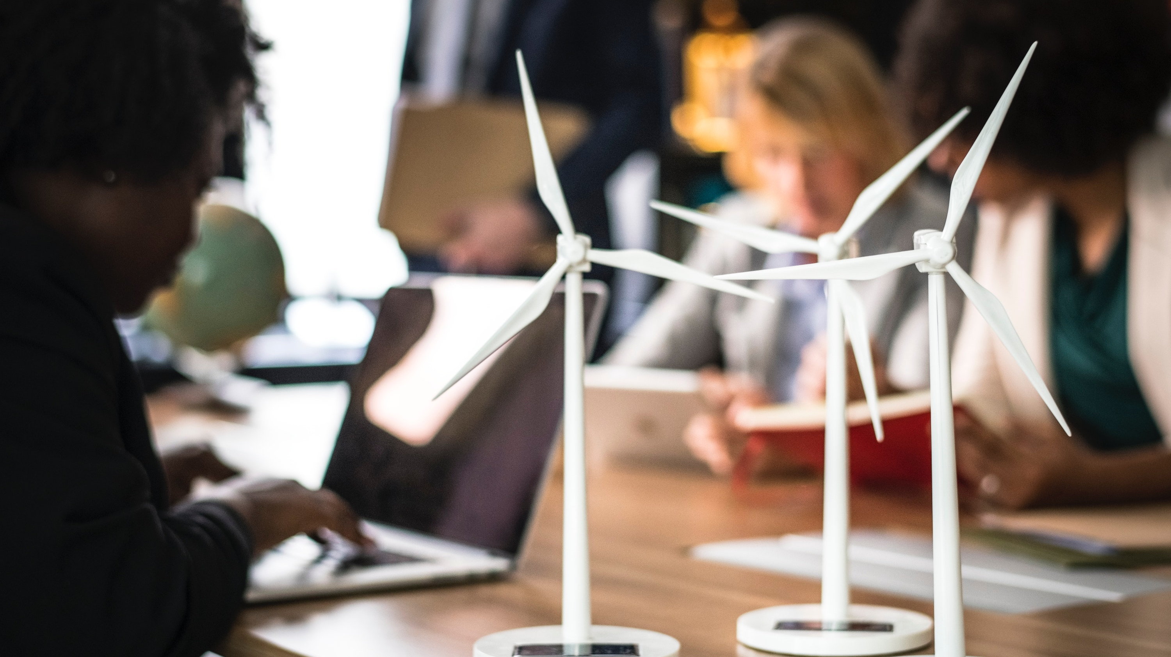
PORTFOLIO OF COMPLEMENTARY ASSETS
Royal Eagle CAP USA operates a geographically diverse portfolio of complementary assets related to:
Crude oil, natural gas and refined product, storage, transportation and terminal/logistics assets;
Renewable power plants, energy production to develop wholesale and retail markets.
Real estate assets related to residential and commercial real properties
Technology and Data through artificial intelligence developments, proprietary algorithms and data.
Our investment strategy included buy-out agreements through common and preferred equity, warrants and stock options, corporate debt and syndicated debt offerings where shares, assets and guarantees of subsidiaries will serve as collateral for risk mitigation and leverage.

Slide 42
PORTFOLIO OF COMPLEMENTARY ASSETS
Royal Eagle CAP USA operates a geographically diverse portfolio of complementary assets related to:
Crude oil, natural gas and refined product, storage, transportation and terminal/logistics assets;
Renewable power plants, energy production to develop wholesale and retail markets.
Real estate assets related to residential and commercial real properties
Technology and Data through artificial intelligence developments, proprietary algorithms and data.
Our investment strategy included buy-out agreements through common and preferred equity, warrants and stock options, corporate debt and syndicated debt offerings where shares, assets and guarantees of subsidiaries will serve as collateral for risk mitigation and leverage.

Slide 43

MANAGEMENT TEAM
Our team is a group of professional financial and strategists looking to create synergies between relationships and businesses that are looking to grow with sophisticated strategies

Slide 44
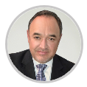
MANAGEMENT TEAM
Alejandro is an entrepreneur, leader and business owner with more than two decades of experience in business, international finance and corporate structure.
He is participating in the capital market industry in North and Latin America, creating equity, debt and exit strategies using Limited Partnership, Offshore Special Purpose Vehicles (SPV’s) and Stock Exchange Public structures.
Since 2018 is Royal Eagle CEO where he is responsible to build the strategy and the TEAM to acqiere the Royal Eagle Portafolio of Companies.
He is Share Holder & Board Member of an Energy Company and a Real Estate Development Company in Texas.
As an entrepreneur he is involved in several non-profit initiatives related to education for underprivileged boys and girls, looking forward to giving back to his community and investing in the success of the next generation.

Slide 45

MANAGEMENT TEAM
Anna has an experience of over 15 years in the International and Local market in the area of operations, overviewing middle and back office of the institutions. She has worked in the largest institutions in Panama like Wall Street Securities, Mundial Asset Management (Operations Manager) and Interbolsa Panama (Operations Director),
IPG Securities (Principal Executive) and Canal Securities (Principal Executive) been part of the managing team and which lead her to have excellent relationship with partners like Pershing LLC, Morgan Stanley and JP Morgan among others.
She has been a partner and the Administration and Operations Manager at Blue Stone Advisory Group (Panamanian Independent Investment Advisory Firm) providing her expertise and excellent quality of personalized customer service to manage the company.
She has also built Prometheus Capital Partners a company focused in emerging markets investments overseeing the capitalization strategies and financial operations of the company. She now joints Royal Eagle Capital Partners as Managing Partner LATAM.

Slide 46

CONTACT DETAILS
CEO Managing Partner Latam
Alejandro Mendez Anna Arias
T: + 1 281-995-9731 T: + 507 6674-2038
E: amendez@royaleaglecap.com E: abarias@royaleaglecap.com
Houston, Texas (USA)
2550 North Loop W Fwy Suite 250 Houston Texas, 77092
Panama (PTY)
San Francisco, Ave. Santa Elena, No. 75ª

Slide 47
Additional Information

Slide 48




Sales vs Receivables
Sales 2018
89M
Receivables 2018
48M
Title delivered
Up to date
19M
Projected Sales
2028
619M

Slide 49


CONSTRUCTION BUDGET PER YEAR
Development
Cost Executed
2018
52M
Total Development
Cost
2015
108M

Slide 50
PRICES PER m²

