Slide 1


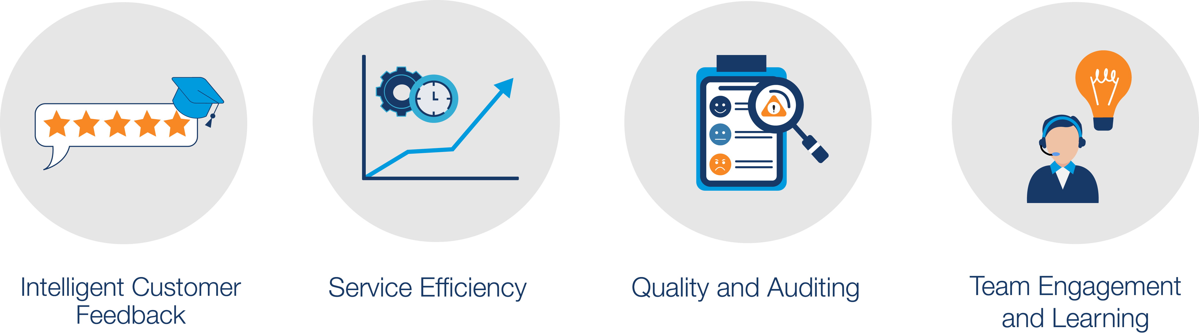
AI Driven – Feedback, Quality, & Efficiency –
that inspires employees, creates raving fans and accelerates businesses
If you have
Ineffective customer feedback
High repeat contact rates
Inconsistent quality of service
Team not engaged or learning fast enough
Change it To
If you want
Fast intelligent customer feedback to each person/team
Solve customers issues first time
Consistent compliant audits in Salesforce
Motivated team regularly coached

Slide 2


Customer feedback automatically categorised
and used in financials
INTELLIGENT CUSTOMER FEEDBACK
IF YOU HAVE
IF YOU WANT
No visibility of customer feedback by agent, process and client
Lack of action and accountability
No link to financial metrics to show the value of improvements
Automatic AIcategorisation customer feedback by agent, process and client
Action through bringing relevant feedback to each individual
Realtime financial reports showing the loyalty value

Slide 3
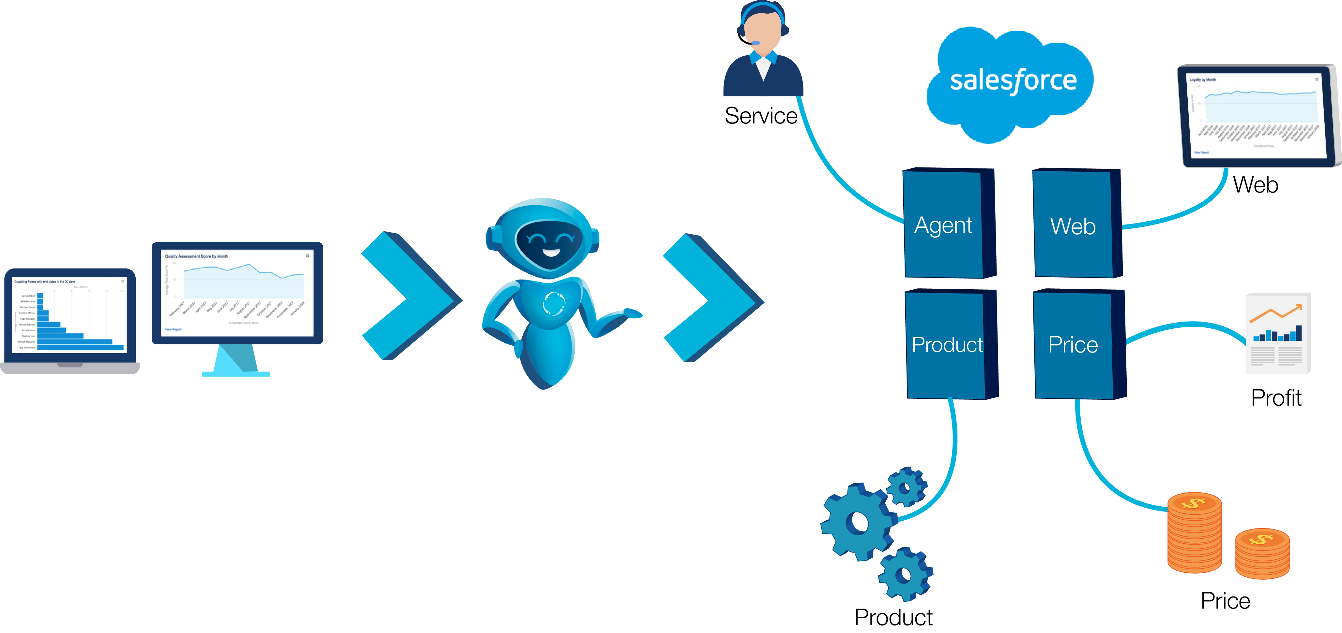

Feedback from all channels delivered to right person
INTELLIGENT CUSTOMER FEEDBACK
INTELLIGENT CUSTOMER FEEDBACK

