Slide 1


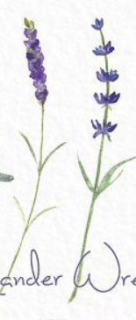


Logo Ideas
Wellness with Tenielle
Style of Front I Like
Curvy neat like its hand written text
The double ll in wellness and Tenielle to be 2 x stalks of lavender instead of the letter
Colour Palate to be soft and feminine
Watercolour drawn theme
Lavender Stalks
Colour Palate I like

Slide 2
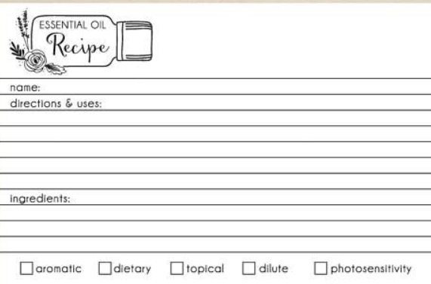
Business Card 1
Front of Card:
“wellness with Tenielle ”logo
Mobile: 0450315510
Email: Tenielles@hotmail.com
Instgram: Teniellexox
Front of Card:
Wellness with Tenielle Logo
Then contact details
Back of Card:
Ingredients page like this one keep similar wording and options.
Similar picture but a watercolour style lavender one with just recipe (no essential oil wording). Allow space for website http://www.mydoterra.com/teniellexox
Note: I want to be able to hole punch one corner of the card without going through either design etc. Please allow for that.
Back of Card

