Slide 1
Brief
Start-slides
  One techy
  One business dev
  One culture focused
Content slide
Text slides
  “Clean and bright”
  Normal (w bubbles?)
  Dark/techy
Picture slides
  100% picture
  50% picture
  Tech pics
  Landscape pics (Stockholm office etc)
  Culture/people/collaboration pics
Contact slide (end-slide)
Break-slide
Quote-slides
  Just text
  With picture of an employee
Slides about us
  Timeline
  The “3 circles” (culture, business intent, technology
  Offerings
  Our consultants
  Our mission/vision
Symbol slide to pic from
Graph slides
Number grab slide
We are a next generation management consulting firm with two focus areas and USPs (unique selling points)
  Technology driven business development
    We are not developers, we are experts in HOW to apply and incorporate technology in your business dna to drive business growth and value-added change.
  Creating high performing teams levering our philosophy of collective intelligence.
    We truly understand the need of human engagement and we know that the only way of getting there is by building strong relationships among people, a warm and open culture is a stepping stone towards effective collaboration within/among teams.
We don't want a ”corporate feel” to our templates. The organic feeling we have with our blue-on-blue blobs has the idea of ever changing movement and shape changing. Please see our website, www.influencetech.se.
In our context we sit among classic business mgmt. consultants and classic IT mgmt. consultants. We cater to business, tech and humans as the ultimate vehicle of change and business value.
To have a clean template one suggestion is to only use blue, white and black and keeping other colors separate, as an alternative
To the right is a list of type of slides we would like to see, just a suggestion feel free to put yourselves into our shoes, where our presentations is part of how the impression we make.
We are looking to find a slide deck which we can pick slides from, depending on what/whom/why we interact with customer we want to create different outcomes and our presentations should support this.
(This slide design is just an early example)

Slide 2
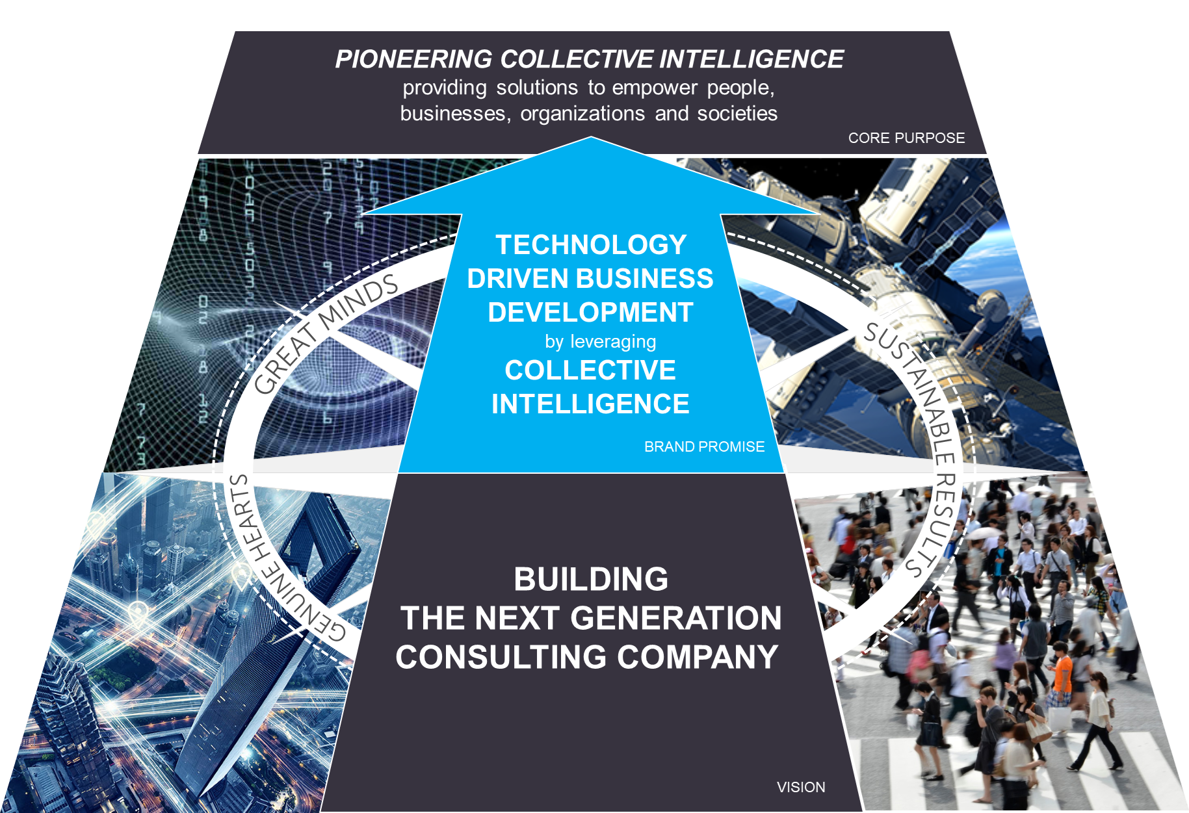
Our cultural platform with our core values of great minds, genuine hearts and sustainable results

Slide 3


Our cells
You can create more shapes of these, but keep the conceptual layout and colours.

Slide 4

one-colour logo

Slide 5

Two-colour logo

Slide 6


Stacked logo – used when space is limiting

Slide 7
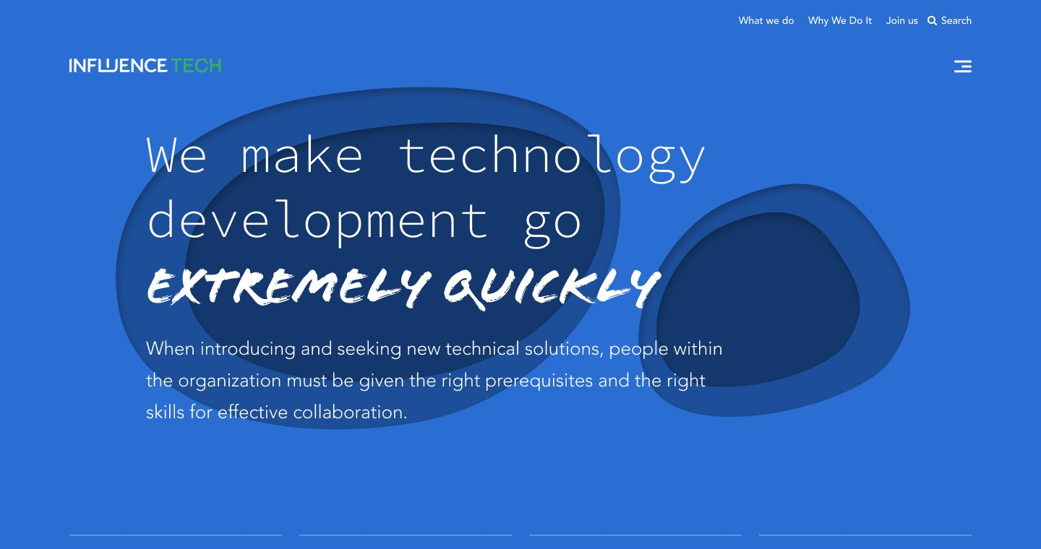
Colors
Old logo!

Slide 8
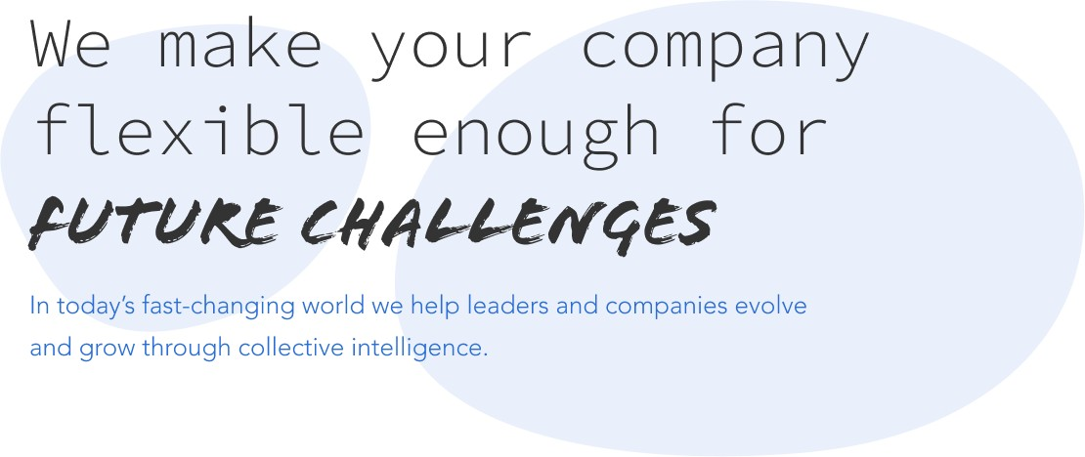
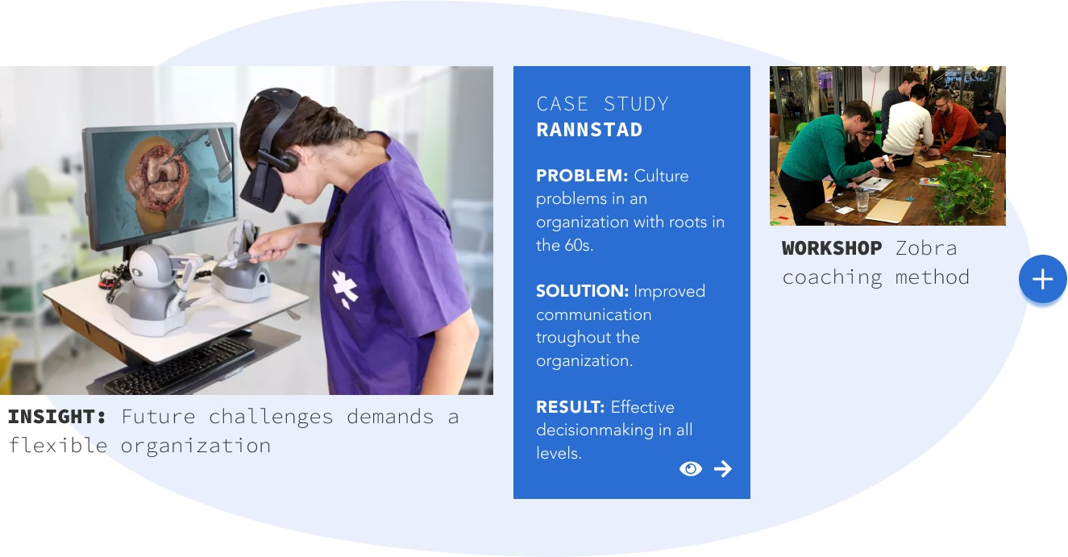
Font
We use following fonts
  Source Code Pro Extralight
  Avenir
  Flood

Slide 9
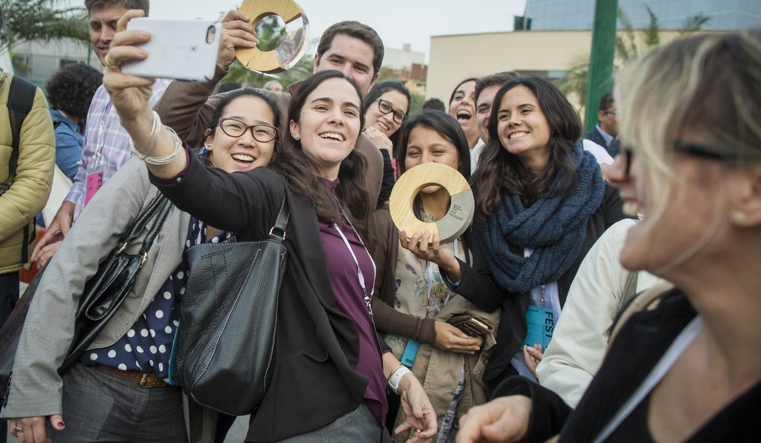
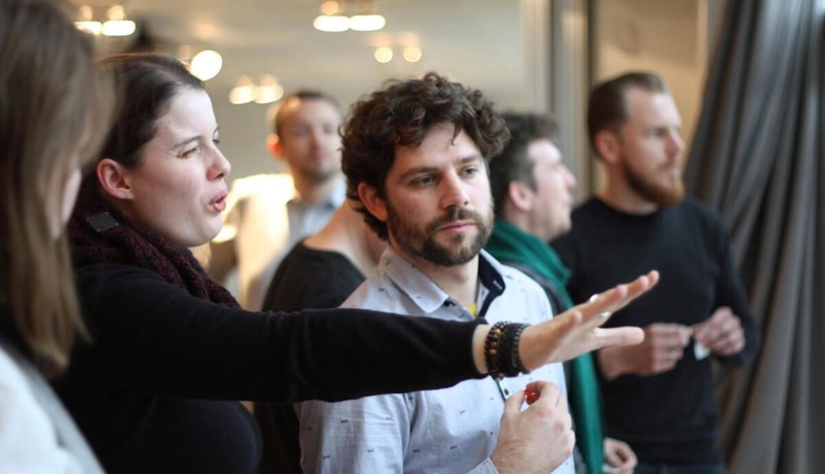
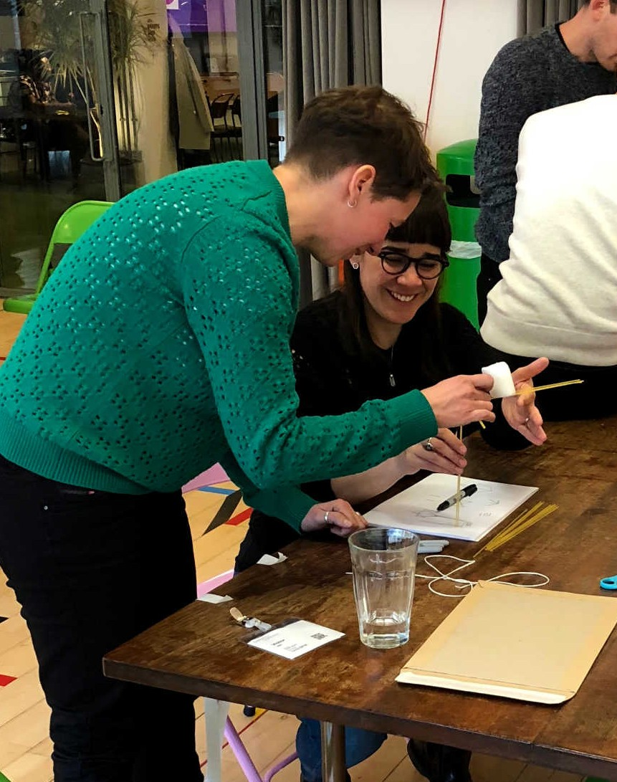
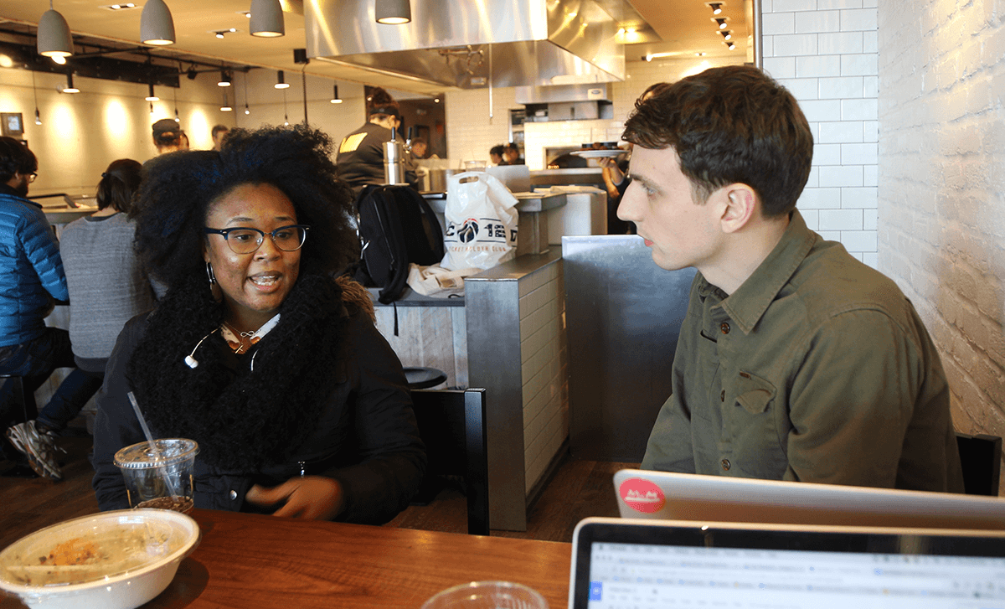
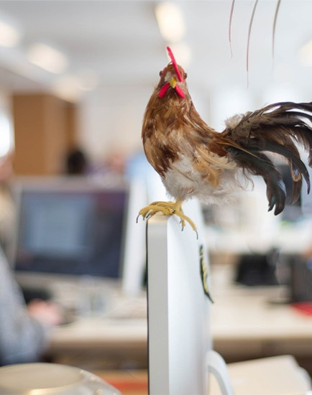
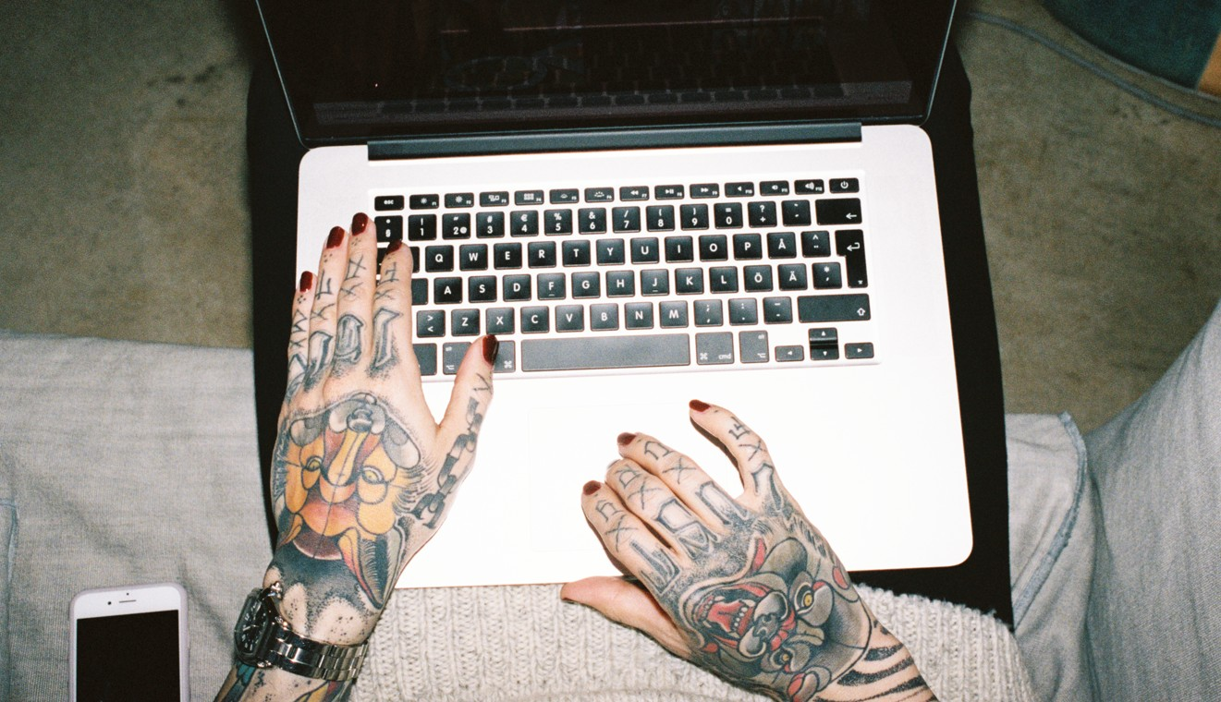
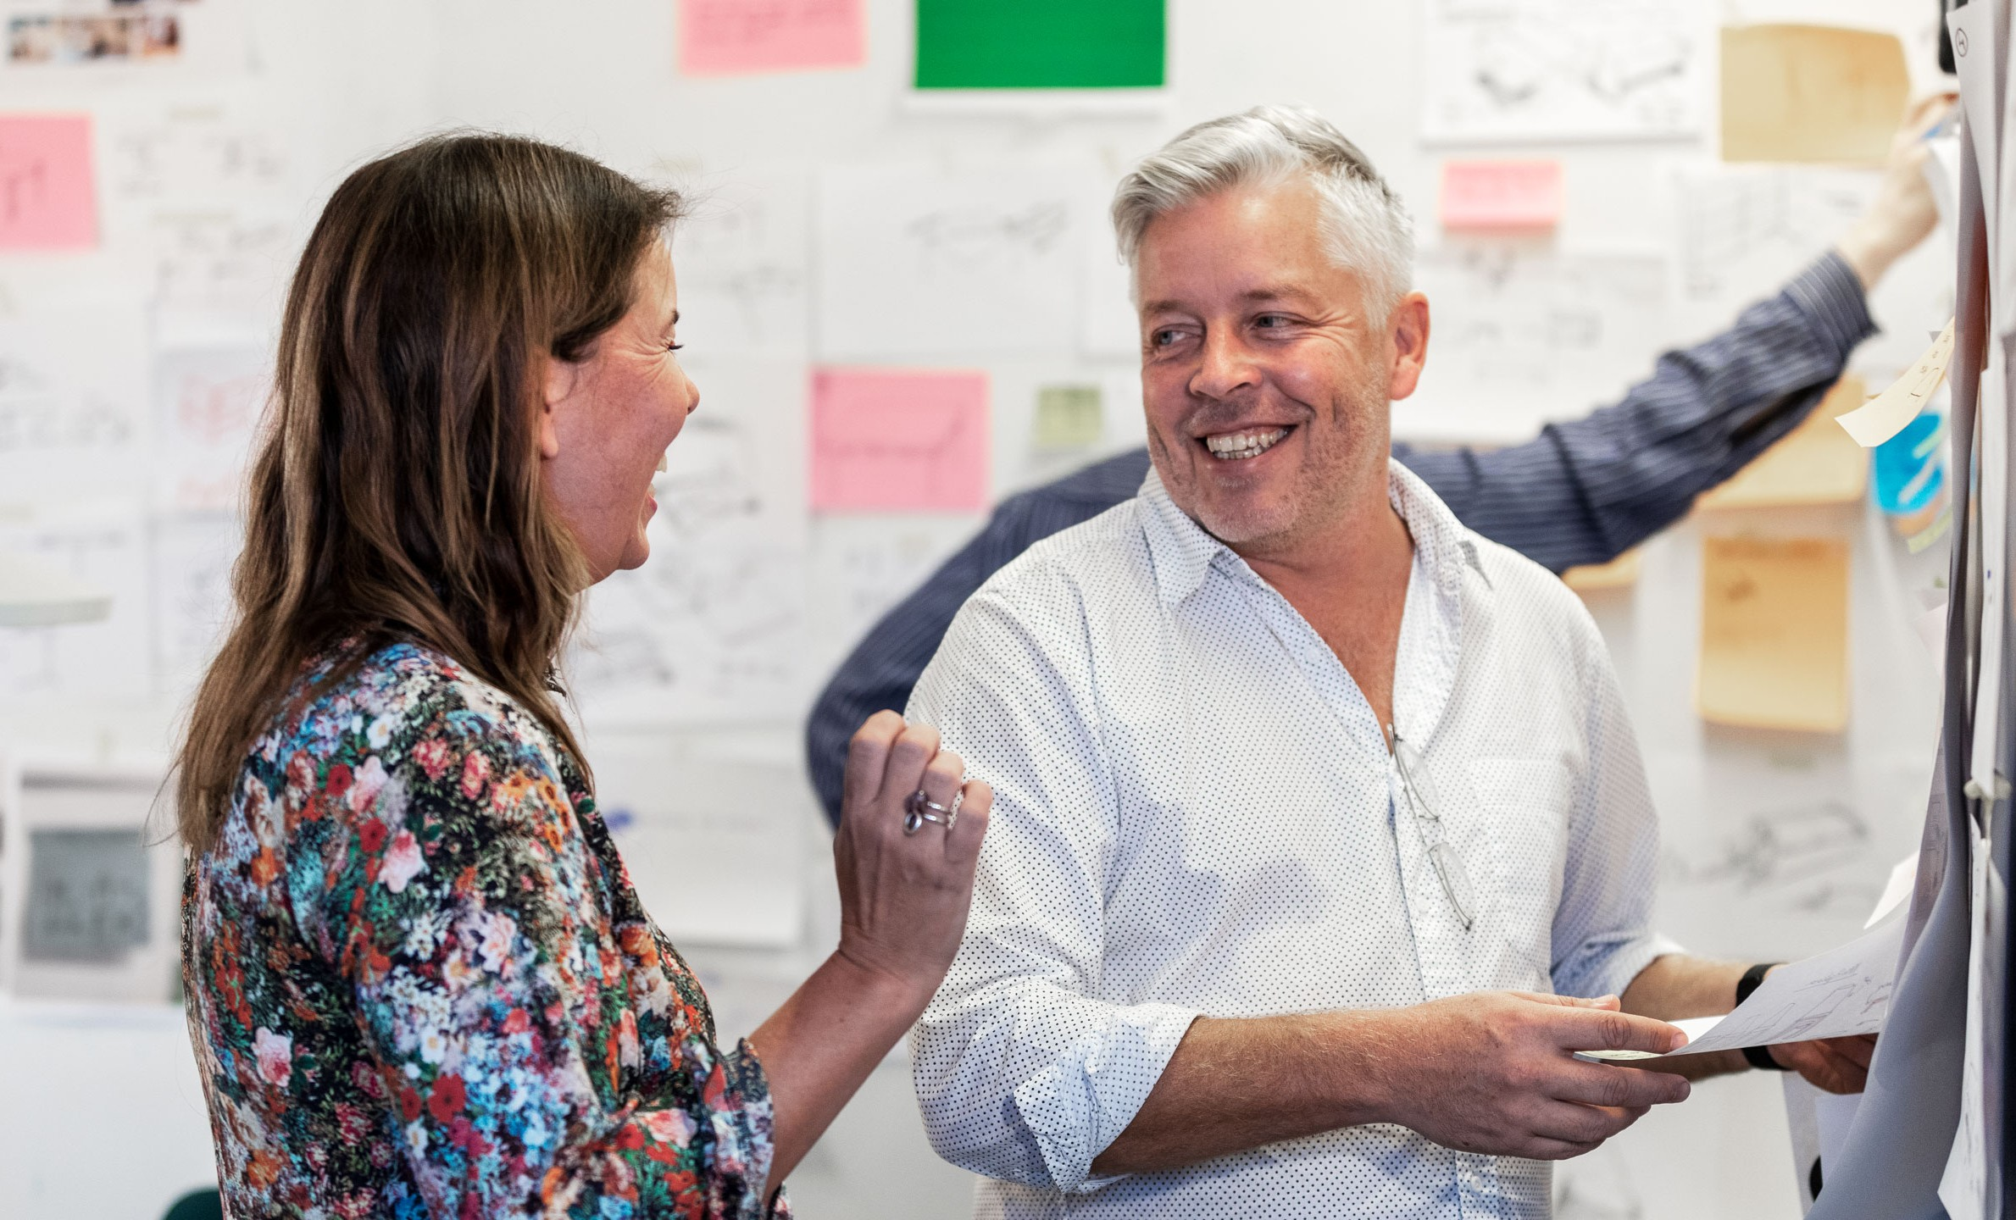
Bilder
Image concept: Human integration
.

Slide 10
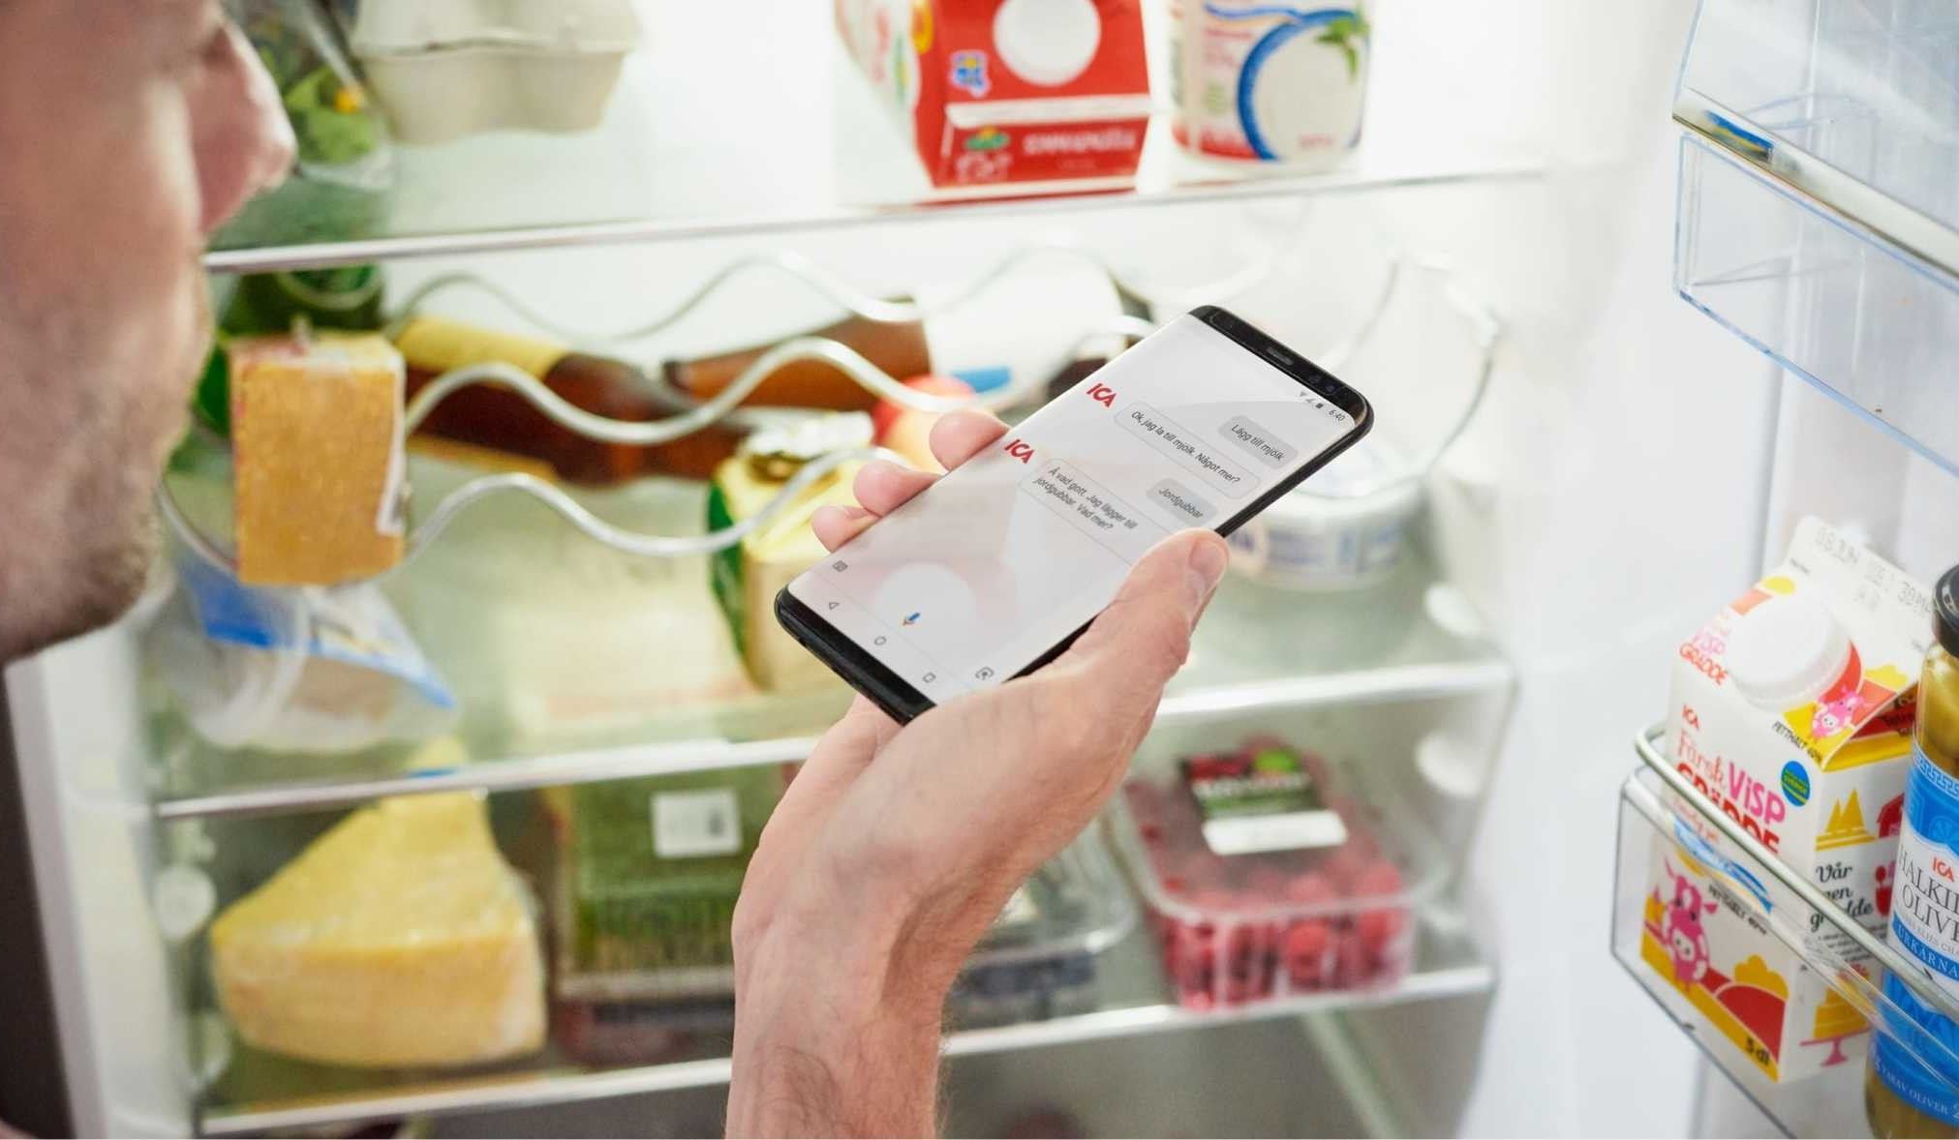
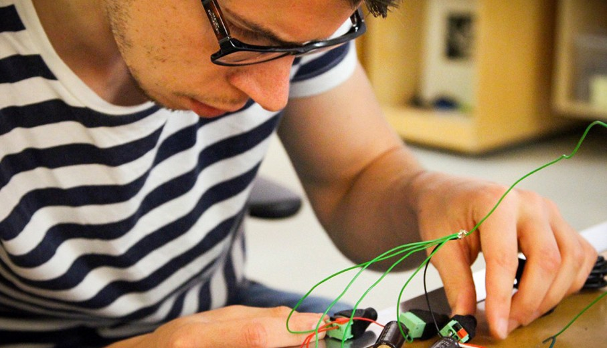
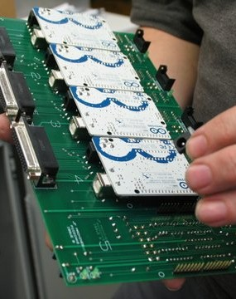
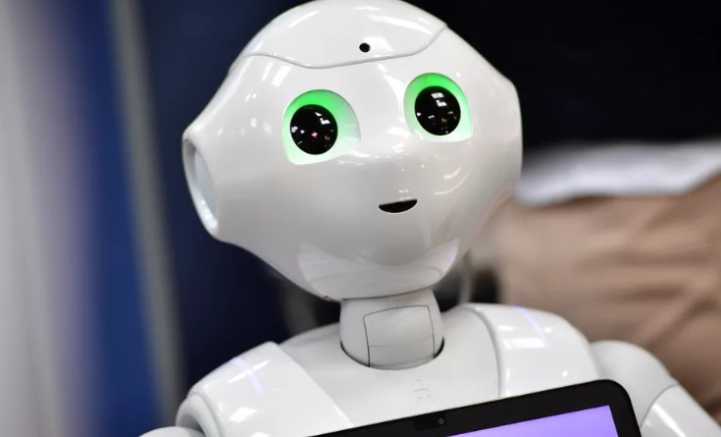
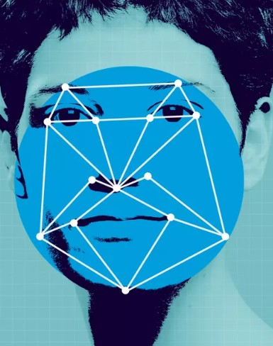
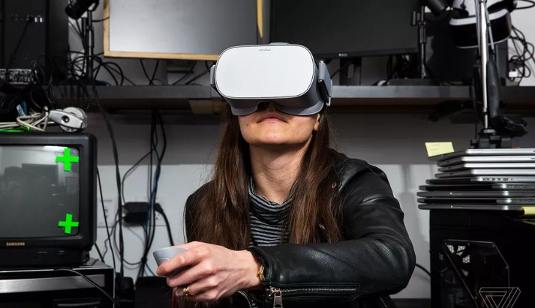
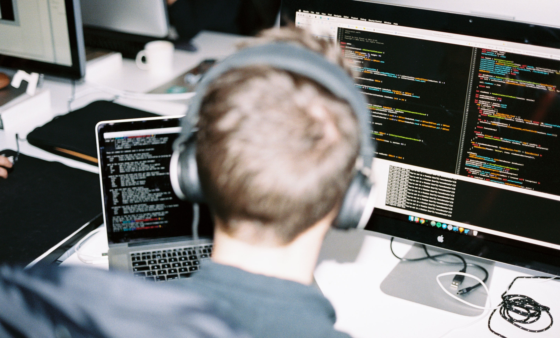
Bilder
Bimage concept: Future optimism
We believe in and feel confident about the future –.

Slide 11
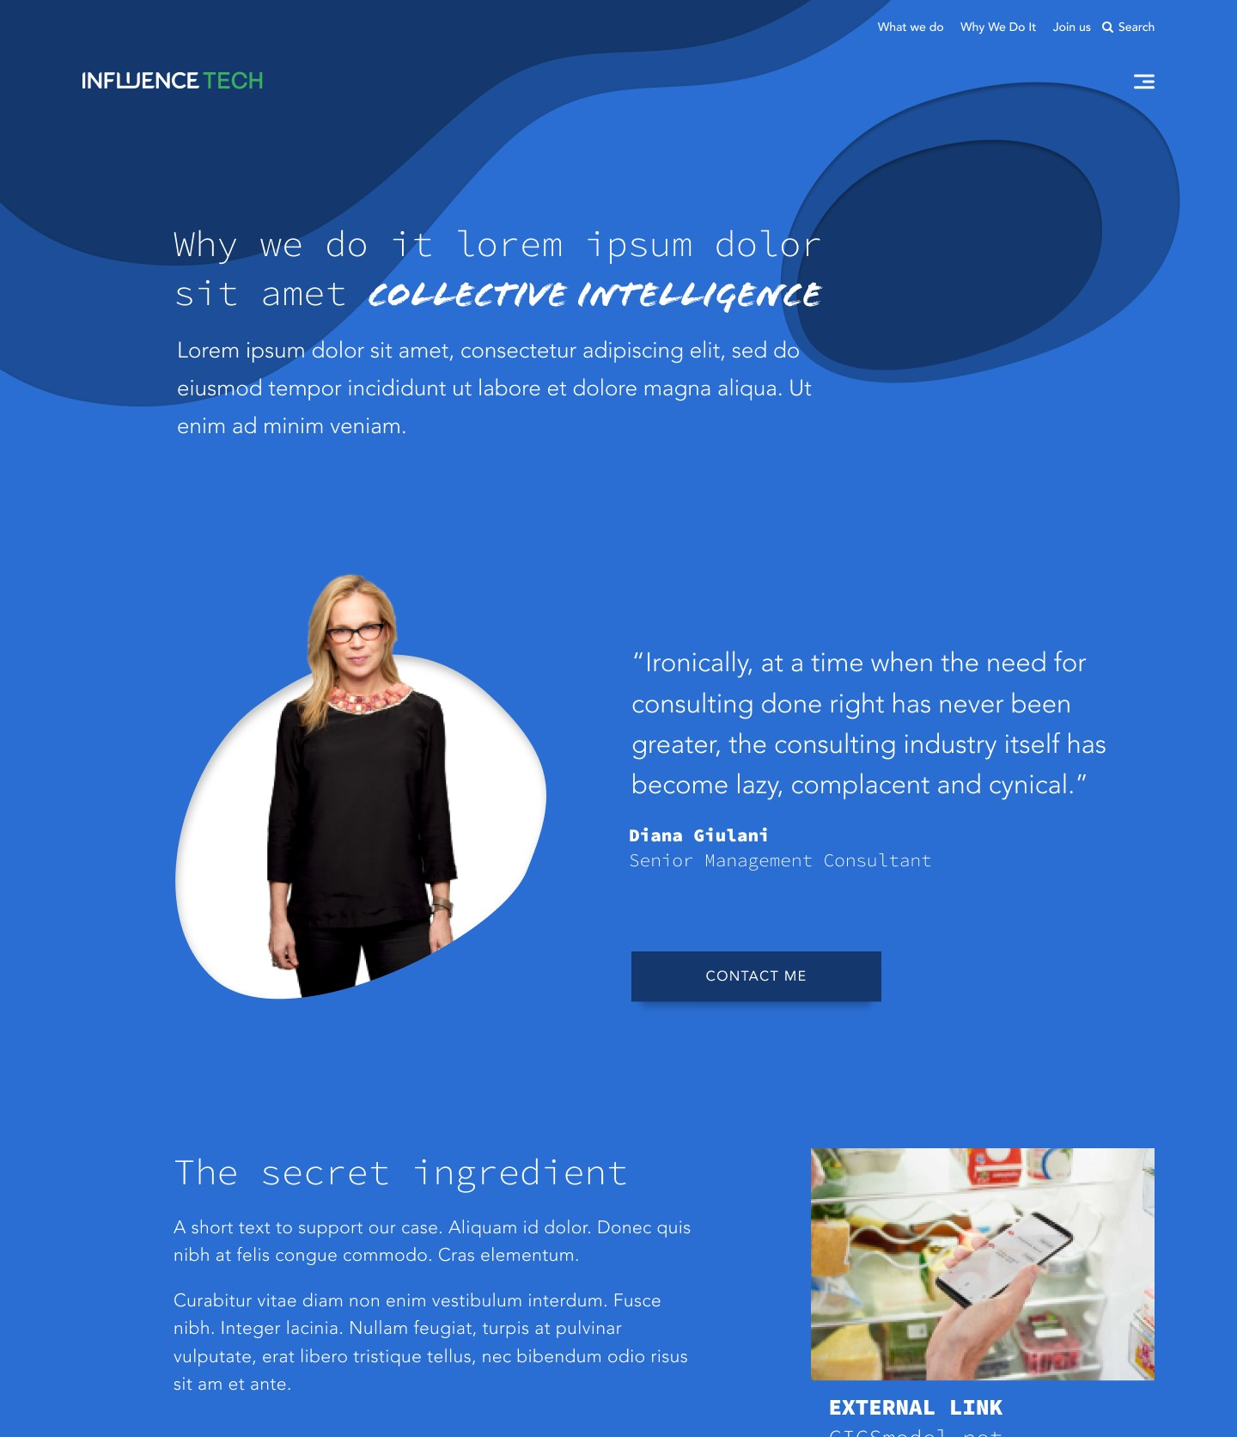
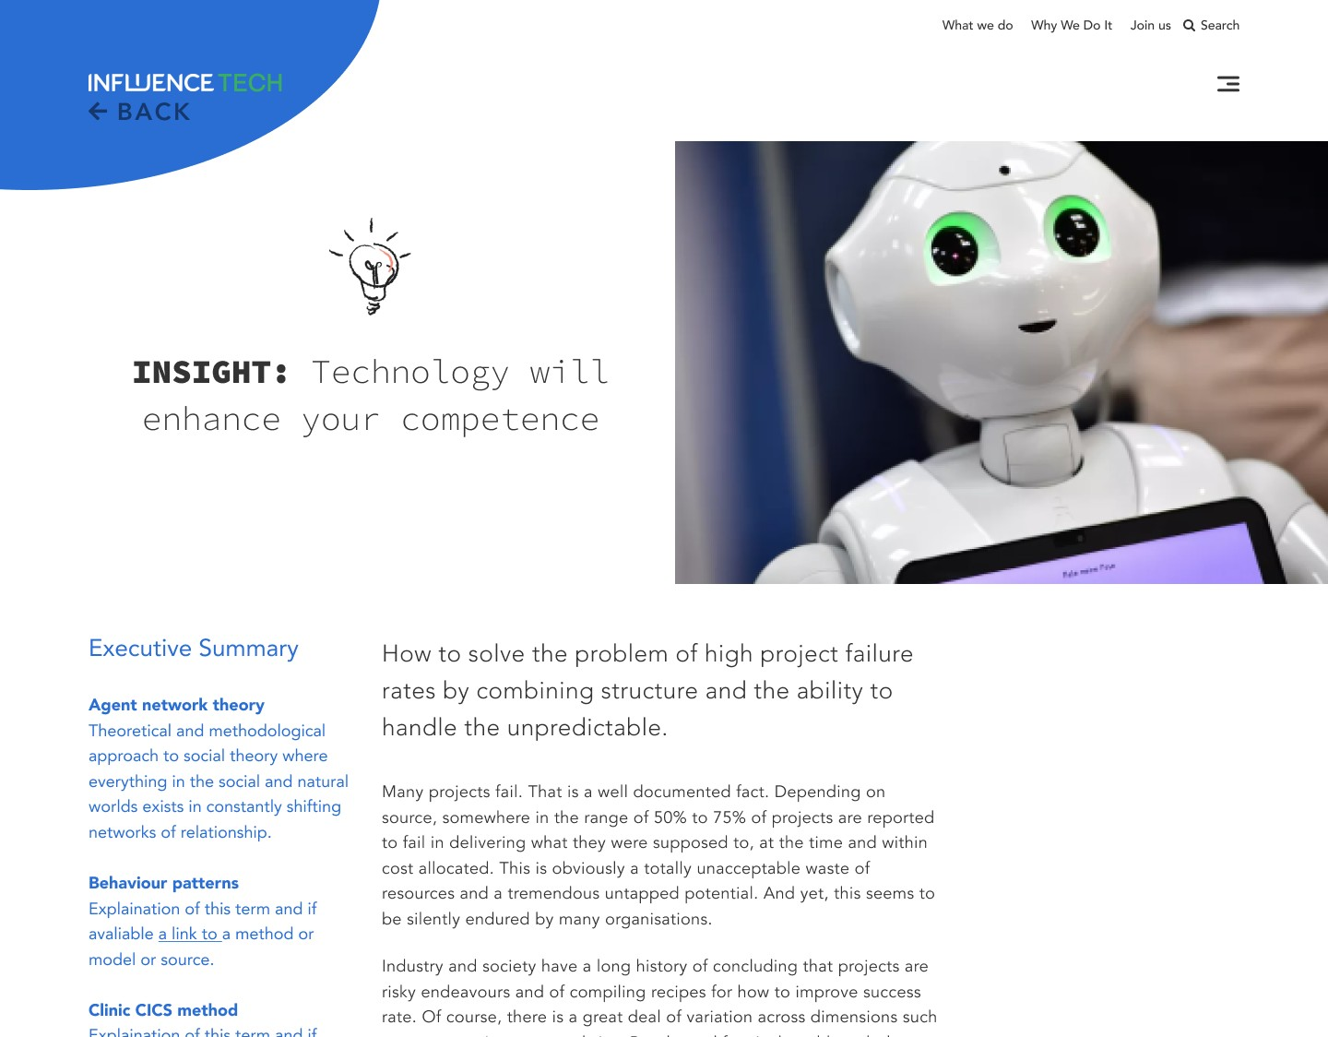

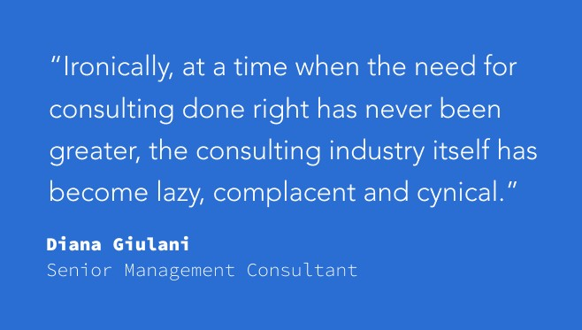
Old logo!

Slide 12

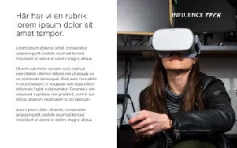
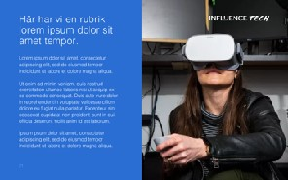
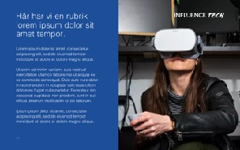
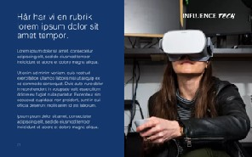
Text + Media
Different shades of hyperlink blue and the white as complementary.

