Slide 1
About Us
Australian financial services consulting company (fintech) founded in 2016
Specialized in advanced analytics, predictive modelling and machine learning applied to risk management and automated decisioning
Open Analytics
Open Data digital strategy
Open Source solutions
Open IP and knowledge sharing

Slide 2

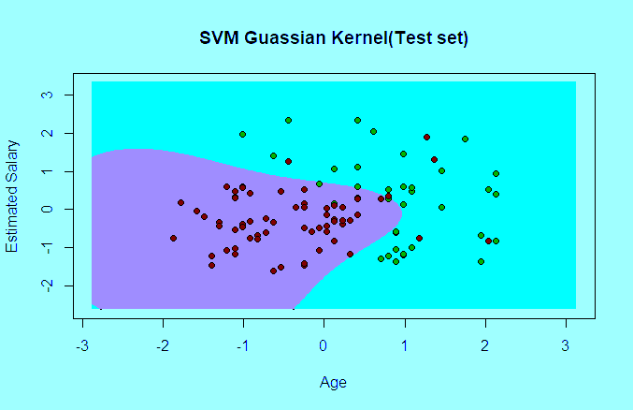
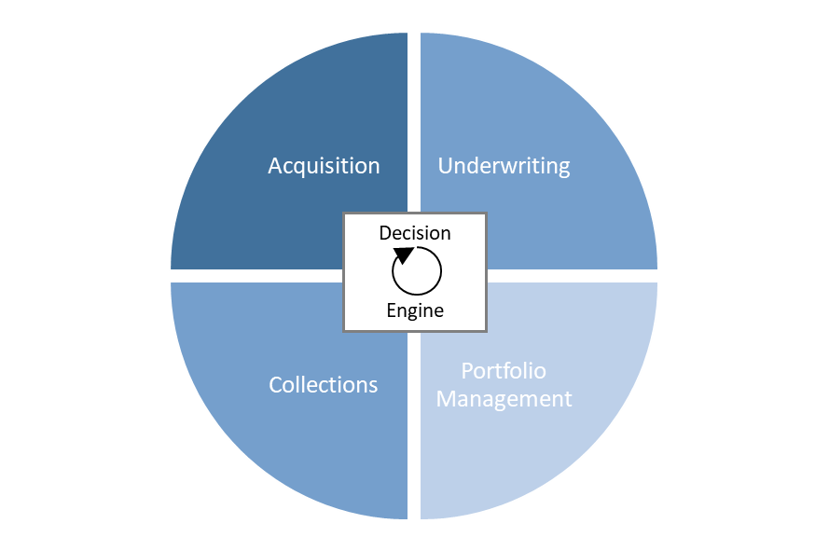

Our Services
Data
Modelling
Automation
Structured data-model design enriches the value of lender’s data assets by increasing interpretability, traceability and consistency of data.
Specialized expertise in advanced predictive modelling and machine learning methods which maximize the use of a broad range of data types.
Optimize automated decisioning processes including acquisitions strategy, underwriting policy, marketing, credit line management, risk based pricing and collections.

Slide 3
Some initial ideas for logo (very preliminary!)…
Open Analytics
Open Analytics
pen
Analytics
pen
Analytics

