Slide 1

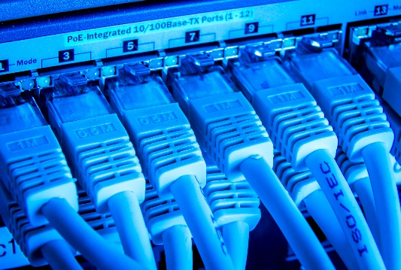

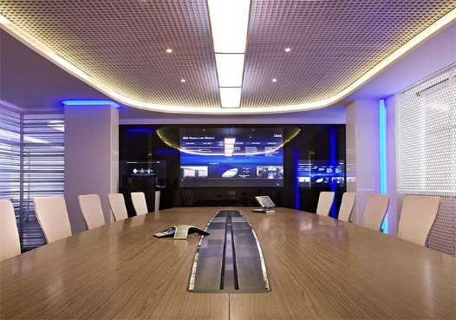
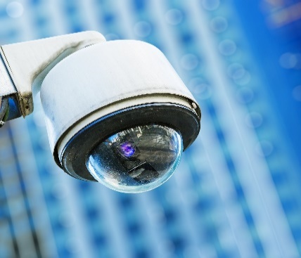
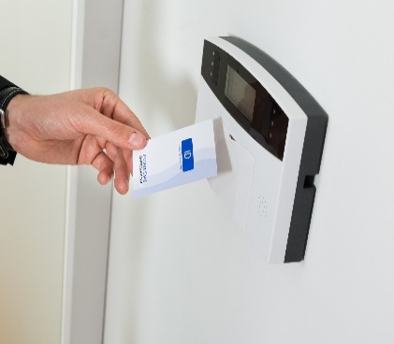
A leading provider of business technology solutions across Asia Pacific.
IT Infrastructure * Structured Cabling * Audio Visual * Security Access Control * Electrical
Design and Build Capability

Slide 2
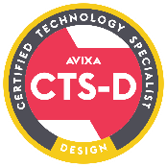


About Us
First Aurora is a leading provider of business technology solutions in Asia Pacific since 2004 with a blue chip clientele that includes Apple, Julius Baer, Uber, Regus.
We have offices in Singapore, Hong Kong, Malaysia, New Zealand, & Australia.
We specialize in complete IT solutions for hotels, commercial offices, trading rooms, educational institutions, and data centres.
First Aurora staff hold relevant industry certifications to support all Audio Visual and Structured Cabling works. We are a certified member of AVIXA, the leading resource for AV standards, certification, training, market intelligence and thought leadership. We are also a certified designer and installer partner with most leading cabling products.
We have a strong track record of implementation capability with signature projects deployed in:
  Australia, New Zealand, China, Myanmar, Indonesia, India, Singapore, Malaysia, Thailand, Hong Kong, South Korea, Japan, Vietnam, Brunei, Philippines.
We can provide local billing in Australia, New Zealand, China, Indonesia, Singapore, Malaysia, Thailand, Hong Kong, Japan, Philippines and Vietnam.

Slide 3
Our Solutions
IT Infrastructure
Audio Visual
Security
Fibre & Copper Cabling
UPS
Network Equipment
Server Room Equipment
PABX & Telephony Systems
Wireless
Design
Display Screens
Video Conference Solutions
Meeting Room Control Systems
Sound Systems
Audio Cabling
Card Access
CCTV
Alarm Systems
Design
Design
Network Engineering Services

Slide 4













Supply & Install all Leading Cabling Brands
Other brands can also be supplied & installed to meet client corporate specifications or budget requirements

Slide 5








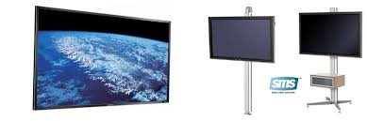

Supply & Install all AV leading brands
AV presentation, room scheduling and room control systems
Video Conferencing Solutions
Speakers
Install & Mount iPads for meeting room booking systems, visitor registration
Microphones, headsets
AV Control systems for video walls, wireless presentation
Any size or brand of display screens
Audio Processors
Other brands can also be supplied & installed to meet client corporate specifications or budget requirements

Slide 6
Managing Director
Greg Parkhurst
General Manager
Neil Steffensen
HR & Accounts Manager
Finance
Technical Leads
Audio Visual
Network Engineering
CAD & Documentation
Client Delivery
Service Management
Qualified Project Managers
Sales Operations
Regional Accounts
Australia / NZ
Singapore / Malaysia
Sales Teams
Hong Kong/North Asia
Structured Cabling
Installation Teams

Slide 7
Clients
Our clients range from hotels, large multi-national companies to any corporate office with an intelligent approach to their IT needs. As a business partner of leading hardware and software manufacturers, First Aurora can offer a wide range of products and services to cater for varying budgets and technology requirements.
We can either work direct with the Client or through your Project Manager or Designer.
Visit our website
www.firstaurora.com
to view our client portfolio

Slide 8

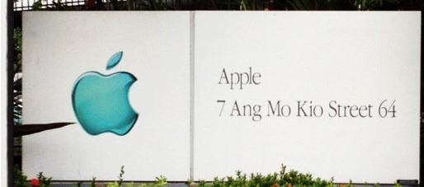
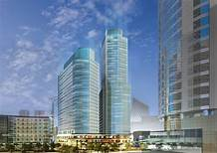
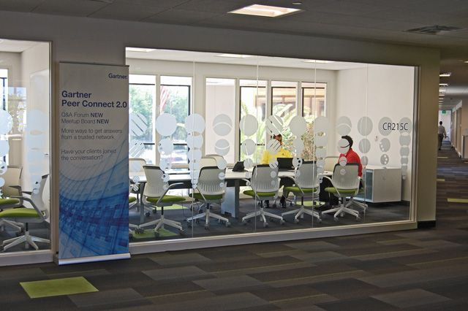



Project Experience
Client: Apple
Project: Singapore, Vietnam, Auckland, Indonesia Corporate Offices
Ongoing projects since 2017
Project Values:$2M+
Client: Novartis
Project: Philippines New Corporate Office, Ayala North Exchange, 2 Floors
November 2018 to January 2019
Client: Gartner
Project: Singapore Corporate Office, Marina One, July 2017
Project Value: $800K
  Property Development
  and Construction
  Technology, Telecoms and Media
  Financial and Professional Services
  Public Sector
  and Charities
Design, supply and install of AV equipment including:-
Installation and Mounting of iPads
Video Conferencing
Training Room with Projector & Integrated Speakers
Boardroom Automation
Crestron control systems
Design, supply and install of structured cabling and audio-visual equipment including:-
Structured Cabling Design
  Datwyler cabling products
  320 data points
  Server room equipment
AV design for 6 room types including boardroom, training, breakout and meeting rooms.
  Cisco Video Conferencing
  Crestron – audio and control systems, speakers
  Shure – wireless microphones
Design, supply and install of structured cabling and audio-visual equipment including:-
Structured Cabling Design
  CommScope Netconnect cabling products
  900 data points
  Server room equipment
AV design for 7 room types including boardroom, training, breakout and 3,4,8,10 pax meeting rooms.
  Barco Click Share
  Webex
  Cisco Video Conferencing
  Crestron – audio and control systems, speakers
  Shure – wireless microphones
  Health and Education

Slide 9
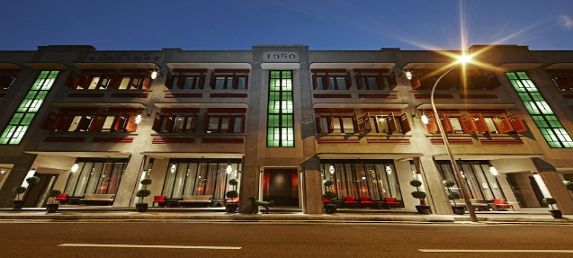
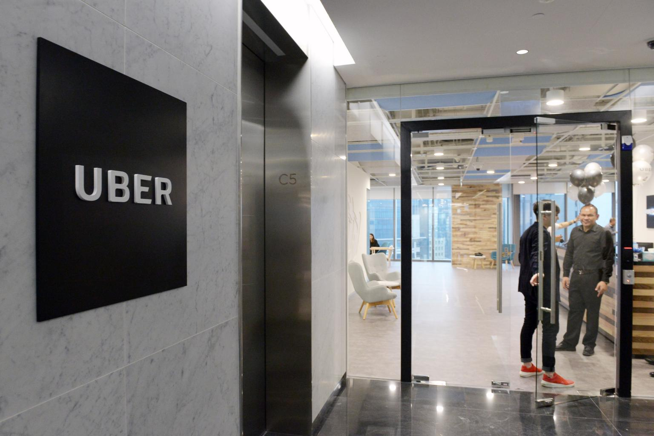



First Aurora – Relevant Project Experience
Project Experience
Client: Uber
Project: Singapore, Ho Chi Minh City, Jakarta, Kula Lumper, Sydney Corporate Offices, ongoing since January 2017
Project Value: $1M+
Client: Allied World
Project: Singapore & Hong Kong, 2015
Project Value: $2.1M+
Client: Garcha Hotels
Project: Duxton Terrace, Duxton House, Vagabond, 2017-2018
Project Value: $1.5M+
  Property Development
  and Construction
  Technology, Telecoms and Media
  Financial and Professional Services
Design & consultancy for IT, Security and AV requirements including:-
Overall project management
Supply & installation of the background music system and emergency PA system
Hotel IT Systems
  Network, Wireless, Server Room equipment
  Horizontal Copper and Fibre backbone systems
Audio Visual systems for Hotel Event spaces and Night Club
  Full DJ and performance spaces,
Guest Room Services
  Telephones (bed, bath, desk),
  Supply and install of guest room TVs , on demand system
  Access Control – Salto and Vingcard
Supply & install of cable containment, fibre and Panduit structured cabling and install/relocation of wireless access points.
New Driver Centres - (Indonesia - Bandung, Surabaya, Bogor, Melawai, Sunter; Australia - Perth, Sydney, Brisbane; Malaysia – Kuala Lumper)
Audio Visual - (Vietnam - Hanoi, Ho Chi Min City)
Misc. Support - (WAP Installs, Additional Datapoints - Melbourne, Brisbane, Sydney (Corporate Office), Glebe, Perth, Wellington, Hong Kong)
  Design, Consultancy, & Project Management for IT, Security and AV requirements
  Supply & install of audio visual equipment for boardroom, meeting rooms, breakout rooms and townhall meeting space including:-
  Boardroom, TV Screens
  Full touch panel control systems with lighting and bind control
  Top of the range PolyComm Group 7000 & 5000 systems
  Wireless presentation support
  Audio conferencing Support
  Video Conference Room
  Touchdown Area with Combined Town Hall Function
  Public Sector
  and Charities
  Health and Education

Slide 10
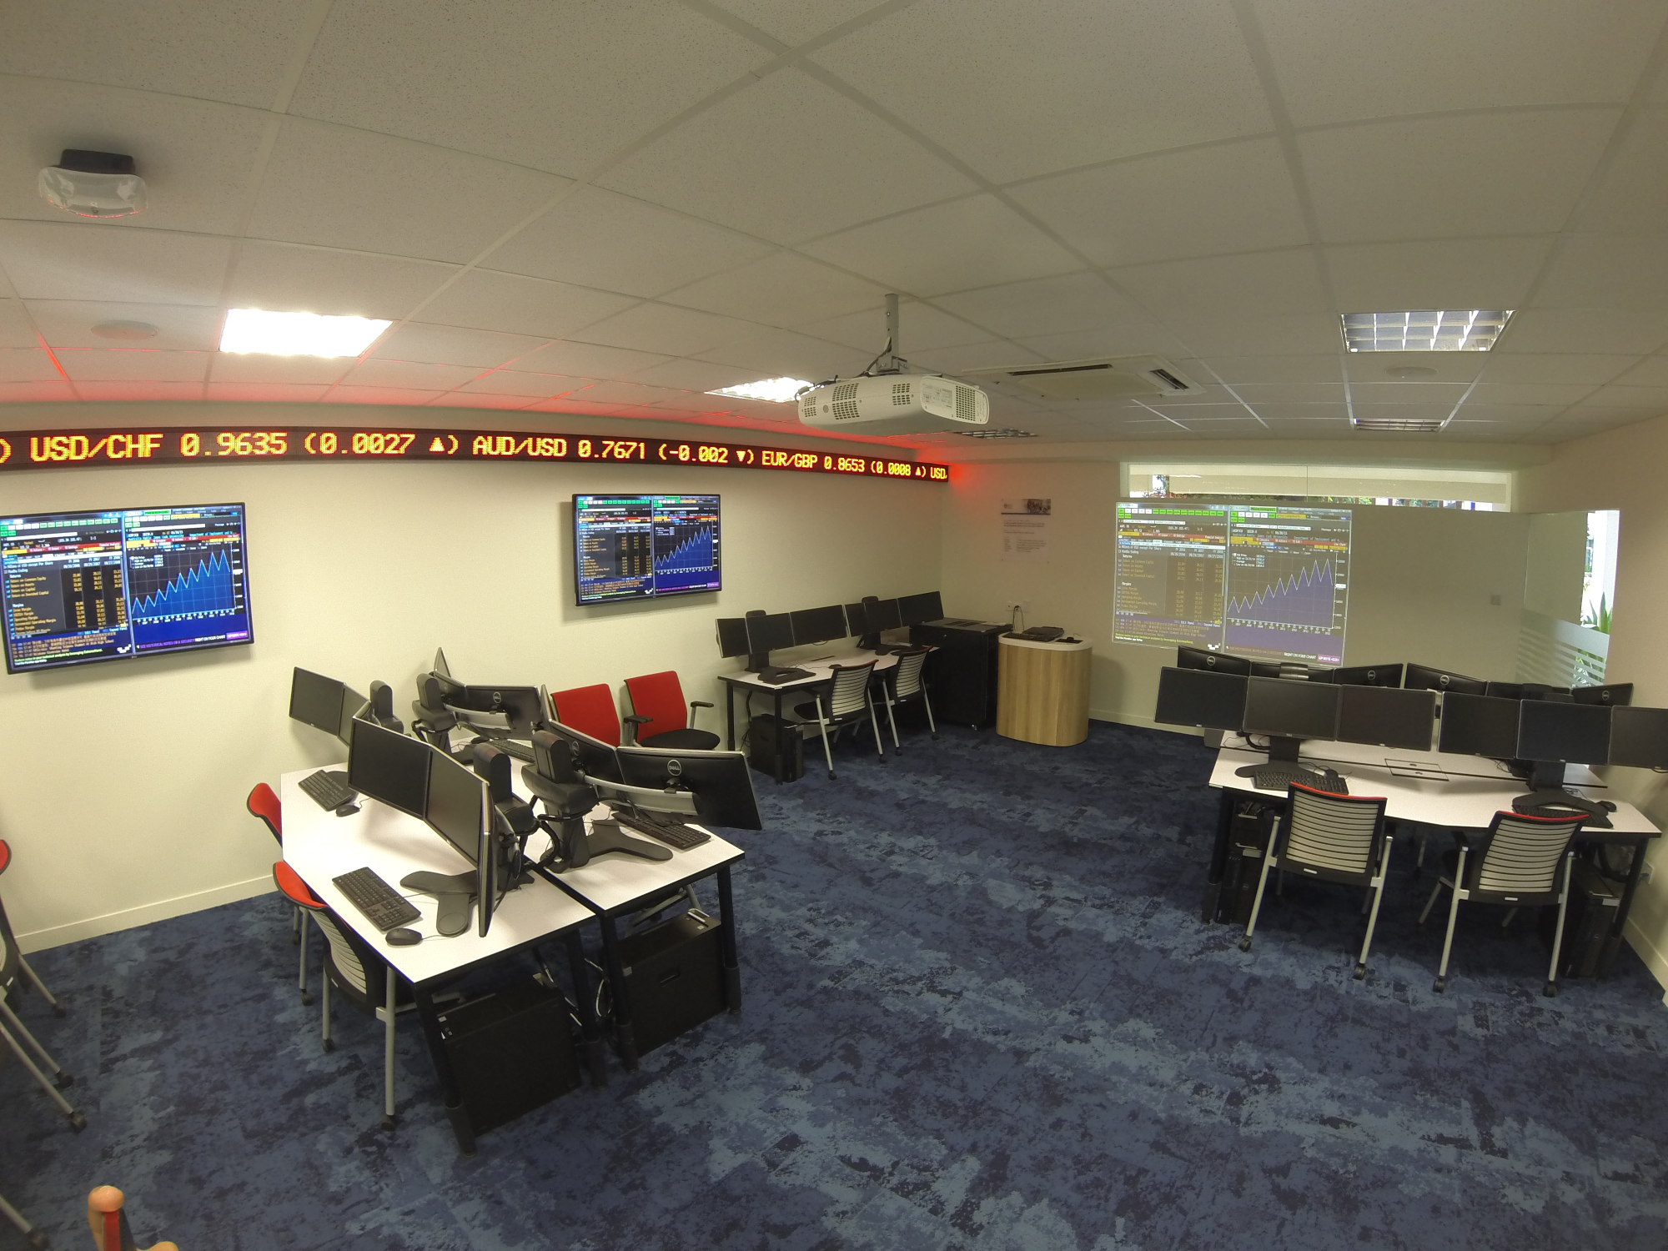
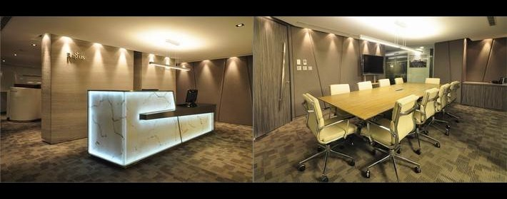
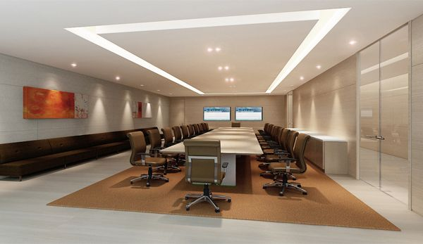


Project Experience
Client: Regus
Project: GT International, World Plaza, Arnaiz Ave, Davos City, Philippines
Client: Julius Baer
Project: Singapore 2018
Project Value: $1M
Client: James Cook University
Project: New Campus, Singapore 2015
Project Value: $2M+
  Property Development
  and Construction
  Technology, Telecoms and Media
  Scope: 60+ classrooms, theatres and lecture halls and administration offices
  Design, Consultancy, & Project Management for IT, Security and AV requirements
  Voice & Data Network, and Structured Cabling
  Server Room – Server Racks, Uninterrupted Power Supplies, Rack cooling, and environmental monitoring
  Telephone/ PABX Systems – Students and Staff
  Wireless Internet – Deploy WiFi throughout campus for guests, students and staff
  Audio Visual – AV equipment design for teaching spaces, staff office and student areas, including
  JCU was awarded the EduTrust Star - the highest level of quality assurance that can be awarded to a private education institution (PEI) by the CPE under the EduTrust Certification Scheme (EduTrust).
  Financial and Professional Services
  Structured Cabling, IT Racks, UPS, Network Support for 30+ sites across Australia, NZ, Indonesia, Brunei, Hong Kong, Malaysia, Singapore, Vietnam, Thailand, Philippines
  Network engineering support for over 12 offices in NZ
  Electrical in Melbourne
  Design, Consultancy, & Project Management New Corporate Office in Singapore at Marina One building.
  Project Management and Installation of structured cabling.
  Supply & Install structured cabling ~ 3000 data points
  Datwyler Products
  Public Sector
  and Charities
  Health and Education

Slide 11

Health & Safety Statement
As part of the First Aurora’s Health & Safety Policy, we will:-
Provide health & safety policy training to all staff.
Ensure all staff are competent and adequately resourced to address the health and safety issues likely to be involved onsite
Check that clients are aware of their duties
When carrying out design and build work, avoid foreseeable risks to those involved in the construction and future use of the equipment, and in doing so, they should estimate hazards and reduce risk associated with those hazards which remain.
Provide adequate information about any significant risks associated with the design and build.
Coordinate work with that of others in order to improve the way in which risks are managed and controlled.
In carrying out those duties, our designers and installers need to consider the hazards any risks to those who carry out construction work including demolition.
Use a structure designed as a place of work may be affected by such work, for example customers or general public.
  Property Development
  and Construction
  Technology, Telecoms and Media
  Financial and Professional Services
  Health and Education

Slide 12
Why HPF?
Why choose First Aurora?
  Property Development
  and Construction
  Technology, Telecoms and Media
With our partners, breadth and depth of experience , we are able to offer you choice for a competitive price with a quality solution and service throughout Asia Pacific markets.
Our team has experience in Audio Visual and IT Infrastructure design & build, both in Singapore and across Asia Pacific for large multi-national organisations. We support leading global companies regionally such as Apple, Uber, and Regus.
Vast experience installing Crestron, Extron, Barco, Clearone, Harman, Sonos, AMX, BIAMP, Shure, JBL, all display brands, touchscreen meeting room boards, and Nureva, Polycom & Cisco conferencing solutions.
Top level management maintain a hands-on involvement in projects.
Committed team who understand the need for effective communication and in non-English speaking markets.
  Financial and Professional Services
  Health and Education

Slide 13







Singapore
  +65 68297048
  Hong Kong
  +852 35893063
  Sydney
  +61 2 82498321 info@firstaurora.com
  Auckland
  +64 9 9274964
  Malaysia
  +601117573948
Keep up to date with new products and technologies, follow-us on

