Slide 1




0425 744 034
JUSTIN
BOWN
Level 3, 546 Collins Street
Melbourne, VIC 3000
justin@pinnacle-group.com.au
www.pinnacle-group.com.au

Slide 2

WE CREATE THE BEST PLACES ON EARTH TO WORK!

Slide 3
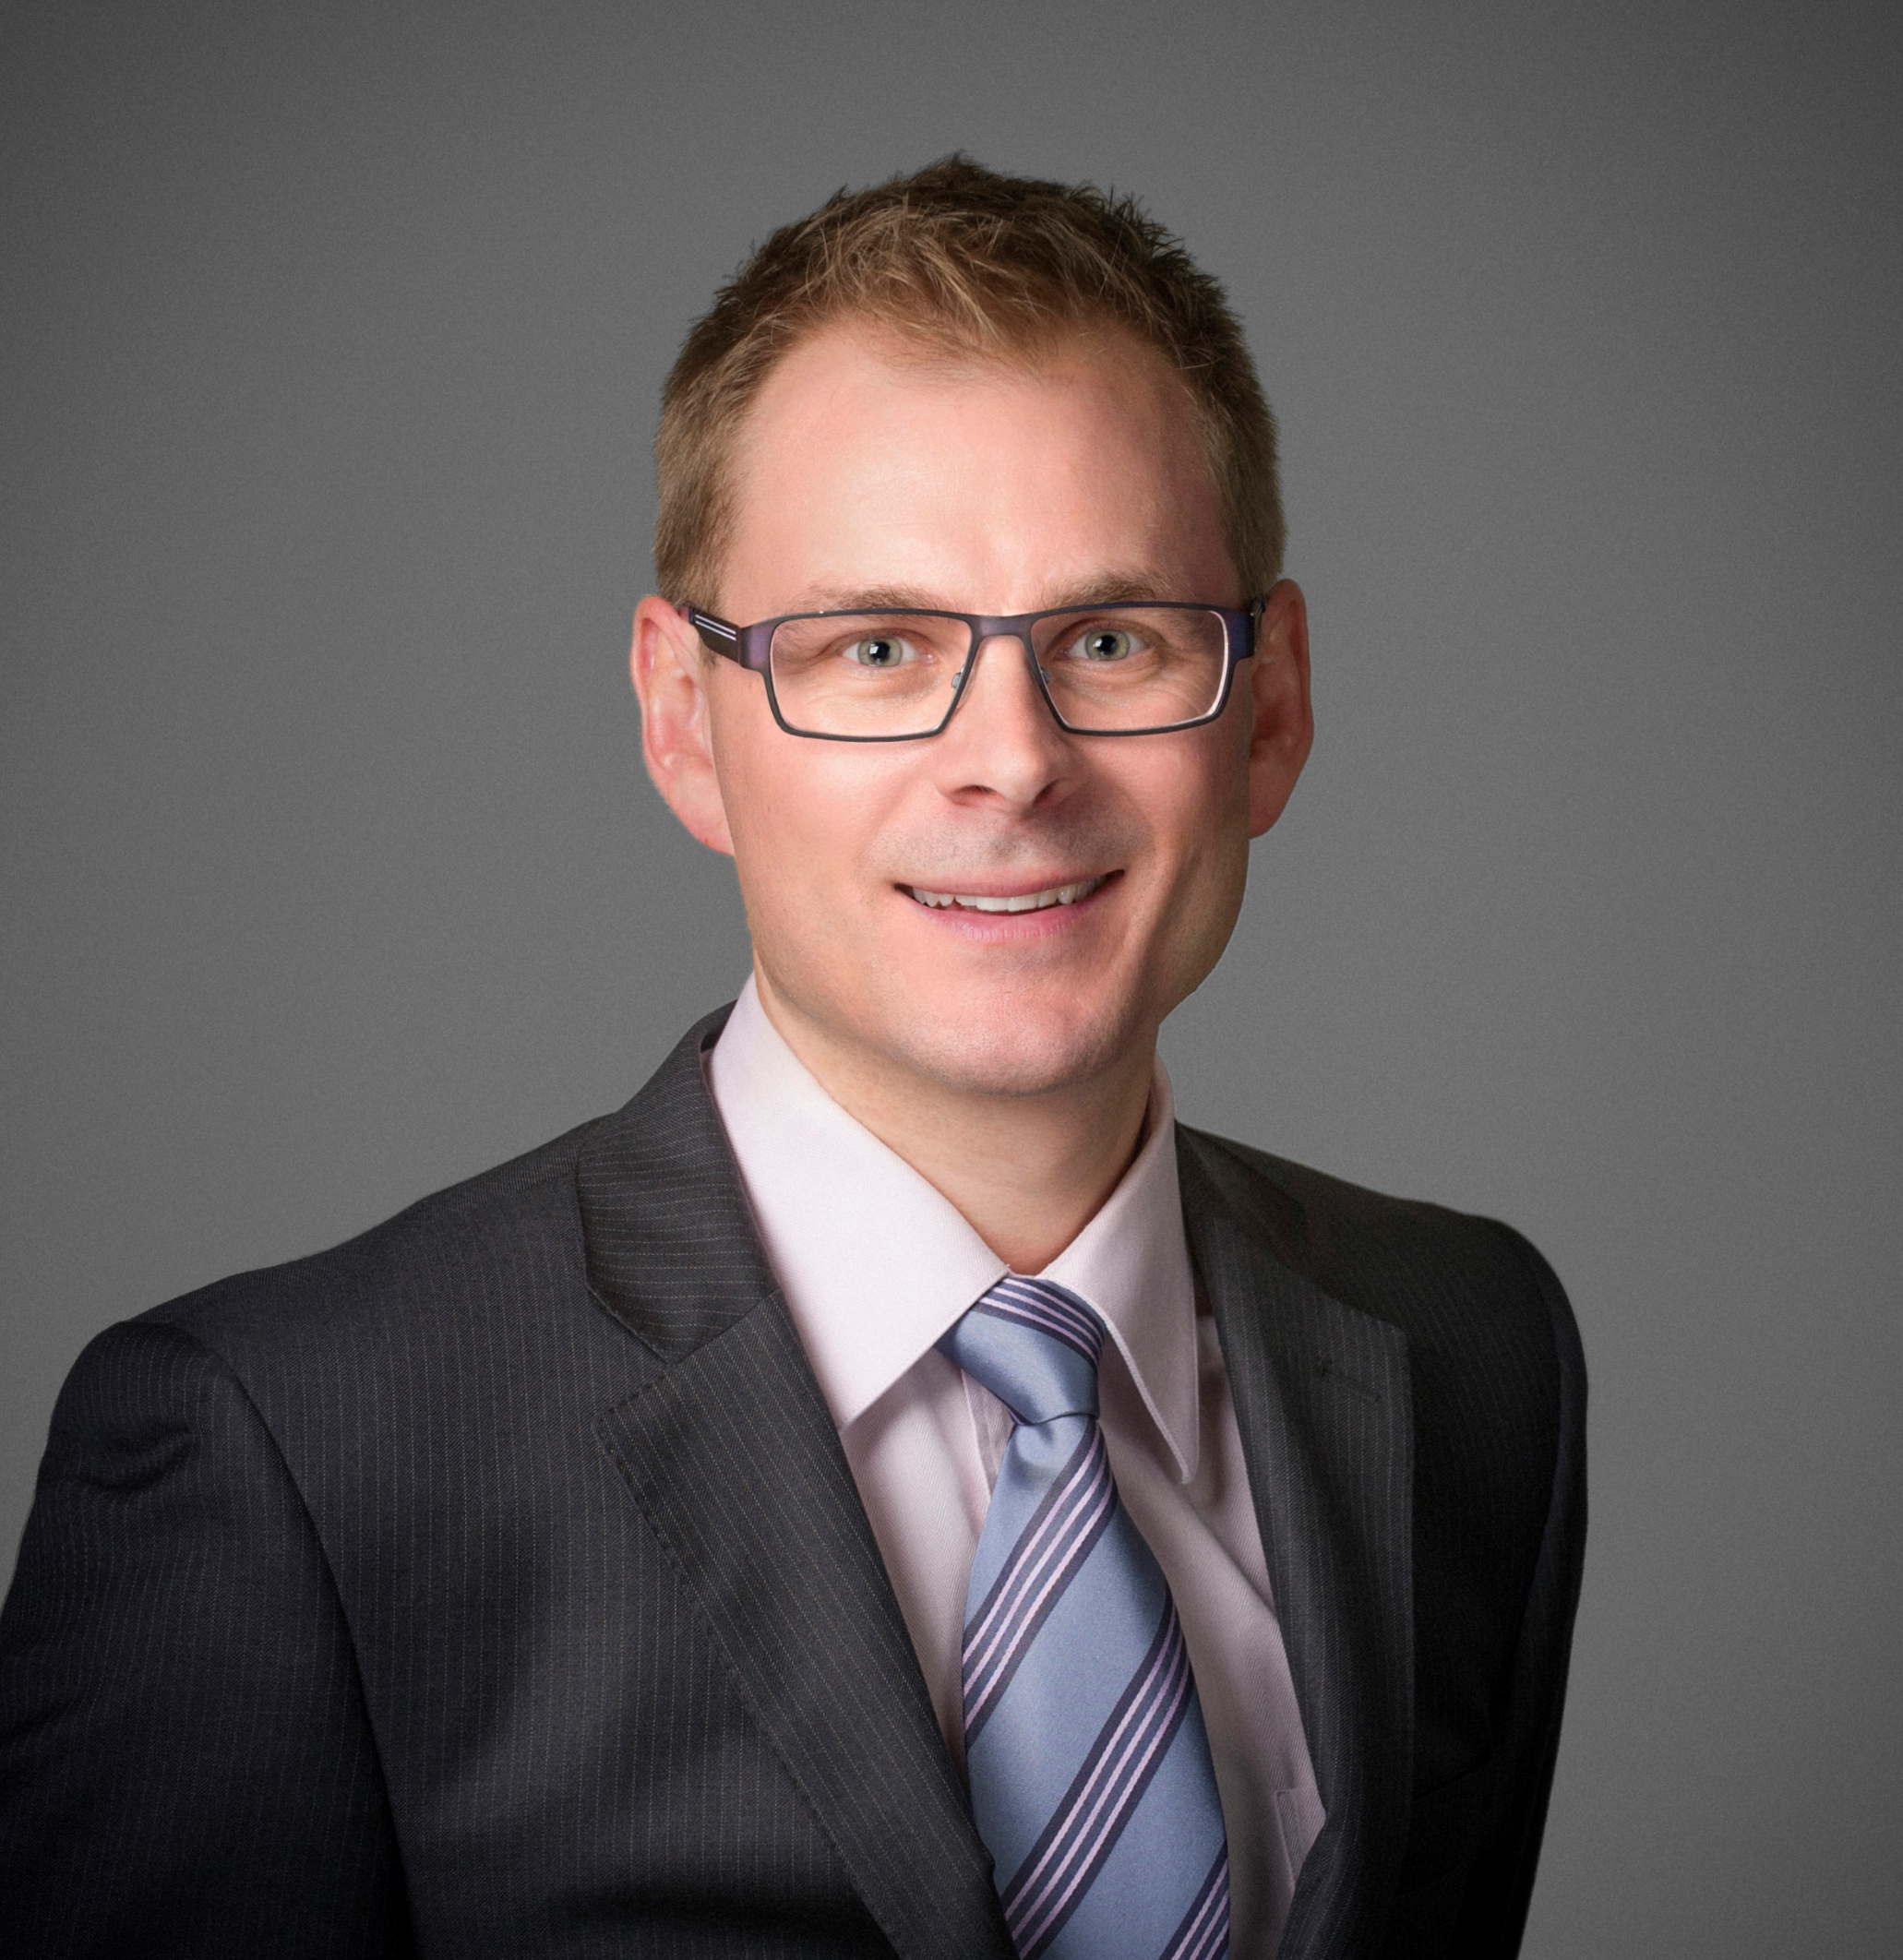

JUSTIN BOWN
DIRECTOR
0425 744 034
Level 3, 546 Collins Street
Melbourne, VIC 3000
justin@pinnacle-group.com.au
www.pinnacle-group.com.au

Slide 4
WE CREATE THE BEST PLACES ON EARTH TO WORK!

