Slide 1
Technology Business Management

Slide 2

Manage Technology as a Business: TBM
Source: tbmcouncil.org
Foster a Business Culture in IT
Enable the right business conversations
Develop Sound Fiscal Disciplines

Slide 3


Manage Technology as a Business: TBM
Source: tbmcouncil.org
Foster a Business Culture in IT
Position for Value
Define what you deliver in terms of busi
ness capabilities that are understood and valued by your business unit partners, so you can work together to improve business outcomes.
Continuously Improve
Execute a strategic roadmap for TBM maturity by integrating TBM into your day-to-day processes and thinking, so that TBM drives every value conversation with your peers.

Slide 4




Manage Technology as a Business: TBM
Source: tbmcouncil.org
Create Transparency
Translate your spending, consumption, and capacity into meaningful perspectives for technology and business decision-makers.
Shape Business Demand
Communicate costs and consumption to business units to drive informed trade-off decisions and better consumption behavior.
Deliver Value for Money
Maximize value and demonstrate industry-comparable cost-effectiveness for services and innovation you provide.
Plan & Govern
Collaborate to align your annual budget and resource plans to strategic business priorities and manage to the plan.
Develop Sound Fiscal Disciplines

Slide 5




Manage Technology as a Business: TBM
Source: tbmcouncil.org
RUN THE BUSINESS SPEND
Cost of Performance
Deliver technology, services, and projects efficiently to the business.
Business-aligned Portfolio
Optimize portfolios to deliver the most value for the level of spending.
GROW THE BUSINESS SPEND
Investment in Innovation
Allocate adequate resources on new and enhanced services and on business innovation.
Enterprise Agility
Help the business respond quickly to market opportunities or threats.
Enable the right business conversations

Slide 6
Who benefits from TBM?
Source: tbmcouncil.org
IT Leaders
“TBM brings business translation so you and your people can quickly decide on trade-offs and new investments to improve competitiveness, customer engagement, and the bottom line.“ Mike Brady, Global CTO, AIG
CFOs
“It changed the discussion with the CFO from ‘We're just spending money,’ to ‘We really are managing what we're doing.’” Steve Adams, Executive Director, IT Finance Kaiser Permanente
CEOs
“All of a sudden, we had clarity. That's the benefit of TBM. It has made a major difference in our company and how we run the business.” Dennis Gilmore, CEO, First American Financial Corporation
Business Unit Executives
“IT has shifted from being an order taker to an originator of ideas to win in the marketplace.” Mike Brown, VP, Information Technology, ExxonMobil

Slide 7
Gartner Says Global IT Spending to Grow 3.2 Percent in 2019
Business (CFO):
Why is IT spend rising (again)?
IT
spend
Technology (CIO):
How do I show increased value?

Slide 8
Technology and the Business understand each other through TBM
CFO:
IT spend and value is in control.
CIO:
Service value is visible.

Slide 9
The TBM Taxonomy: a template and a common language
Source: tbmcouncil.org
To gain alignment between IT, Finance, and Business Unit leaders, TBM provides a standard taxonomy to describe cost sources, technologies, IT resources (IT towers), applications, and services. The TBM taxonomy provides the ability to compare technologies, towers, and services to peers and third-party options (e.g., public cloud).
Just as businesses rely on generally accepted accounting principles (or GAAP) to drive standard practices for financial reporting — and thus comparability between financial statements — the TBM taxonomy provides a generally accepted way of reporting IT costs and other metrics. A simple view of the TBM taxonomy is shown.

Slide 10
CostPerform is widely accepted
Clients in 45 countries on 6 continents
500 Organizations use CostPerform
Cost modeling and TBM software since 1992

Slide 11
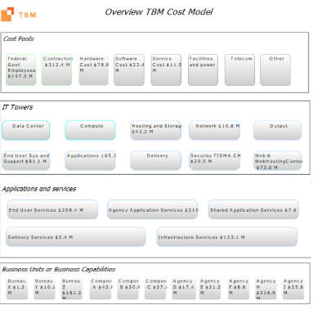
Cost Modeling Process
CostPerform
Publicly available data
Financial Data
Qlik
Cognos
Tableau
Etc
Data Processing
ETL Function
Data Import/export
Reporting
- Built-in
Operational, driver and HR data
Cost Model Build
TBM Taxonomy
Transparancy
Visual/Graphical
Modeling Logic
Analysis
Scenarios
Capacity
User friendly
Business Unit and Output data

Slide 12
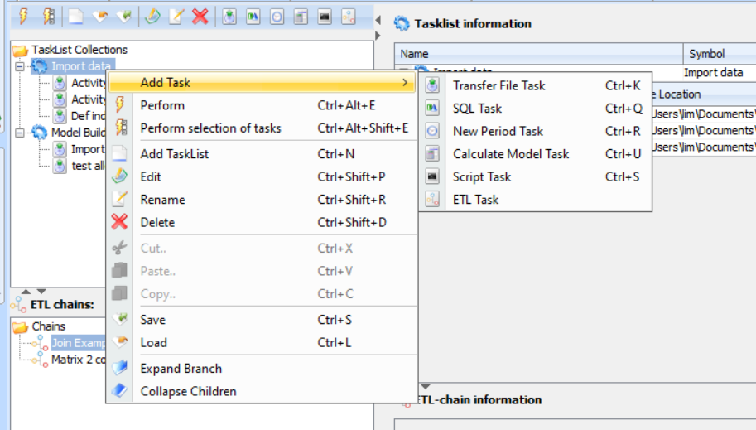
Standardize periodic import routine from different sources

Slide 13
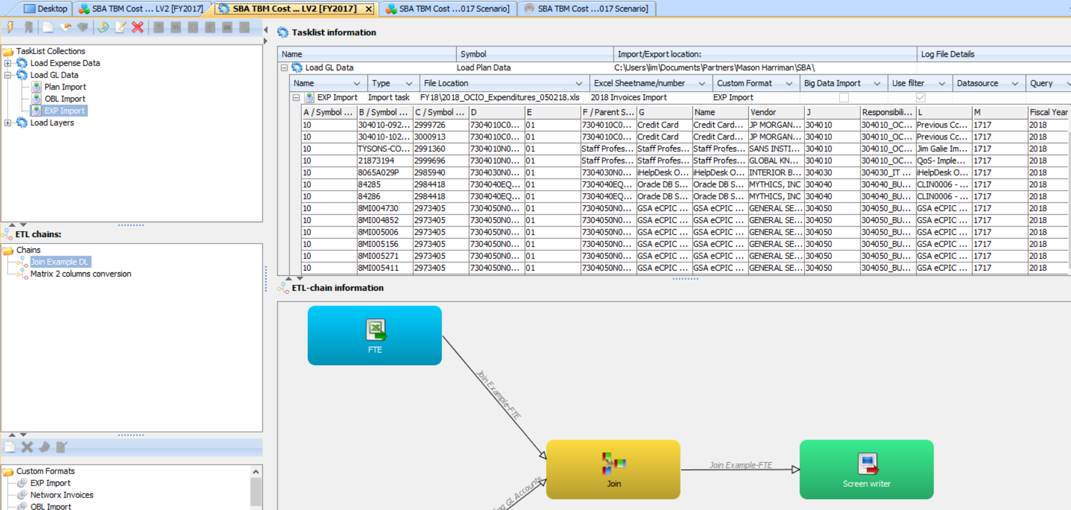
“Regular” import, ETL functionality and API Scripting

Slide 14
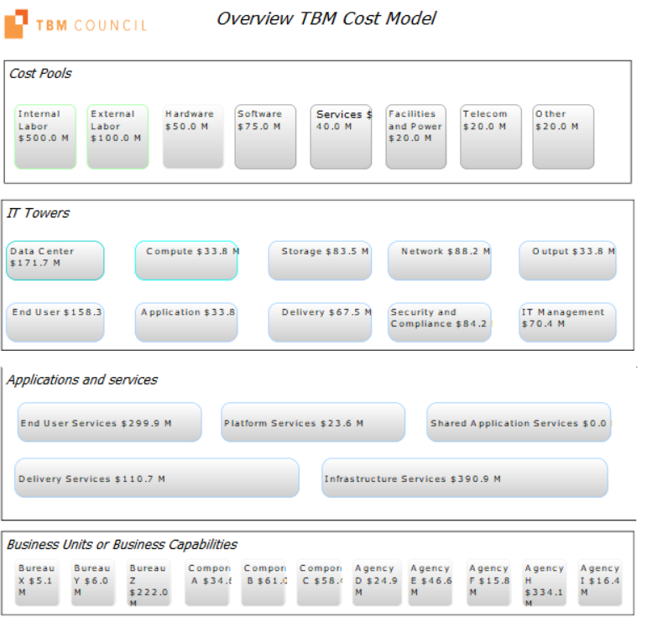
TBM Template Model Structure in CostPerform

Slide 15
Different data needs for different stages in the model
Financial Data
Allocation data
Metrics and usage by “customer”

Slide 16
Types of data
Financial Data
Financial Systems
Publicly available data
Fedscope for labor data
Fpds for contract data
Allocation data
Partly 1-1
Partly based on interviews with managers
Partly based on usage of drivers / metrics (HR, operations)
Consulting services
Metrics and usage by customers
Usage of products by customer based on # workstations, Gb’s, FTE’s, devices, users of specific systems, etc

Slide 17
Additional Functionality
Showback / chargeback
Visualization of cost and volume flows
Dashboarding for what-if analyses and predictive modeling

Slide 18
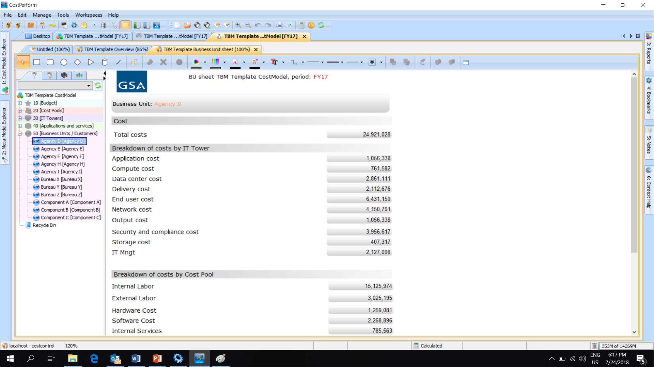
Showback / charge back example

Slide 19
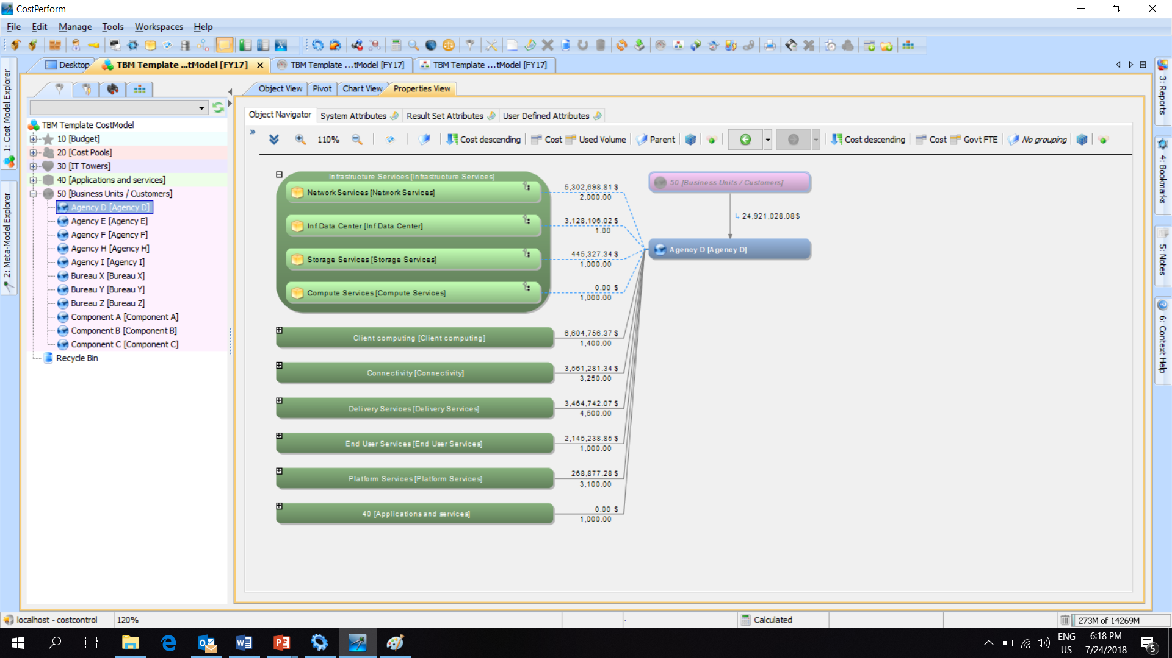
Navigator view for incoming and outgoing allocations

Slide 20
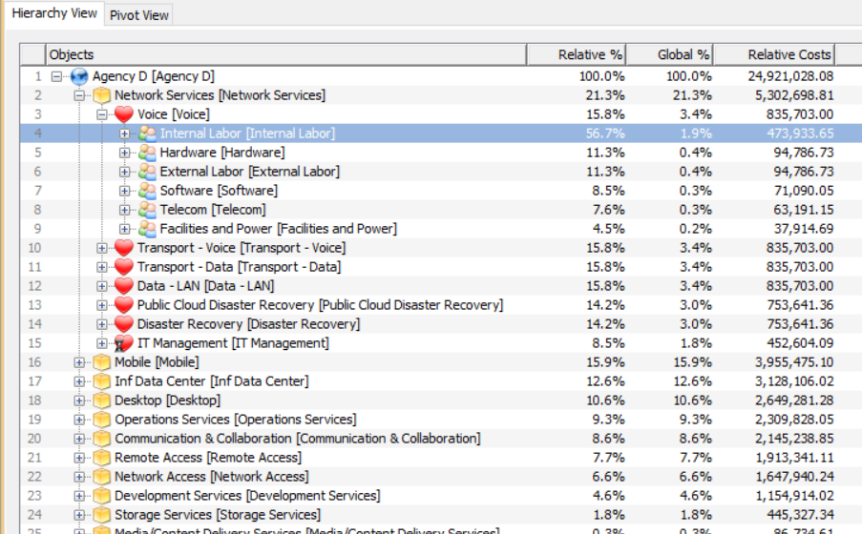
Drill down capability

Slide 21
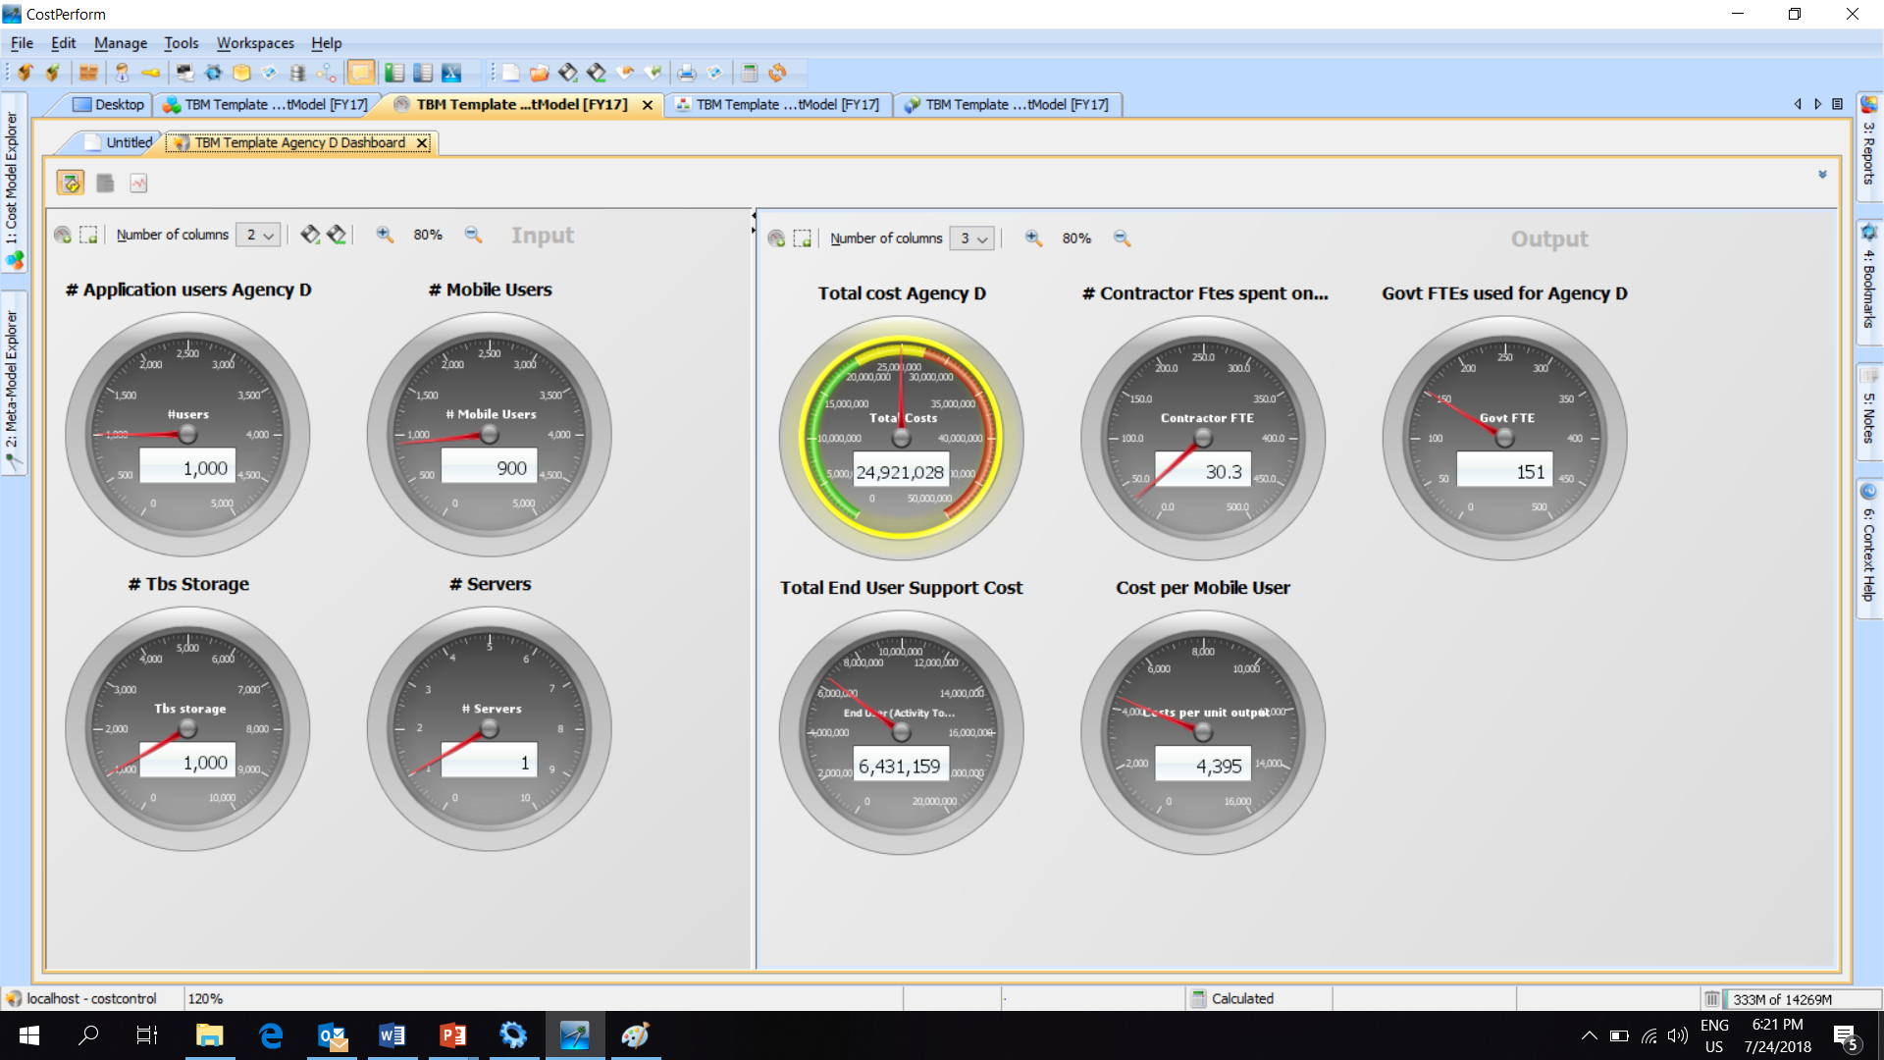
Dashboard function

Slide 22
TBM in CostPerform
Effective and affordable
www.TBMsoftware.com

