Slide 1

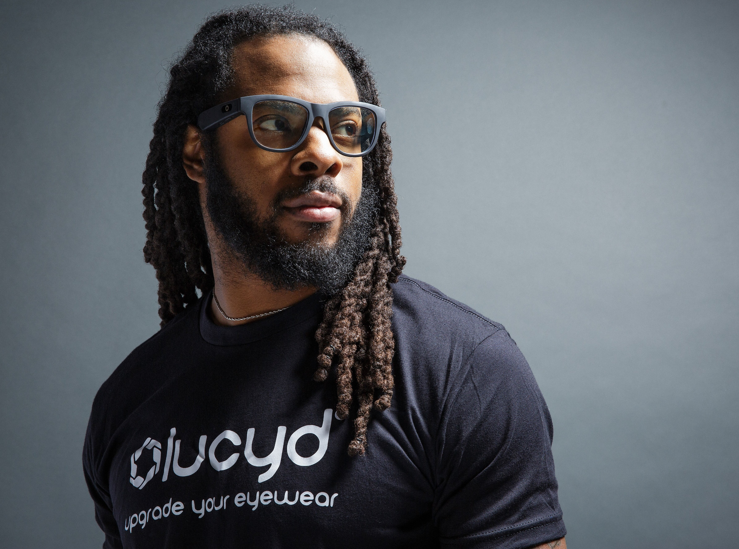
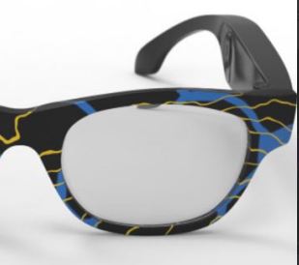
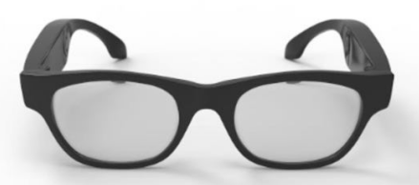
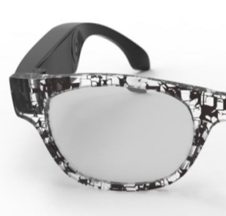
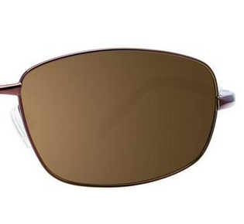
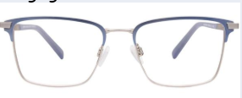
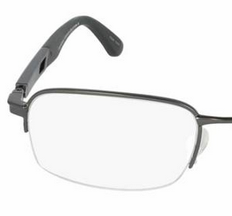
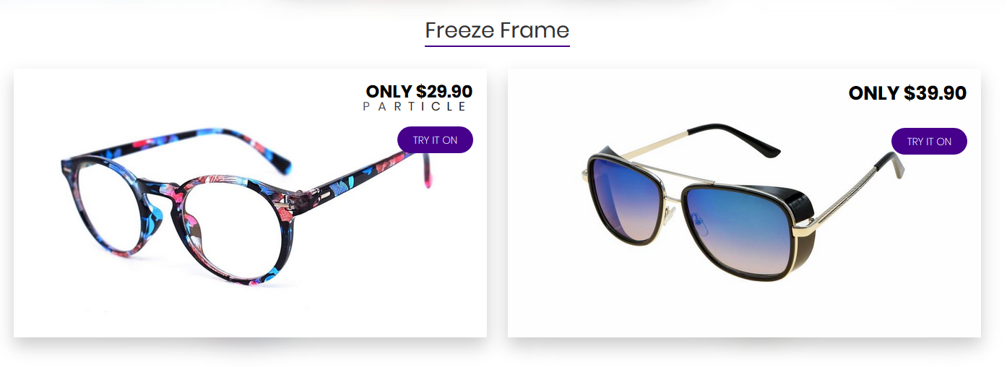

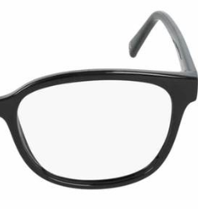
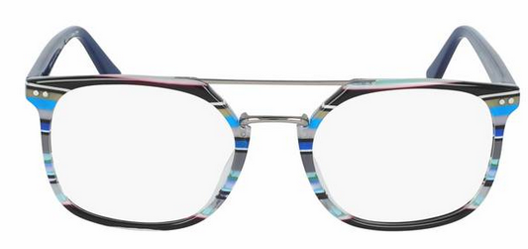
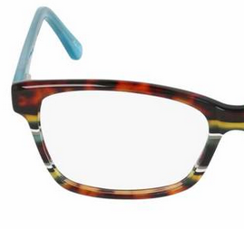
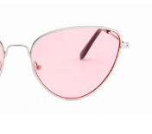
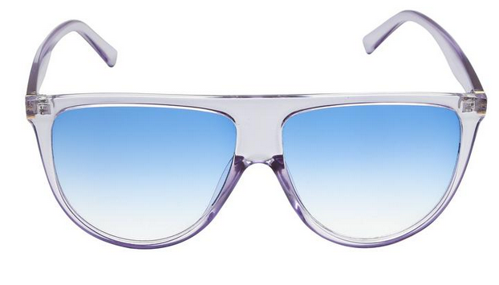
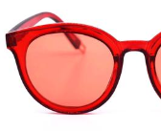

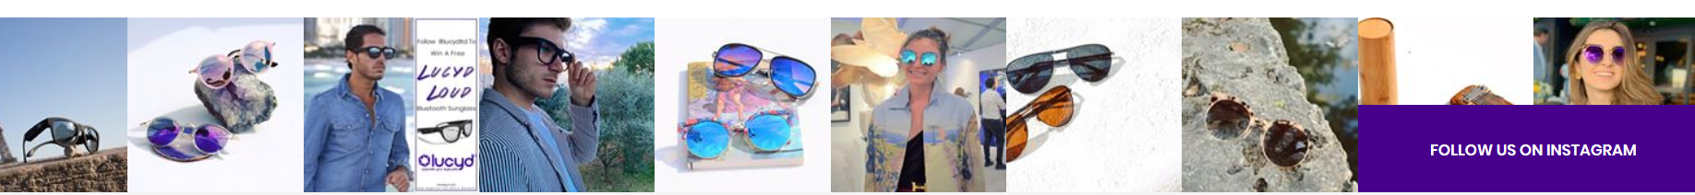
SHOP SUN SHOP Rx CONTACT BLOG RESOURCES COMMUNITY
“It’s time to upgrade your eyewear.
It’s time to live LUCYD.”
-Richard Sherman, football pro
Scroll to shop
LUCYD LOUD
Bluetooth headset and glasses in one sleek package.
Listen to music, take calls and use voice assistant.
Available in prescription, blue light blocking, and sunglass.
TRY ON
Darkside - $99
BUY
MORE INFO
TURBOFLEX
Flexible frames with 360 hinges.
The most durable frame on the market.
Available in prescription, blue light blocking and sunglass.
Pop-up/collapsible:
Select lens/RX options.
Quantity adjust.
Add to cart.
TRY ON
Full Moon - $149
BUY
MORE INFO
Take $10 off this week’s most popular frames.
LUCYD LOOKS
Quality designer frames at factory direct prices.
All are available with or without prescription,
in clear, transitional, sunglass and blue light.
TRY ON
Blastoff - $99
BUY
MORE INFO
LUCYD LUSTER
Edgy designer sunglasses at a discount.
Many come standard with polarized lenses.
Many are prescription adaptable.
TRY ON
Buzz - $29
BUY
MORE INFO
ACTIVE PROMOTIONS
SUBSCRIBE HERE__________

