Slide 1
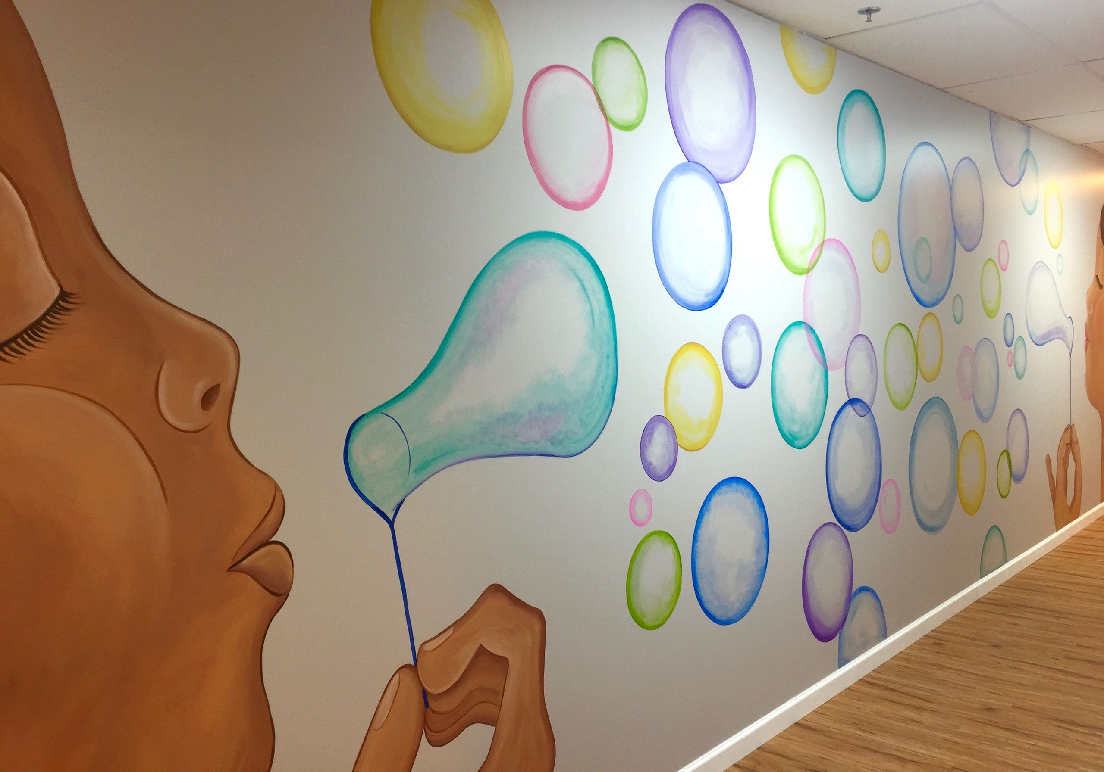



Left Window 40” wide , 101” height
Entry Door 32” wide, 71” height
“Getting Our Kids Back on Track”
Speech Feeding Occupational
Applied Behavior Analysis
Physical Therapy
“You Are Not Alone.”
“…where serving you is therapeutic!”
Hours: 9 a.m. – 8 p.m.
Phone: 678 –878-9905
Follow @lttcampcreek

Slide 2
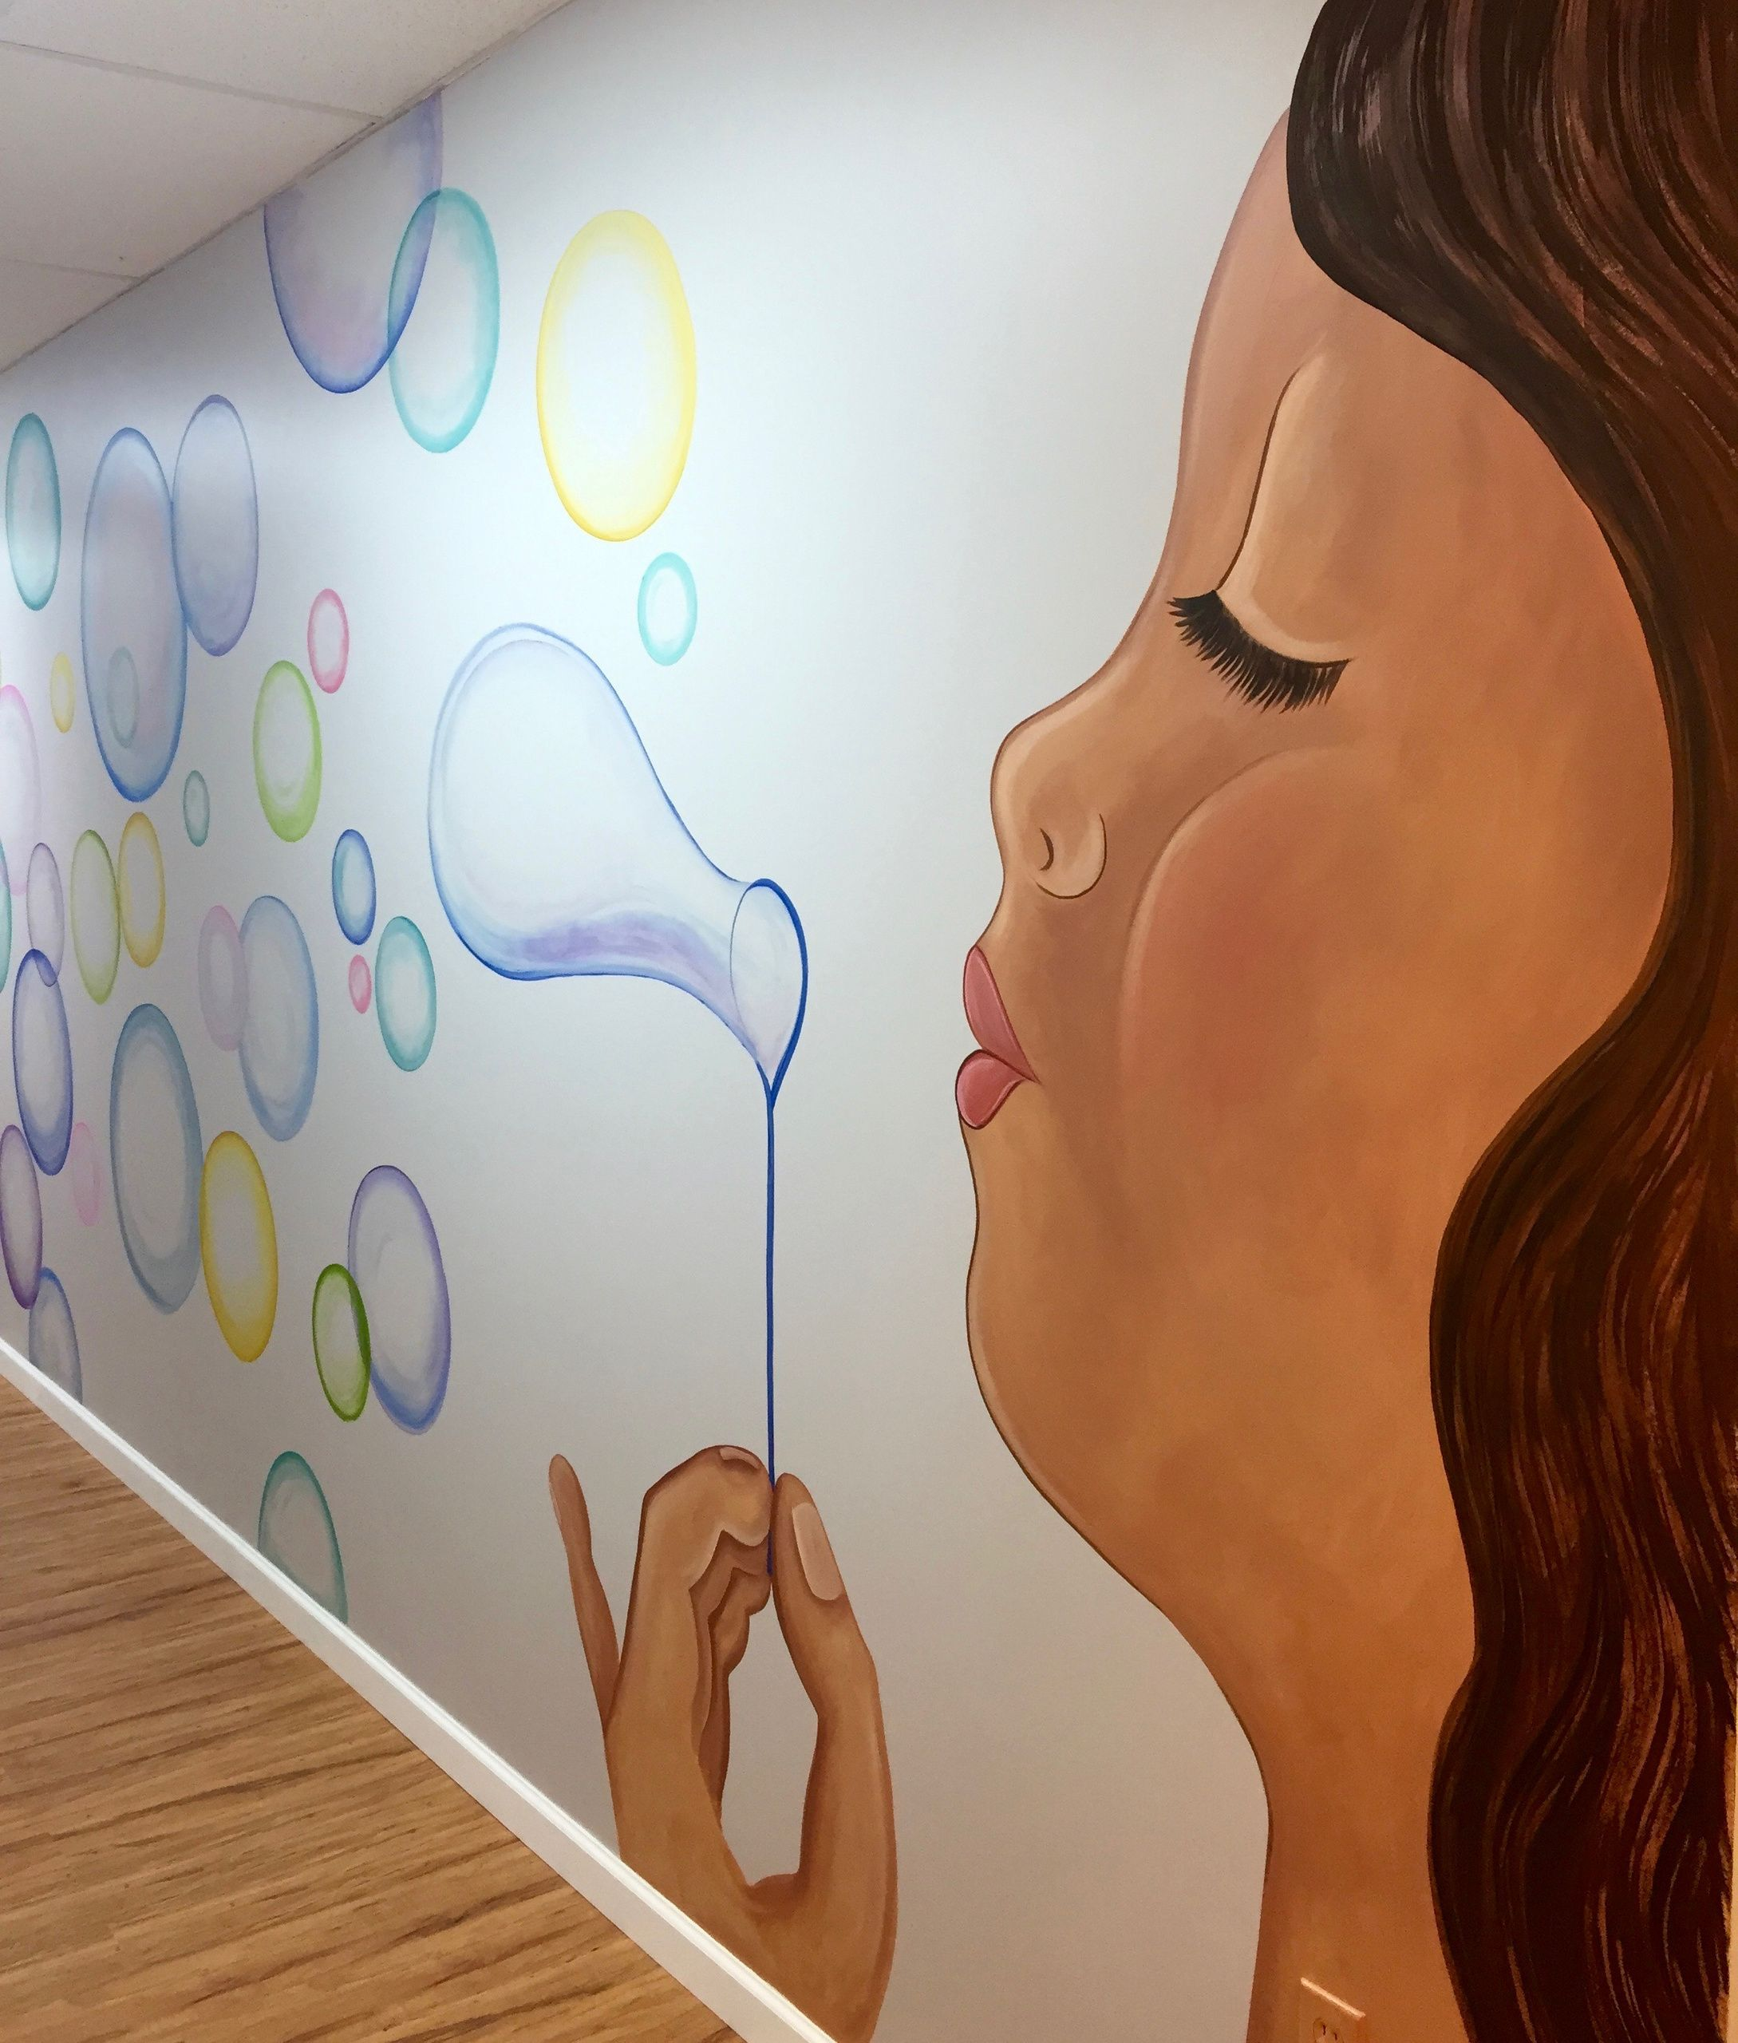
Window 1 – 57” wide, 101” height
Window 2 – 57” wide, 101” height
Window 3 – 57” wide, 101” height
Picky
Eater
Balance
&
Coordination
Articulation
Is Your Child
on Track?
Early Intervention Matters
Autism
Social
Skills
Speech
Delay
Voice
Disorder
Toe
Walking
Stuttering

