Slide 1
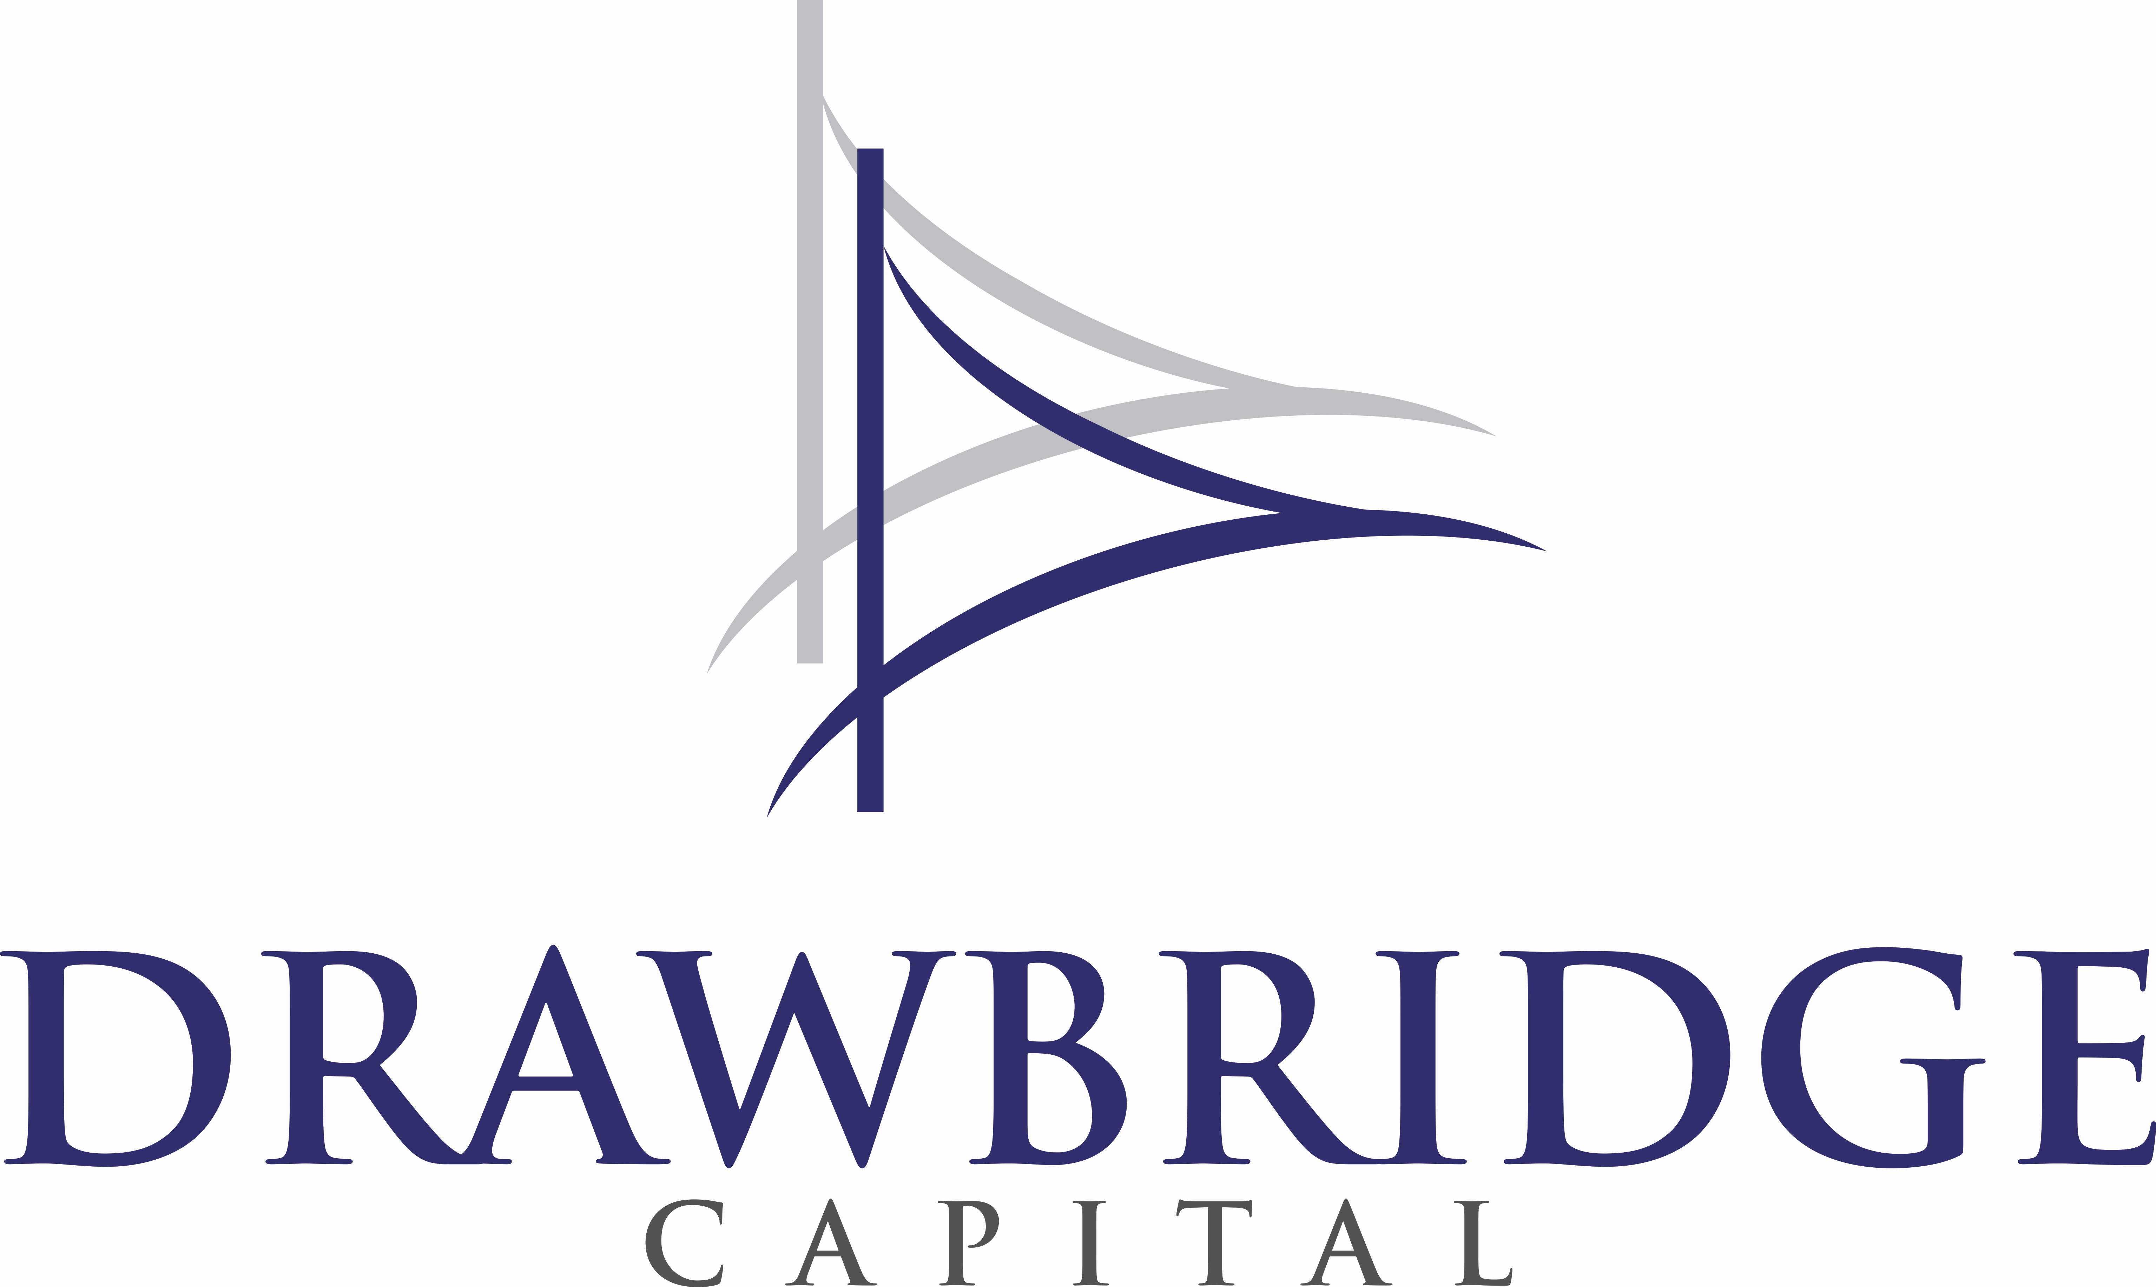
Asset Management
US Small Cap Growth Strategy
John Smith, Chief Investment Officer
April 2019
Notes:
Kelly to get logo

Slide 2
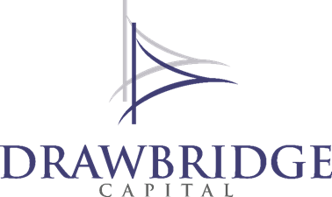
Table of Contents
Section | Page
Overview | 2 - 6
Philosophy, Process & Design | 7 - 15
Why Drawbridge | 16
Exhibits | Bios Performance A B C D GIPS
This does not need to be formatted this way against a colored background…
©2019 Drawbridge Capital LLC

Slide 3
Drawbridge Overview
Who is Drawbridge
Tulsa based emerging US small-cap growth (SCG) active equity manager serving institutional investors
CIO Glenn Fogle has over 25 years experience in fundamental growth investing
Why Drawbridge
Investment industry evolution presents a business opportunity
Institutional demand for actively managed SCG equity
Proven history high-alpha low correlated returns
©2018 Drawbridge Capital LLC

Slide 4
Drawbridge 2025
Vision
To advise over $1 billion in assets and be recognized among the best US equity managers
Mission
To deliver high-alpha investment returns at low correlation over 3- and 5-year periods
Core values
Consistent disciplined process
Facts over forecasts
Proprietary fundamental equity research
Concentrated, high conviction names with 90% active share
Clarity and transparency in communications
Outstanding client service
©2019 Drawbridge Capital LLC

Slide 5
Boldly Different
Departing from benchmarks
Delivers Superior Performance
Concentrated and Selective
High Conviction
Moderate Turnover
High Active Share
High Alpha
Higher Sharpe Ratio
Lower Beta
Asymmetric Risk Profile
Low Correlation
“If you want to have a better performance than the crowd, you must do things differently from the crowd.”
-- Sir John Templeton
©2019 Drawbridge Capital LLC

Slide 6
Synergy Beyond the Style Box
A strategy enhances a client’s total portfolio performance through
Higher returns or
Lower volatility or
Lower correlation to other assets
Our goal is to add value across all three
©2018 Drawbridge Capital LLC

Slide 7

Drawbridge Leverages Two Alpha Drivers
Fundamental
Behavioral
Accelerating Growth
Price Momentum
The two overlapping circles are primary, the bottom box is supportive and secondary
©2019 Drawbridge Capital LLC
Notes:
Q - It’s GF’s background and ability to tap into these three (3) alpha sources that is at the root of shaping Drawbridge’s growth investment philosophy, yes??? If so, then we need to create a smooth/logical segue from THIS slide to the “growth investment process”, “intelligent design” and “portfolio specification” 3-in-1 slide that follows?!
Q – Where/how to sharpen the storyline for merging GF’s Market Dashboard “Play Offense/Defense” “weather vane” indicator with GF’s Equity Holdings Dashboard? Should we actually have an exhibit enumerating what’s on the Market and Holdings dashboard to tell a story around, but NOT make available for process Q&A.
Q – GF we spoke of your coming up with some ideas about how to address the risk barometer & the possibility of adding alpha, from holding cash?
RC
DO –Sector/Industry story shape and tighten-up i.e. agnostic, but with exposure constraints where, when and how?! And, why GICS adherence is N/A (b/c NOT predictive) or secondary to holdings “cross-correlations” . . .
DO – Ensure the there is no question that the investment process is Bottom-up . . . . with “Market Dashboard” indicators as the “weather vane” (or some other analogy) we keep an eye on it for a # of reasons
Integrate the story of portfolio holdings paleontology evolution from Vista’s 120 names to DB’s 20+ concentration. E.g. # of holdings contributing to what % of return . . . Bill Kaylor’s (sp) research . . . . segue to percolating SC/SCG/SCV in the Regent Financial “Skunk Works” , given the retail client type being served, holdings have tended toward a conservative approach (singles and doubles) . . . . . Character of institutional investors will lead to buying more doubles, triples and homers. Here’s where we need to convey something, constructively, about the addition of resource (analyst) will further support the segue to an institutional portfolio “feel.” (Gotta shape a smooth path story re: the segue from retail to institutional feel.)

Slide 8
Investment Philosophy and Process
  We believe in owning companies with
  Improving business fundamentals (accelerating earnings growth)
  Improving investor sentiment (positive price momentum)
  Process reduces uncertainty and improves returns by emphasizing
    Facts over forecasts
    Evidence not estimates
    Probability rather than prediction
  Portfolio holdings exhibit
  Rising EPS and revenue growth rates
  Strong relative returns over the preceding 6 to 12 months
  Increasing earnings estimates
  High earnings quality
©2018 Drawbridge Capital LLC

Slide 9
Bold Performance Objectives
Value | Measure | Objective
Total Return | Annualized return (net) | 3% > R2000G
Risk (Volatility) | Annualized standard deviation Beta | <= R2000G < 1.0
Risk-Adjusted Return | Alpha Sharpe Ratio | > 3% > R2000G
Diversification Contribution | R² to R3000 | 0.20 < R2000G
Consistency | 36- and 60-month total return 36- and 60-month alpha | 75% of periods > R2000G 75% of periods > 0
©2019 Drawbridge Capital LLC

Slide 10
Investment Process
Data and Screening
Research and Analysis
Stock Selection
The idea of this graphic is to demonstrate 5 steps leading to the portfolio at the bottom.
Portfolio Construction
Monitor, Modify and Sell
Drawbridge Edge: Concentrated portfolios of companies with accelerating growth rates, solid momentum and high potential returns
©2019 Drawbridge Capital LLC

Slide 11
Data and Screening
    Objective: Select stocks poised to outperform
    Screened universe contains 50 - 100 companies exhibiting
    Earnings acceleration and price momentum
    Plus: quality of earnings, positive estimate revisions, positive surprise
    Further research triggered by
    Trend changes or inflection points
    Recent positive news
    Breadth of alpha factors
    Valuation
    Neglect
  Drawbridge Edge: Objective criteria lead us to a short list of high potential names
©2019 Drawbridge Capital LLC

Slide 12
Research and Analysis
  Objective: Understand sales and growth dynamics, sustainability and potential
    Proprietary tools to analyze financial data
    Breadth and magnitude of acceleration
    Operating and financial leverage
    Timeliness
    Identify inflection points and evaluate fundamentals driving growth
    Growth acceleration and sustainability
    Margin trends
    Risks to growth and margins
    Range of probable revenues and earnings
    Our outlook versus consensus
  Drawbridge Edge: Unique perspective on earnings growth

Slide 13
Stock Selection
  Objective: Own companies with high probability of exceptional returns over 12 - 18 months
  Potential to double or triple the benchmark
  Earnings and P/Es to produce 20%, 30%, 40% over time
  Upside for higher gains or longer duration
  Highest probability for return that compensates for risk
  Five essential questions
  Is earnings acceleration material?
  Was acceleration unanticipated?
  Is acceleration sustainable ?
  Is story overlooked or underappreciated?
  Do price trends suggest continued leadership?
  Drawbridge Edge: Every position has the potential for significant returns

Slide 14
Portfolio Construction
Objective: Build a concentrated portfolio of high potential stocks
Portfolio construction guidelines
20 to 30 positions
US listed companies and ADRs
Position size up to 7% at cost
Sector exposure up to 40% at market
Volatility comparable to benchmark
Drawbridge Edge: Better potential reward-to-risk than benchmark
©2018 Drawbridge Capital LC

Slide 15
Monitor, Modify and Sell Discipline
  Objective: Cut losses quickly and let the winners run
  Monitor
  Alpha factors
  Investment policy compliance
  Return contributors
  Unintended or excessive risks
  Sales triggers
  Decelerating growth or negative surprise
  Diminished outlook or increasing risk
  Deteriorating relative strength
  Hold or trade?
  Occasionally add on weakness or strength
  Rarely trim
Drawbridge Edge: Maximize upside, manage risk, and keep turnover low

Slide 16
Risk Management
Objective: Choose risks wisely
Integral to our process (Risk Aware)
Level and trend of indicators at company and portfolio level
Earnings quality impacts persistence of growth
Valuation and volatility gain significance as business or cycle matures
Price trends reflect changes in investor sentiment
Drawbridge Edge: Identify under-performers early and let winners run

Slide 17
Why Drawbridge
Twenty-five-year track record of growth investing success
Distinctive fundamental and behavioral alpha drivers
Proven disciplined investment process
Bold Performance Objectives
Concentrated portfolios with few alpha limiting constraints
Consistently strong risk-adjusted returns
Low correlation to other strategies
Capacity for growth in an attractive niche market

Slide 18
Exhibits
Bios
Performance
Selected research
Other, if any

Slide 19
Drawbridge Team
Glenn Fogle, CFA, Chief Investment Officer
Glenn joined Regent Financial Services in 2015 and Drawbridge Capital at its inception. With an extensive and successful background in fundamental growth investing, his long-term professional objective was to incubate and launch a suite of active equity strategies for the institutional marketplace.
Glenn joined American Century Investments in 1990 as an equity analyst. In 1993 he became lead manager of its Vista and Giftrust mutual funds. For seventeen years his teams successfully managed strategies against large, mid and small cap benchmarks. During his tenure Glenn also incubated and launched a small cap growth fund, led two turnaround projects, and hired and trained fourteen analysts.
From 1999 through 2009 American Century Vista returned 8.4% per year (gross) compared to 3.4% for the Russell Mid Cap Growth Index. The fund’s assets grew to over $2 billion with another $600 million in institutional separate accounts.
Among notable industry accolades, Glenn was recognized by Mutual Funds Magazine as “Best in Class” in 2002 and was also named by Business Week as one of its “Best Fund Managers” in 2007. In 2009 American Century named him Chief Investment Officer, US Growth Equity Strategies – Mid and Small Cap, where he oversaw fourteen investment professionals managing over $7 billion.
Glenn joined a former American Century executive in 2010 to develop three institutional equity strategies, a venture he pursued through 2014. Before his career in investment management Glenn was an entrepreneur, a professional musician, and an Instructor of Finance and Statistics. He served as a Director for a denominational 403(b) plan as its assets grew from $50 million to $500 million with 6,000 participants. Glenn holds BBA and MBA degrees from Texas Christian University which he attended on full academic scholarships. He earned the Chartered Financial Analyst® designation in 1989.
©2019 Drawbridge Capital LLC

Slide 20
Drawbridge Team
Gary Stanislawski, President
Gary is the President of Drawbridge Capital and of its parent, Regent Financial Services, which he founded in 2002. He has worked in the financial services industry since 1993.
Gary was awarded a four-year ROTC scholarship and attended Oregon State University where he received his Bachelor of Science degree in Business Administration. Upon graduation Gary entered the Air Force and earned his wings as a pilot in 1984. For eight years Gary flew such planes as the B-52 and B-1 bombers. He has approximately 2,000 hours of flying time.
In 2008 Gary was elected to the Oklahoma State Senate, serving as the Chairman of the Education Committee since 2017. He has served his community as past president of Jenks Public Schools’ Board of Education, the Jenks Public School Foundation Board, and the Planned Giving Committee of the Parent Child Center. Gary has also served on the boards of directors for Glory House, a local women’s shelter, and India Missions, which brings health and wholeness to the people of India.
Monty Dossman, Portfolio Manager
Monty assists and implements the management of Drawbridge Capital’s portfolios across numerous multi-asset strategies. He began his investment career in 1984 as an advisor with a leading investment company. Serving clients in this capacity for fourteen years, Monty led the portfolio analysis and management efforts of his respective firms. He has held positions as a branch office manager, compliance officer, and options principal.
Monty joined Regent Financial Services in 2002. After leaving in 2011 to pursue an opportunity in the energy industry he was recruited to return in 2015 and joined Drawbridge Capital at its inception. Monty brings expertise in strategic and tactical asset management, sector rotation, relative strength analysis, and portfolio positioning. He earned a Bachelor of Science in Geology from Yale University.
Mitch Robinson, Chief Compliance Officer
Mitch is Chief Compliance Officer for Drawbridge Capital. Mitch has over 25 years of experience in the financial services industry the majority of which has been in the compliance arena. Prior to joining Regent in 2012 he worked at BOSC, Inc., a subsidiary of BOK Financial Corp., for 9 years including 3 years as Chief Compliance Officer.
Mitch earned his Bachelor of Business Administration degree from the University of Oklahoma. He holds FINRA’s Series 7, 63, and 24 (held with LPL Financial) and Series 65 (with Drawbridge Capital).

Slide 21
Drawbridge Team
Russ Cembrinski, Marketing, Sales and Client Relations Consultant
Russ brings over two decades of investment industry experience in institutional marketing, sales, and client relations to the Drawbridge team and will lead business development and client service initiatives.
Russ and Glenn were colleagues at American Century Investments in the mid-1990s, when Russ joined the firm to help expand its geographical footprint establishing the first northeast institutional sales office. They reconnected in 2018, committing to work together in building an institutional asset management presence for Drawbridge.
Having worked with an array of notable investment firms (Russell Investments, Alliance|Bernstein, Neuberger Berman), Russ has implemented business plans and sales growth strategies across broad market segments and institutional client types. Since 2008, Russ has provided marketing, sales and investor relations consulting services to traditional, alternative and ETF managers and M&A firms.
Russ has been an active board member on professional, municipal and nonprofit organizations in the local community. Serving in roles as Committee Member, Chairperson, and President, he has been instrumental in fundraising and program development for building community-based social service and educational programs and advocating for township parks and recreational facilities. Translating a life-long passion for athletics into coaching youth sports for more than two decades, Russ maintains his U.S. professional certifications in lacrosse, alpine ski teaching and race coaching.
Based in the Metro New York area, Russ has conducted business throughout U.S. and international markets, and has managed sales and service teams for the Northeast, Midwest, and Mid-Atlantic states and Canada. Russ earned a Bachelor of Science from Cornell University and an MBA in finance and corporate accounting from the University of Rochester’s Simon Business School. He remains active in his college alumni associations through social networking events, university presentations, and interviewing potential academic and employment candidates.
©2018 Drawbridge Capital LLC

Slide 22
Superior Performance Since 1999
Whether applied by a team running a billion dollar portfolio or a solo manager incubating multiple strategies, this discipline has consistently delivered strong and uncorrelated risk-adjusted returns.
This table is presented as supplemental information. Statistics are calculated from monthly returns before management fees. Monthly returns 2011-2014 have been adjusted to eliminate the estimated impact of excess cash and thus only approximate fully invested portfolio returns. Returns have not been audited. Benchmarks: AC Vista: Russell Mid Cap Growth; Small Cap Growth: Russell 2000 Growth Index; SMid Growth: Russell 2500 Growth Index.
 | Vista (1999 - 2009) | Small Cap Growth (1/11 - 4/14) | SMid Growth (10/11 - 4/14) | Small Cap Growth (1/16 - 1/19)
Excess Return Annualized Returns | 5.06% 8.41% v. 3.35% | 0.88% 14.25% v. 13.37% | 3.70% 21.24% v. 17.55% | 0.21% 11.12% v. 10.90%
Alpha | 5.68% | 3.39% | 5.77% | 5.63%
Beta | 0.88 | 0.84 | 0.85 | 0.47
Volatility | 25.4% v. 24.3% | 18.7% v. 17.1% | 11.1% v. 10.6% | 11.8% v. 17.3%
R² to Russell 3000 | 0.45 | 0.55 v. 0.87 | 0.56 v. 0.85 | 0.48 v. 0.82
The table must have footnotes below and we’d like to somehow highlight the final column as well as the 2nd/3rd rows.
©2019 Drawbridge Capital LLC

Slide 23
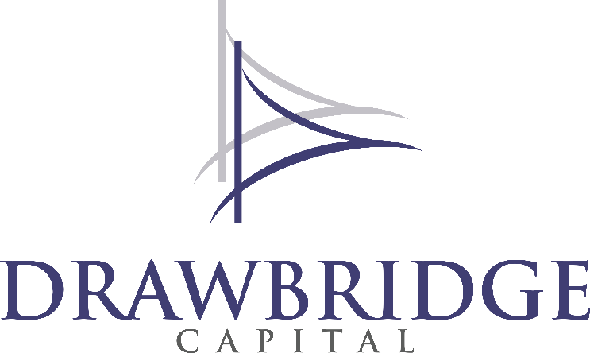
Our Mission
Deliver high-alpha investment returns at low correlation over 3 and 5-year periods
918 . 493 . 4190
drawbridge.capital
The foregoing presentation has been prepared by Drawbridge Capital, LLC for information purposes only. This book does not constitute an offer or solicitation to buy or sell shares or securities in our firm or any related or associated company. None of the information presented here is intended to form the basis for any investment decision and no specific recommendations are being made herein.
The presentation does not constitute and should not be construed as investment advice, counsel or solicitation for the purchase or sale of any particular security.
Performance objectives are not actual returns but goals for the strategies referenced. There is no guarantee that any stated performance objective will be met or exceeded. Past performance is no guarantee of future results.
Drawbridge Capital expressly disclaims any and all responsibility for any direct or consequential loss or damage of any kind whatsoever arising directly or indirectly from use of this presentation or reliance on any information contained herein or any error, omission or inaccuracy in any such information or any action resulting therefrom.

Slide 24
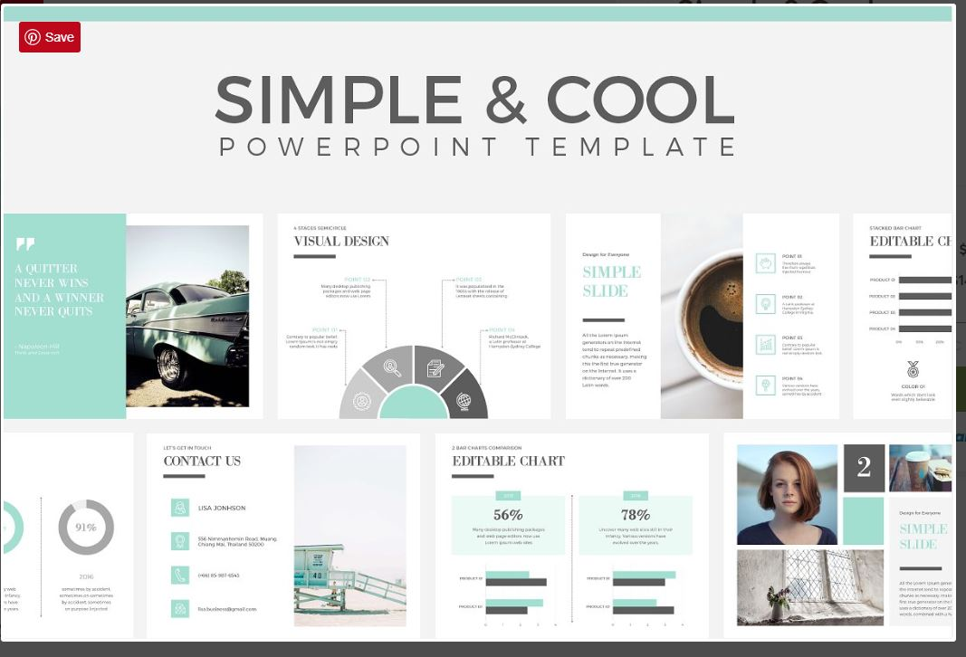
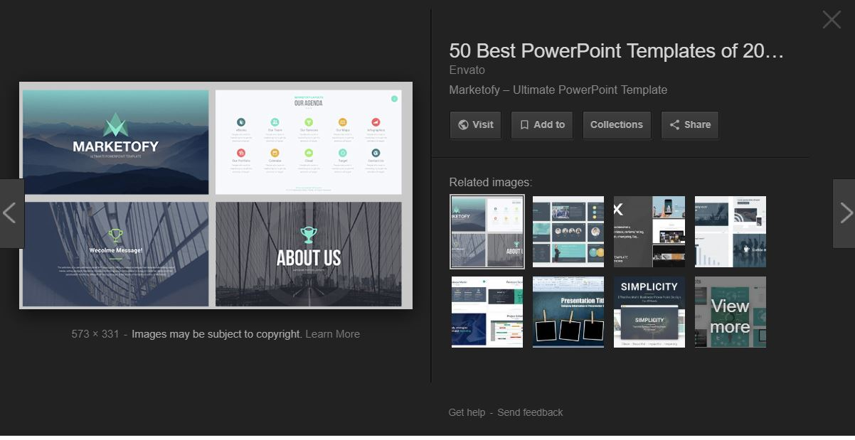
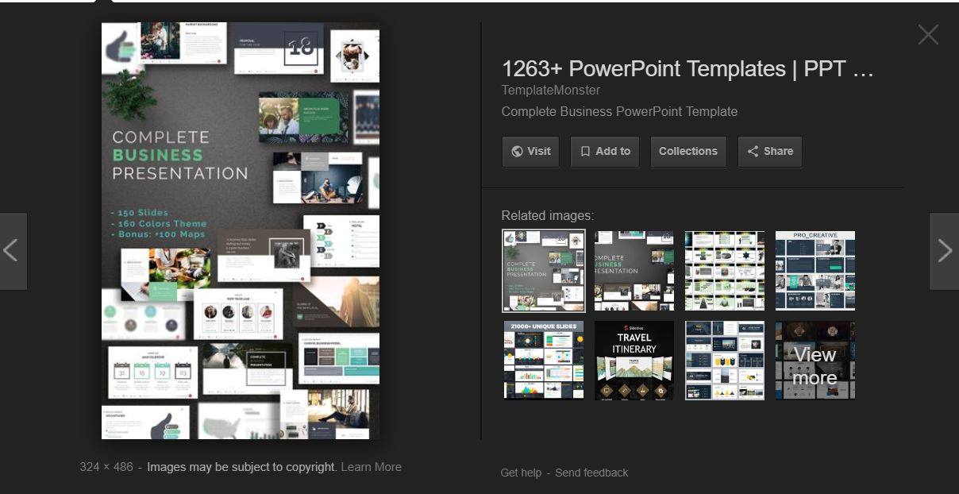
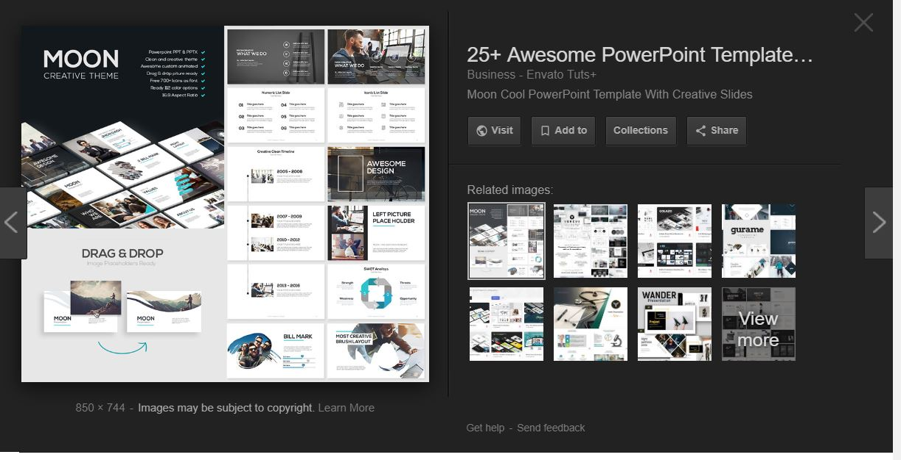
EXAMPLE OF PALETTE
Imagine these tones with blue/gray Drawbridge color scheme (NOT the right look & feel for us)

