Slide 1
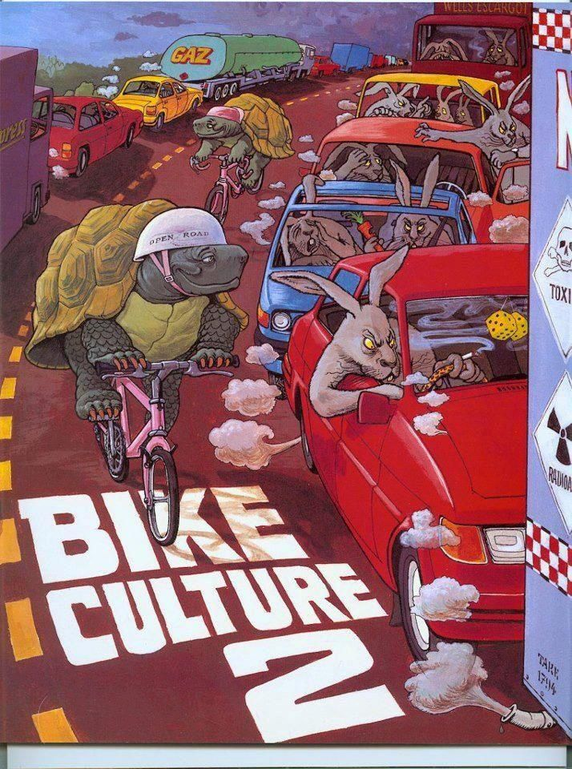
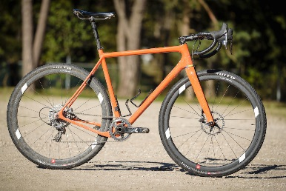
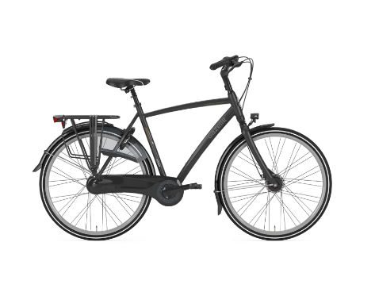
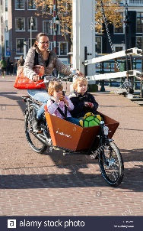
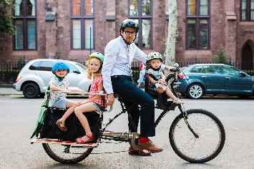
Please show turtle and snail on bike/in cargo bike/ ‘kid’ bike seat.
1st turtle/snail riding a gravel bike which are the hype right now (see https://www.cyclingabout.com/complete-list-of-all-road-gravel-grinder-adventure-road-bikes/).
2nd turtle/snail riding upright city Dutch type city bicycle.
3rd bike should be a Cargo bike that can carry kids. Rider is one turtle/snail and two little ‘kid’ turtle/snails in cart (mix of turtles and snails).
Bikes and turtles should be in trendy colors and distinct from cars.
Turtles/snails should look cute, optimistic, intelligent and preferably smiling.
Gravel bike example
Dutch bike example
Delete “bike culture 2”
Cargo bike examples
Cars/van etc. should be bumper to bumper in traffic jam/gridlock (showing car exhaust fumes etc)
Drivers should be ‘fast’ animals.
At least a rabbit, a Chita and a tiger. One or more animal in each car, van, truck. Car passengers animals should look impatient and nervous (honking etc) vs turtle/snail cyclist that should appear calm and easy going.
Ears of rabbit protruding from car roof, Chita in expensive looking convertible car. Long line of cars shown like in picture..
The new illustration can be in a city surrounding
but can also be in a suburb in sunny weather with trees around.

