Slide 1
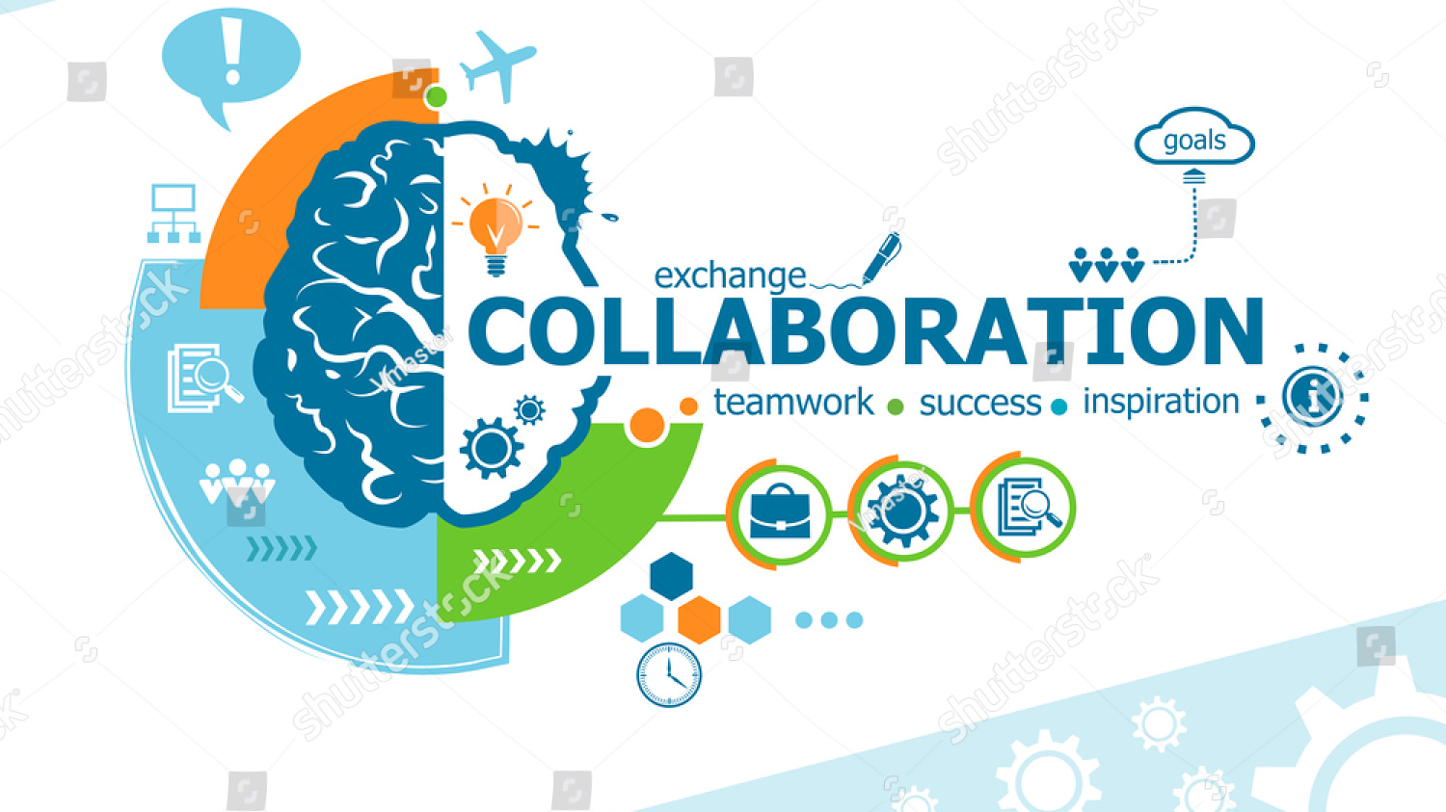

Slide 2
Icons, or words of employee challenges such as talent management, engagement, performance, etc.
Icons, or words of business partner challenges such collaboration, service and efficiency
D&I Models, Assessments & Tools for You!
Relevant
Knowledge
Customized Strategies
Measurable
Results
Icons, or words of community challenges such recruiting, economic development and advocacy
Icons, or words of customer challenges such as sales, satisfaction, loyalty, etc.
Three icons that correspond with three deliverables
Though not a brain, this section could represent a variety of employee, customer, business partner and community challenges, and opportunities symbolized by statements, and, or icons.

