Slide 1



Slide 2
The core philosophy of the program
Worldview
A view Held inside of us as to how things work
Biases
Our own behaviours and the behaviours of others that reinforce this worldviews
Error Scripts
Stories implanted by us or others that limits our potential
Rewiting a new Personal Narrative allows us to shatter our own glass celing

Slide 3

DOWNLOADING
Past patterns
PERFORMING
Operating from the whole
SUSPENDING
Seeing with fresh eyes
OPEN MIND
EMBODYING
Prototyping the new linking head, heart, hand
REDIRECTING
Sensing from the field
OPEN HEART
ENACTING
Crystallizing vision and intention
RELEASING
OPEN WILL
EMERGING
PRESENCING
Connecting to source

Slide 4
Program outline
Program and Upcoming Dates
2 ½ Days residential – 26th to 28th May 2019
May Venue - The Sebel Hawkesbury Valley, Windsor NSW
Future Programs - August, October, March
Why
The program is emersive and wholistic which includes development of y0ur life and leadership skills, by rewriting your narrative and a personal action plan for change
Support & Program Inclusions
LSI Assessment, leadership skills sessions, indevidual coaching sessions, guest speakers, body wellness therapists as well as accomodation and all meals are included
Investment for May 2019 Program
$3,495 (Early Bird Book by 26th April) $3,095
Quote IML Code 9455 for a further $100 Discount

Slide 5
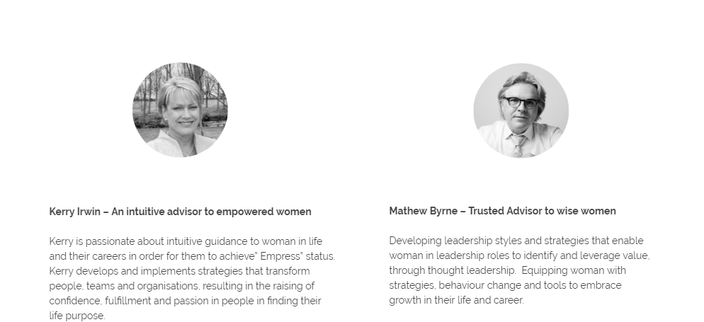
Program Mentors and Founders

Slide 6
Thank you

