Slide 1

COMBITECH INDUSTRIAL Company Presentation

Slide 2
INTRODUCTION
Combitech is a Romanian company established in 2006 from a group of people with global experience in the Oil &. Gas industry.
In 1992 started as INCAS Automation &.Engineering
Specialized in technical services provider focusing on completions management and commissioning support services for projects in upstream, midstream and downstream sectors.
We adapt our experience to solve challenges and achieve better return on investment for our clients.

Slide 3
INTRODUCTION
In 2011 – Combitech was associated with Dutch Contractor – IMTECH Analizer ( now VONK International Industry ) as main sub-contractor for Gas metering stations in OMV Petrom
In 2017 – Combitech name was changed into Combitech Industrial – also the share holders
Combitech Industrial acts now as a General Contractor for services and new projects .

Slide 4
MAIN BUSINESS AREAS :
EXPLORATION AND PRODUCTION in OIL &. GAS Industries
REFINING AND STORAGE DEPOTS ;
CHEMICAL AND PETROCHEMICAL INDUSTRY
UNDERGROUND GAS STORAGE
POWER PLANTS ;
WATER AND WASTEWATER TREATMENT PLANT ;
RENEWABLE ENERGY AND ENVIRONMENTAL PROTECTION
MAINTENANCE AND SERVICES

Slide 5
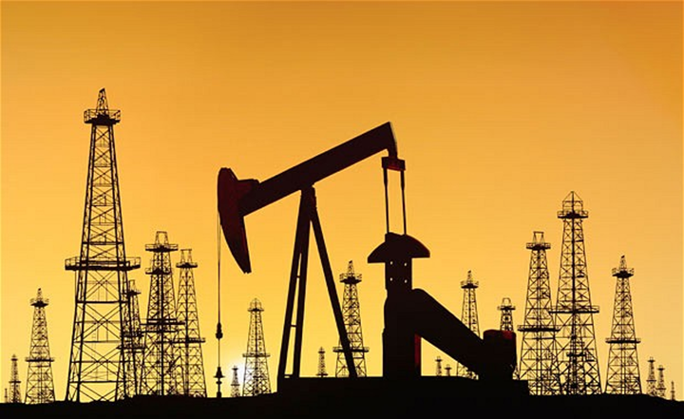
Exploration and Production
Applications in :
Gas Metering Station
Oil Metering Station
Water Cut Analyzer
Analyzer House (Container)
Compression Station
ESD SCADA Systems
Off Shore Safety Instrumented System
Hydraulic Power Units
TEG (Water removal from CO2 and natural gas)
Multiphase Separators
Electrostatic Coalescers
Heat Exchangers

Slide 6
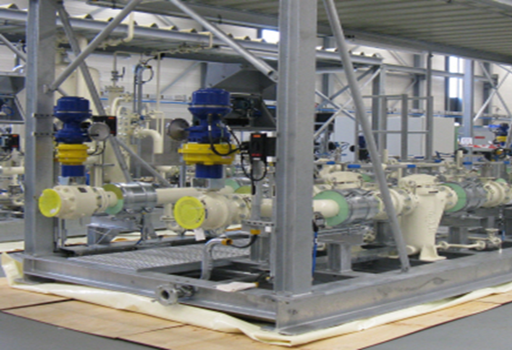
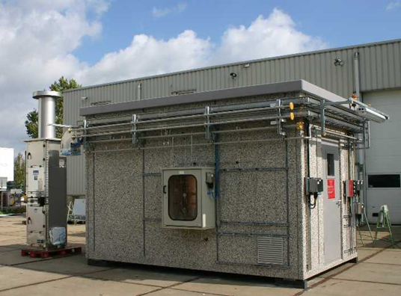
Exploration and Production (2)

Slide 7
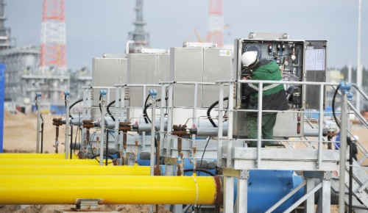
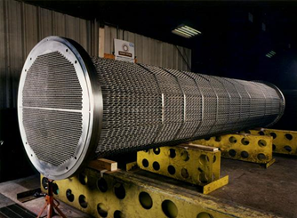
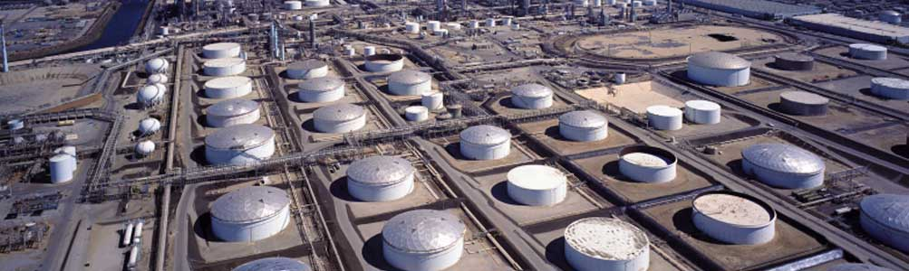
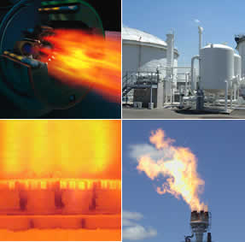
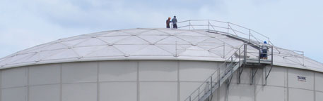
Refining and Storage depots
Application:
Internal Floating Roofs – HMT designs and supplies internal floating roofs to reduce emissions.
Tank Seals – are designed for both external and internal type of floating roofs
Aluminum Domes ( HMT )
Tank Roof Drain System
Loading Arms – ZIPP FLUID
Floating Suction Lines
Integral Foam Dams
Vapor Recovery Units
Burners, Flares - Zeeco
Valves and Actuators
Instrumentation
Analyzers and Sampling
systems

Slide 8
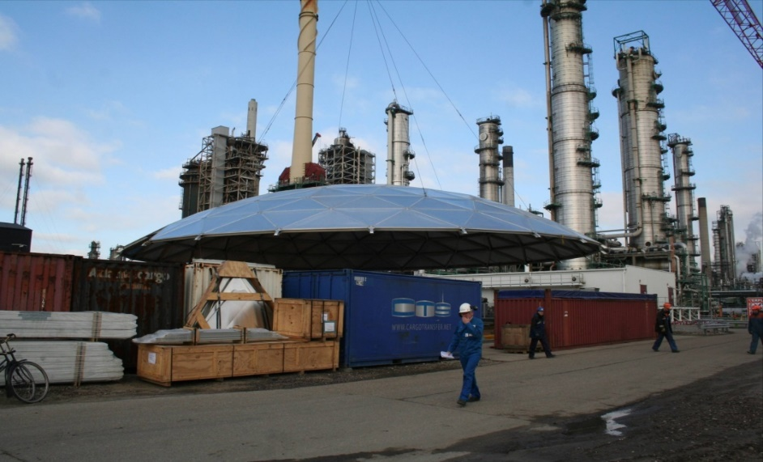
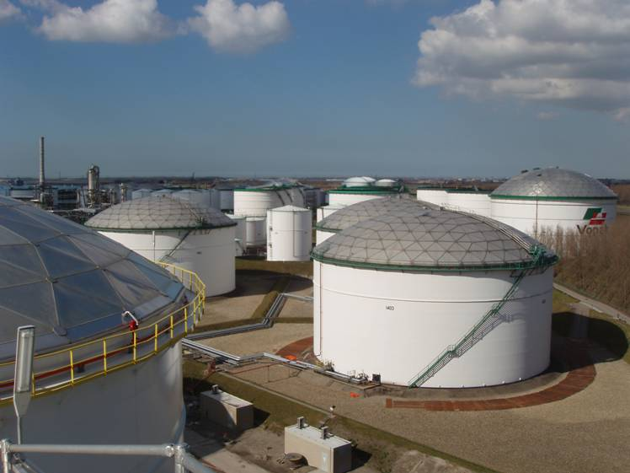
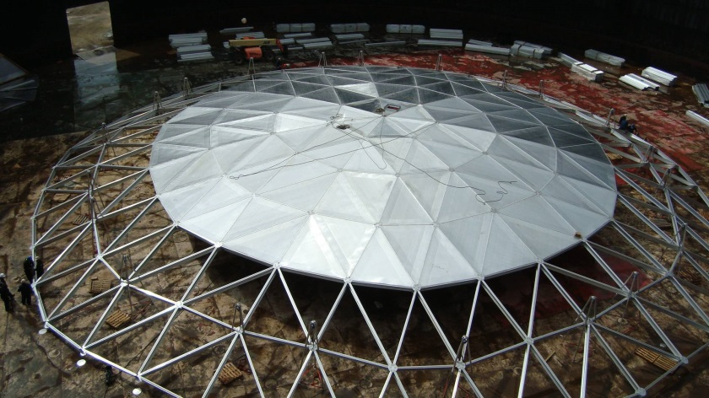
Tank Farms and Storage Depots
Domes and Roofs

Slide 9
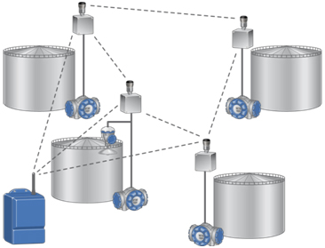
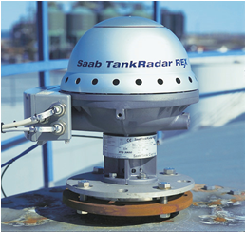
Tank Farm and Storage Depots (2)
The system really takes tank gauging to another level, making you better equipped to handle the ever-increasing demands on efficiency, safety and accuracy. It is a complete and flexible tank gauging system, based on the open industry standard foundation field-bus. The system can be used in refineries, tank terminals and the petrochemical industry for custody transfer, process and inventory control.
Wired and wireless !
Overfill Protection !

Slide 10
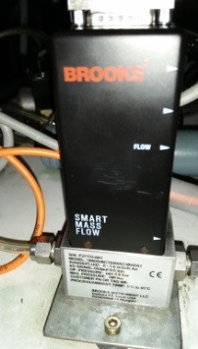
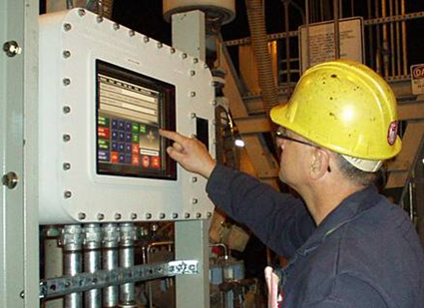
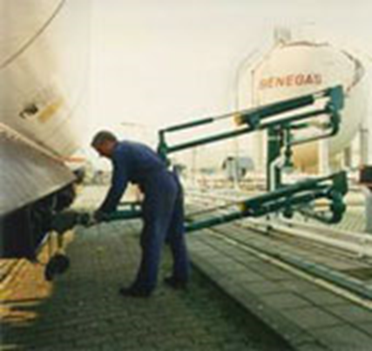
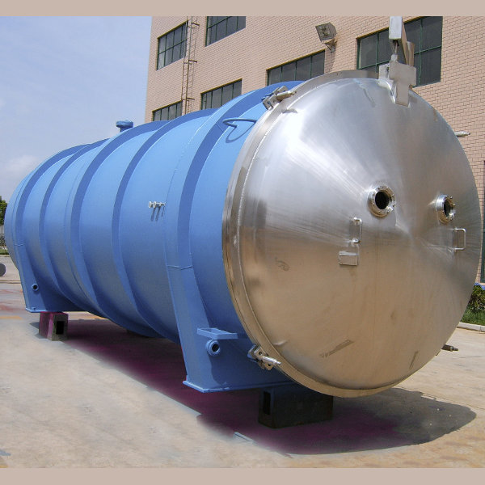
Chemical and Petrochemical
Application:
Process Control Software
Instrumentation
ESD Safety Valves
Control Valves and Actuators
Loading / Unloading Equipment
Metering Skids
Tank Level Control Systems

Slide 11
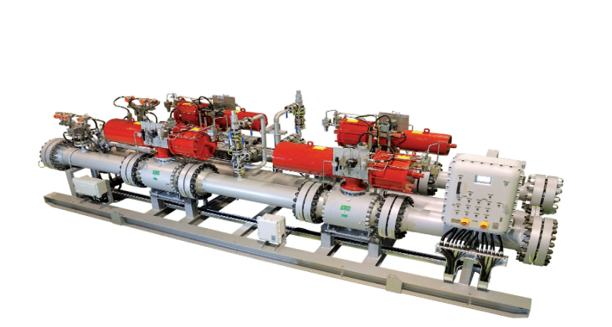
Underground Gas Storage
Natural gas-a colorless, odorless, gaseous hydrocarbon-may be stored in a number of different ways. It is most commonly held in inventory underground under pressure in three types of facilities. These are: (1) depleted reservoirs in oil and/or gas fields, (2) aquifers, and (3) salt cavern formations
We offer :
Engineering studies and design ;
And related equipment : compressors, HIPPS,
metering and analyzers, safety and control valve, DCS monitoring and SCADA systems !

Slide 12
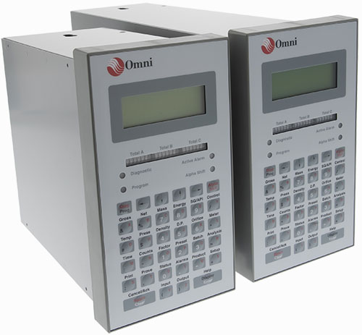
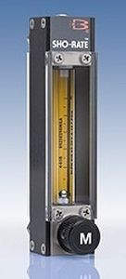
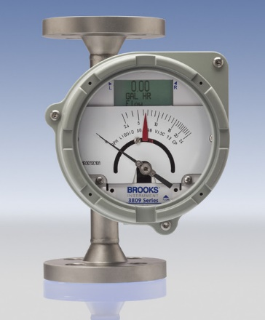
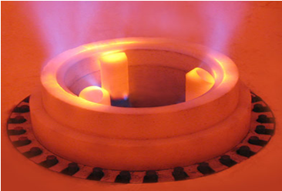
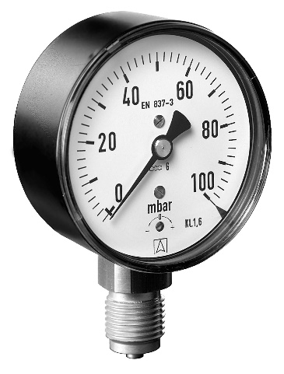
Power Plants
Application:
Monitoring and Safety Instrumentation – plays a major role in the profitable operation of a plant by achieving maximum availability, reliability, flexibility, maintainability, and efficiency. These system can also assist in maintaining emissions compliance.
Burners for Boilers, BMS

Slide 13
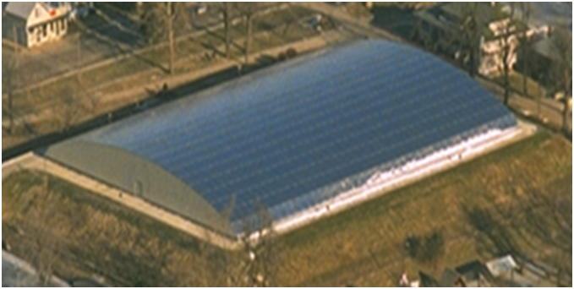
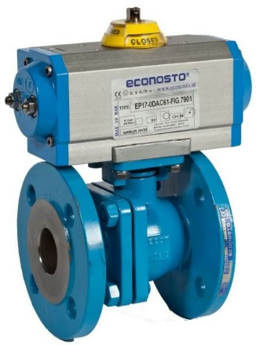
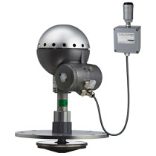
Water and Wastewater Treatment Plant
Application:
Instrumentation – Level indicator, Manometer, Thermometer
Valves - Gate valves, Globe valves, Check valves, Butterfly valves, Control Valves, Double Block and Bleed
Actuators – Electric, Pneumatic, Hydraulic, etc.
Filters – Y filters, Mechanical filters, Duplex filters,
Coalescent filters, Cyclon
Domes

Slide 14
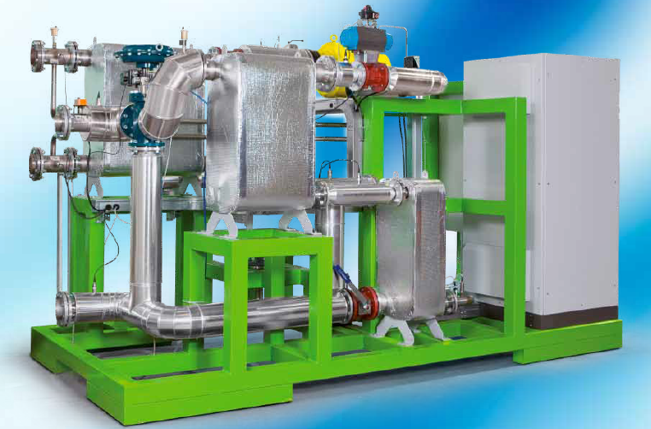
Renewable Energy and Environmental Protection
Application:
Renewable Modules:
- Low-Temperature Organic Rankine
Cycle (LT-ORC) Technology
- Emission-free closed loop
Operation
May be used to tap “low-grade”
heat sources
- Simpler plants, no turbine blade
Erosion
- State-of-the-art technology
Automated, operator-less systems
- Widely tested technology
- Primary energy production from
biomass-fueled boilers
- Safe for man and environment

Slide 15
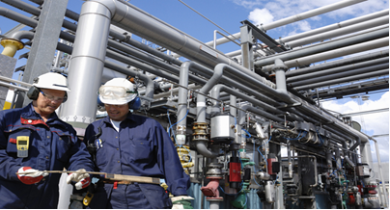
MAINTENANCE &.SERVICES
Combitech Industrial has service engineers capable to offer all services for installation and start up of the equipments delivered and also to give the warranty services.
Combitech Industrial
is a services company

Slide 16
PROJECTS and MARKETS
COMBITECH
INDUSTRIAL
Exploration and production
Renewable energy and environmental protection
Refining and storage depots
Chemical and petrochemical industry
Underground gas storage
Power plants
Our Market:
Upstream and Downstream Oil & Gas Facilities

Slide 17
Markets &.Customers
REFINERIES ( 4)
- OMV Petrom – Petrobrazi Refinery
- Petrotel-LUKOIL
- ROMPETROL Vega Refinery
- ROMPETROL Petromidia Refinery
TANK STORAGE
- OMV Petrom – 9 new Depots
- Rompetrol – 6 Depots ( build in 2003 )
- LUKOIL – 6 Depots( 1997 )
- OIL Terminal Constanta
- Oscar Downstream
- ANRS ( State reserves tank storages )

Slide 18
CUSTOMERS ( 2)
CHEMICAL PLANTS
OLTCHIM
AZOMURES
CHIMCOMPLEX
POLICOLOR
ARGUS
FOOD Industry
MARINE
Constanta Shipyards
Galati, Braila Port

Slide 19
CONCLUSION
Romanian market is very dynamic and with future perspectives !
New projects are coming and new services will be need it !
We trust our company be deeply involved in these changes !
We trust YOU to become one of our customer
We are here to serve YOU !

