Slide 1
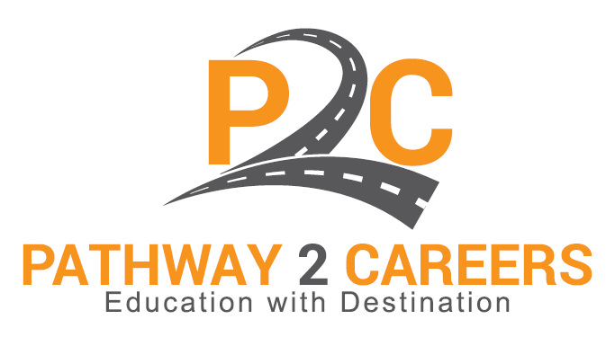
“To find out what one is fitted to do, and to secure an opportunity to do it, is the key to happiness.”
― John Dewey

Slide 2

Has personalized learning has gotten it wrong?

Slide 3

Personalized Learning Model
Personalized Learning Model Definition:
Personalized-learning models seek to adapt the pace of learning and the instructional strategies being used to best fit each individual child's strengths, weaknesses, and interests.
Personalized Learning Results:
"The evidence base is very weak at this point," said John F. Pane, a senior scientist and the group's distinguished chair in education innovation.

Slide 4
Where has it Gone Wrong?
many versions of personalized learning seek to change or replace fundamental processes that shape the day-to-day life of schools—everything from how teachers prepare lessons to how students are graded.
HINT: We weren’t doing that well to begin with, replicating what doesn’t work into personalized learning plans doesn’t change behavior

Slide 5
NAEP Math Scores

Slide 6
NAEP Reading

Slide 7
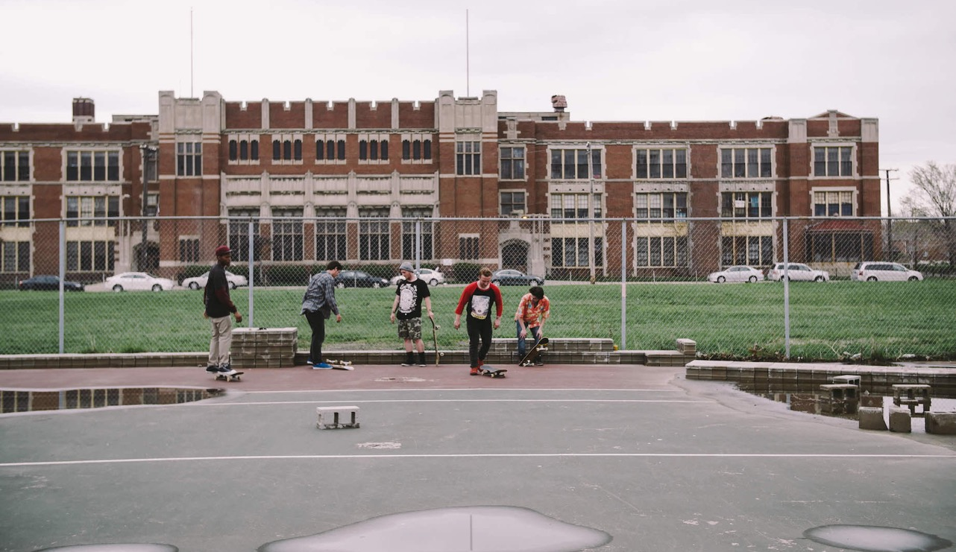

15
Nationwide, there are 2,397 high schools, , that do not graduate one-third or more of their students.
Source: http://www.gradnation.org/sites/default/files/civic_2016_full_report_FNL2-2_0.pdf (accessed August 25, 2016)

Slide 8
What is the disconnect?

Slide 9
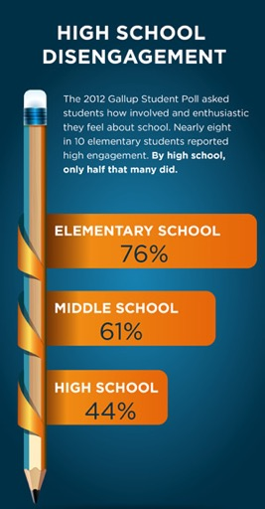
Students Not Feeling Engaged
How can relevance be increased while supporting the pathway to postsecondary success for all students, particularly those traditionally underserved?
Source: http://www.ed.gov/highschool (accessed August 24, 2016)

Slide 10
Not connecting students to their interest and career paths matter

Slide 11
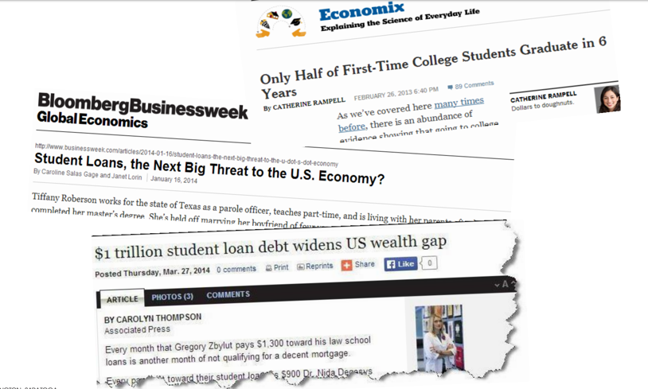
Long Term Impact of not Getting it Right

Slide 12
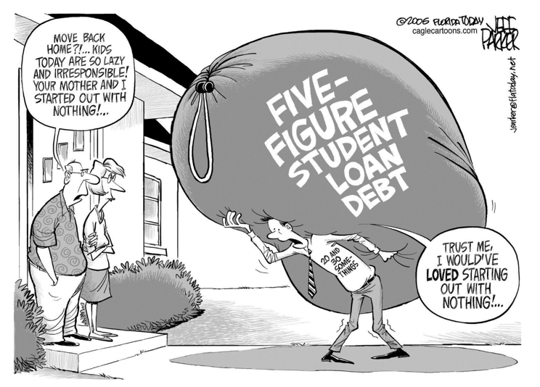
Student Debt not connected to Careers

Slide 13

“In today’s world, twenty-first-century skill demands are steadily increasing. Most high-paying jobs require additional education and training beyond a high school diploma. We must make sure that our children, particularly those who are traditionally underserved, are prepared for and have access to postsecondary education.”
–Gov. Bob Wise, Alliance for Excellent Education

Slide 14

Less than 10 percent of children born in the bottom quartile of household incomes attain a bachelor’s degree by age 25, compared to more than 50 percent in the top quartile.
Source: http://www.ed.gov/news/press-releases/fact-sheet-expanding-college-access-through-dual-enrollment-pell-experiment (accessed August 16, 2016)

Slide 15


By 2025, 68 percent of jobs will require postsecondary education and training beyond high school.
Source: https://cew.georgetown.edu/states-initiative/ (accessed August 24, 2016)

Slide 16
Disconnect between Education to the Realities of Employment
Employment
Economic Development
Education

Slide 17
How to Provide a solution

Slide 18

The Pathway 2 Careers Solution
Education + Industry
  We connect education and industry to assist and motivate students to achieve employment success.
Pathway2Careers
  P2C offers the bridge between education and industry that can help educators and students connect with the opportunities in their local job market

Slide 19

The P2C Mission
The mission of Pathway2Careers is to promote education with destination through the creation of high-quality tools and resources that enhance the intersection of educational practices with high-value career opportunities.
Our goal is to assist students in becoming:
Career-Ready
Career-Wise
Career-Engaged

Slide 20
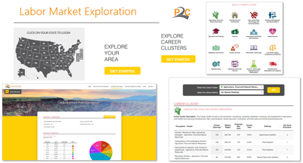
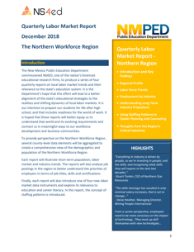
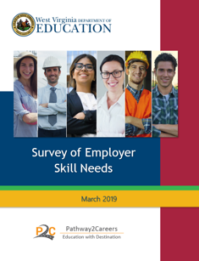
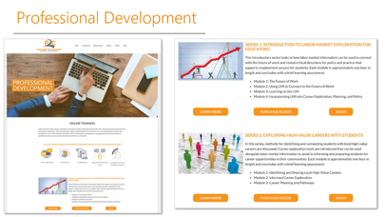
Career-Wise
Students will have the necessary information to support informed career decisions.
Target Outputs: tools and services that support critical awareness of labor market demands, career requirements, and education pathways
Currently Available
Labor Market Exploration System
  State and Local Data
Online Professional Development
  Designed for Educators
Employer Survey Tool
State and Regional Labor Market Reports
Current Development
Student Career Exploration System

Slide 21
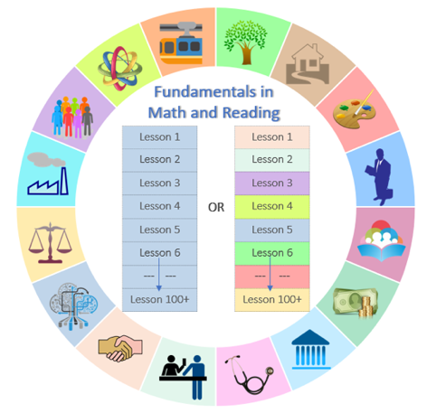

Career-Engaged
Students will be motivated to develop foundational skills and seek career opportunities.
Target Outputs: career-relevant learning opportunities aligned with personal career choices that allow students to experience purpose in education and motivation to learn
Currently Available
Conceptual Framework and Development Strategy for Choice-Based Career Learning System
Future Development
Choice-Based Career Learning System
Personalized Learning in Context

Slide 22
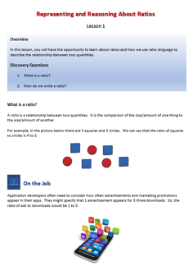
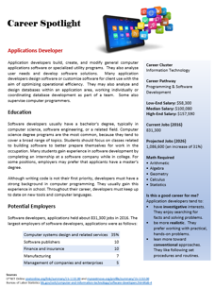
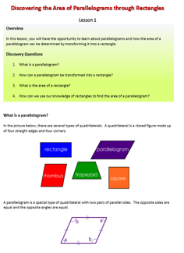
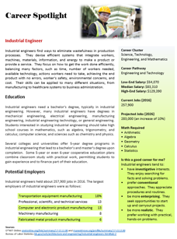
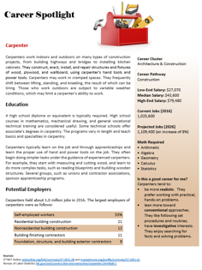
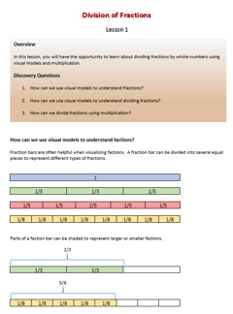
Career-Ready
Students will have the skills needed to achieve employment success.
Target Outputs: high-quality math and reading curriculum that presents fundamental concepts in the context of high-value careers aligned with students’ personal career goals
Currently Available
Conceptual Framework and Development Strategy for Career-Relevant Math and Reading Curriculum
Future Development
Career-Relevant Math and Reading Curriculum

Slide 23
What we know works:
Preparing Students for Employment Success
Make education relevant to personal employment goals
When students experience purpose in their learning…
When students experience choice in their learning…
Motivation to Learn
Retention of New Knowledge
Understanding over Memorizing
Drive toward High School and College Completion
Education
Career
Interest in Content
Independence and Autonomy
Self-Efficacy and Confidence
Persistence in Mastering New and Challenging Concepts

Slide 24

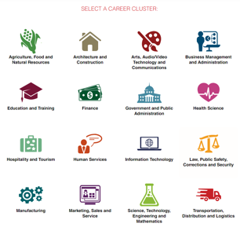

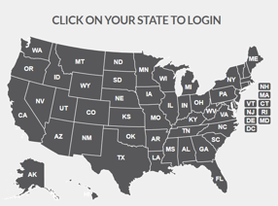


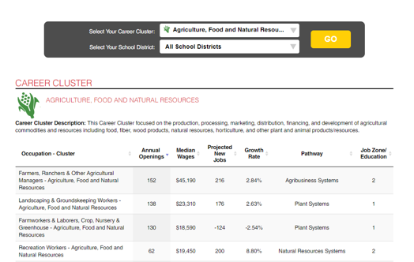
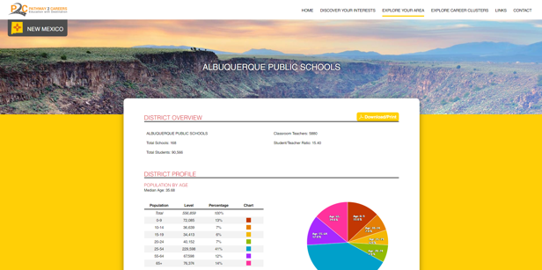
Pathways2Careers Works!

Slide 25
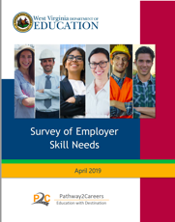
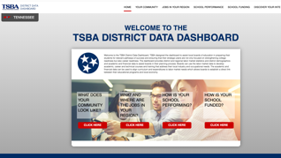
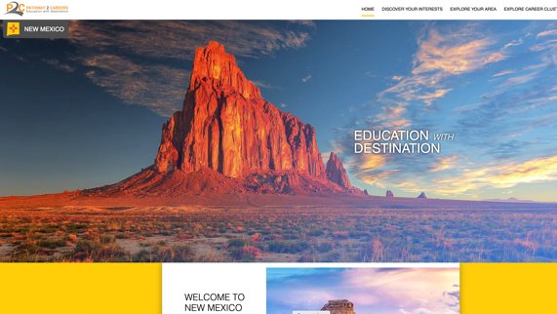
Current Successes
Tennessee
New Mexico
West Virginia
Kentucky
Nebraska
Arkansas

