Slide 1
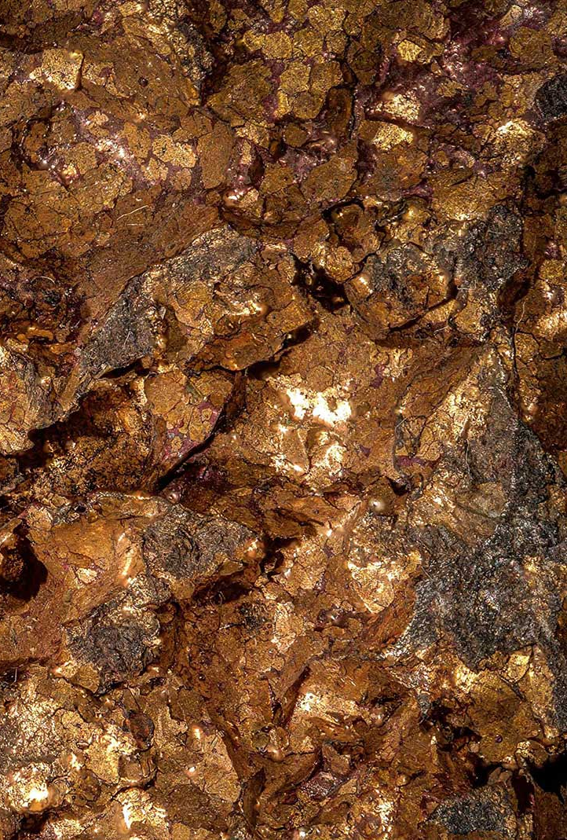

Investor Presentation
February 2019
Chris Schauffele
CEO
cschauffele@atlasmining.net

Slide 2
Objective
We target neglected assets and turn them into professional operations
Immediate Operating Cash Flow
Form a new copper focused Mining Company
Acquire majority in small scale producing operations
Targets are:
Under-capitalized
Hold numerous under-explored concessions
Located in proven mining districts
High Probability for added Value and Growth
Ultimate Business Strategy: Public Company – Multiple Operations
Notes:
My concern with this slide is that it has arrows pointing down which can give a negative sub-concession message about the future of the company.

Slide 3
Solution
$
Owner 2
Owner 1`
Owner 3
Majority Owner
Ownership Consolidation
Management with track record in district
Smart low level capital
Exploration Drilling
Increased Profits & Company Value
Step change the operating model = lower costs increased production
Small capital investments to increase production
Create intrinsic value by developing a resource and reserve
Notes:
Ownership consolidation allows Las Animas to pursue a common goal.
UG mining know how and track record in the same district
Low level capital investments provide large returns for small operations
Exploration and Resource development provides a certain future to secure investment returns

Slide 4
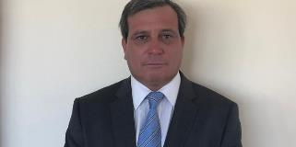
Team
<photo>
<photo>
Chris Schauffele
CEO
Mauricio Myer
COO
Sofía Mellibosky
Legal Consul
13 yr mining experience
Masters in Mining Engineering from Colorado School of Mines.
Formal General Manger Lundin Mining Candelaria
Proven history of UG mine production growth and reserve increases
Passed all roles at Open Pit and Underground Operations: Superintendent up to General Manger
9 yr mining experience
Current General Manager of San Andrés & Alianza
Currently 3% owner of Las Animas
Born and raised in the district well connected
15 yr mining expereince
Local Counsel for Norte Abierto Project(Cerro Casale-Caspiche)
Local Counsel for Kinross Maricungia Mine
Currently 6% owner of Las Animas
Team is well connected and has a proven track record in the Region

Slide 5
Financials and Growth Cases
Base Case Op Improvements
Case 1: Mill + Exploration
Case 2: Mill + Exploration + Mine Development
Operational Improvements
Opex increase, hire mine and plant managers
Increase head grade & mill rec.
Capex = $4M (purchase price)
Base Case operational improvements
Plant (12.5 kt/month to 17 kt/m)
Exploration drilling (10,000m)
Capex = $6.4M (incld. purchase)
Base Case + Case 1
Exploration drilling (30,000m)
Mine development – Mina Jardin
Rehabilitate, New drifting, Equipment, services
Capex = $11M (incld. purchase)
Financial Metrics
After 25% Tax, Cu = $2.80/lb, Au = $1200/oz, Ag = $15/oz, USD = 638 CLP. All scenarios include 6 yr debt repayment plan.
Notes:
The key to this slide is the remaining cash flow after tax and debt repayment. The company has a very strong cash position. Free cash remaining of 770k to 2.7M per year for dividends, faster debt repayment or re-investment in the business.

Slide 6


