Slide 1
About us
  Mission statement – what we do
  What we are looking for – finance or Partnerships with Operations
Current opportunity
  Description
  Their problem
  Our solution
Management
Contact information
You can remove the events part, and make the Current opportunity the focus of the page.
You management section is good.

Slide 2
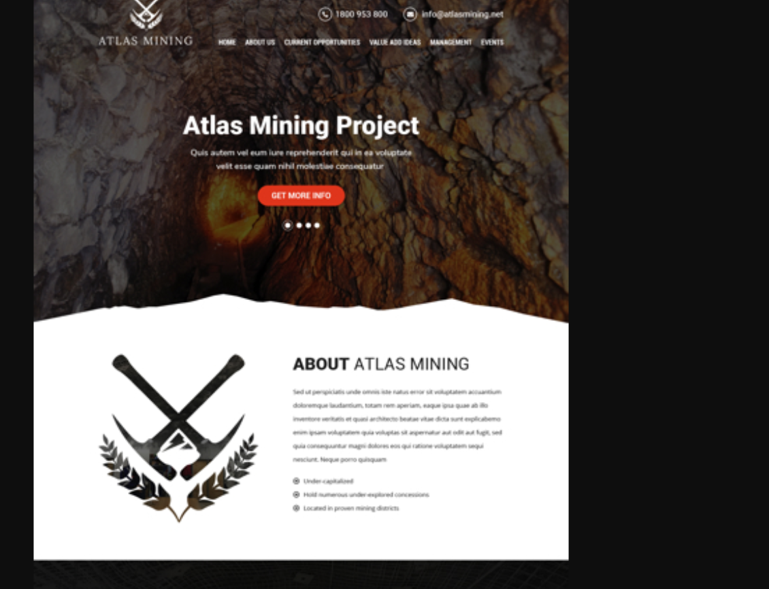
About Us
A Copper Focused Mining Company
We target neglected assets and turn them into professional operations
Acquire majority in small scale producing operations
Our Targets are:
  Under-capitalized
  Hold numerous under-explored concessions
  Located in proven mining districts
Immediate Operating Cash Flow
High Probability for added Value and Growth

Slide 3
Current Opportunity Page
Needs to have the following flow and information
  Description
  Their problem
  Our solution
  Scenario Evaluation
Description
Seeking invest to obtain majority ownership in an active copper operation located in Chile.
Multiple underground mine open stoping operations feeding two separate mills.
Classified under Chilean Law as a “pequeño minería”
Sells concentrate and Run of Mine Mineral to ENAMI – guaranteed buyer under small miner law
ENAMI as the purchaser protects the business during low copper prices as they pay over spot for business in the pequeño minería category
Current production 3.5 Cu mlbs/yr, plus by products Gold, Silver, Iron
Combined processing rate = 22,250 tonnes/month
Very simple metallurgy, no concentrate penalty elements
921 Hectares of under-explored mining concessions

Slide 4
Current Opportunity
Needs to have the following flow and information
  Description
  Their problem
  Our solution
  Scenario Evaluation
Their Problem
Business has many owners with divided interests – stalling company growth
Operating for decades without resource or reserve - but hold 921 Hac of concessions
Current shareholders are descendants of founders and do not understand mining
  Lack of operational and industry knowledge leads to their unwilling to reinvest in business
Our Solution
Small miners suffer from numerous inefficiencies which we can turn into value
Implement Immediate Operational Improvements:
  Constant effort, educate work force
  Efficiencies: drill, blast, load, haul
  Measure KPIs, Set goals, Incentive system
  Fragmentation – P80 ideal for crusher
  Maintenance, improve equipment availabilities
  Plant improvements (recovery, power and water use)
  Critical spares & House keeping
  Safety culture
Exploration on the 921 Hacs of concessions
Complete our virtuous mining cycle

Slide 5
Current Opportunity
Needs to have the following flow and information
  Description
  Their problem
  Our solution
  Scenario Evaluation
We have developed 3 cases showing our plans once we are the majority owners of this business.
See Next slide for details

Slide 6
Base Case Op Improvements
Case 1: Mill + Exploration
Case 2: Mill + Exploration + Mine Development
Operational Improvements
Opex increase, hire mine and plant managers
Increase head grade & mill rec.
Capex = $4M (purchase price)
Base Case operational improvements
Plant (12.5 kt/month to 17 kt/m)
Exploration drilling (10,000m)
Capex = $6.4M (purchase + exploration)
Base Case + Case 1
Exploration drilling (30,000m)
Mine development – Mina Jardin
  Rehabilitate, New drifting, Equipment, services
Capex = $11M (purchase, + exploration + new mine)
Financial Metrics
After 25% Tax, Cu = $2.80/lb, Au = $1200/oz, Ag = $15/oz, USD = 638 CLP. All scenarios include 6 yr debt repayment plan.
6

Slide 7
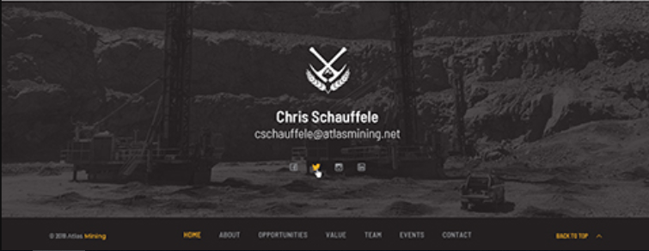
Examples I liked

Slide 8
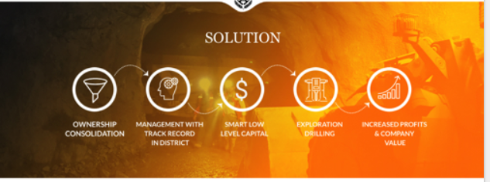
Please fix the last two icons they are hard to read
You can also make the last circle larger to draw attention to it

Slide 9

This is a good image with a black background to use.

Slide 10
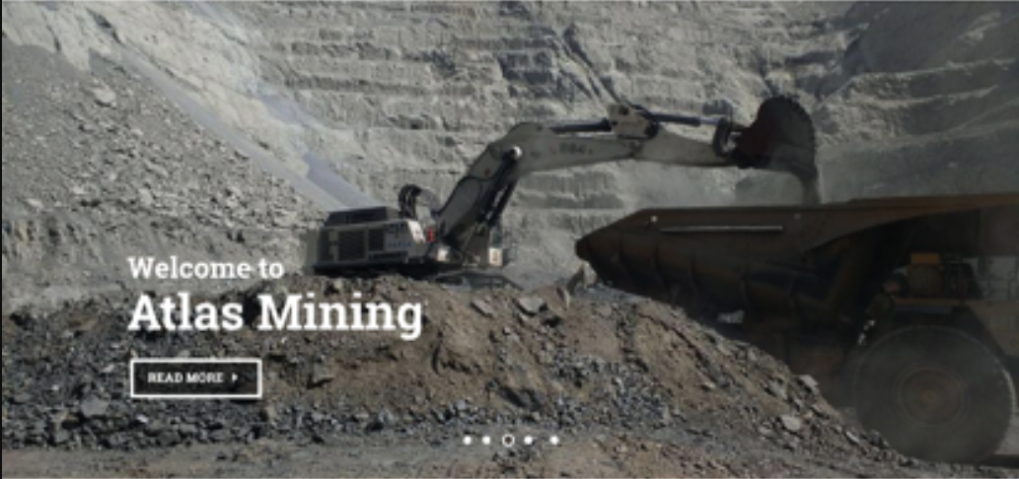

Slide 11
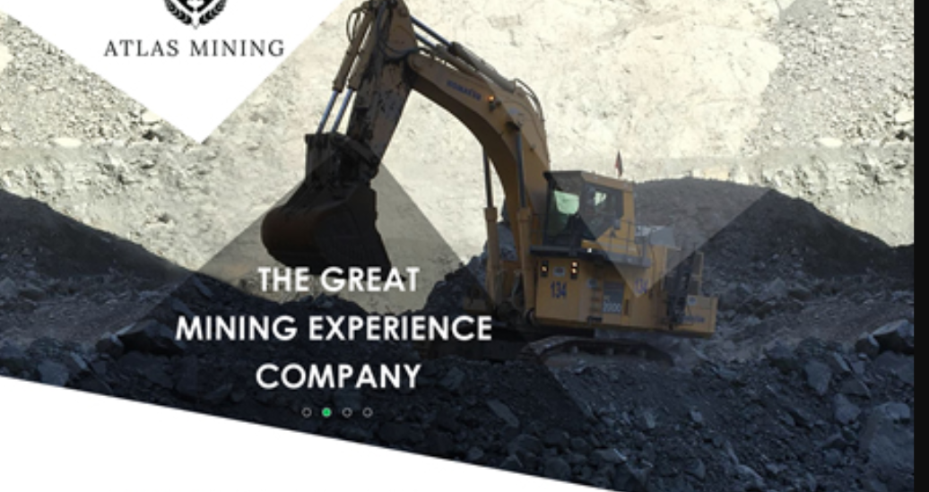
This is a good image with the excavators bucket in the center.

