Slide 1

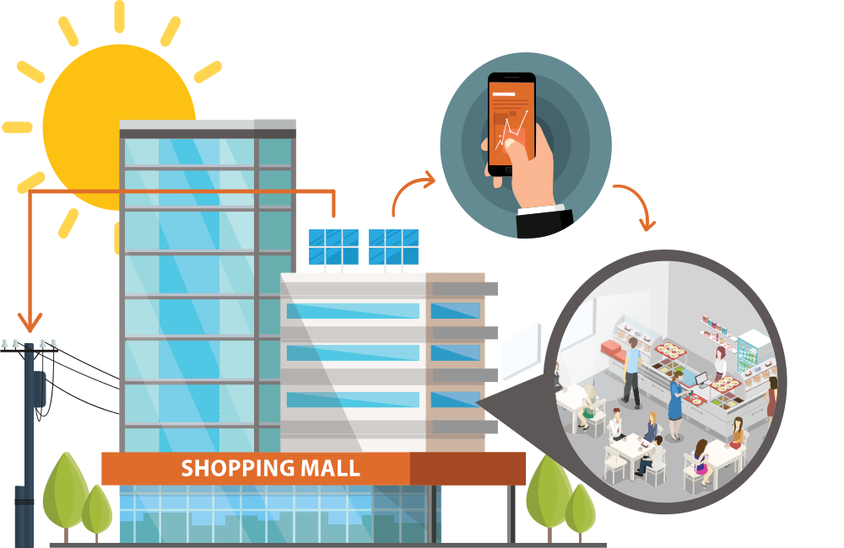
Solar Garden Produces Energy which becomes Utility Credits
$
$
$
$
$
$
Utility Bill Credits Available for Tenants
$
$
$
Sign Up to Receive Utility Bill Credits. Save 5%
$
$
$

Slide 2
Discount-Price Electricity Offer
Save 5% on your Electricity Cost
Step 1
Step 2
Sign Up for the Solar Subscription Agreement.
It runs only for as long as you lease your space
Securely Provide Generate Solar with your Utility information through UtiiltyAPI
We use the information only to credit your bill, generate your invoice, and provide clean discounted energy.
Click here to learn more.
Contact Us

