Slide 1

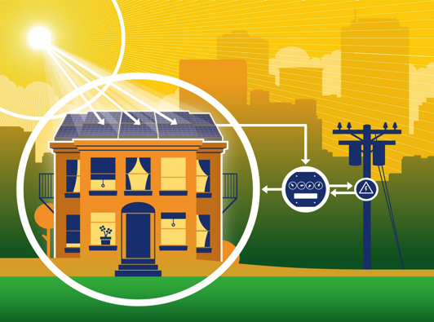
Solar Production Credits
2
1
Credits available for building and tenants
Subscribe to receive credits & Save 5%

Slide 2
Secure 5% Energy Savings in 2 Simple Steps
Sign the Solar Subscription Agreement which runs only as long as you lease your space
Provide Generate Capital with your PG&E Account information so that we can credit your bill and save you money.
Contact us to learn more.
  If you have or want a PG&E online account, provide access securely through UtilityAPI
  If you don’t have or want a PG&E online account, provide access with this PGE form.

