Slide 1
Eden Builds
Brand Dev
13 Jan 19

Slide 2
Naming background
Eden Builds is construction business in Bali, primarily building villas, high-class renovations and design.
The name ‘Eden’ represents that they create the ‘dream’ experience of living in paradise.
We want the name to represent paradise but have a hard edge so it’s not too feminine.
We also want it to have the feel of high class and modern design – so not just builders – but a brand that considers architecture
We have 2 styles in mind and would like a designer to creatively work with these. Escher style we believe is the way to go.
Colours – Gold is something we want to explore, but also keen on blues and seeing how we can use shades of blue to create some depth.
Font- want to explore. Needs to be classy and elegant. Brand needs to be represented as professional and with style.

Slide 3
EDEN BUILDS
1.
EDEN BUILDS
Cleaner and bolder
Different colour palettes
Can this icon be made Escher style?(See next slide) We like how the icon also looks like a flower
EDEN BUILDS

Slide 4
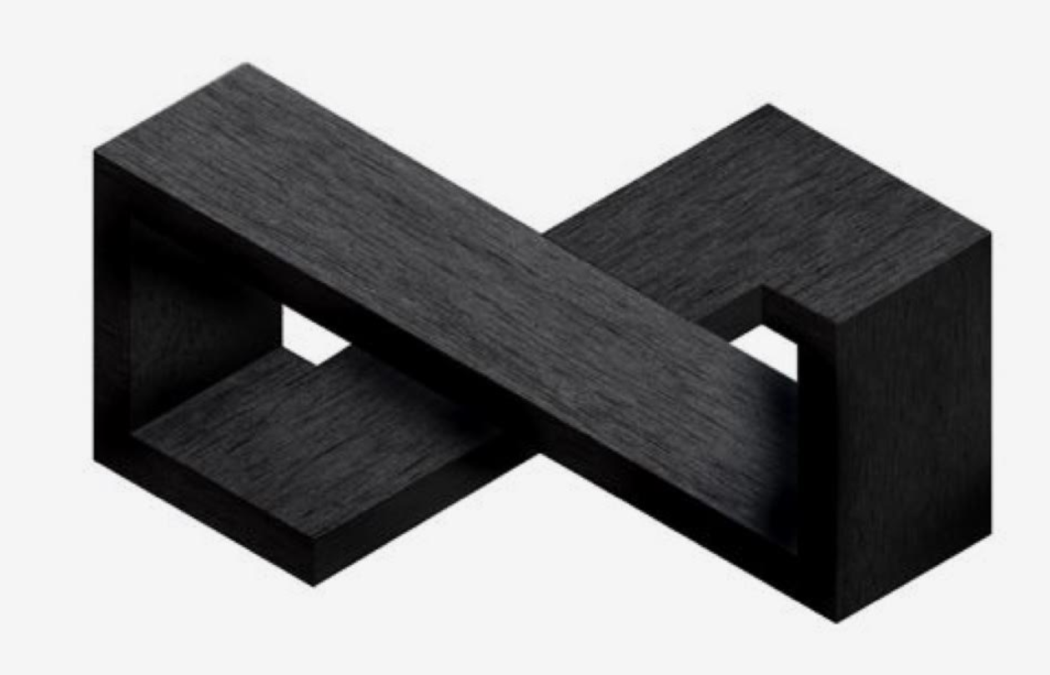
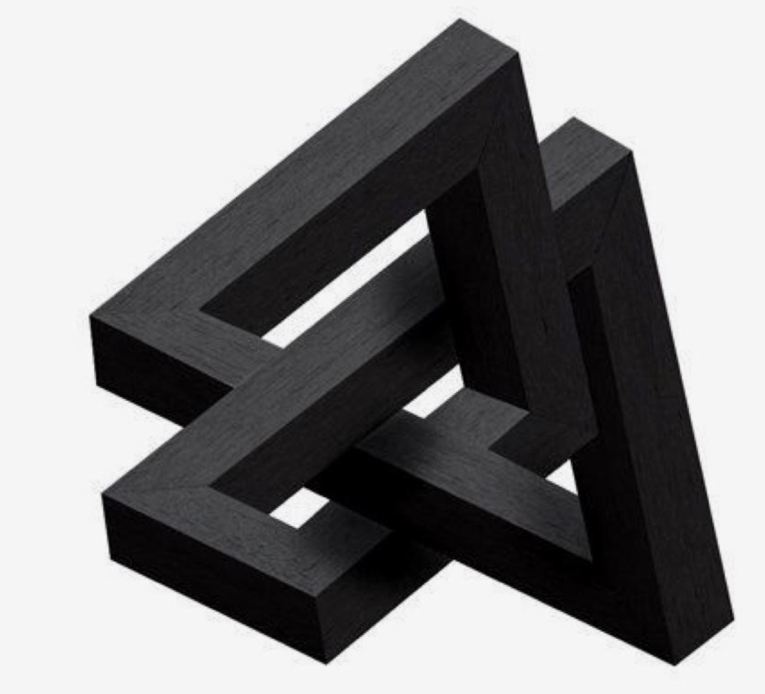
Escher style
Keen to explore other Escher styles that could represent the beauty of Eden with the structure of building. Gives the idea of making the possible out of the impossible

