Slide 1
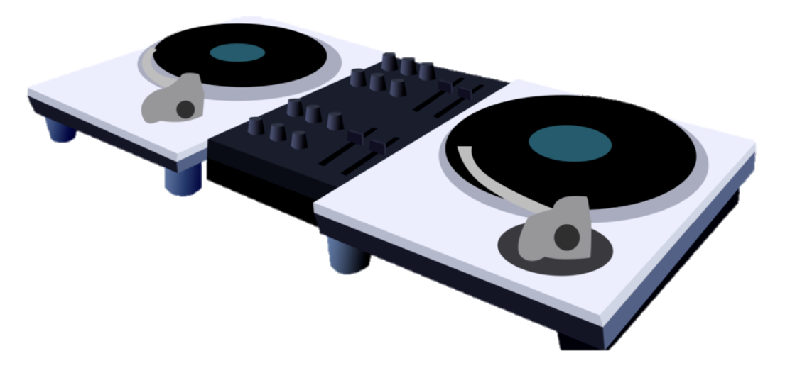
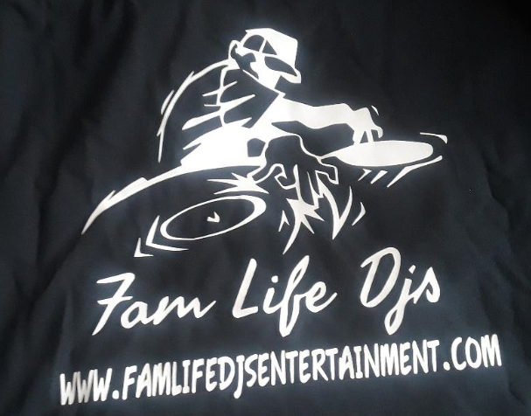



New design should incorporate some of these items and the company name – Fam Life DJ’s
OUR OLD DESIGN

