Slide 1

Rcarré – Luxconnect First Trial for an elastic Cloud « Made in Luxembourg »
Elasticity : capability to adapt cloud based IT capacity to specific requirements ( volume or power) to the fonctionnality needs.

Slide 2









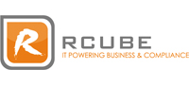
RGROUPE: WHO WE ARE ?
20M€
Total Turnover 2018
5
+500
2001
Subsidiaries
Rcarre / Rcube
R-Lease / Rcarre Be LDL Connect
Projects/year
Birth of Rcarré Luxembourg
140
PME &
SPOC approach
PSF &
Mission Critical
employees, including100 IT experts
2700
Customers in the Cloud

Slide 3
LUXCONNECT: WHO WE ARE ?
KEY PARAMETERS
Private company owned by the Luxembourg State
Founded on 10 October 2006
Capital : 75 M€
21 employees
SERVICES FOCUSSED ON STATE OF THE ART INFRASTRUCTURE, NO IT SERVICES
Multi-tenant Data Centers : Shared and private rooms & cages
Dark Fiber in Luxembourg
Office space (incubator offices)
SLA From 99,XXX TO
Recently, LuxConnect adopted a new strategy and is now offering colocation services DIRECTLY to end-customers.

Slide 4
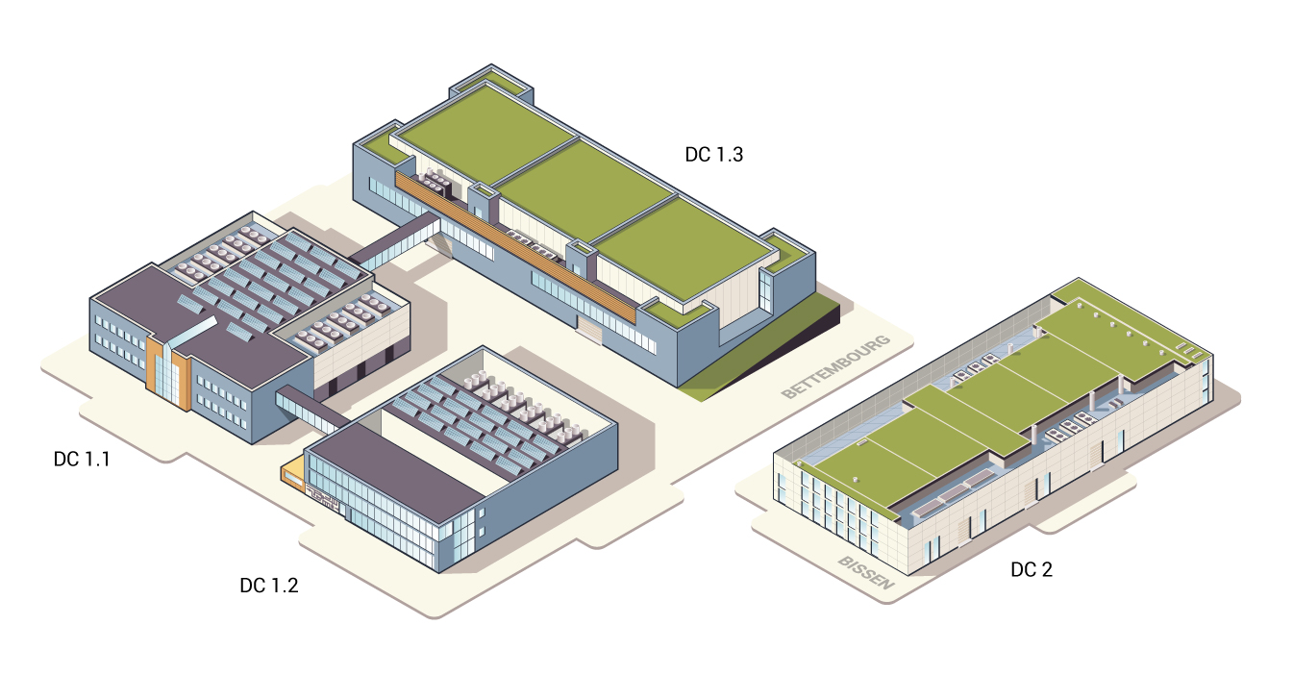
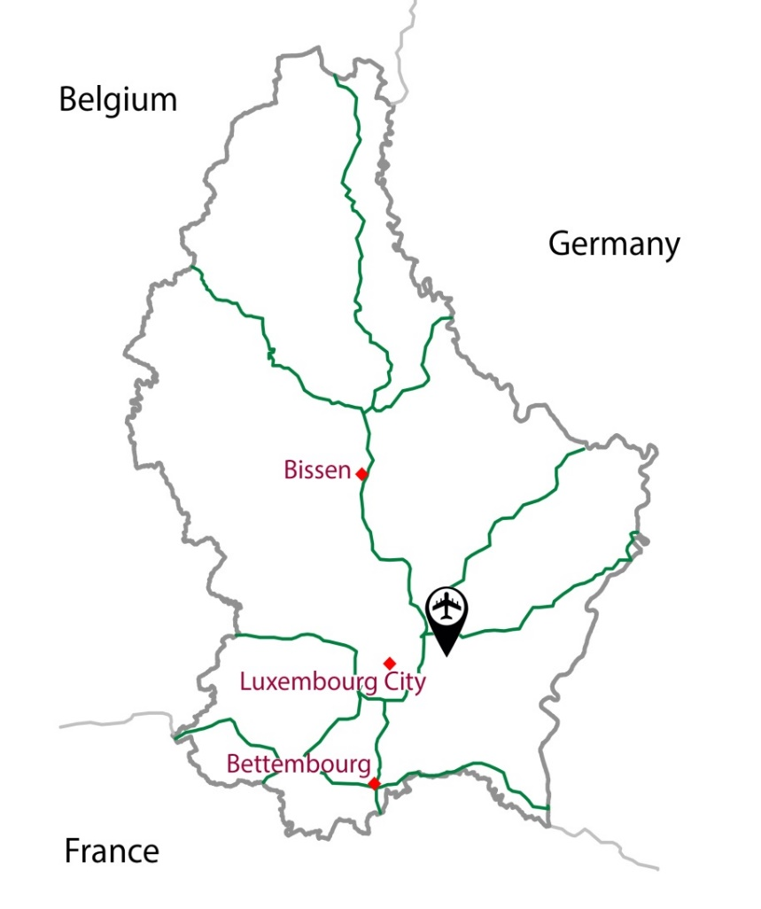
LUXCONNECT DATACENTERS
4 MULTI-TIER and MULTI-TENANT data centers in Luxembourg, located on 2 campuses
ICT Campus Bettembourg with DC1.1, 1.2 and 1.3 covering in total 9.900m² of server space
ICT Campus Bissen with DC2 covering 4.800m² of server space
Both campuses are interconnected and managed by LuxConnect staff at distance in the very unlikely case of major disaster

Slide 5
Cloud : global market
Main market based on US Solutions : Google, Microsoft, Amazon, …
European players like One and One, OVH,…
Luxembourg : high density Datacenters. No public cloud solution.
WE WANT TO CREATE A PUBLIC CLOUD FOR LUXEMBOURG!
Because :
Luxembourg is a digital country and must be present on the global cloud market
Luxembourg IT players must work together to give a united strategy for Luxembourg
Luxembourg must be an IT safe on the European market
Luxembourg Datacenter market will decrease without new position on the market

