Slide 1
Niagara Falls Craft Distillery: RTD Opportunity

Slide 2
Consumer Beverage Trends
Healthier & Weight Concerns
Lower Calories
Gluten Free
Less Sweet:
Lower Sugar Content
Dryer Liquid: i.e. Georgian Bay Smash
Lower ABV: 0% to 3%
Beer, Radlers, 4% coolers
Growing 10% in US and Europe
All Natural, Organic and Locally Sourced
No Artificial flavours, Local Providence
Sessionability
More occasions i.e. post workout

Slide 3
BRAND POSITIONING
Positioning Statement (TBD) “Niagara Farms is a Sparkling Cooler with a fruit forward taste made from all natural flavours from the local Niagara region. At only 75 calories, 2.5% ABV and made with no artificial sweetners, means that it’s a healthier choice for any occasion.
1. Market Segment | Ready to Drink Beverages: Coolers
2. Consumer Insight | Consumers are transitioning to healthy eating and drinking habits. In drinking occasions, they still want to be part of the crowd in enjoy a beverage but want something that fits with their healthy lifestyle, but does not compromise on taste.
3. Unique Selling Proposition | The only Canadian liquid that is low calorie/low ABV that has a fruit forward taste made with all-natural local ingredients from the Niagara Region
4. Target Market | Males, Females aged 18 to 35+ who are drinking this because: I want a refreshing alcohol beverage/soda that tastes more like natural fresh fruit but I am concerned about my health and calories, And want a lower ABV so can stay in control but feel part of the group.
5. Occasions | Easy drinking times, after work, weekends, cocktail occasion and summer time. Drinking this instead of: Light Beer, Sweeter Coolers, Vodka Soda, Wine

Slide 4



Packaging Inspiration:
Vivid, Monochromatic Colours

Slide 5
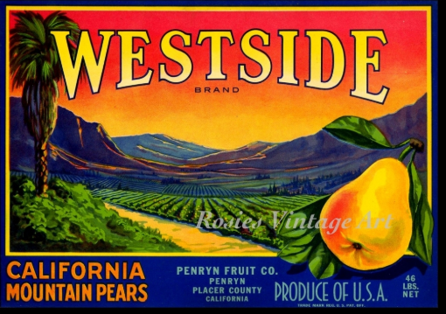
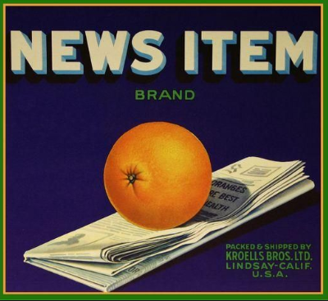
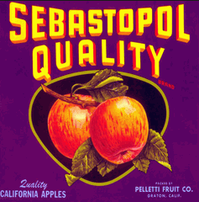
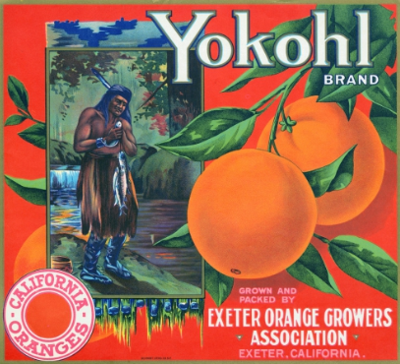
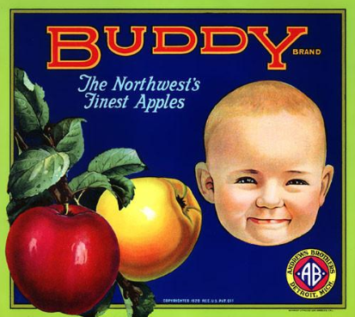
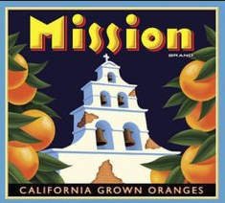
Packaging Inspiration: Vintage Fruit Labels Does this appeal to younger generation?

Slide 6

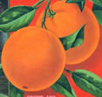
Can Packaging Line-up Idea: 355ml Slimline Can
Names Options
Niagara Fresh
Niagara Farms
Packaging Highlights
75 Calories
2.5% ABV
All Natural Flavour
Gluten Free
Designation
Fruit First Crush
Lite Sparkling Crush
Flavours
Peach
Apple
Raspberry
Niagara Farms
Fruit First Sparkling Lite Crush
Apple Spice
Niagara Farms
Fruit First
Sparkling Lite Crush
Peachy Peach
Niagara Farms
Fruit First
Sparkling Lite Crush
Rousing Raspberry
75 Calories
2.5 ABV
gluten
Free
Core Image Attributes Appetite Appeal: Food Porn: Convey Great Taste & Refreshment Authentic and Local Vibrant Colours Simplicity Vintage?

Slide 7
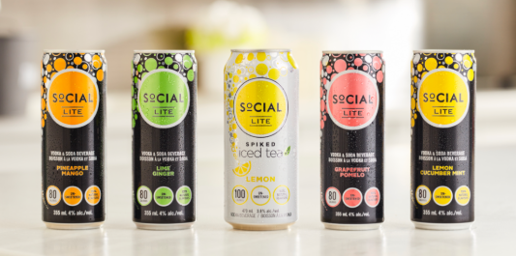
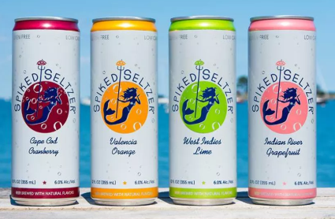
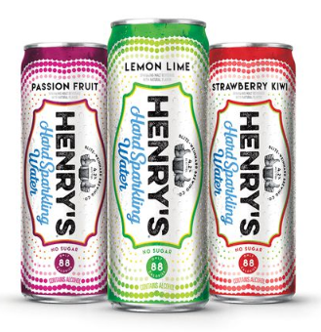
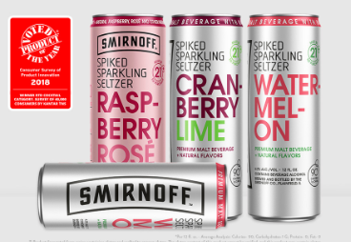
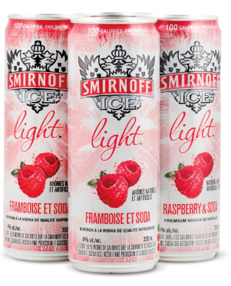
Competitive Set: Need differenciate

