Slide 1
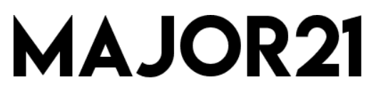
21st century - science based.
NO EMPTY CALORIES.

Slide 2
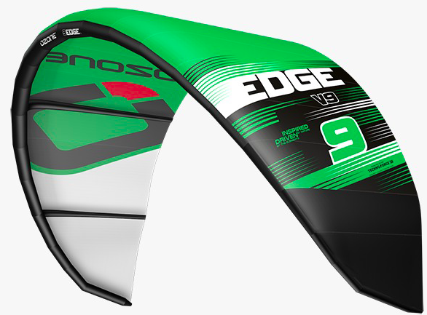
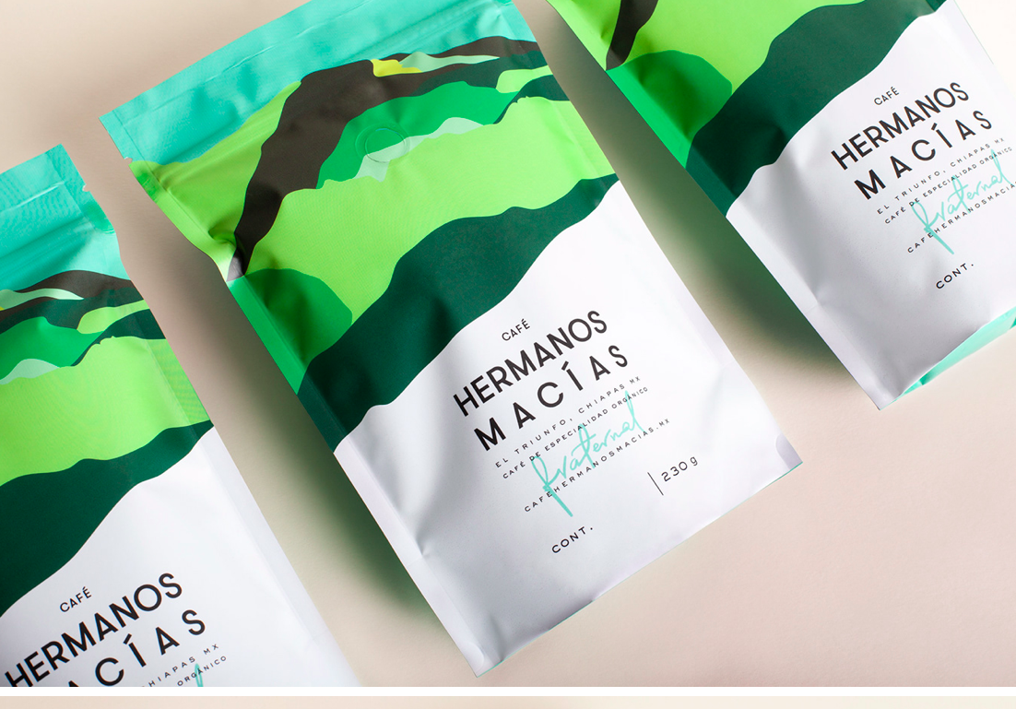
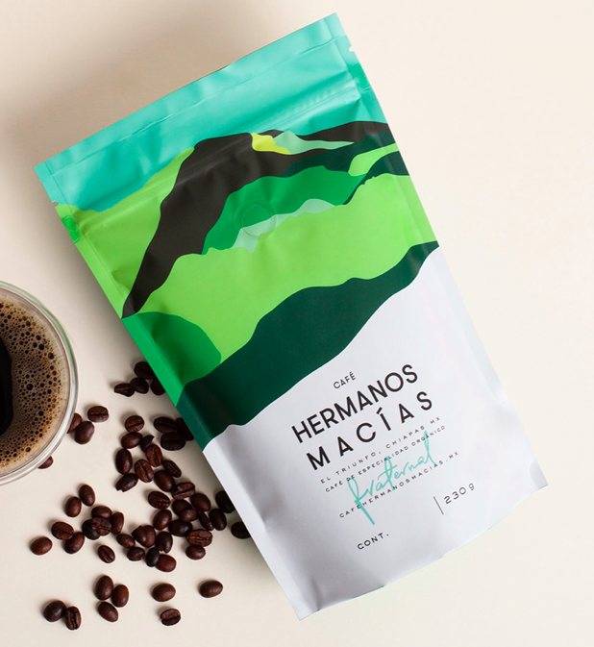
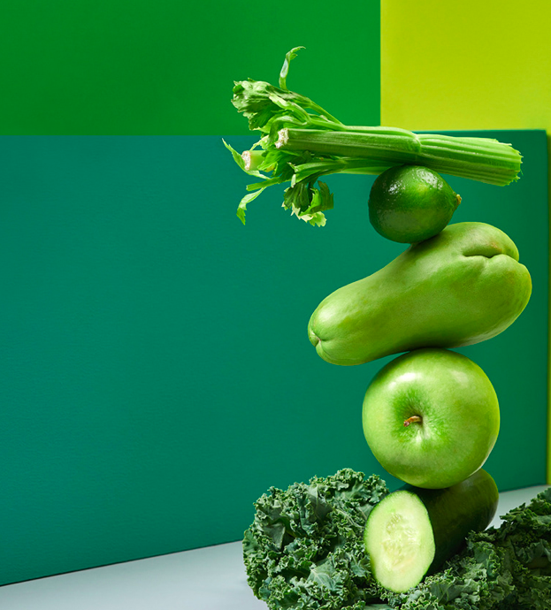
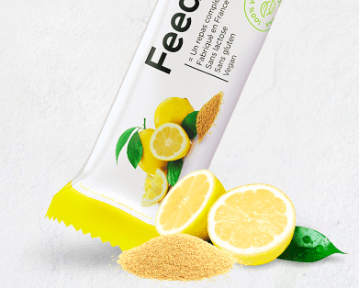



Slide 3
MAJOR21 is designed to make you feel HEALTHY AND SATISFIED, perform at your best, and MEET ALL YOUR NUTRITIONAL NEEDS.
 | .
We did this by freeze drying REAL FOOD with a high nutritional value. This way we were able to conserve most (98%) of the nutritional goodness and because we offer it in a powdered form you can absorb even better all the NUTRIENTS!

Slide 4
Fast food can be HEALTHY. Refueling ON THE GO meet your basic human needs. REAL INGREDIENTS and great taste.

Slide 5
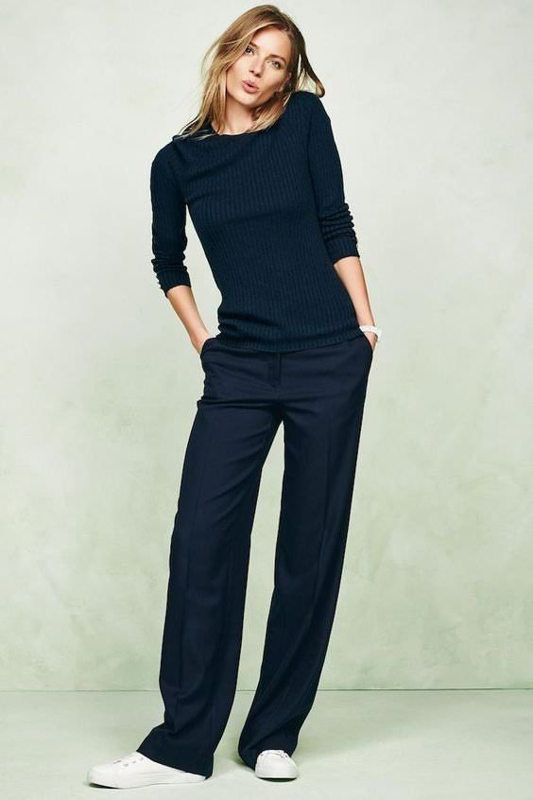
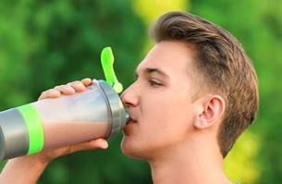

Ambitious
SMART
Balance
Sportive
Passionate
TO BE (PRO) ACTIVE
NO COMPROMISE ON HEALTH
Keeps you going

Slide 6
Our aim is not to be a gourmet meal, however MAJOR21 wants to help you make a healthy diet a whole lot easier.

Slide 7
