Slide 1

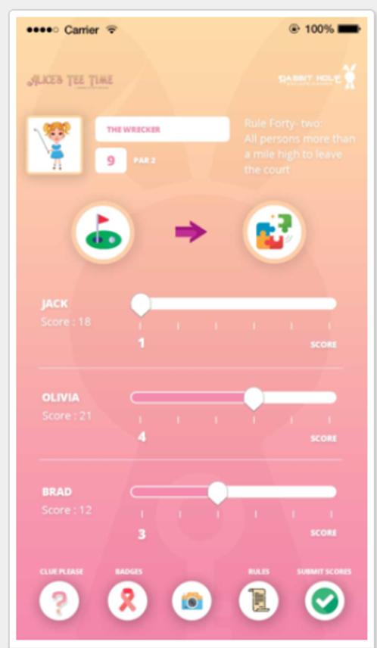
Change to Green background
Blank templates
Hole
Placeholder for Name
Par
Placeholder for Score
We’ll insert icons. Please send separately
Change Ribbon to Medal
Add Selfie above camera
Please send sliders separate and not pink
Please send icons separate

