Slide 1

Strategic Growth Advisory
Discover, Develop, Deliver
^{12th} December 2018

Slide 2
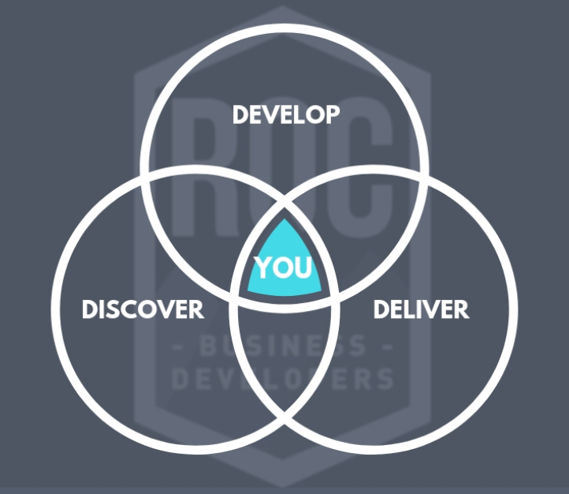
Aligning Our Process

Slide 3
Would like a slide where we can insert all 3 directors experience

Slide 4
Opportunity Planning Process
Identify
Opportunity
Qualify
Opportunity
(Discover)
Identify
Key Individuals of
Influence to
Decision Process
Discover
Develop
Deliver
Develop
& Implement Sales
Strategy & Plan
Negotiate
and Sign
Execute Plan
And Deliver
Proposal
Align & Develop
Relationships with
Key people of
Influence
Notes:
4

Slide 5
Market Region & Account Planning Process
Market Region & Account Planning Process
Segment your
Regions into
Accounts
Analyse your
Current
Business
Identify
“New”
Opportunities
Its all about
Your
Customer
Measure and
Monitor
Progress
Create an
Account Strategy
& Plan
Implement
the Strategy
Action Plan
Manage the
Key
Relationships
(Walk the Halls)
Select Strategy &
Market to
the Account

Slide 6
Discover – Analyze your Business Territory & Market Segment
DISCOVER
Analyse Your Business & all of its current Sales Territory(s)
Understand What Drives Customers to Buy.
Understand Your Customers Business Drivers and Objectives they need to achieve.
Identify what your Customers Clients need ( Perceived / Unperceived)
Clarify Your Strengths, Weaknesses, Opportunities and Threats (SWOT).
Clarify Your COMPETITORS Strengths, Weaknesses, Opportunities and Threats (SWOT).
Clarify Your CUSTOMERS Strengths, Weaknesses, Opportunities and Threats (SWOT).

Slide 7
Discover – Analyze your Business Territory & Market Segment
DEVELOP
Determine Your Objectives
Develop Strategies to Accomplish Your Goals
Engage the Resources You Need.
Create an Influencing Strategy to develop key Relationships.
Create a Marketing Strategy – Create Alignment with the Sales and Marketing teams.
Create a complete Action Plan – Strategy and Tactics.
Develop the Project Management discipline to manage the full life cycle of your Relationship with the Customer.

Slide 8
Discover – Analyze your Business Territory & Market Segment
DELIVER
Work Your Plan.
Measure & Monitor progress, Stakeholder alignment and capture growth through your Project Management discipline
Deepen your Client Relationship to leverage future opportunity as a Partner.

Slide 9




ROC BD Current Opportunity & Account Management Process
Client CRM, Account Management Tool: All Opportunities, Deal Progress, Sales Forecasting, Tender or Deal management.
For All ROC BD or Client Templated Formal Proposals and Sales Contract / T&C’s Management.
Client Information, Invoicing and Full Suite Business Accounting Software

