Slide 1
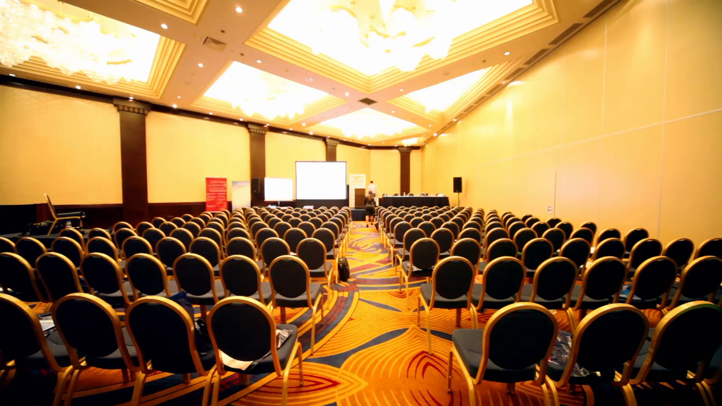



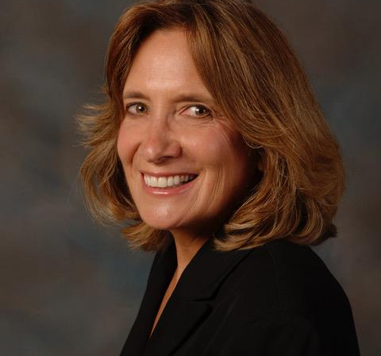
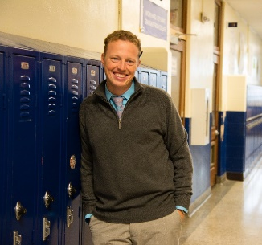
Join RestorativeUS on Month, Day, Year as we partner with Indianapolis Lighthouse Charter School South to unite educators from across the region as they explore and further the work of serving all students, even those hardest to reach and teach. We all acknowledge that serving students in struggling communities is hard work. With emerging state, federal, and authorizer expectations that we reduce and, in some cases, eliminate out of school suspension- the work has gotten even harder.
Some in the restorative movement are solely focused on alternatives to suspension. At RestorativeUS and LHA, the focus is on proactive, relationship-based tools and strategies to increase student ability to self-manage in the midst of emotional and behavioral incidents while remaining in school.
SPEAKERS
This workshop will provide participants with tools to address the two central challenges to implementing restorative justice: mindset and strategy. By the end of this 90-minute workshop participants will:
Understand of the intent and context of the restorative movement
Implement restorative tools to help students self-manage and resolve conflicts that may have previously resulted in punitive consequences
Support adults and they provide increased proactive support and thus decrease reactive counter-productive exclusion from school and learning
Own The Restorative Playbook: a 48-page guide to 15 restorative strategies/tools ($15.00 value)
SUE JAMBACK
Sue.Jamback@restorativeus.com
813 530 2826
Or Visit:
restorativeUS.com
To register:
Send check to:
Lighthouse Academies: 29140 Chapel Park Drive
Wesley Chapel, FL 33543
RYAN GALL
Limited Availability Registration Deadline: Monday, October 15
Location:
Lighthouse College Prep Academy South
1780 Sloan Avenue
Indianapolis

