Slide 1
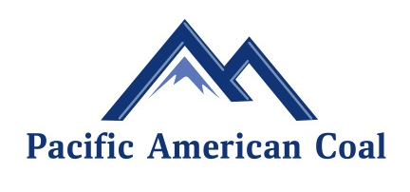
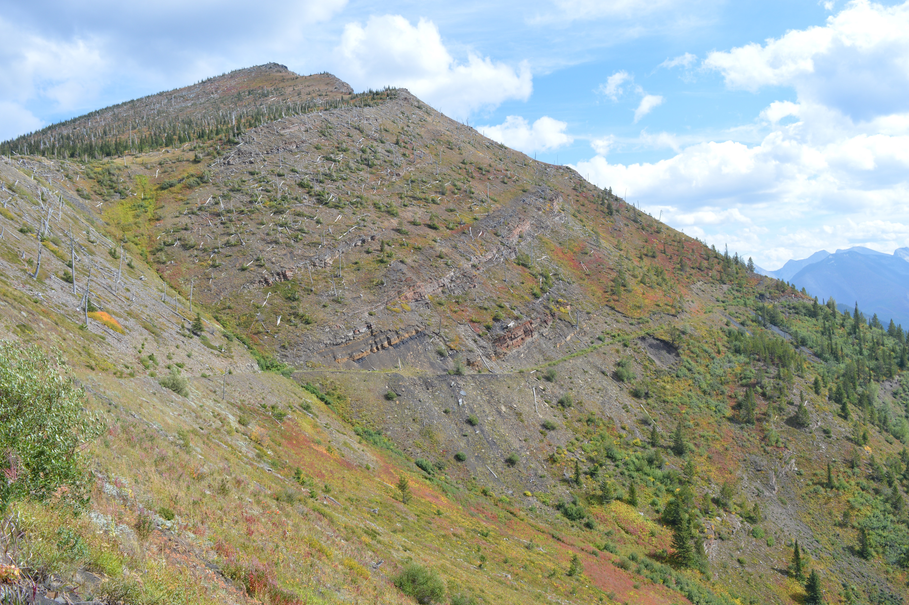
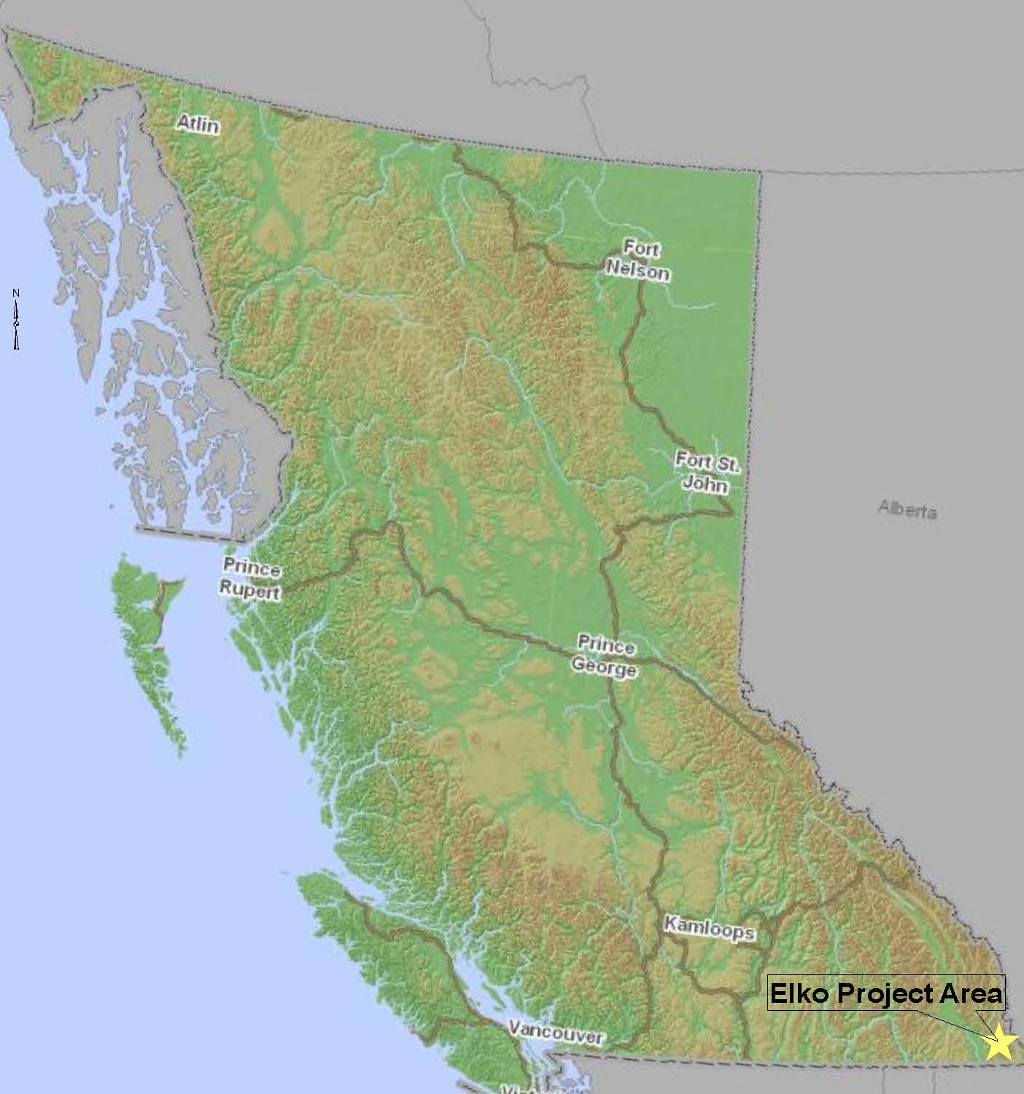
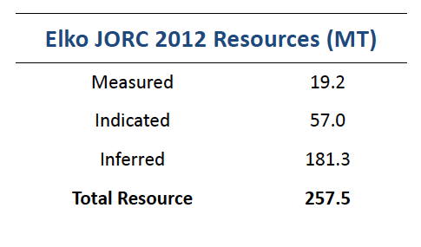
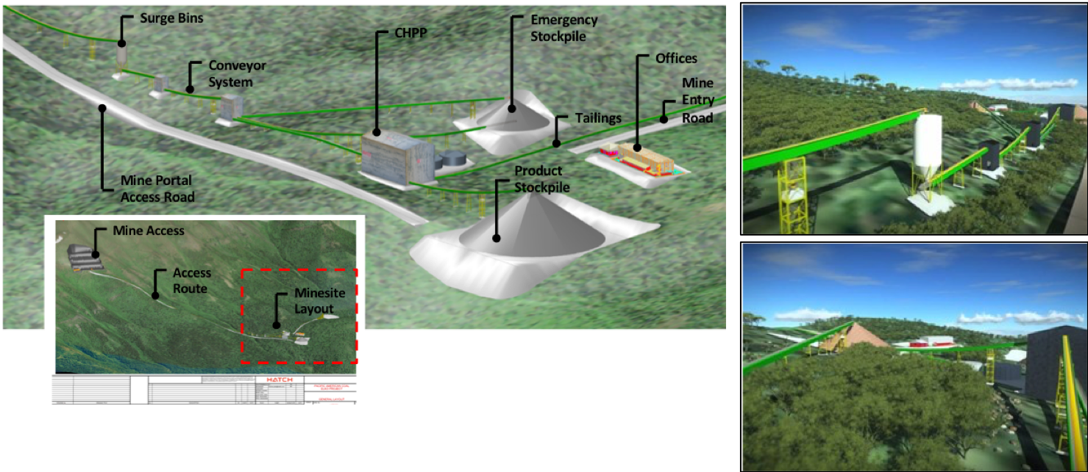
The Elko Coking Coal Project
Significant Land Holding
[Left Poster]
Location: | East Kootenay Coal Basin Crowsnest Coal Field
Ownership: | 100%
Area: | 2,995 Ha (3 adjoining tenements)
Environmental Status: | Highly disturbed land (logging)
Resources: | 257.5MT
Mining Method: | Underground
Approvals: | Notice of Work for the Western Coal License valid until May 2022

Slide 2

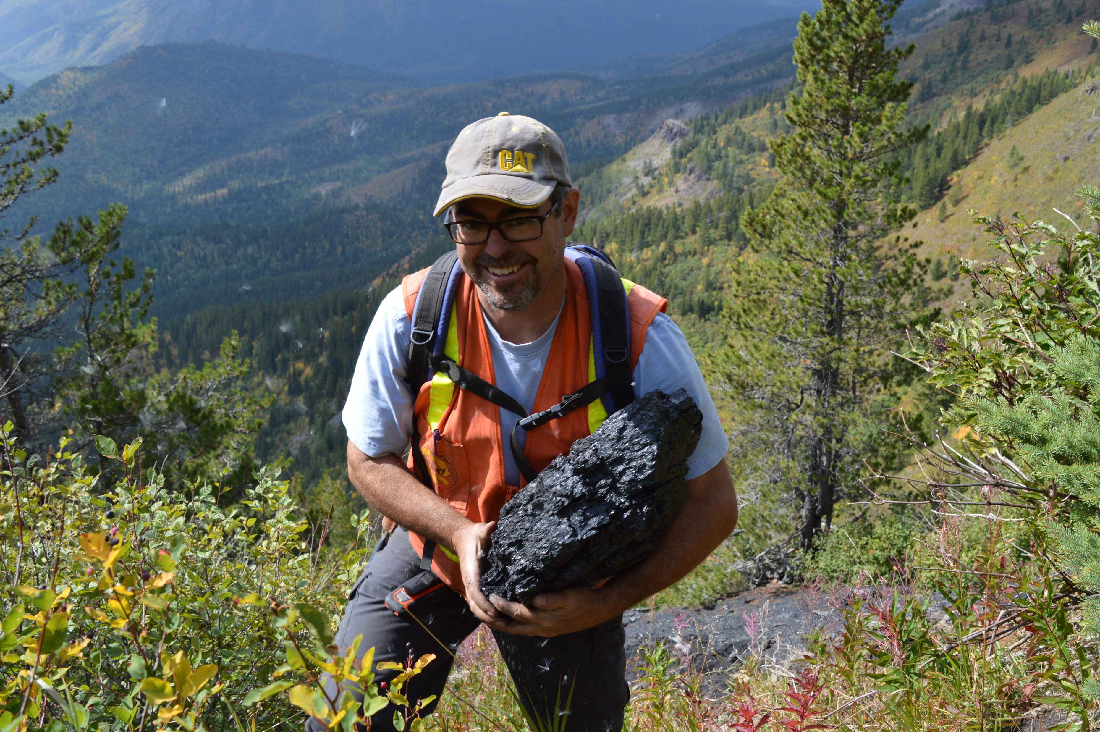
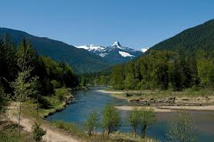

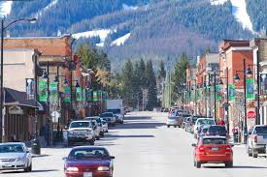
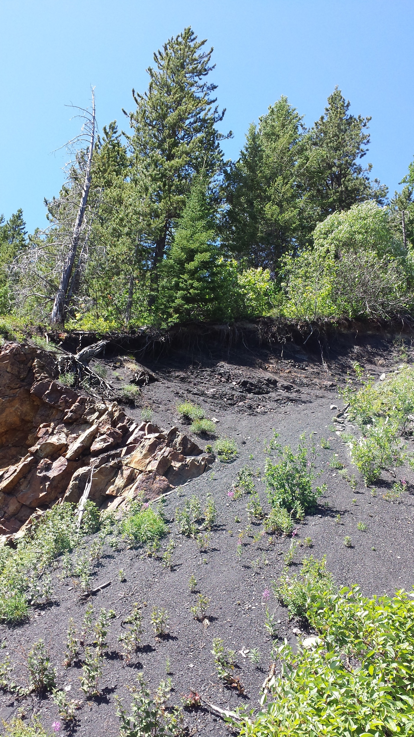
[Middle Poster]
: PAK
High Value Coking Coal in B.C. Canada
Corporate Highlights
Elko Coking Coal Project BC Canada (PAK:100%)
257.5 MT JORC 2012 Resources
2018 drilling program exceeded expectations
Seeking Development Partners
Corporate Overview
Capital Structure
ASX: | PAK
Shares on Issue | 165,305,889
Market Cap: | A$ 5,800,000
Cash: | A$3,580,000
Debt: | 0
committed to the environment and the community
Shareholders Focus on delivering shareholder value through minerals exploration and investment. The company will continue to review opportunities and invest in assets that add value to shareholders. |  | Community PAK is committed to working with the communities in which it works. The company is using local personnel to complete tasks and will continue to work with communities in a transparent way.
 | Environment PAK is committed to developing environmentally sustainable projects that have minimal impact on the environment and the community as a whole. PAK sees its environmental stewardship as paramount to the viability of its projects and will continue to work with its partners to ensure the company is doing everything possible to preserve the environment.

