Slide 1
Let’s get back to Basics

Slide 2
Commicare means to share
Communication is from late Middle English: from Old French from the verb communicare ‘to share’
To share, there must be at least:
Giver (you trying to communicate)
The gift (message)
Recipient
What may not be obvious is that there should be some kind of connection.
Notes:
Illustration notes:
Illustration of the components. Giver, the message, Recipient, and some suggestion of a connection between the Giver and Recipient (See next slide for animation of this slide)
Speaker notes:
It’s useful to think of communication as sharing; it helps us understand the components more fully and appreciate the interactions

Slide 3
Do You Like My Cookie?
Imaging communication is like sharing a cookie…
Notes:
Illustration notes:
--Illustration of Giver throwing message (cookie) and it hitting the head of the Recipient.
--Maybe Giver keeps throwing cookies while Recipient remains obvious or gets angry
--Could end with a different animation, different slide of Giver offering with two hands a delicious cookie and Recipient accepting cookie
--Backup: In case animation is too hard, find a photo of someone offering a cookie to another person.
Speaking notes: Do you throw it?
Or do you offer it proudly and wait for them to take a bite and shower you with praise?
(image: animation of someone throwing cookie at someone’s head)

Slide 4
You
Your knowledge of product, company, customer
Your role/responsibilities
Your goal in the communication
Your communication style
Cognitive biases
Skill and training
Notes:
Illustration notes:
Could be a face/head with cloud of the above points.
Speaker notes:
You as the communicator can leverage your knowledge and expertise.
You also have a role in the communication. You’re facilitating communication, or your responsible for educating your customer.
In short, you have goals for communicating
But besides knowledge and a goal, you also have challenges:
Like your own skills, communication style, and even cognitive biases that may prevent you from understanding your audience.

Slide 5
Your Roles
Two of the common communication roles you adopt to do your job:
Primary Communicator--you have and understand the information
Facilitator--You help others, SMEs, exchange information
Depending on your role, you’ll handle the communication differently; for example, if you are facilitating, you schedule, coordinate, and play the role of the customer in preparing your messages
Notes:
Illustration notes:
Speaker notes:

Slide 6
Communication Styles
Important to understand your own
Required to understand your customer’s .
Some people like to receive and read information in advance
Some people prefer to receive a verbal summary
Adapt your message and style accordingly
Notes:
Illustration notes:
Speaker notes:

Slide 7
Cognitive Biases
Important to understand your own cognitive biases and how they can complicate communication
Required to understand your customer’s customer’s.
Confirmation Bias
Halo Affect
False Consensus Effect
Via Best Practices, we’ll look at ways to minize these but it’s important to remembers we like to assume others think like we do, agree with us (way more than they actually do).
Notes:
Illustration notes:
Maybe 3 columns. One for each bias listed below.
Could be text element for name of bias.
Would be cool to have a graphic summarizing each bias…maybe too hard.
Speaker notes:
Confirmation Bias: You’re more likely to believe things that reaffirm what you know
https://www.verywellmind.com/what-is-a-confirmation-bias-2795024
Book: LINK
Halo affect: Your overall feelings, impressions of a person influences your tendency to believe/trust someone and thus impacts your ability to assess their communication
LINK
False Consensus Effect: This is the tendency to overestimate how much other people agree with you. “...cognitive bias whereby people tend to overestimate the extent to which their opinions, beliefs, preferences, values, and habits are normal and typical of those of others (i.e., that others also think the same way that they do).[1] This cognitive bias tends to lead to the perception of a consensus that does not exist, a "false consensus".
Wikipedia: LINK

Slide 8
Your Training/Skills
Notes:
Illustration notes:
Speaker notes:

Slide 9
Message
Information type: objective (fact/reference), subjective (opinion, recommended guidance)
Complexity: Simple or detailed
Requirements to understand: layman, SME?
Medium (in-person speaking, text, email)
Packaging/how it’s communicated: text, audio, visual, physical/virtual models
Quality: How correct and effective is it?
Notes:
Illustration notes:
Maybe two columns
1: left side: simple user guide looking book that looks clean, easy to understand.
2. Right side: Messy scribbled notes, disorganized, math calculations that are hard to read, URGENT indicators (suggesting time sensitive urgent matter)
Speaker notes:
The message is arguable one of the most challenging parts of communication.
Well designed, positive messages that follow a proven recipe enable effective communication.
Poorly designed messages, communicated unskillfully create confusion, frustration, and prevent forward progress
But as a CSM, many times we have to have nuanced conversations that if communicated poorly, results in a bad customer experience.

Slide 10
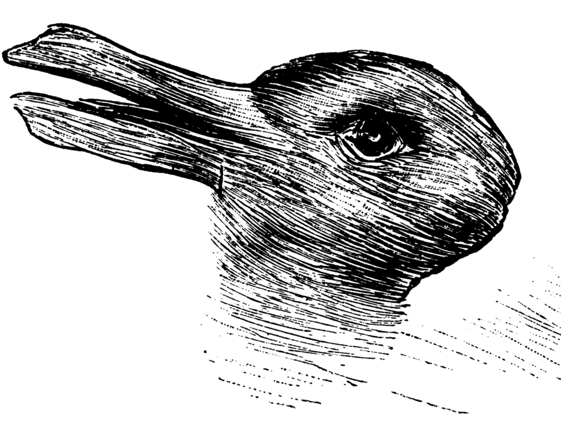
How clear is your message?
Notes:
Illustration notes:
Speaker notes:
No matter how clear we think we’re communicating, others can misinterpret our message. This is a famous example an an image from the late 1800 used to illustrate perception challenges (objectivity)

Slide 11
Receiver
NOT you
Their role
Cognitive biases
Notes:
Illustration notes:
Speaker notes:

