Slide 1


SCOPE OF WORK
Providing Turnkey Properties in
Memphis | Dallas | Houston | Little Rock | Oklahoma City | St. Louis | Tulsa

Slide 2


Contact Us!
Phone: 877-371-2625
Website: www.MemphisInvest.com
130 Timber Creek Dr.
Cordova,TN 38018

Slide 3
PROPERTY INFORMATION FOR:
4631 Priscilla Avenue, Memphis,TN 38128
Purchase Price $124,900.00
Number of Bedrooms 3 Number of Bathrooms 2 Car Storage 2CA Estimated Rent Range
$895-$995
Estimated Annual Property Taxes
$1,418.81
Estimated Annual
Homeowners Insurance $505.93 Estimated Annual HOA Dues $0.00 Estimated Annual
Management Fee (10%) $1,442.75 Year Built 1960
Square Footage 1,606
Total Renovation Cost $33,500

Slide 4
4631 Priscilla Avenue, Memphis,TN 38128 Rob Robertson & Carlos Taylor

Slide 5
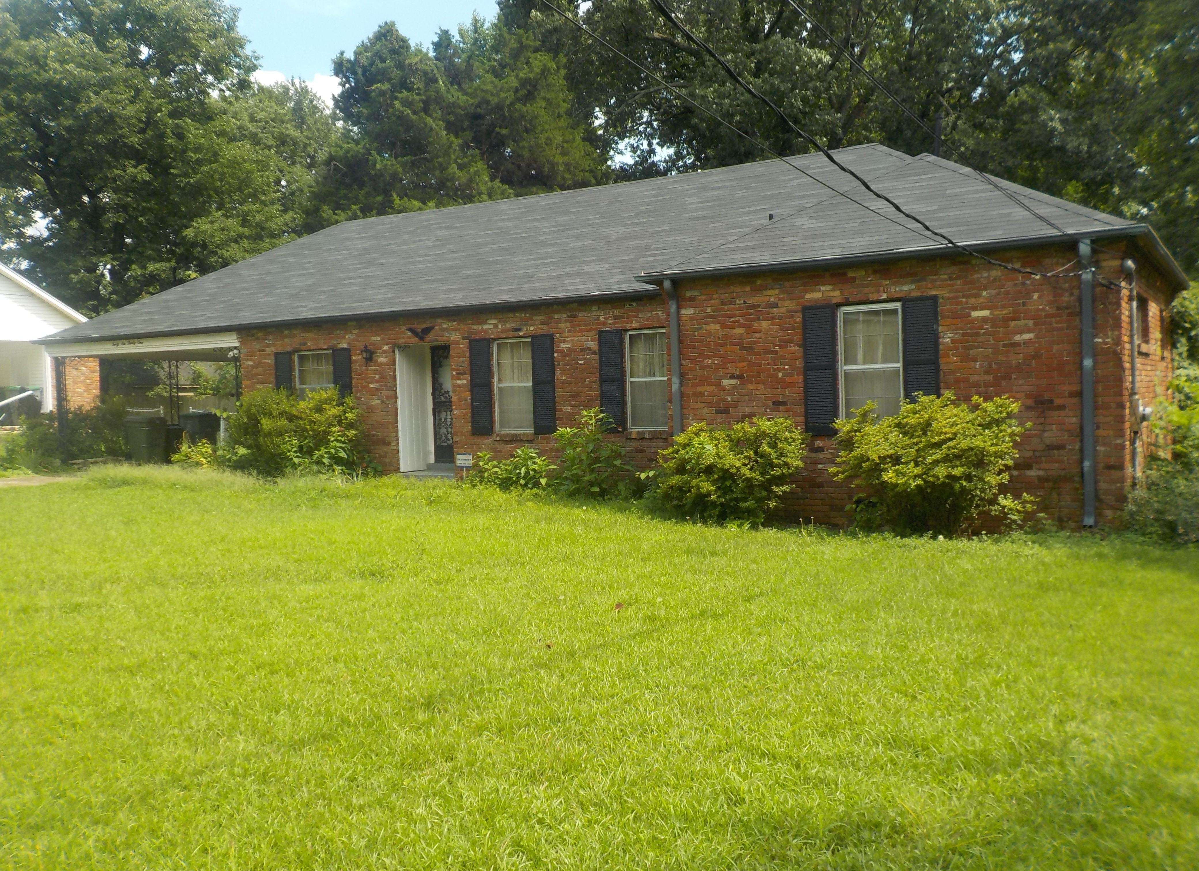
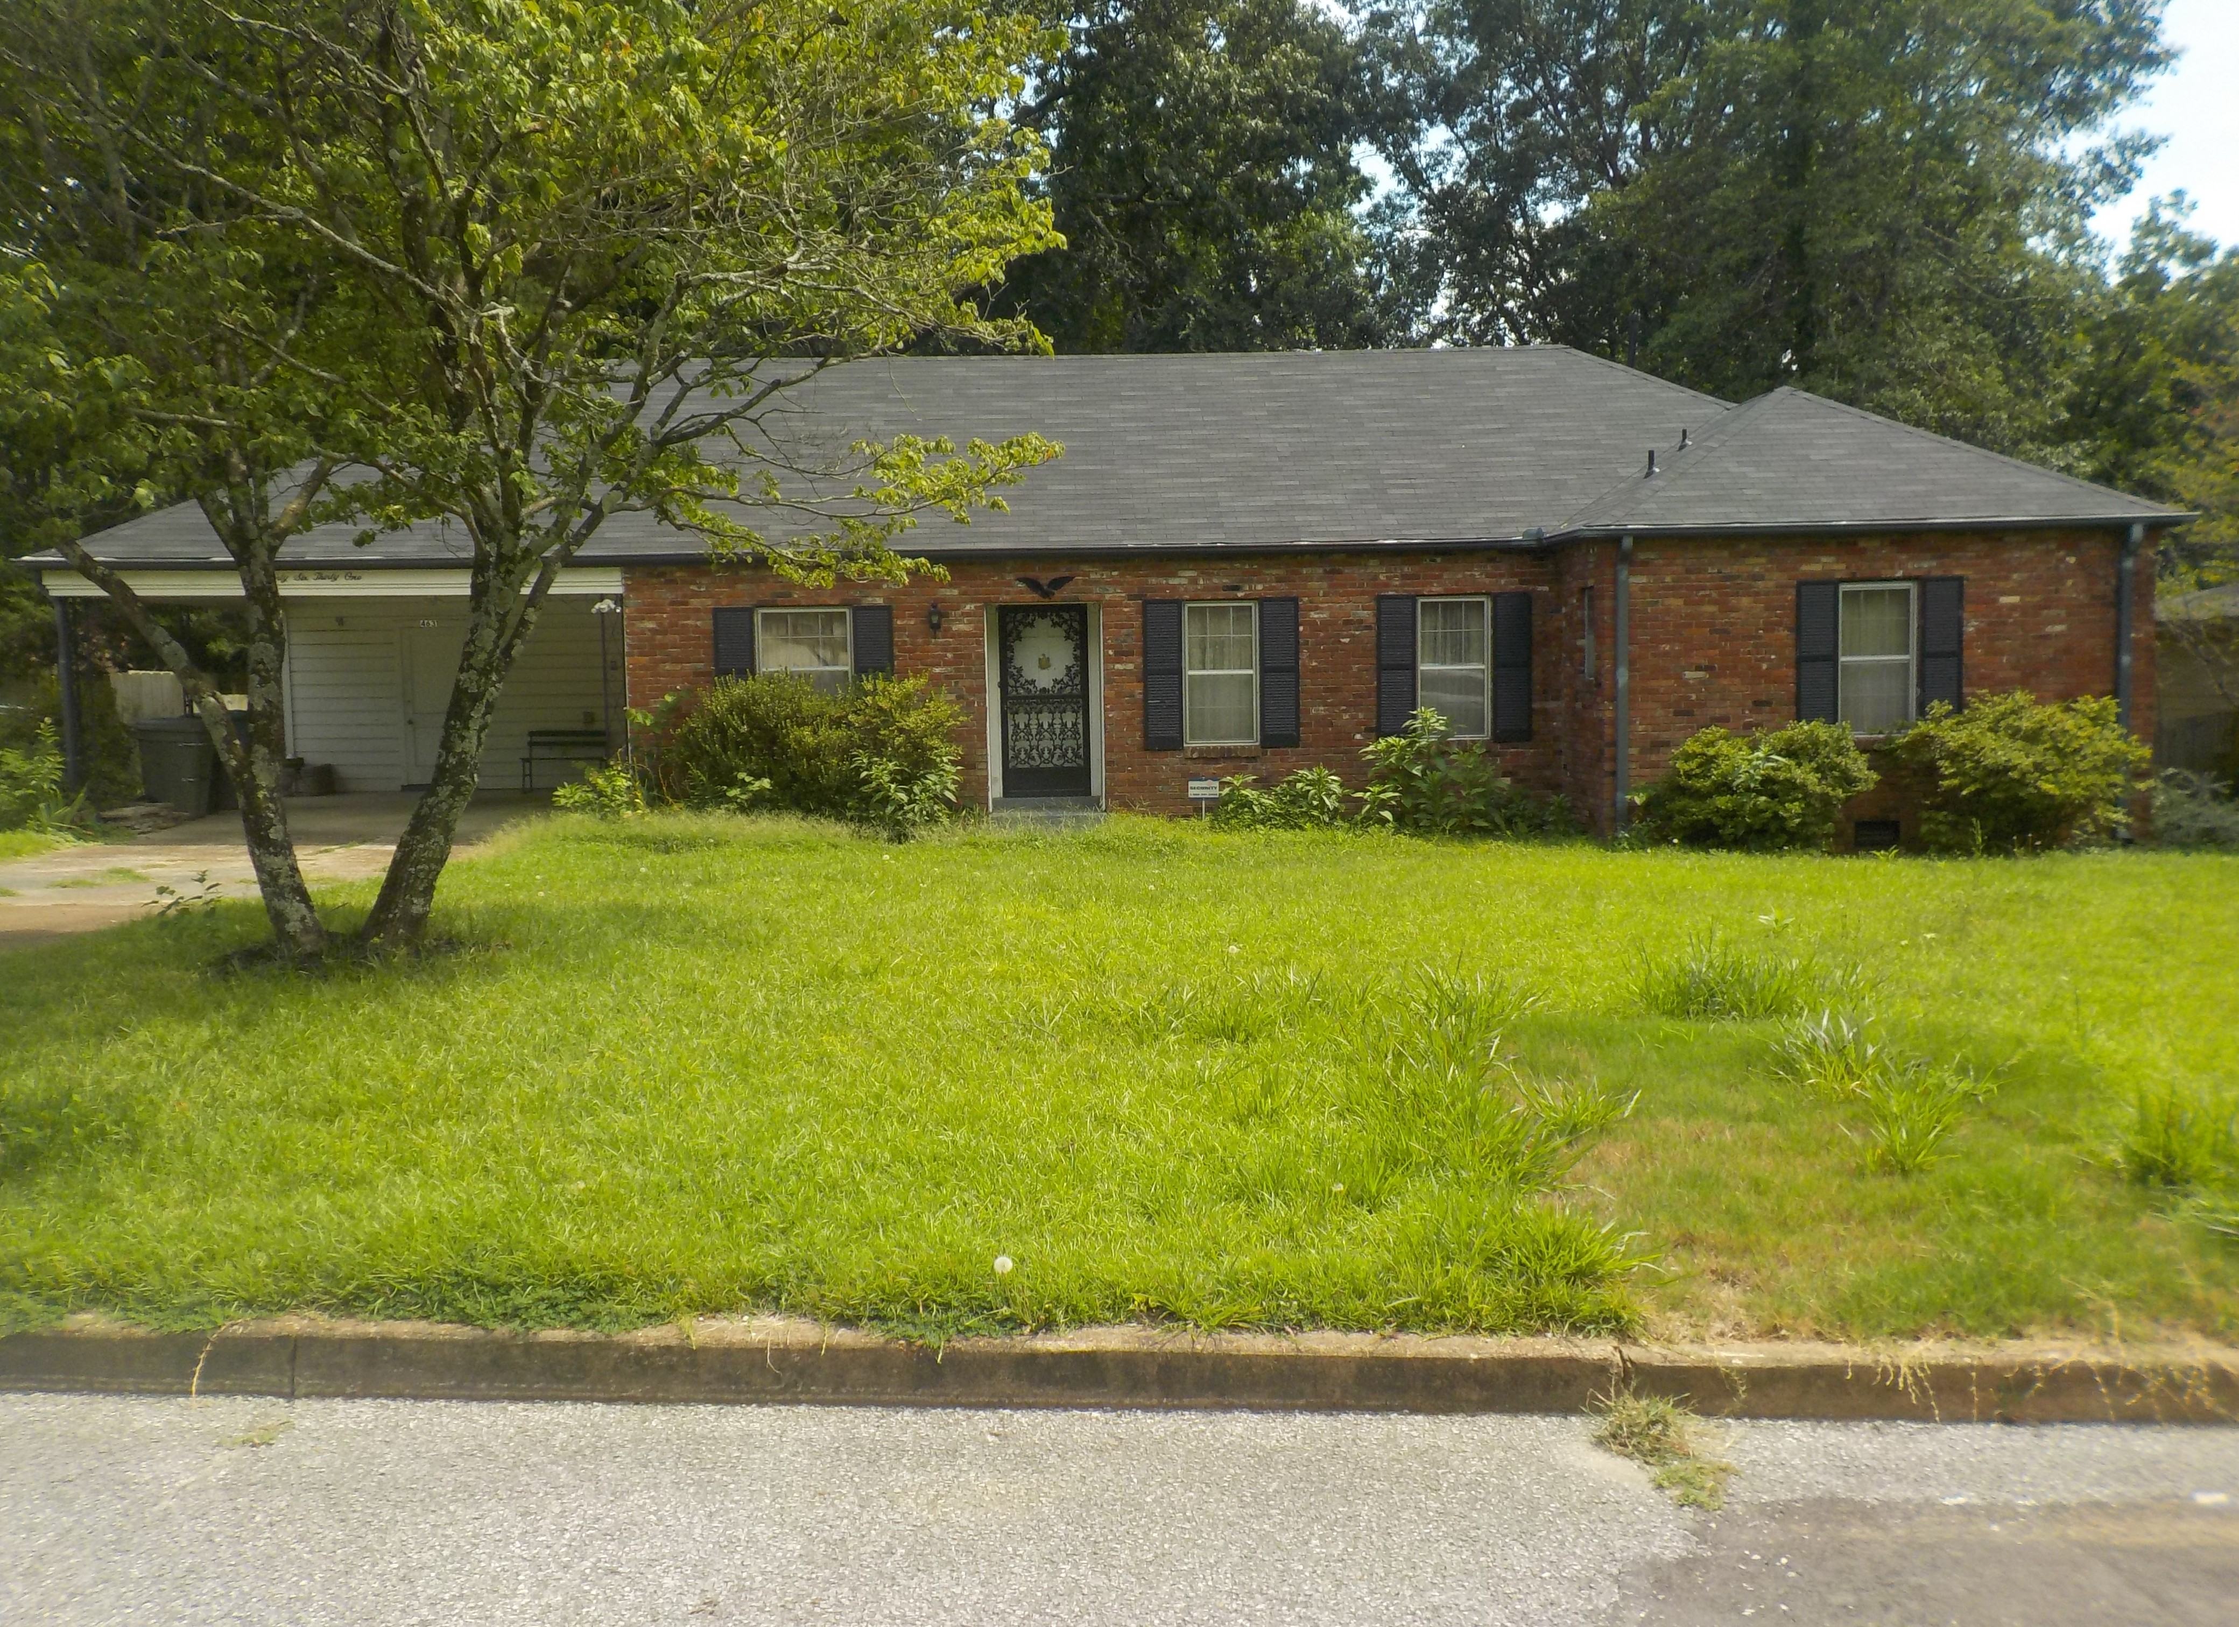
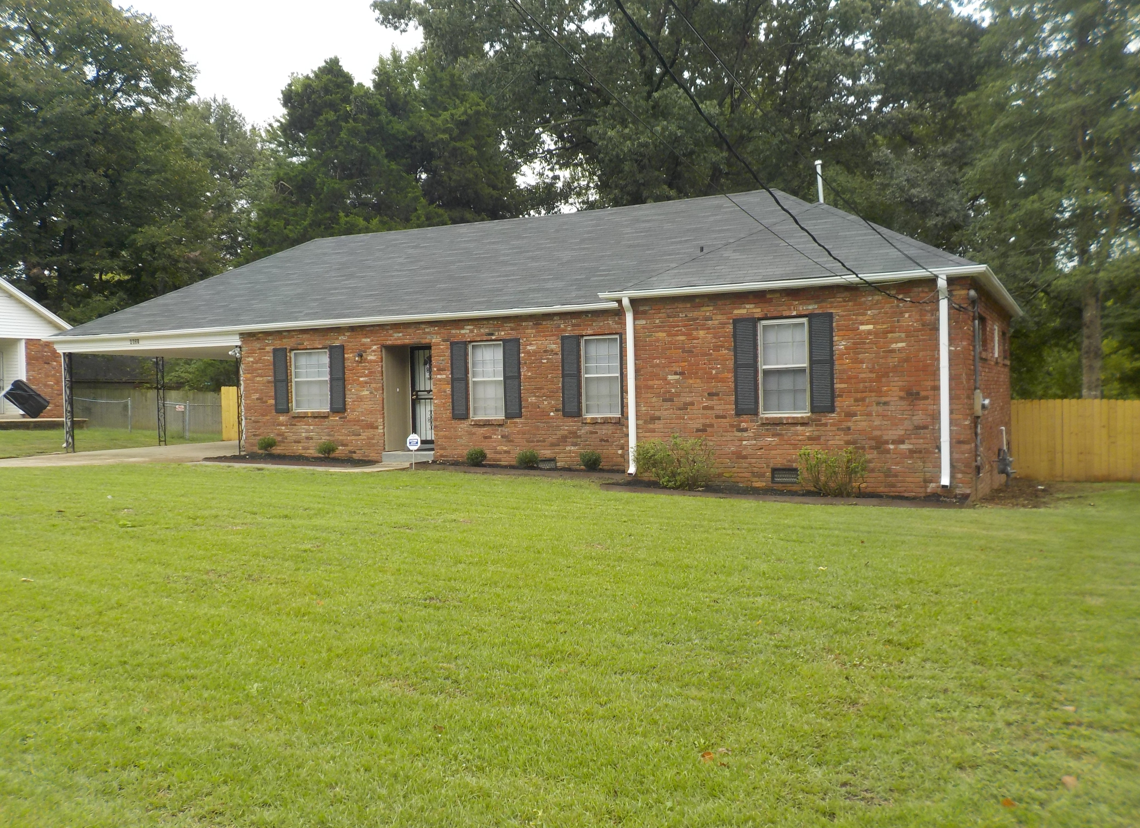
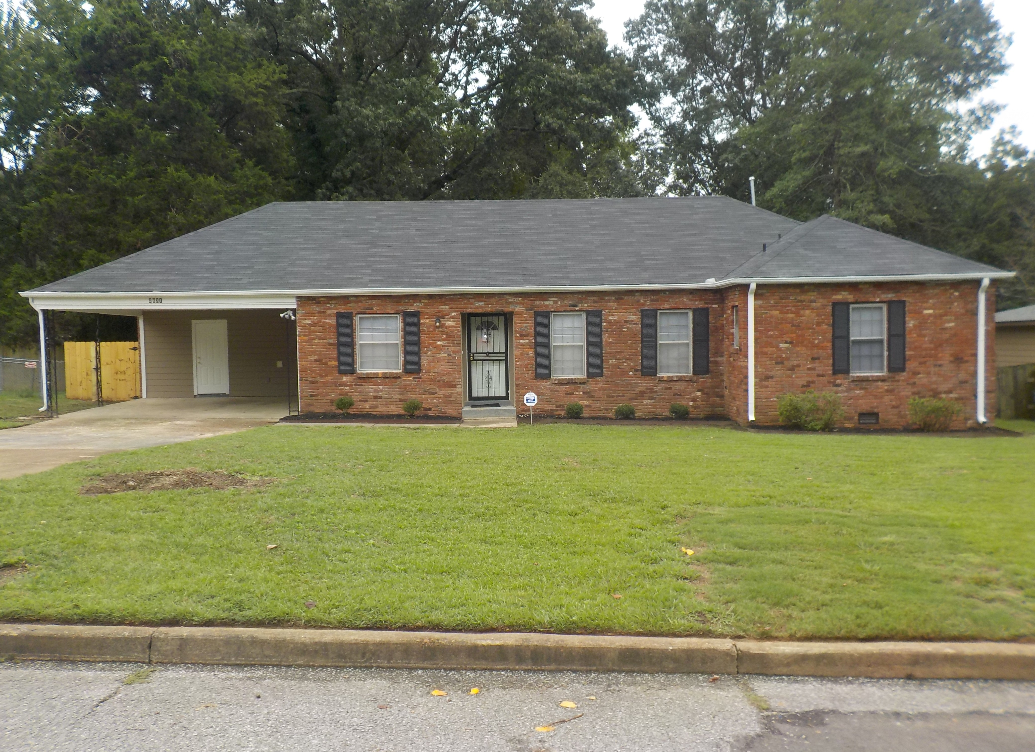
BEFORE BEFORE
AFTER
AFTER
Page Exterior of Home

Slide 6
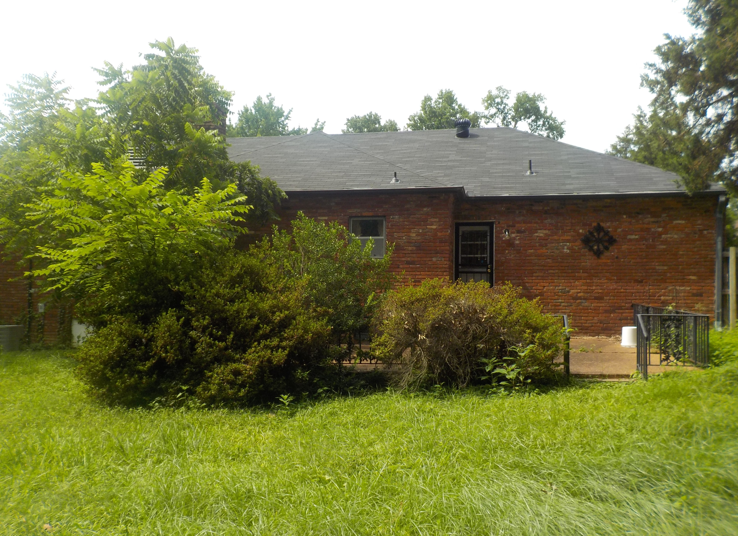
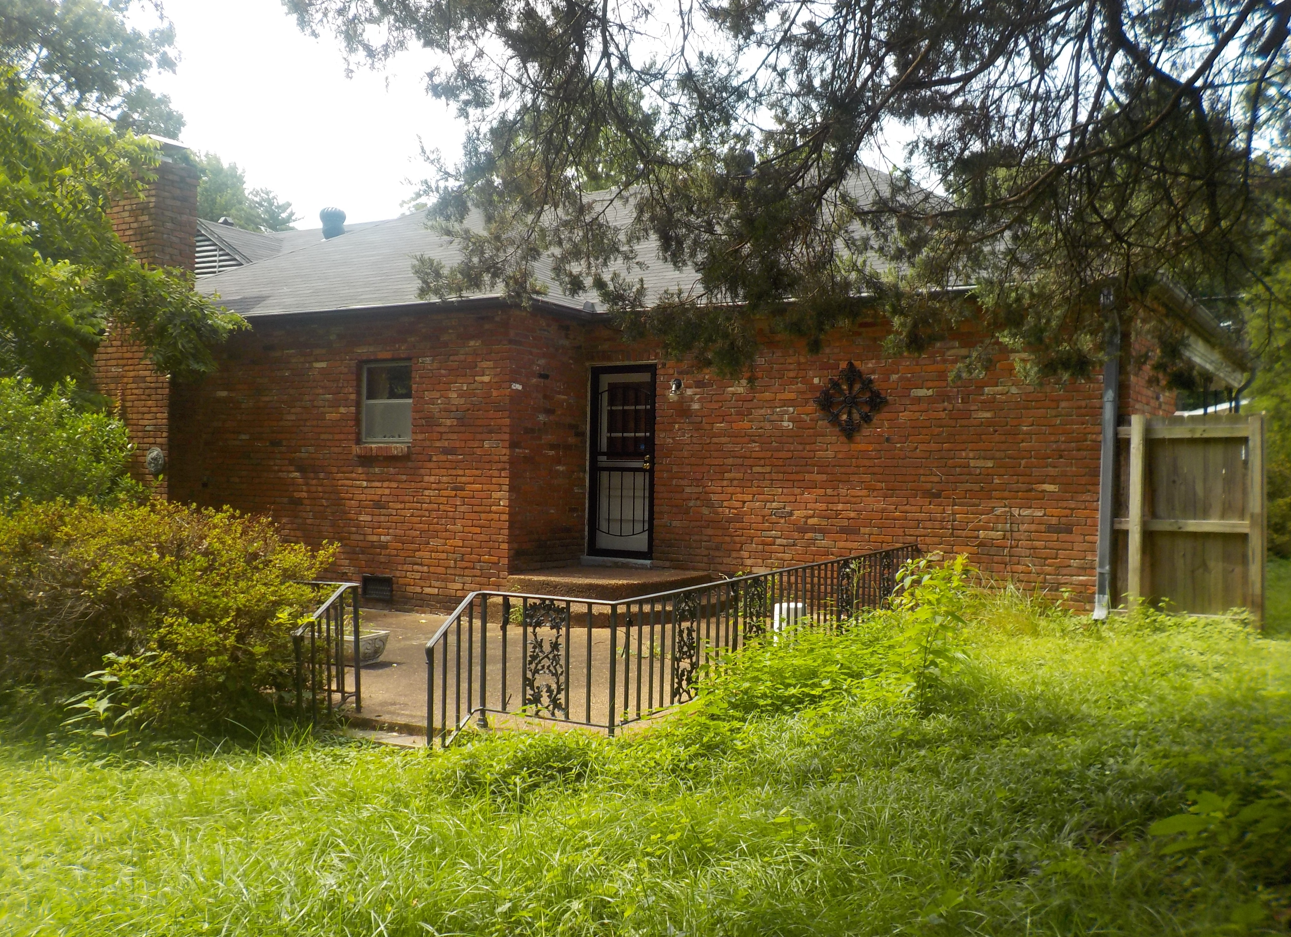
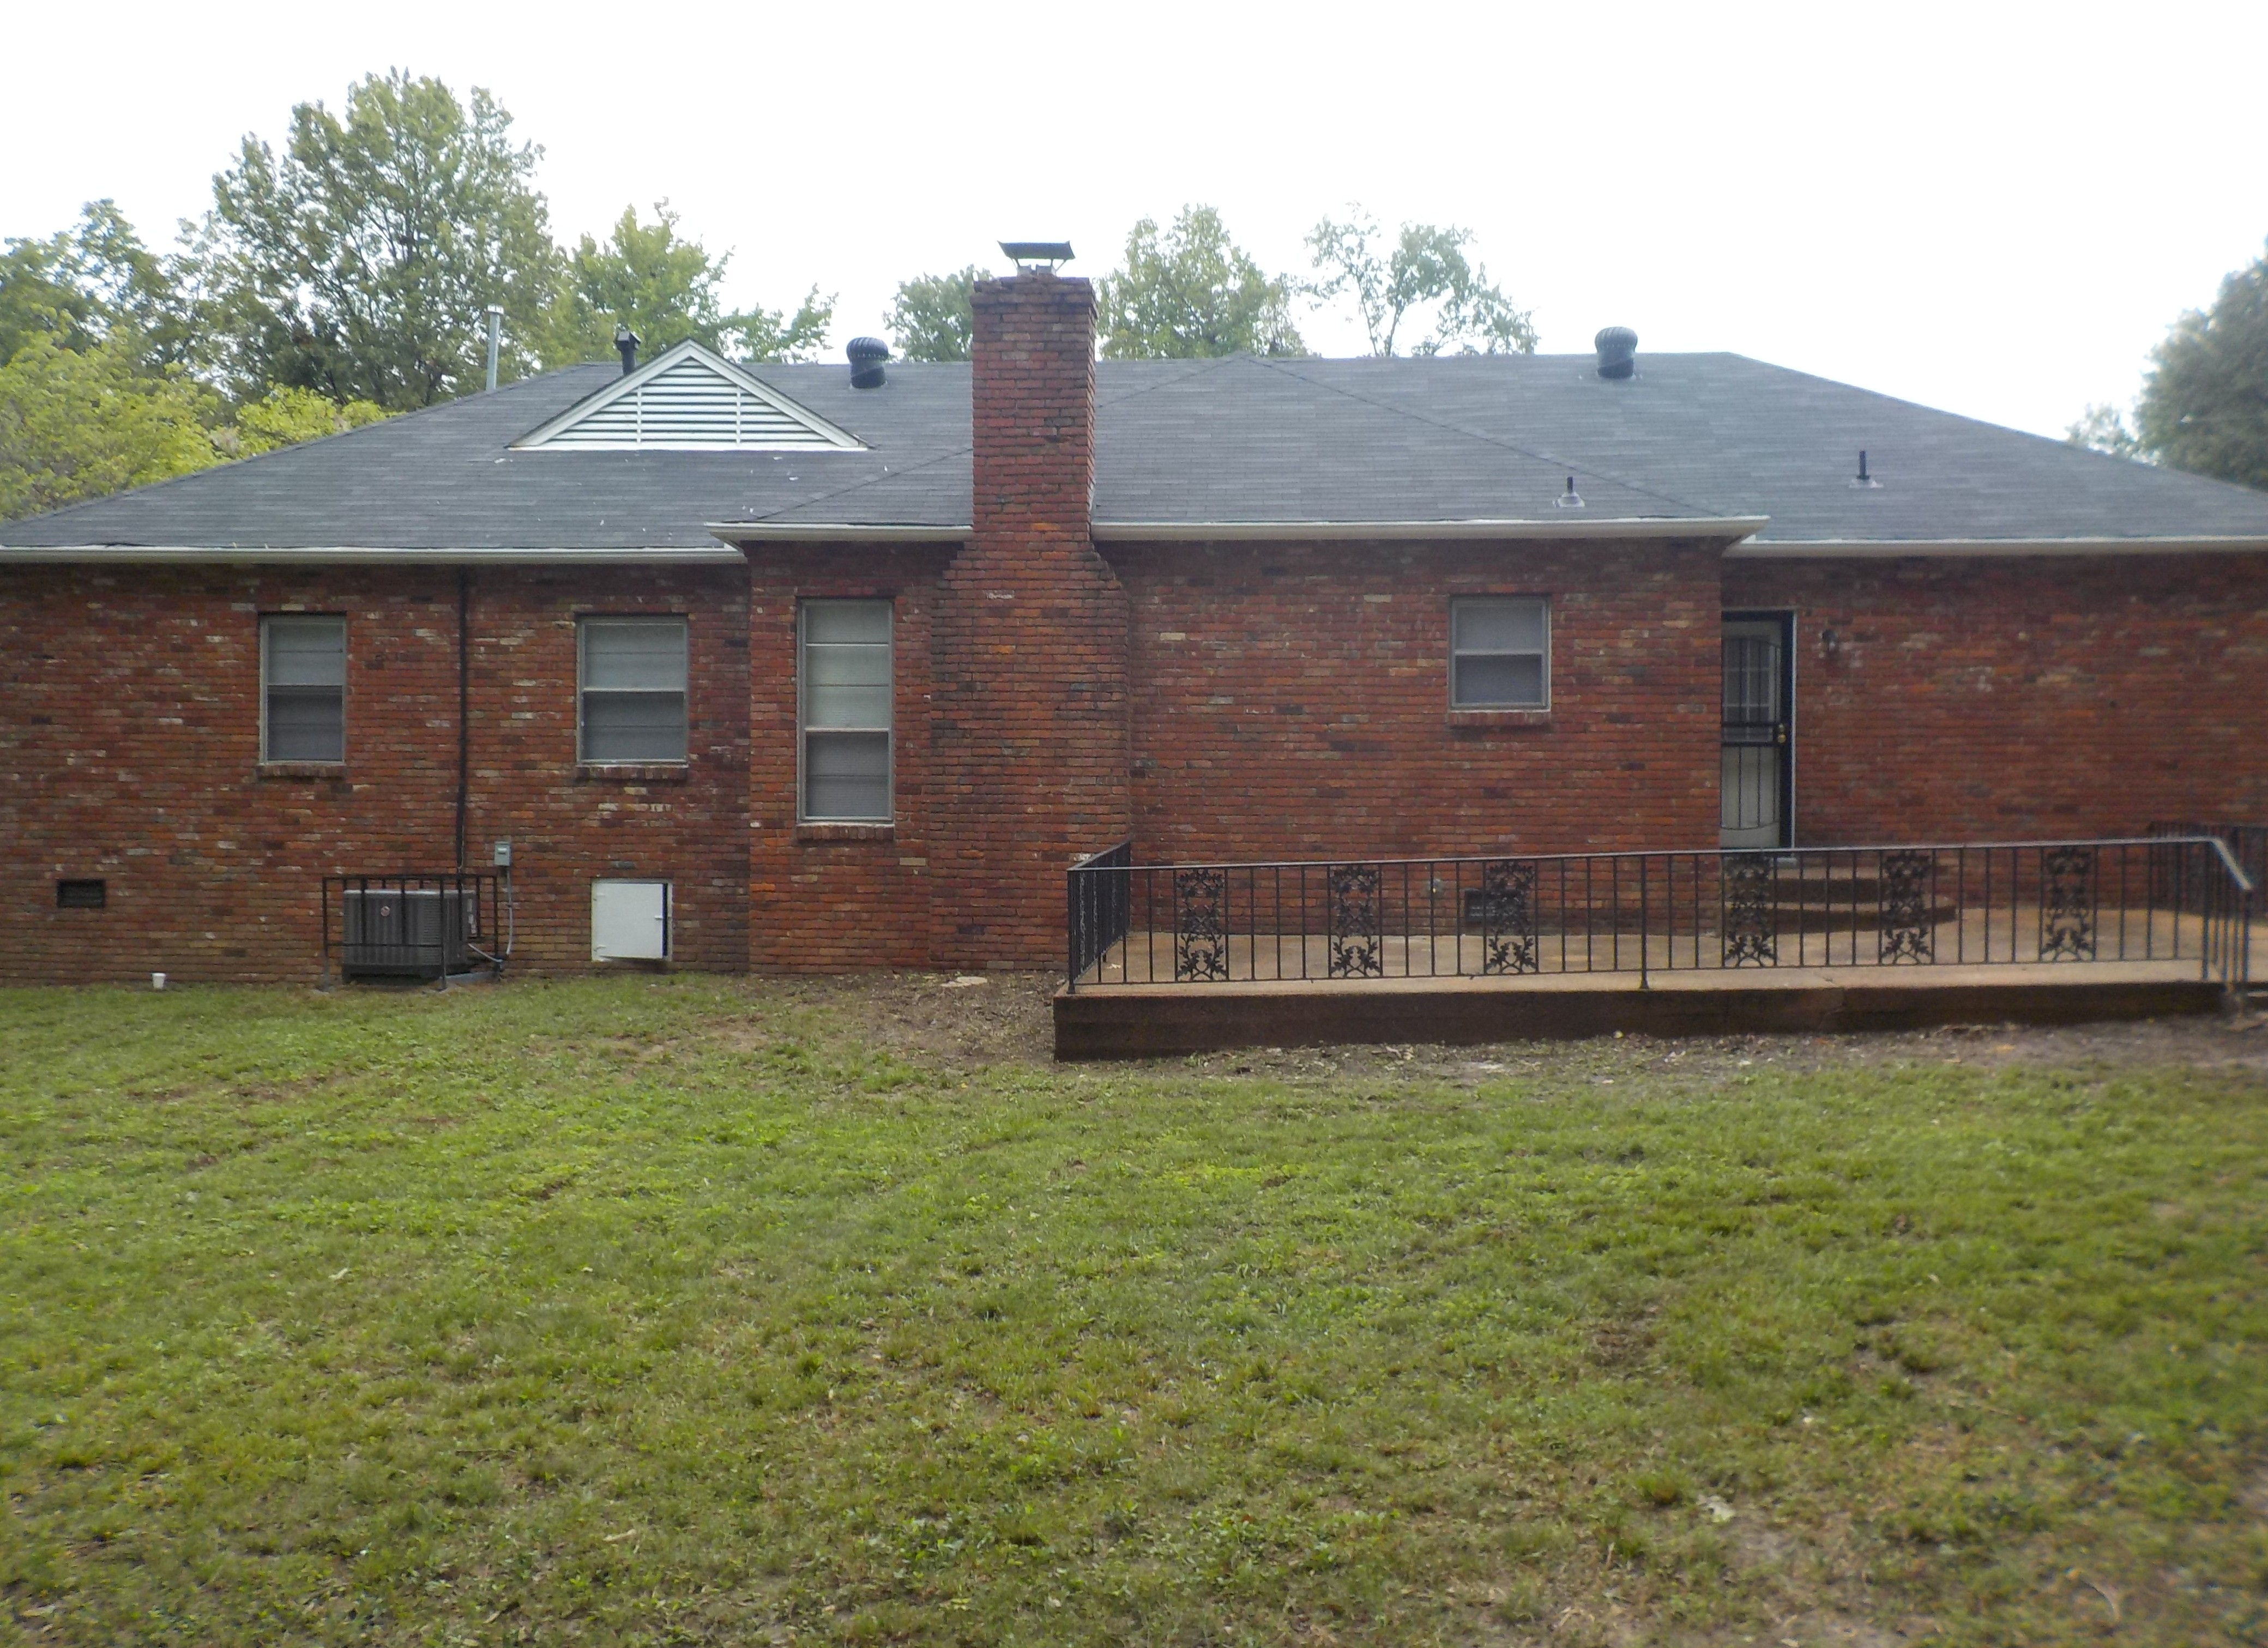
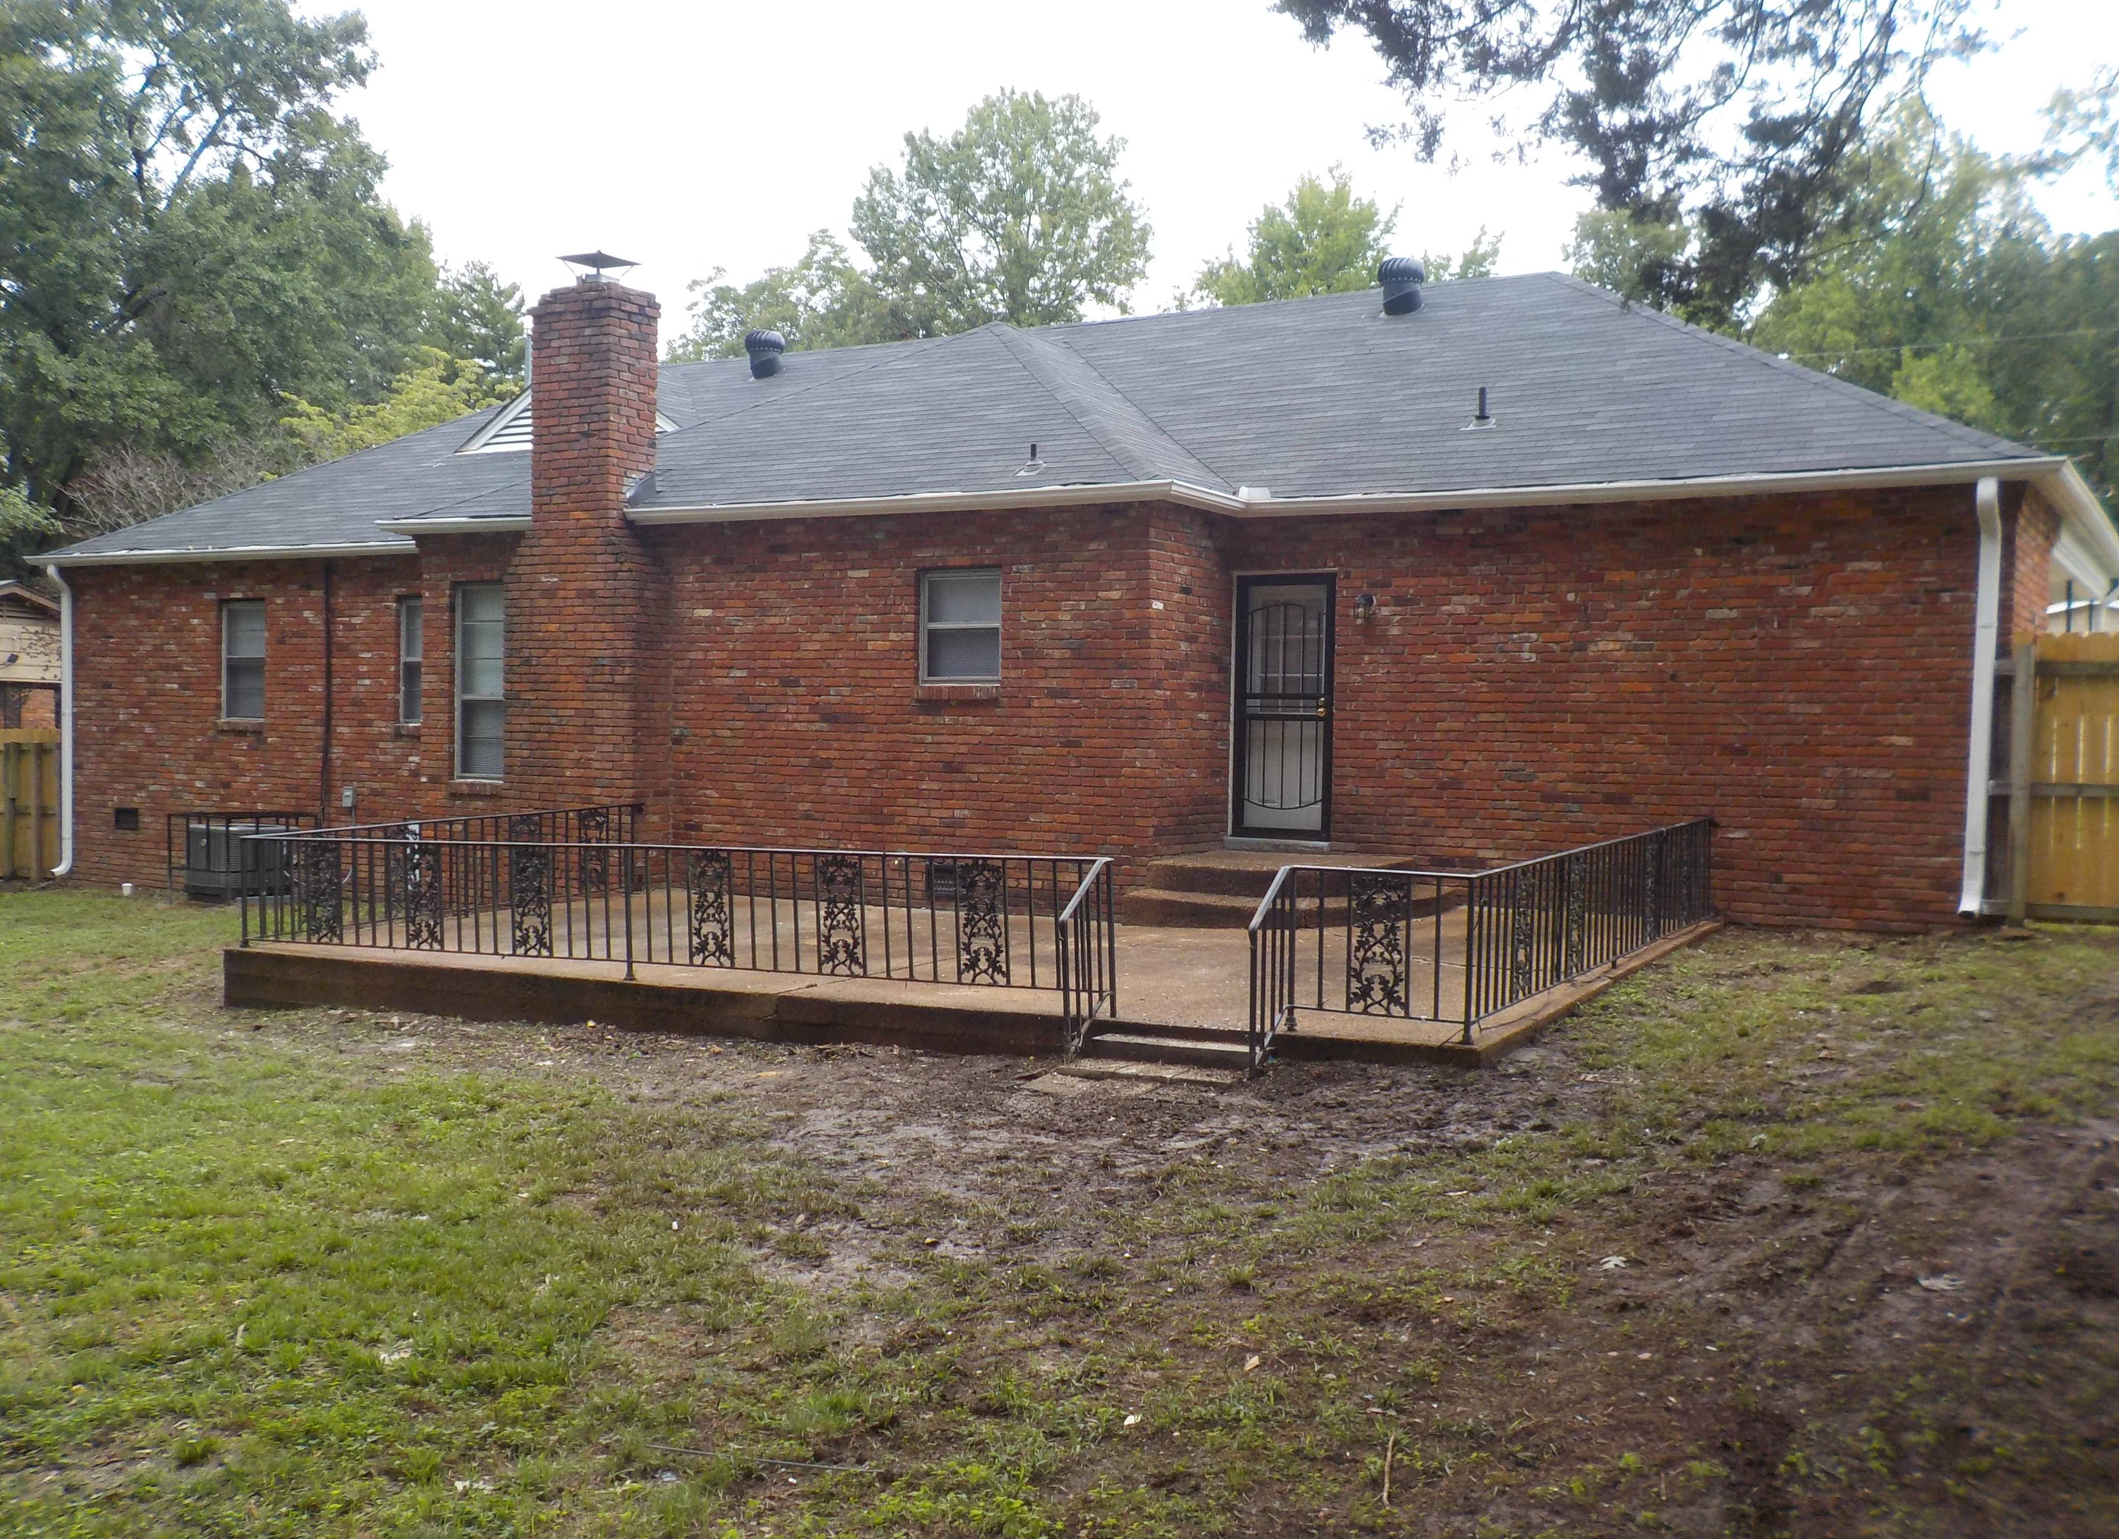
BEFORE BEFORE
AFTER
AFTER
Page Exterior of Home

Slide 7
Work Performed On The Home’s Exterior:
pressure wash
new mailbox and new stand
new address numbers
paint trim
paint siding
paint doors
paint security or storm doors
paint metal railings
repair concrete around foundation
paint foundation around perimeter of house
clean out gutters
repair gutters around house as needed
new light fixture in front
new light fixture in back
new light fixture in carport
replace all damaged/rotten wood/trim/ siding around house
new fence front right
new fence front left
new fence down left side of yard
new fence across back yard
new fence and gate front left
new double sided gate latch
repair fence around yard
replace any missing/broken tension pumps on storm/security doors
new storage room door
clean out storage room
repair and paint inside storage room
remove satellite dish, wires, and bracket
replace any missing/torn/damaged window screens
remove all stickers from all windows

Slide 8
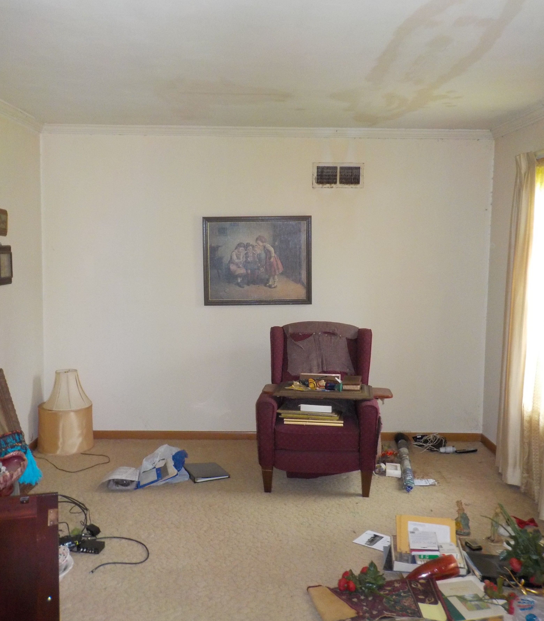
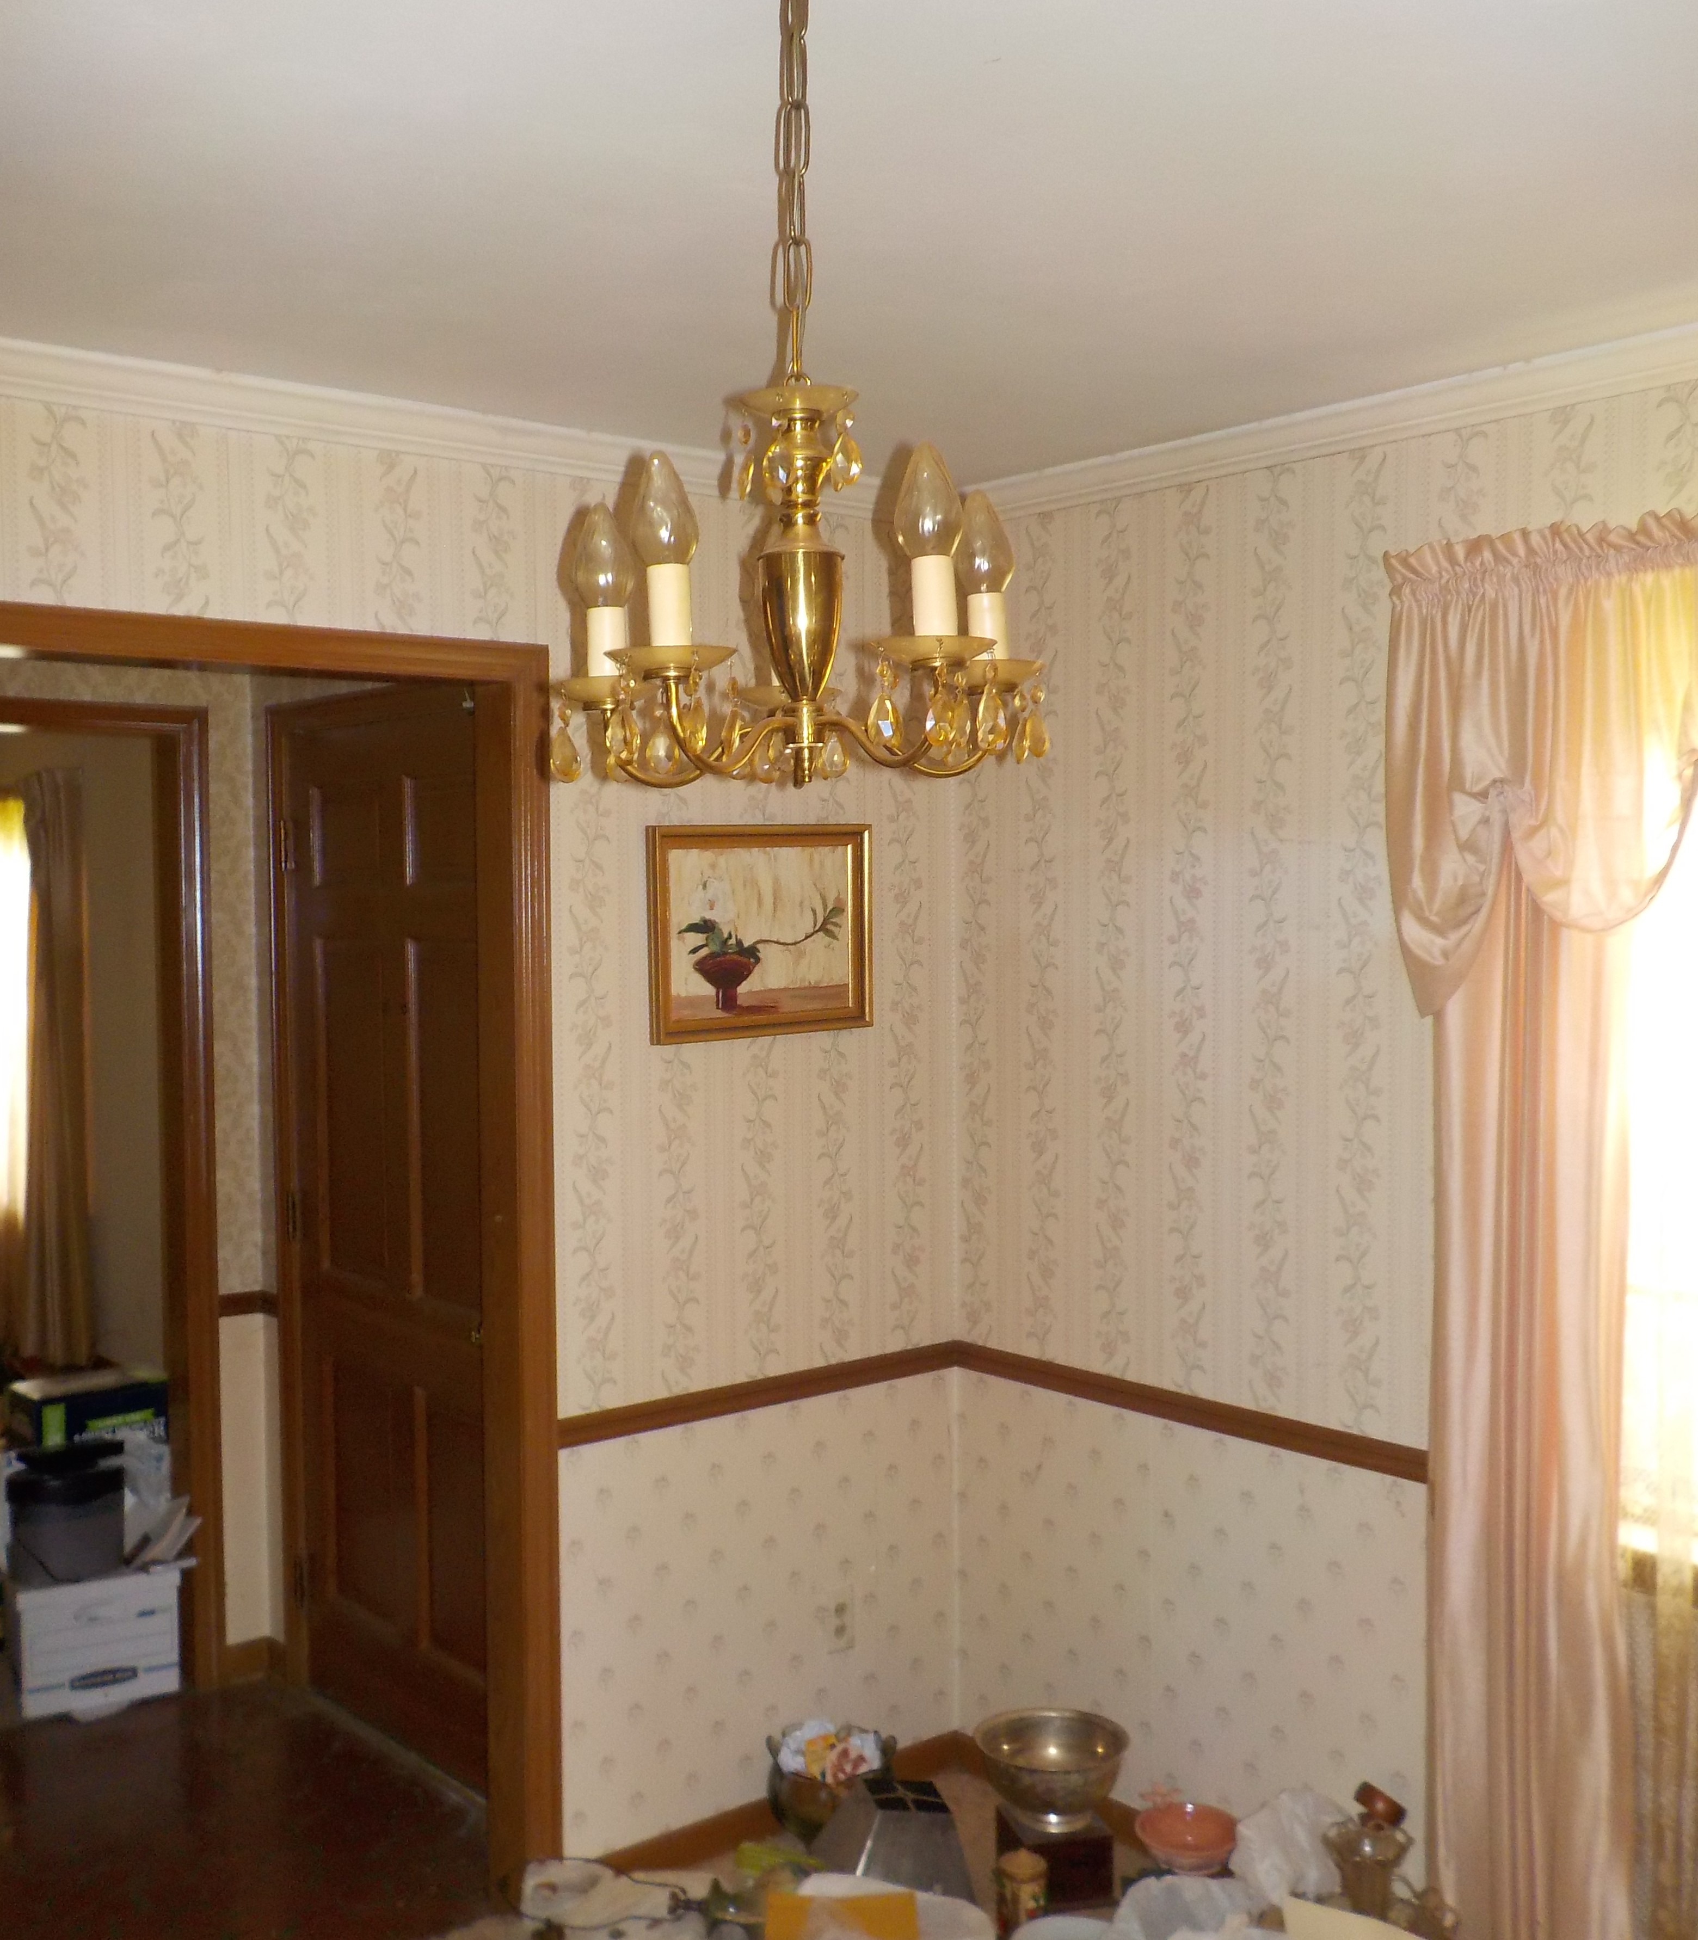
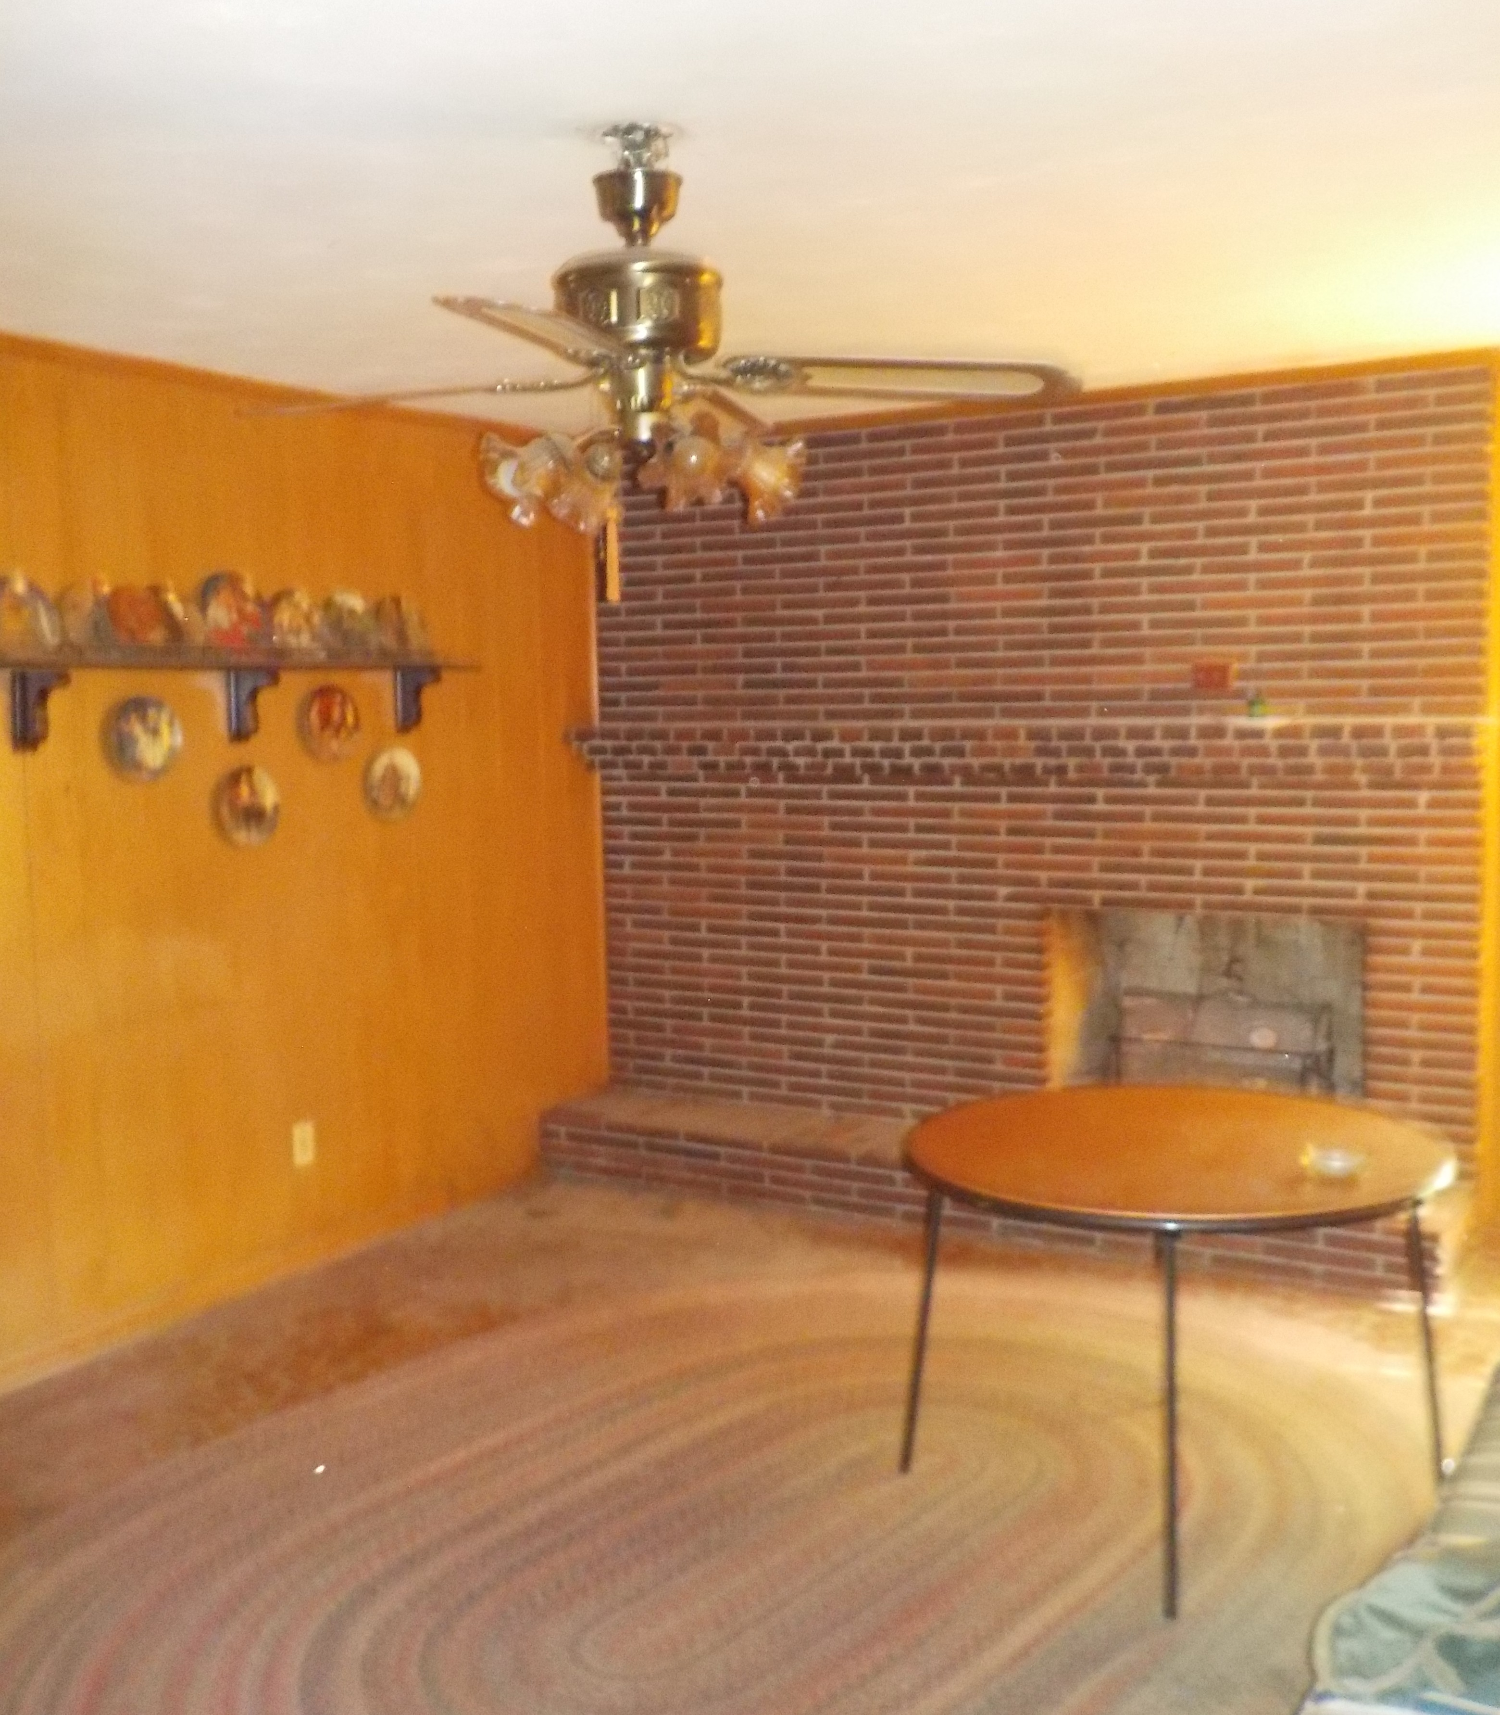
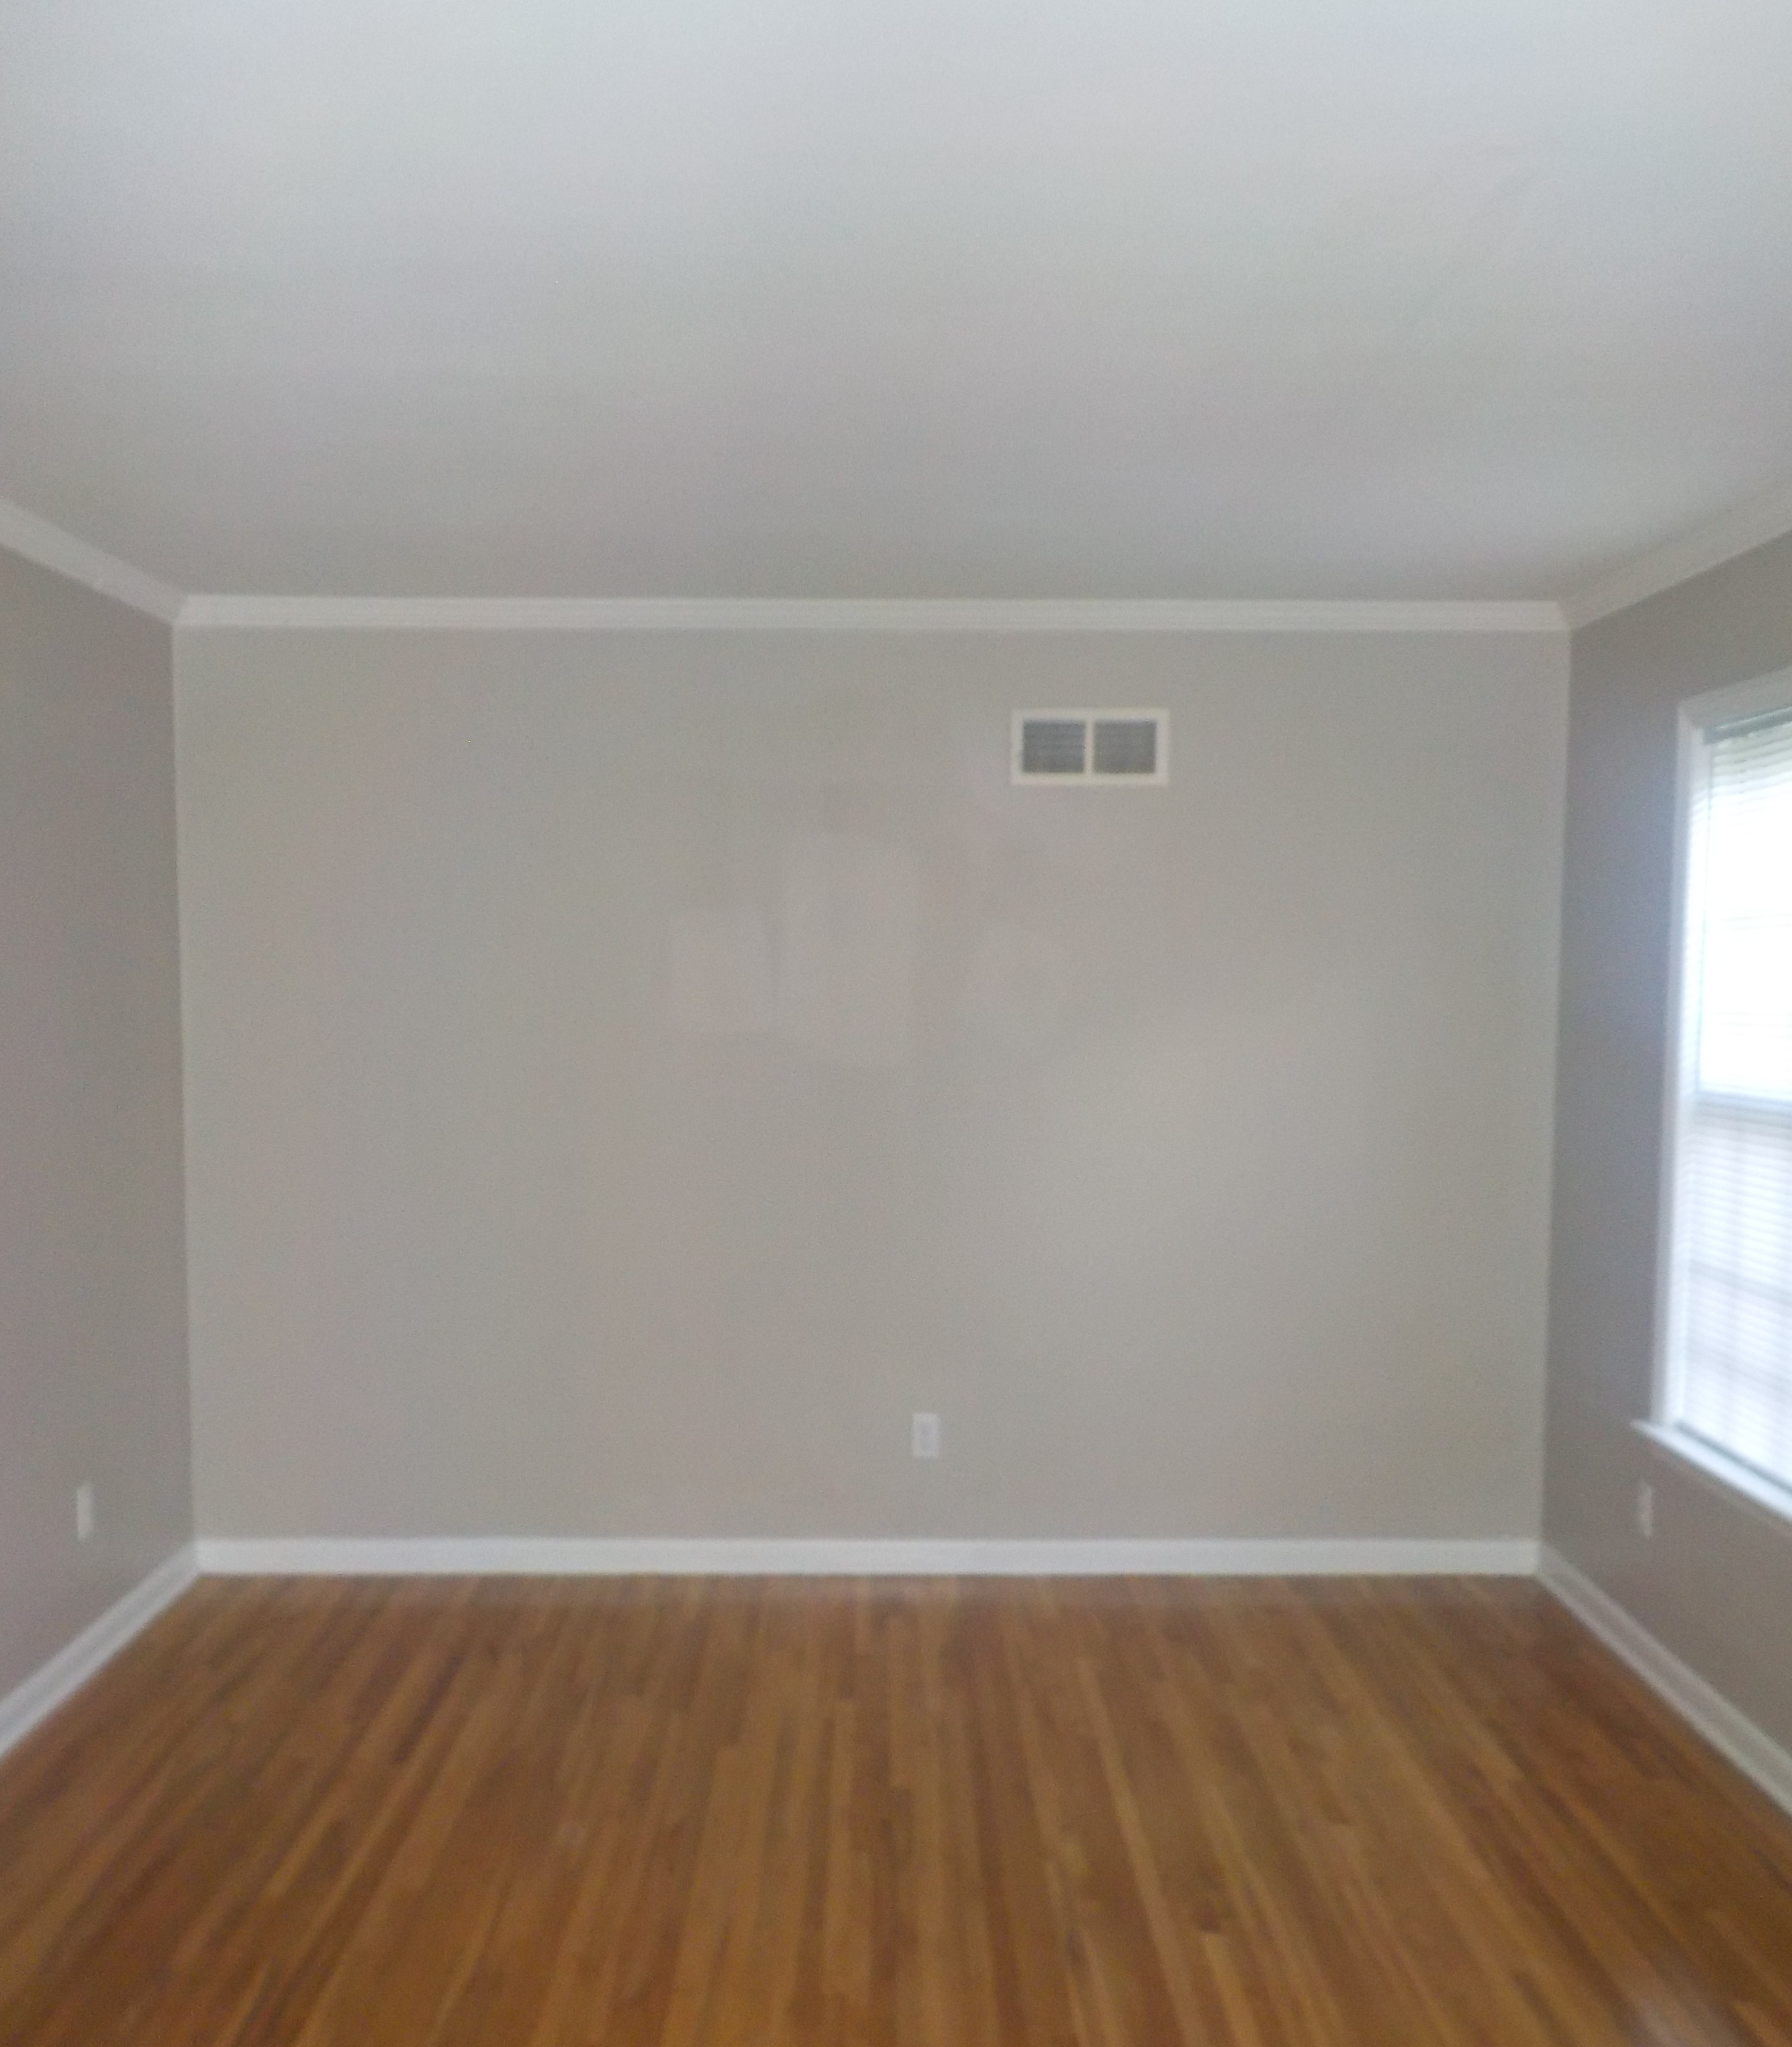
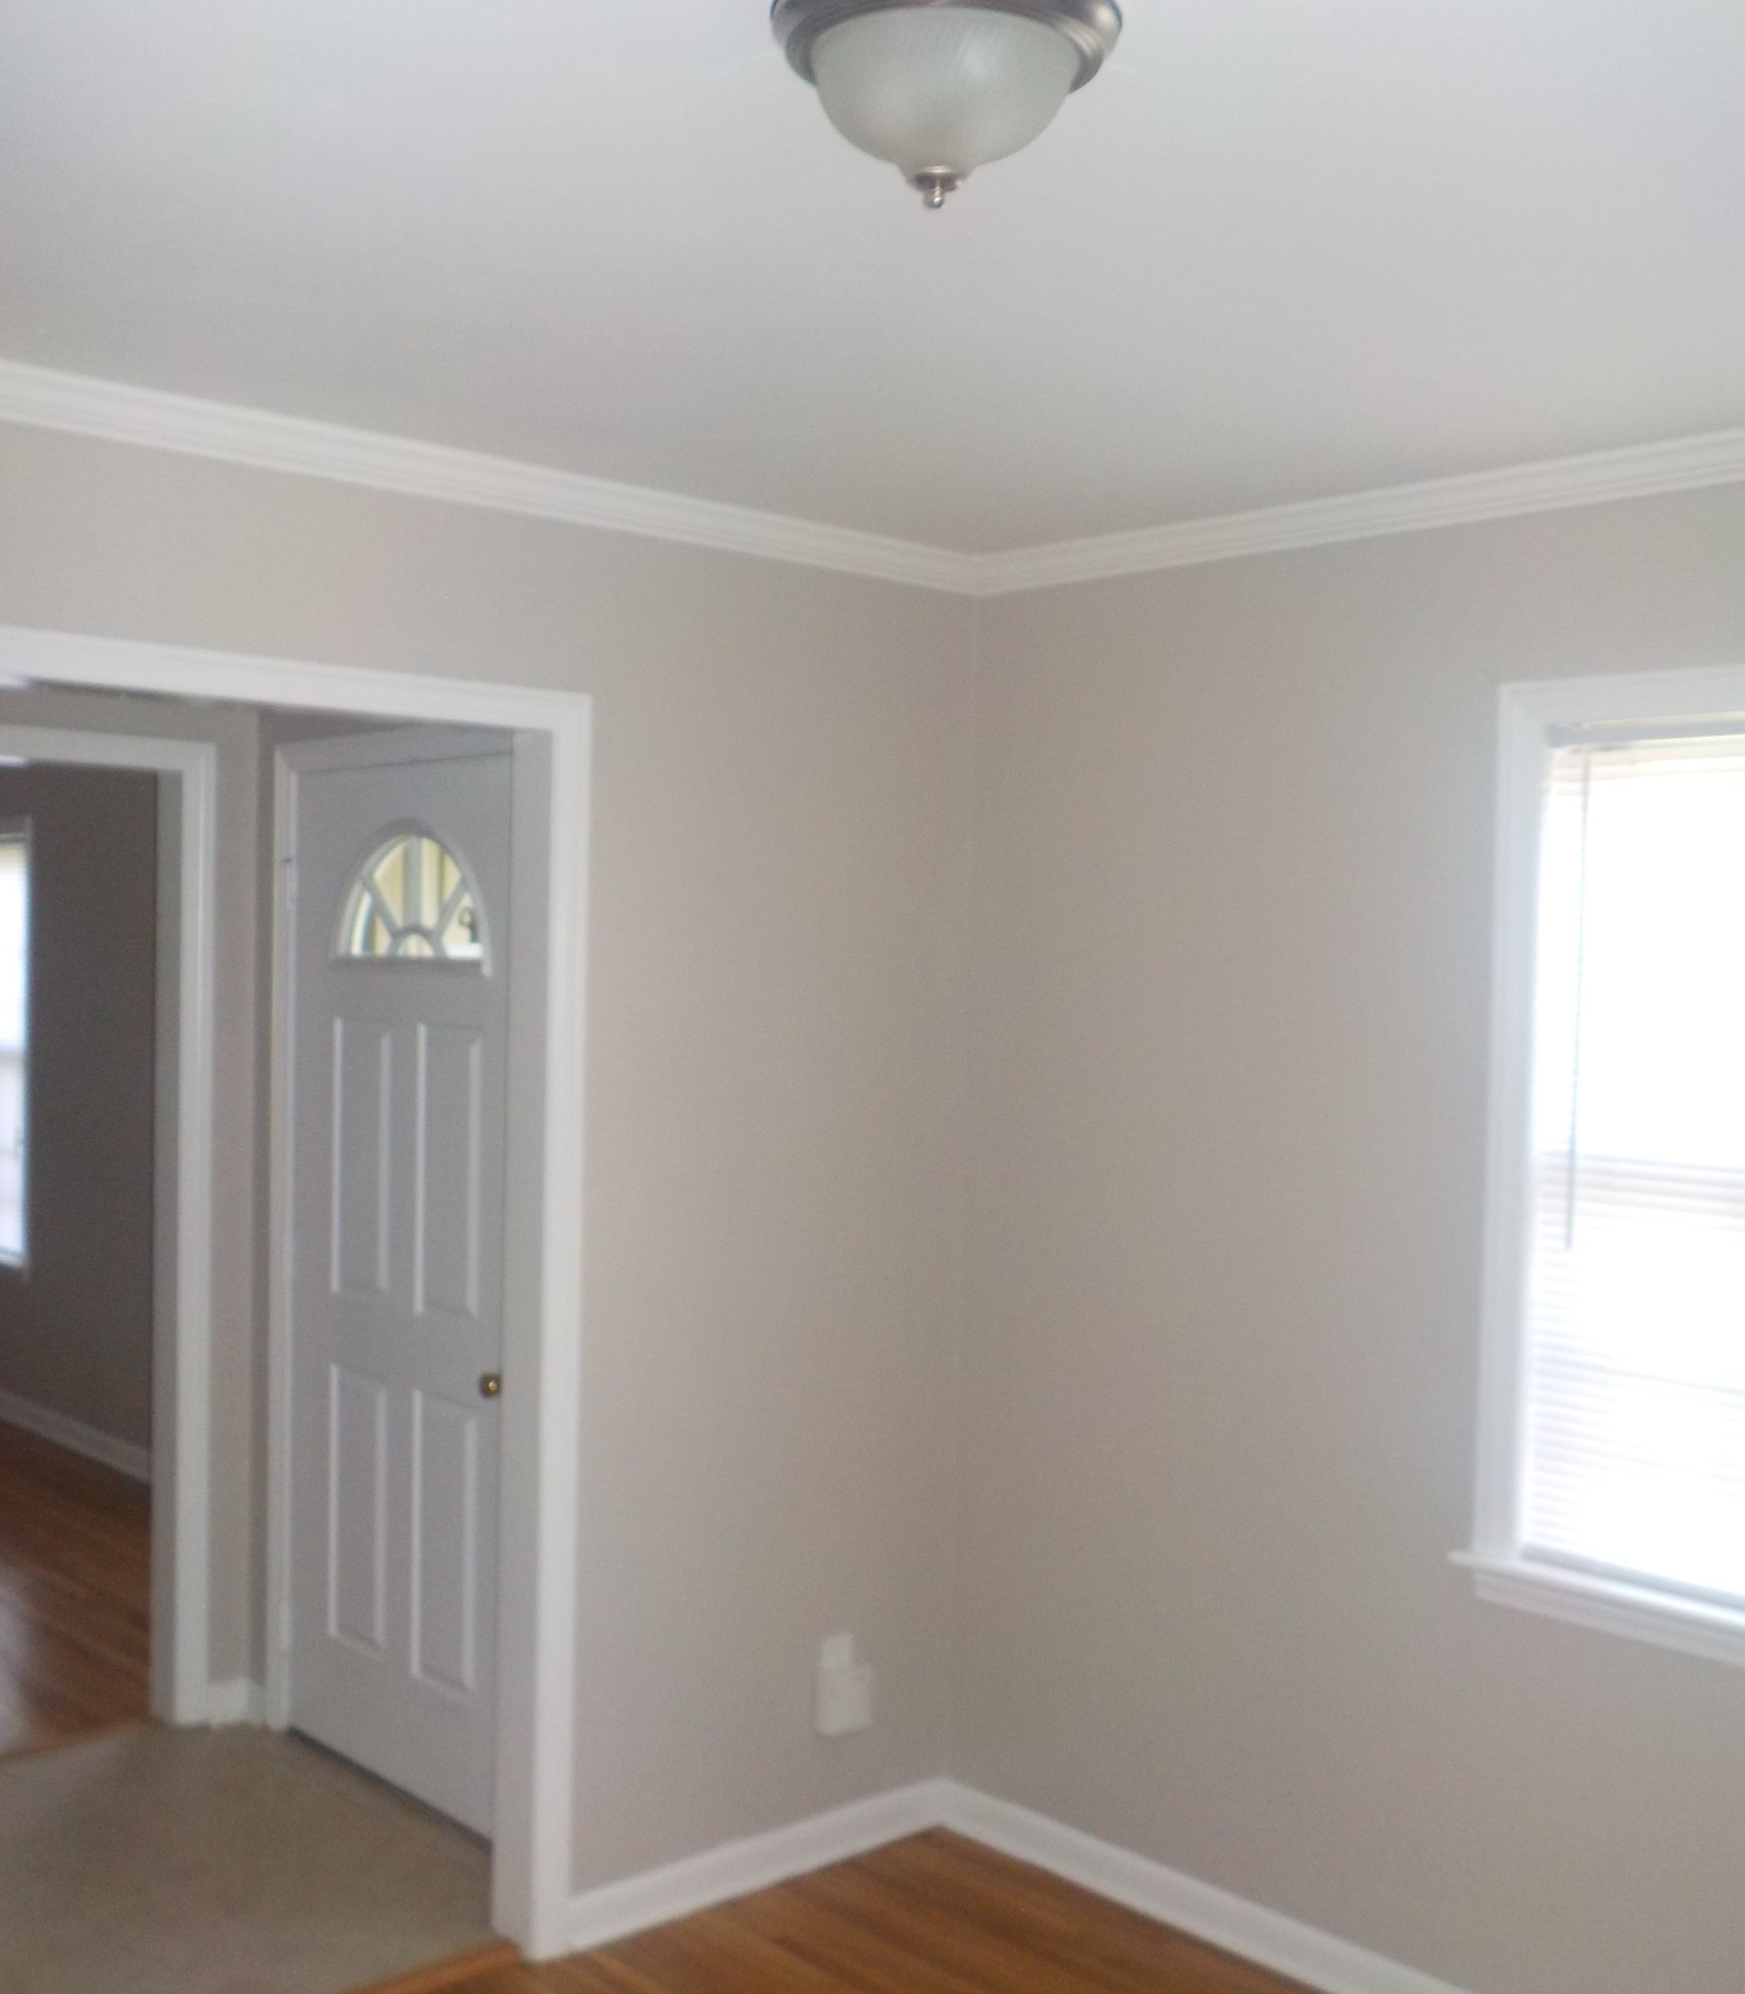
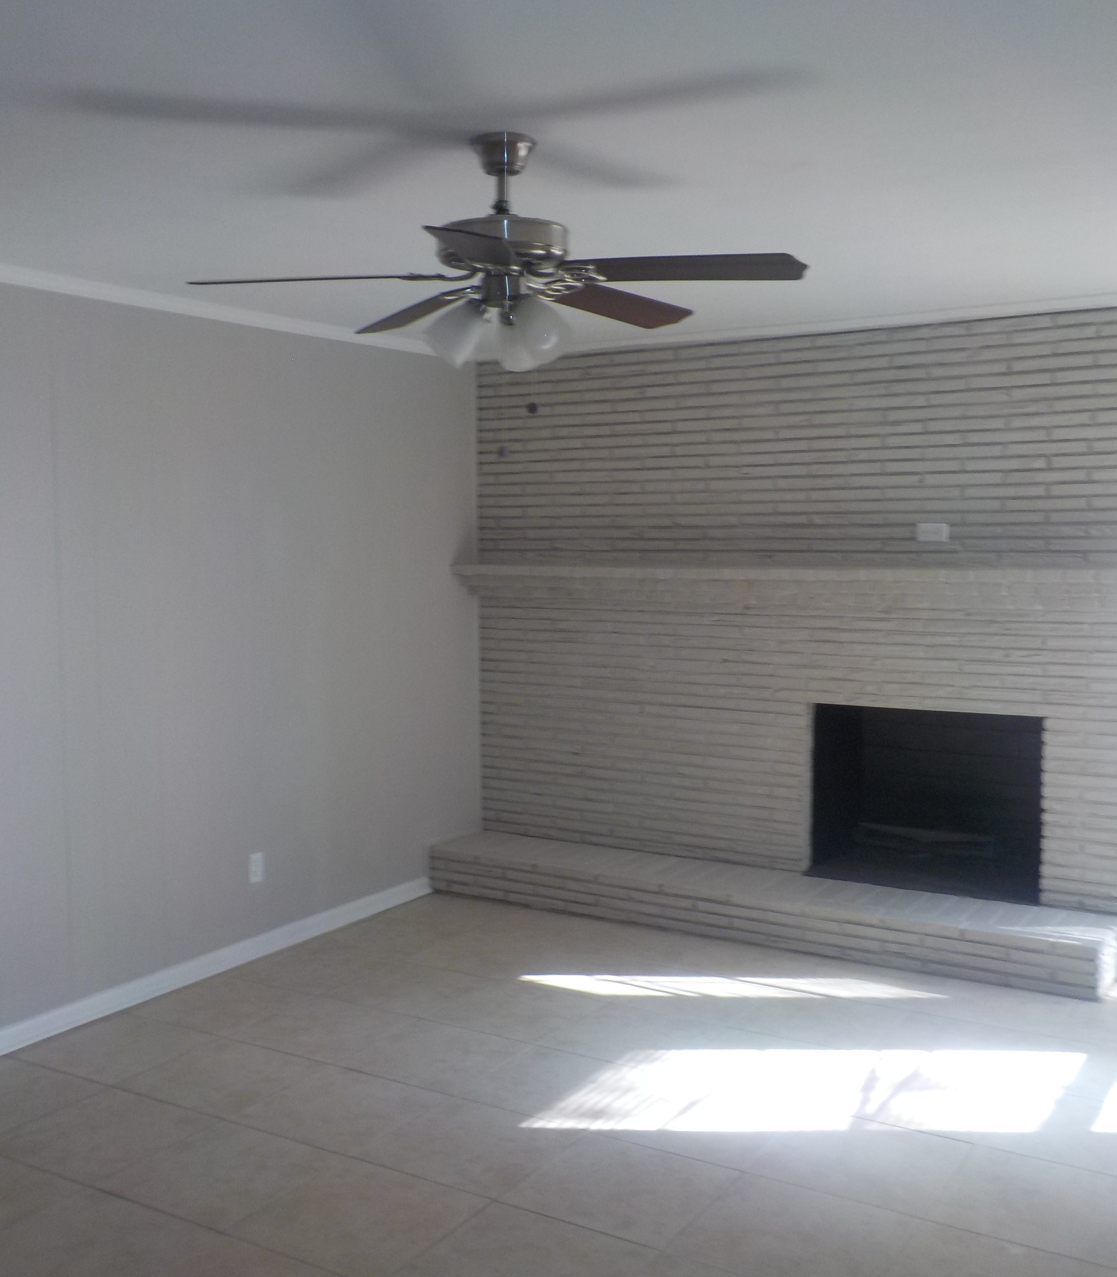
BEFORE BEFORE BEFORE
AFTER
AFTER
AFTER Page Interior of Home

Slide 9
Work Performed On The Home’s Interior:
paint all walls
paint trim and doors
paint ceilings and closets
install new blinds throughout
install new doorstops throughout
install new doorknobs throughout
replace broken light switch and outlet covers
replace missing/broken light bulbs
install new smoke detectors
install new fire extinguisher
remove all trash from attic

Slide 10
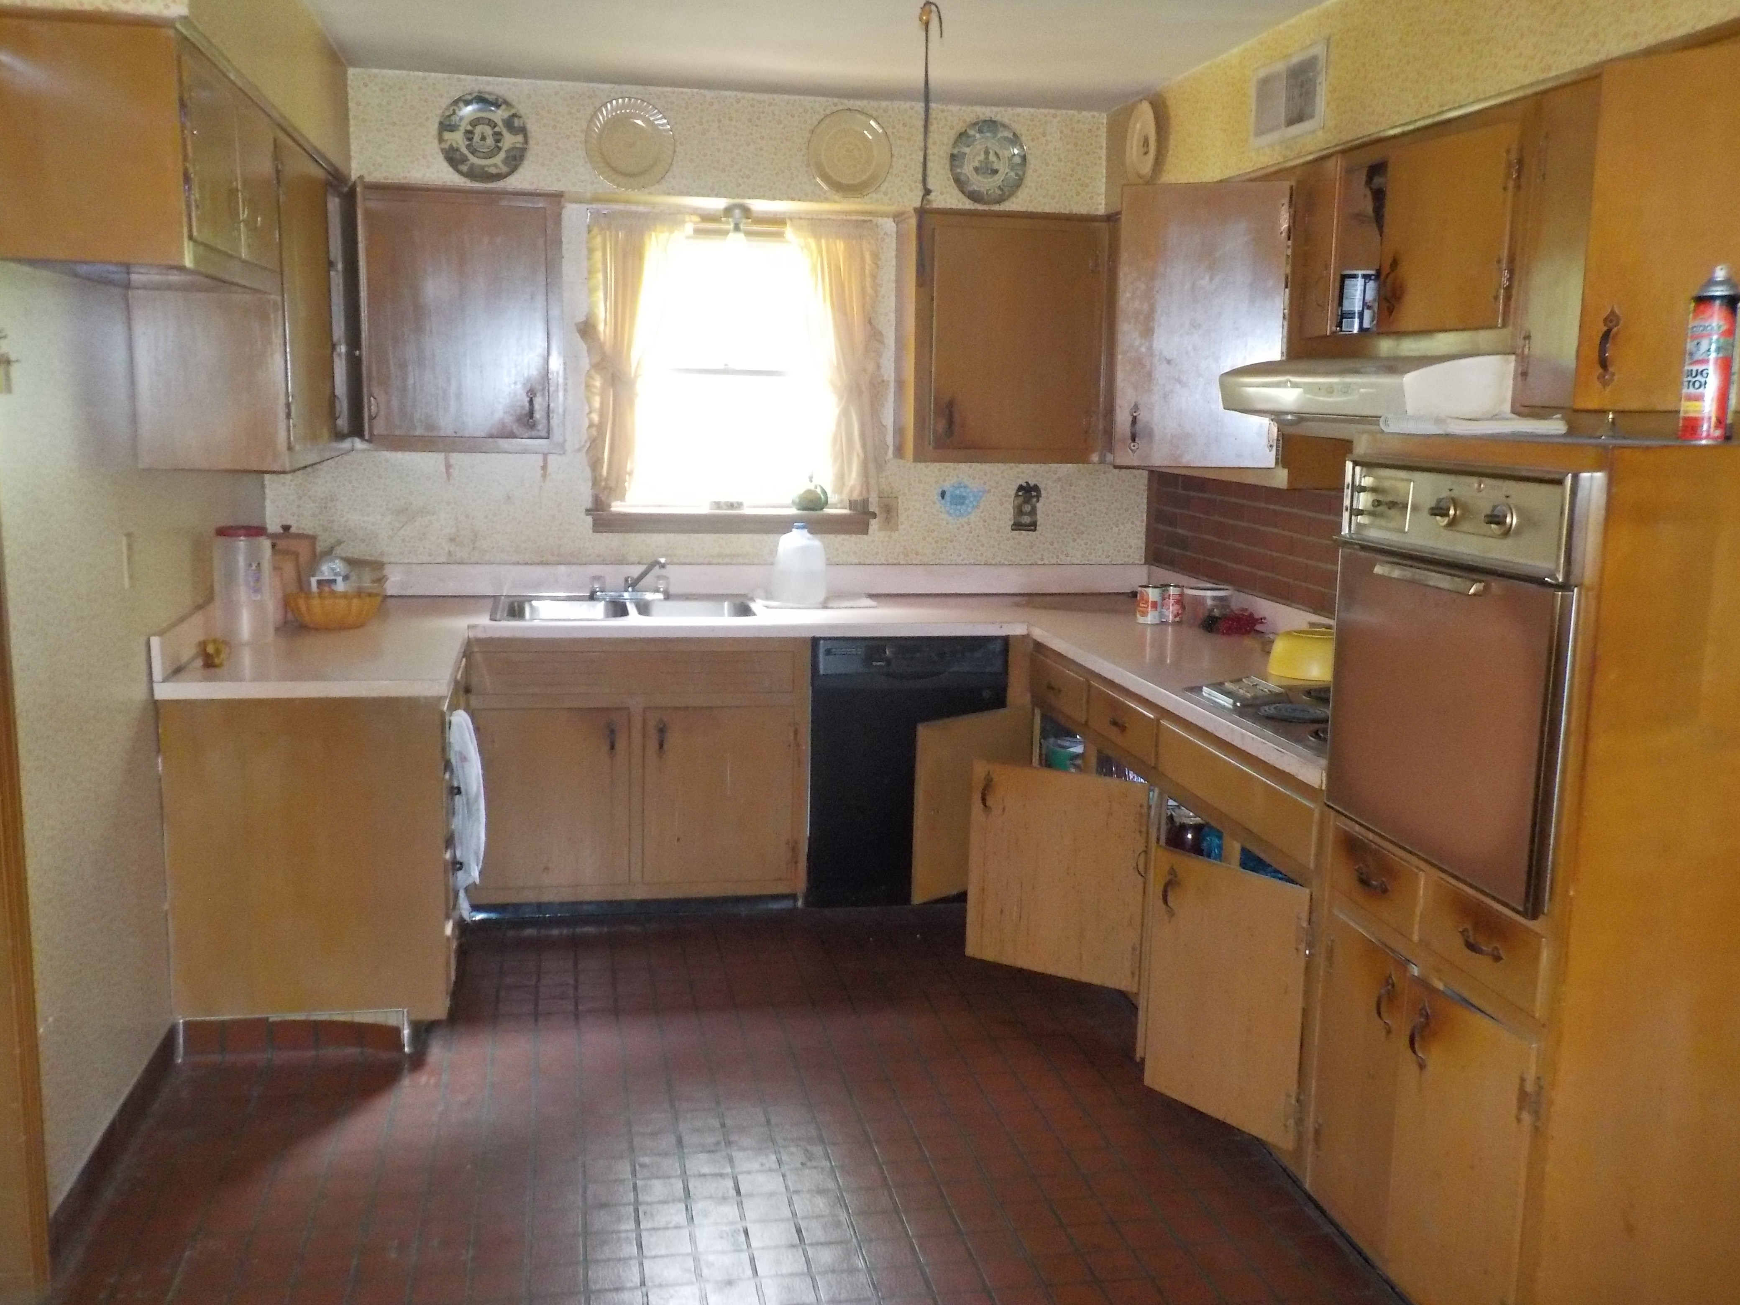
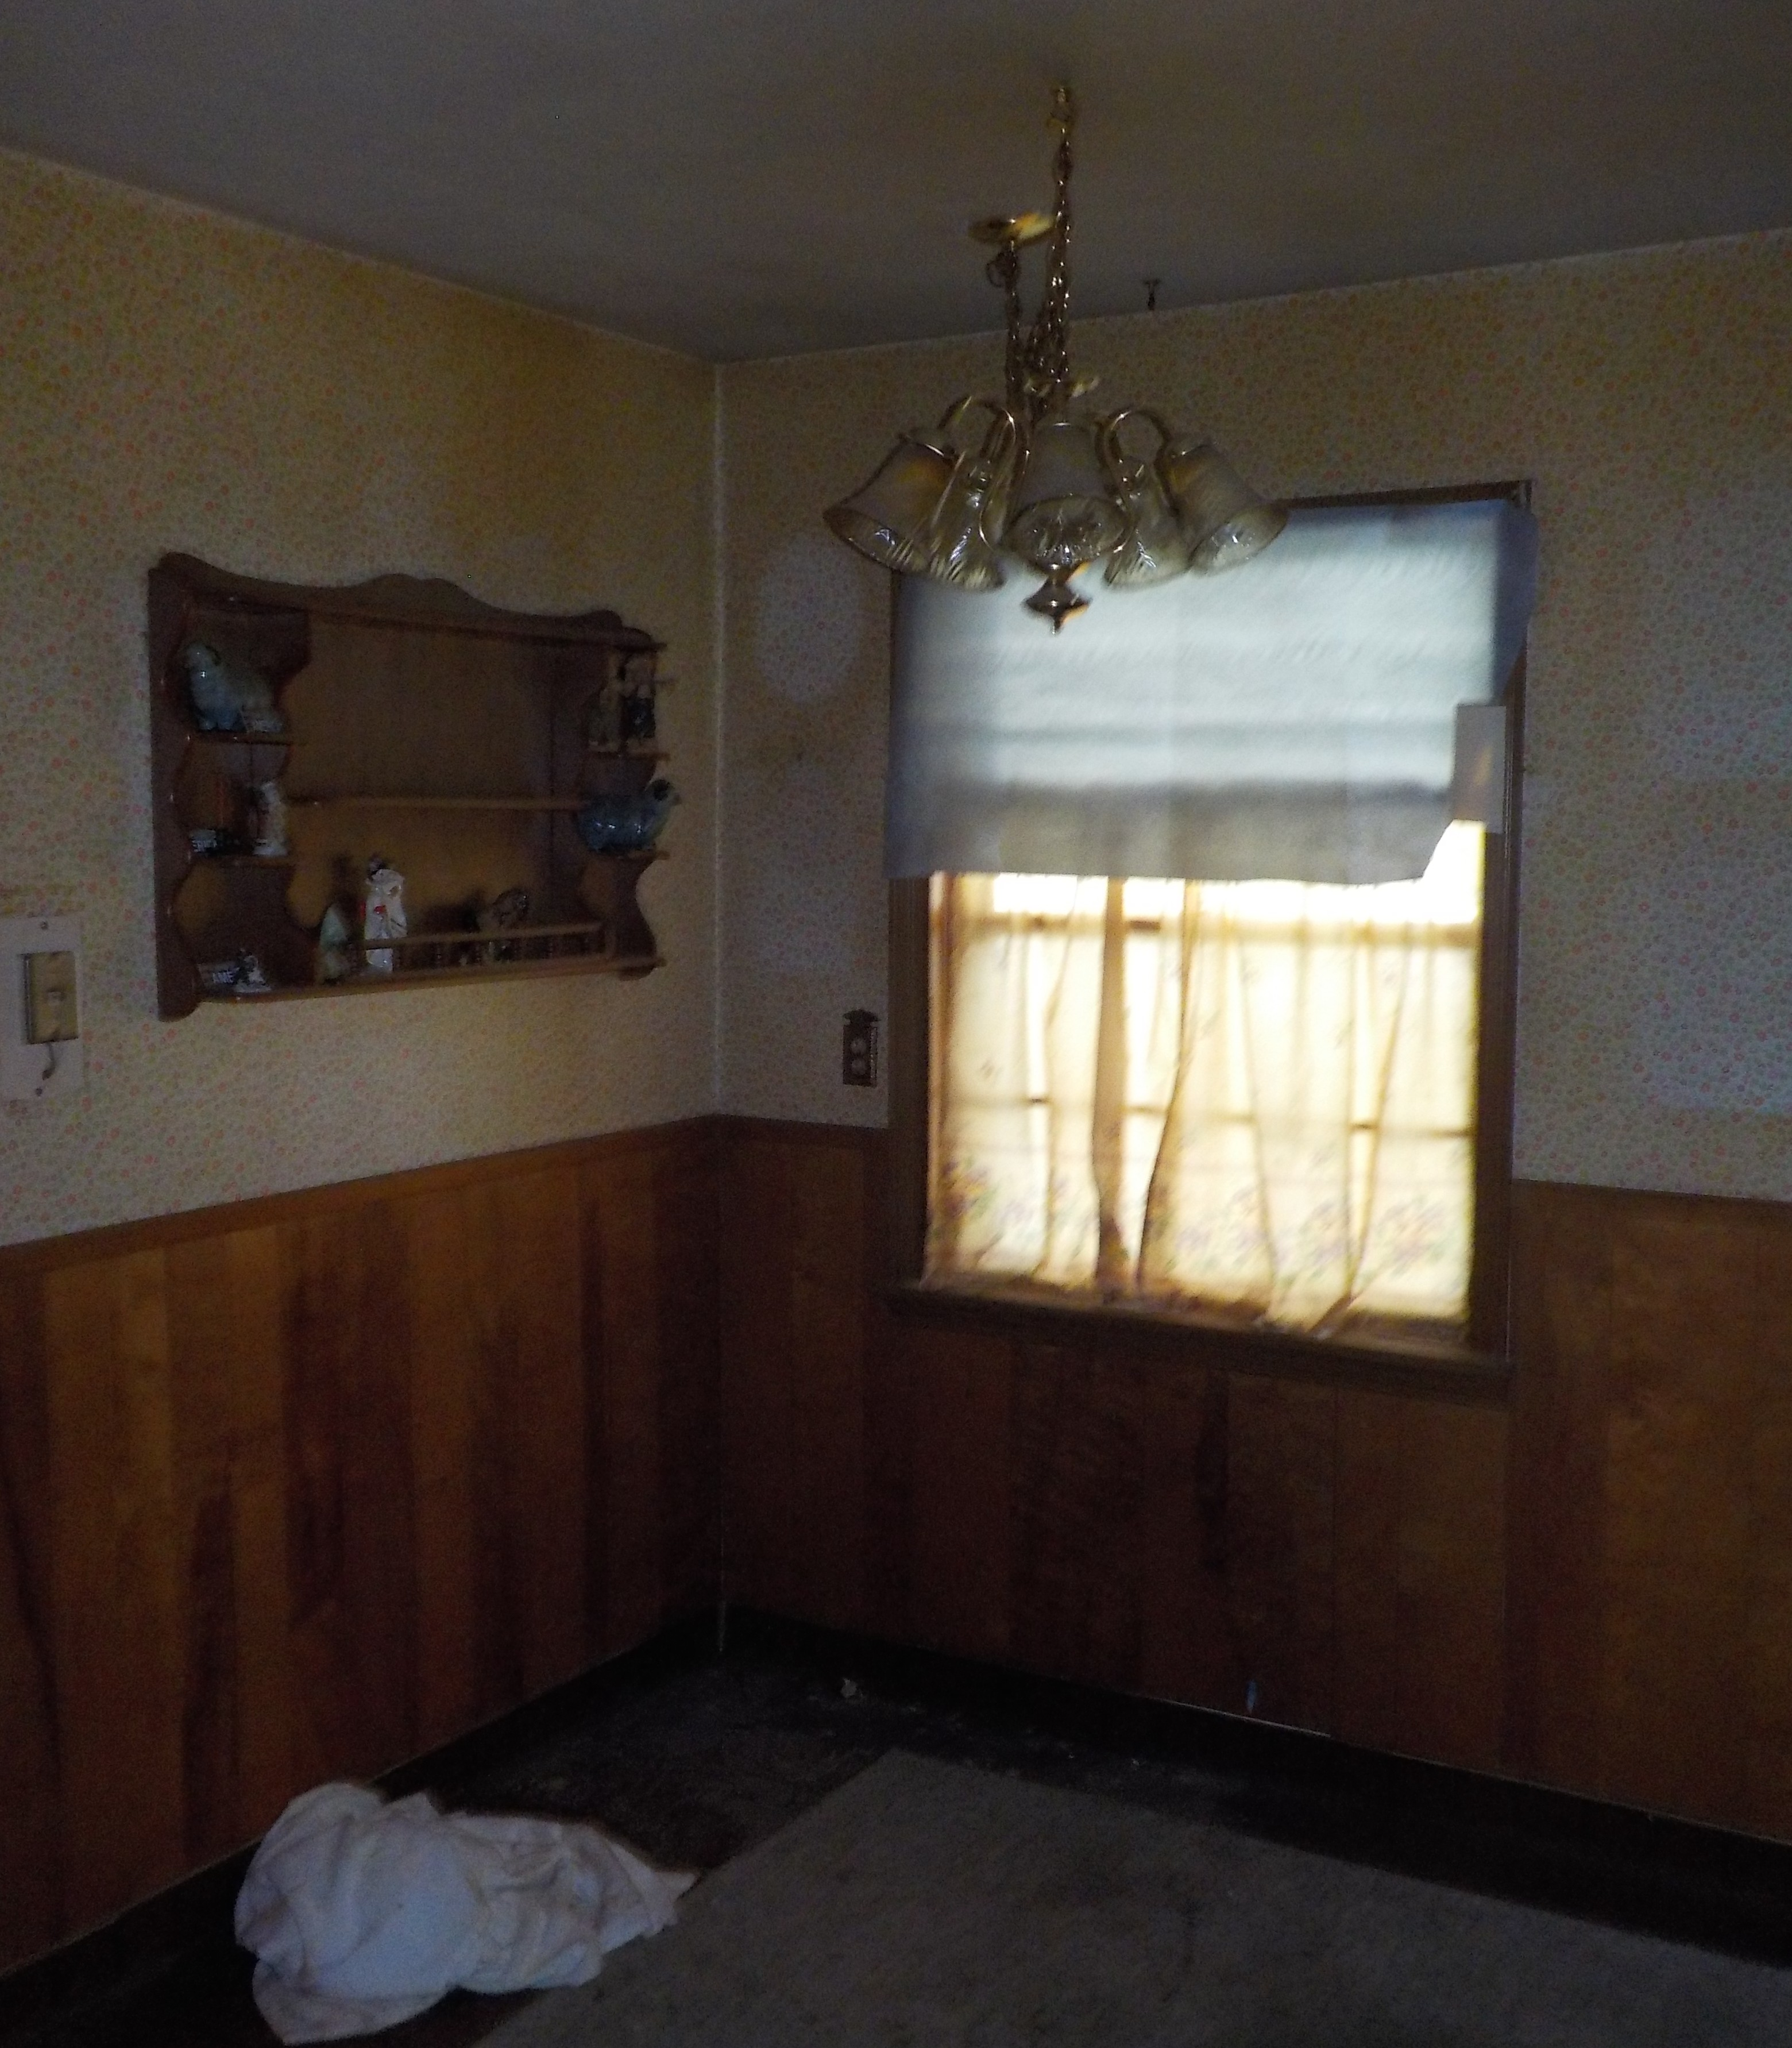
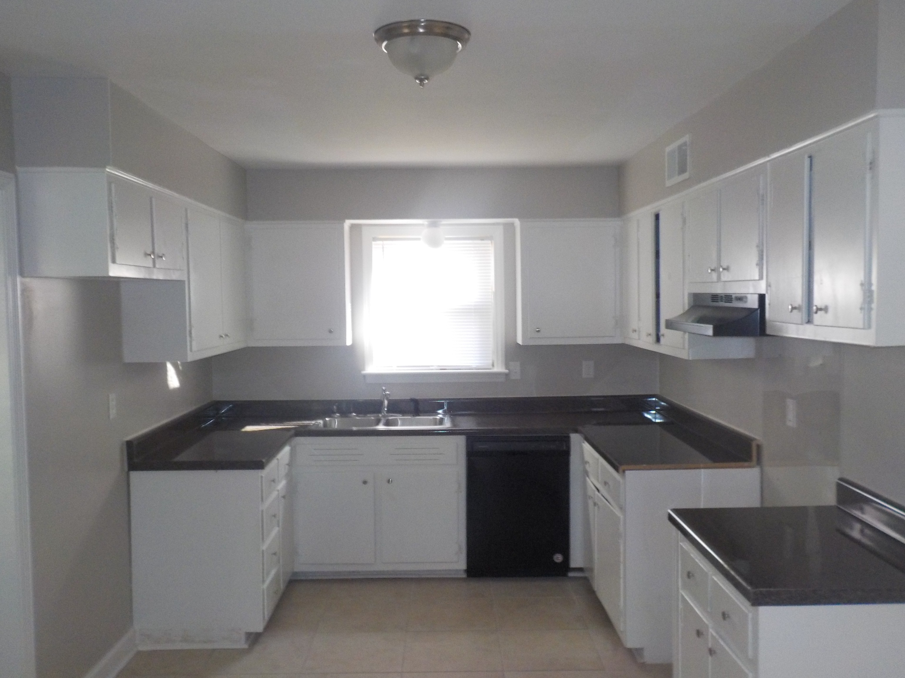
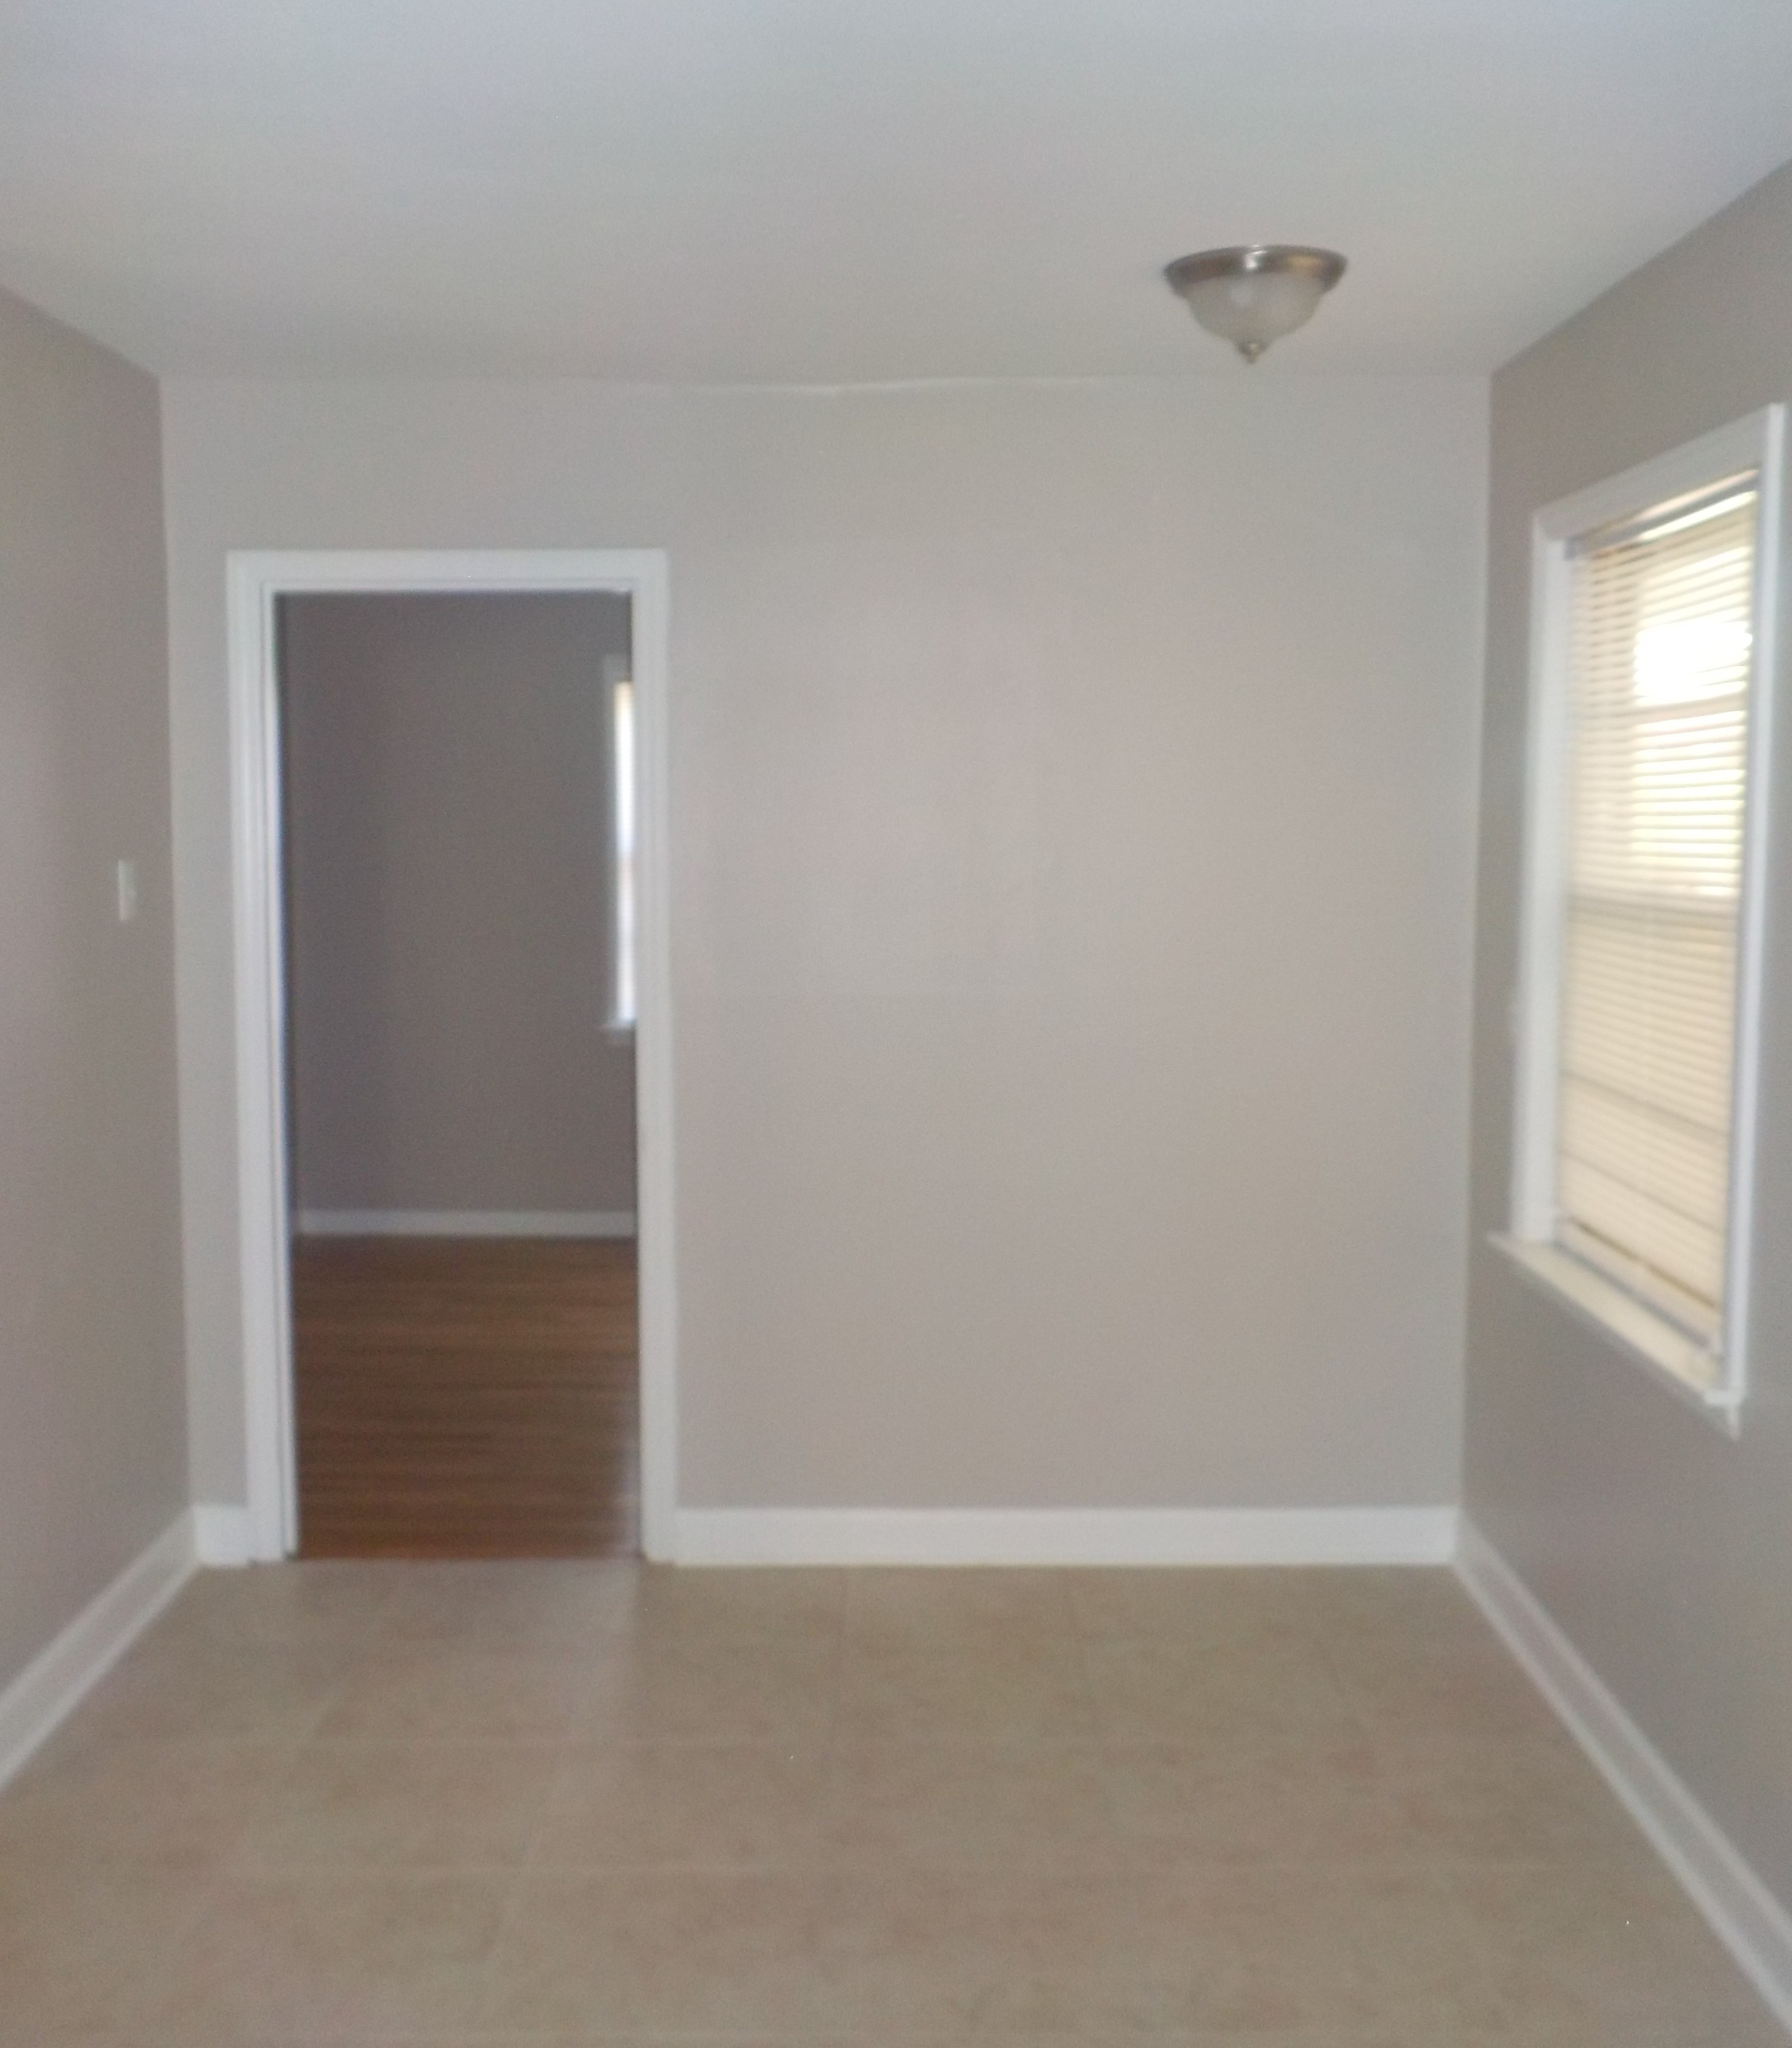
BEFORE BEFORE
AFTER
AFTER
Page Kitchen

Slide 11
Work Performed On The Home’s Kitchen:
install new concrete backer board
new tile floor
install baseboards as needed
install quarter round as needed
3 new two-bulb brushed nickel light fixture(s)
paint cabinets inside and out
new hardware on cabinets
install new countertops
new backsplash at stove opening
new vent-a-hood
remove old dishwasher
remove old stove and make room for a standard 30 inch stove
remove oven and convert space to cabinet
caulk sink, floor, counter

Slide 12
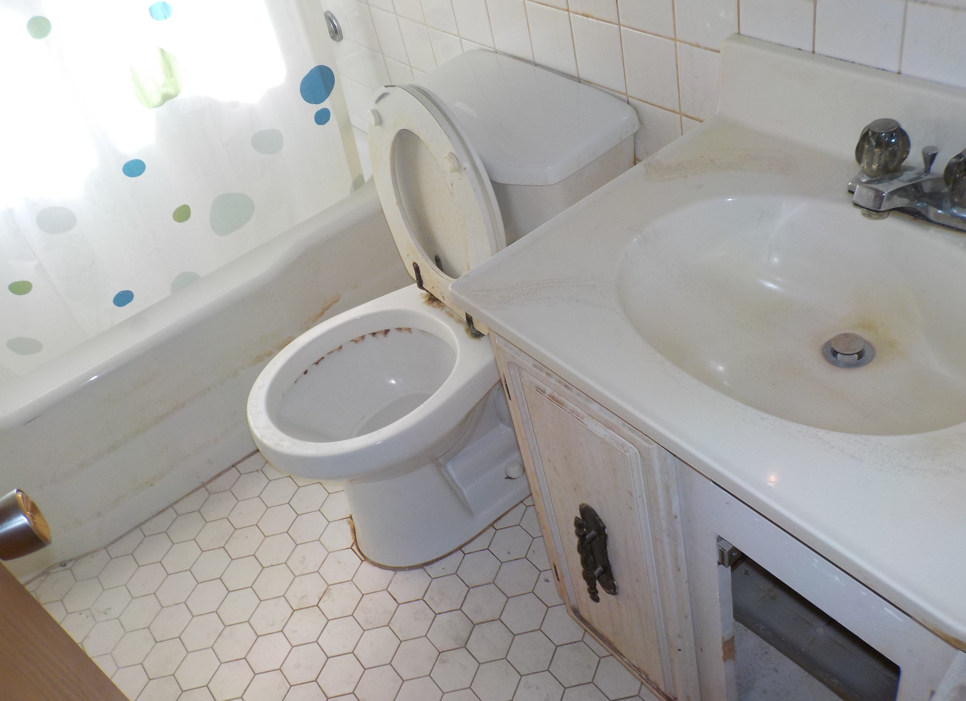
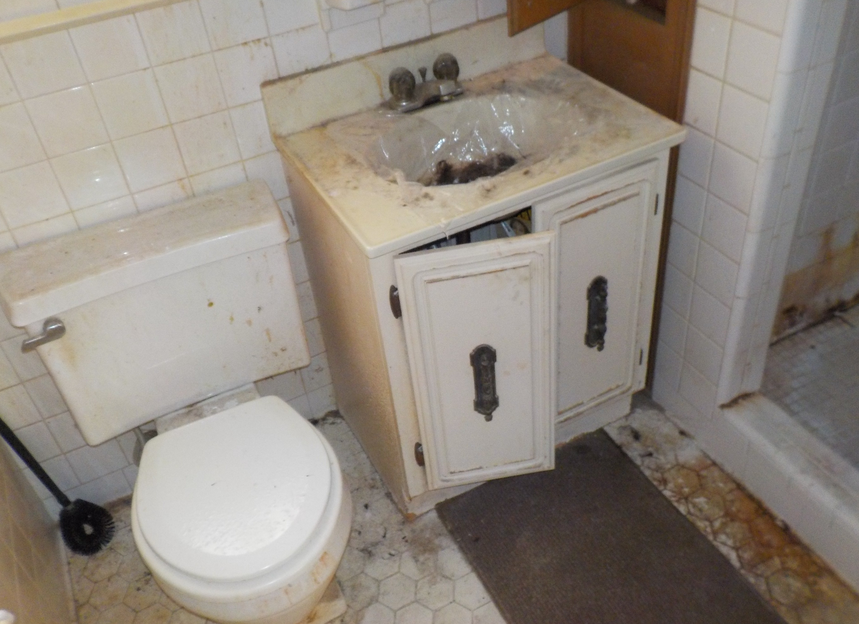
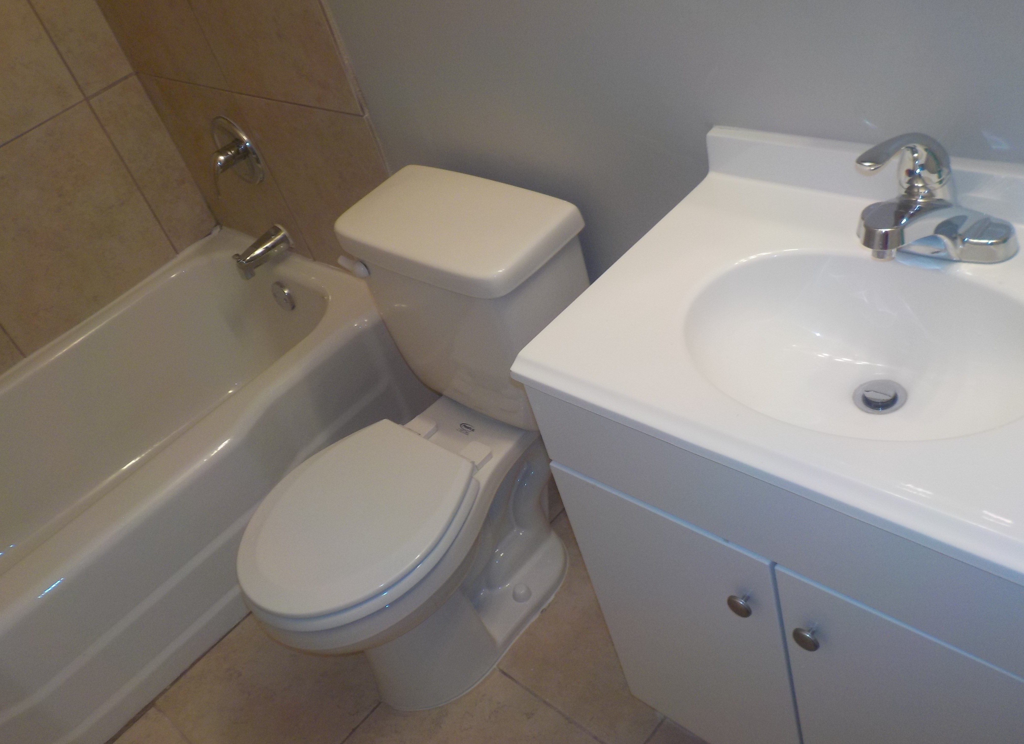
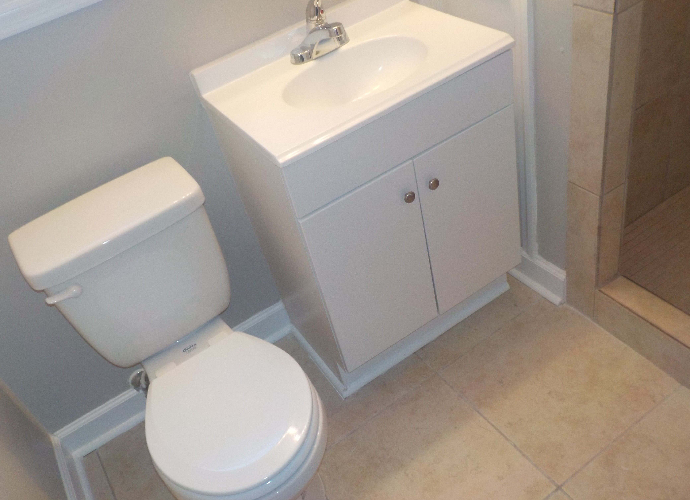
BEFORE BEFORE
AFTER
AFTER
Page Bathrooms

Slide 13
Work Performed On The Home’s Bathrooms:
Hallway Bathroom:
install new concrete backer board
new tile floor
install baseboards as needed
install quarter round as needed
3 new light fixture(s)
paint cabinets inside and out
new hardware on cabinets
install new countertops
new backsplash at stove opening
new vent-a-hood
remove old dishwasher
remove old stove and make room for a standard 30 inch stove
remove oven and convert space to cabinet
caulk sink, floor, counter
Master Bathroom:
install new concrete backer board
new tile floor
install baseboards as needed
install quarter round as needed
new hardware on cabinets
new sink/cabinet combo
remove wall tiles
new tile shower surround
new shower head
new shower bar
new mirror
new toilet seat
new toilet paper holder
new bar for toilet paper holder
caulk toilet, sink, tub, floor

Slide 14
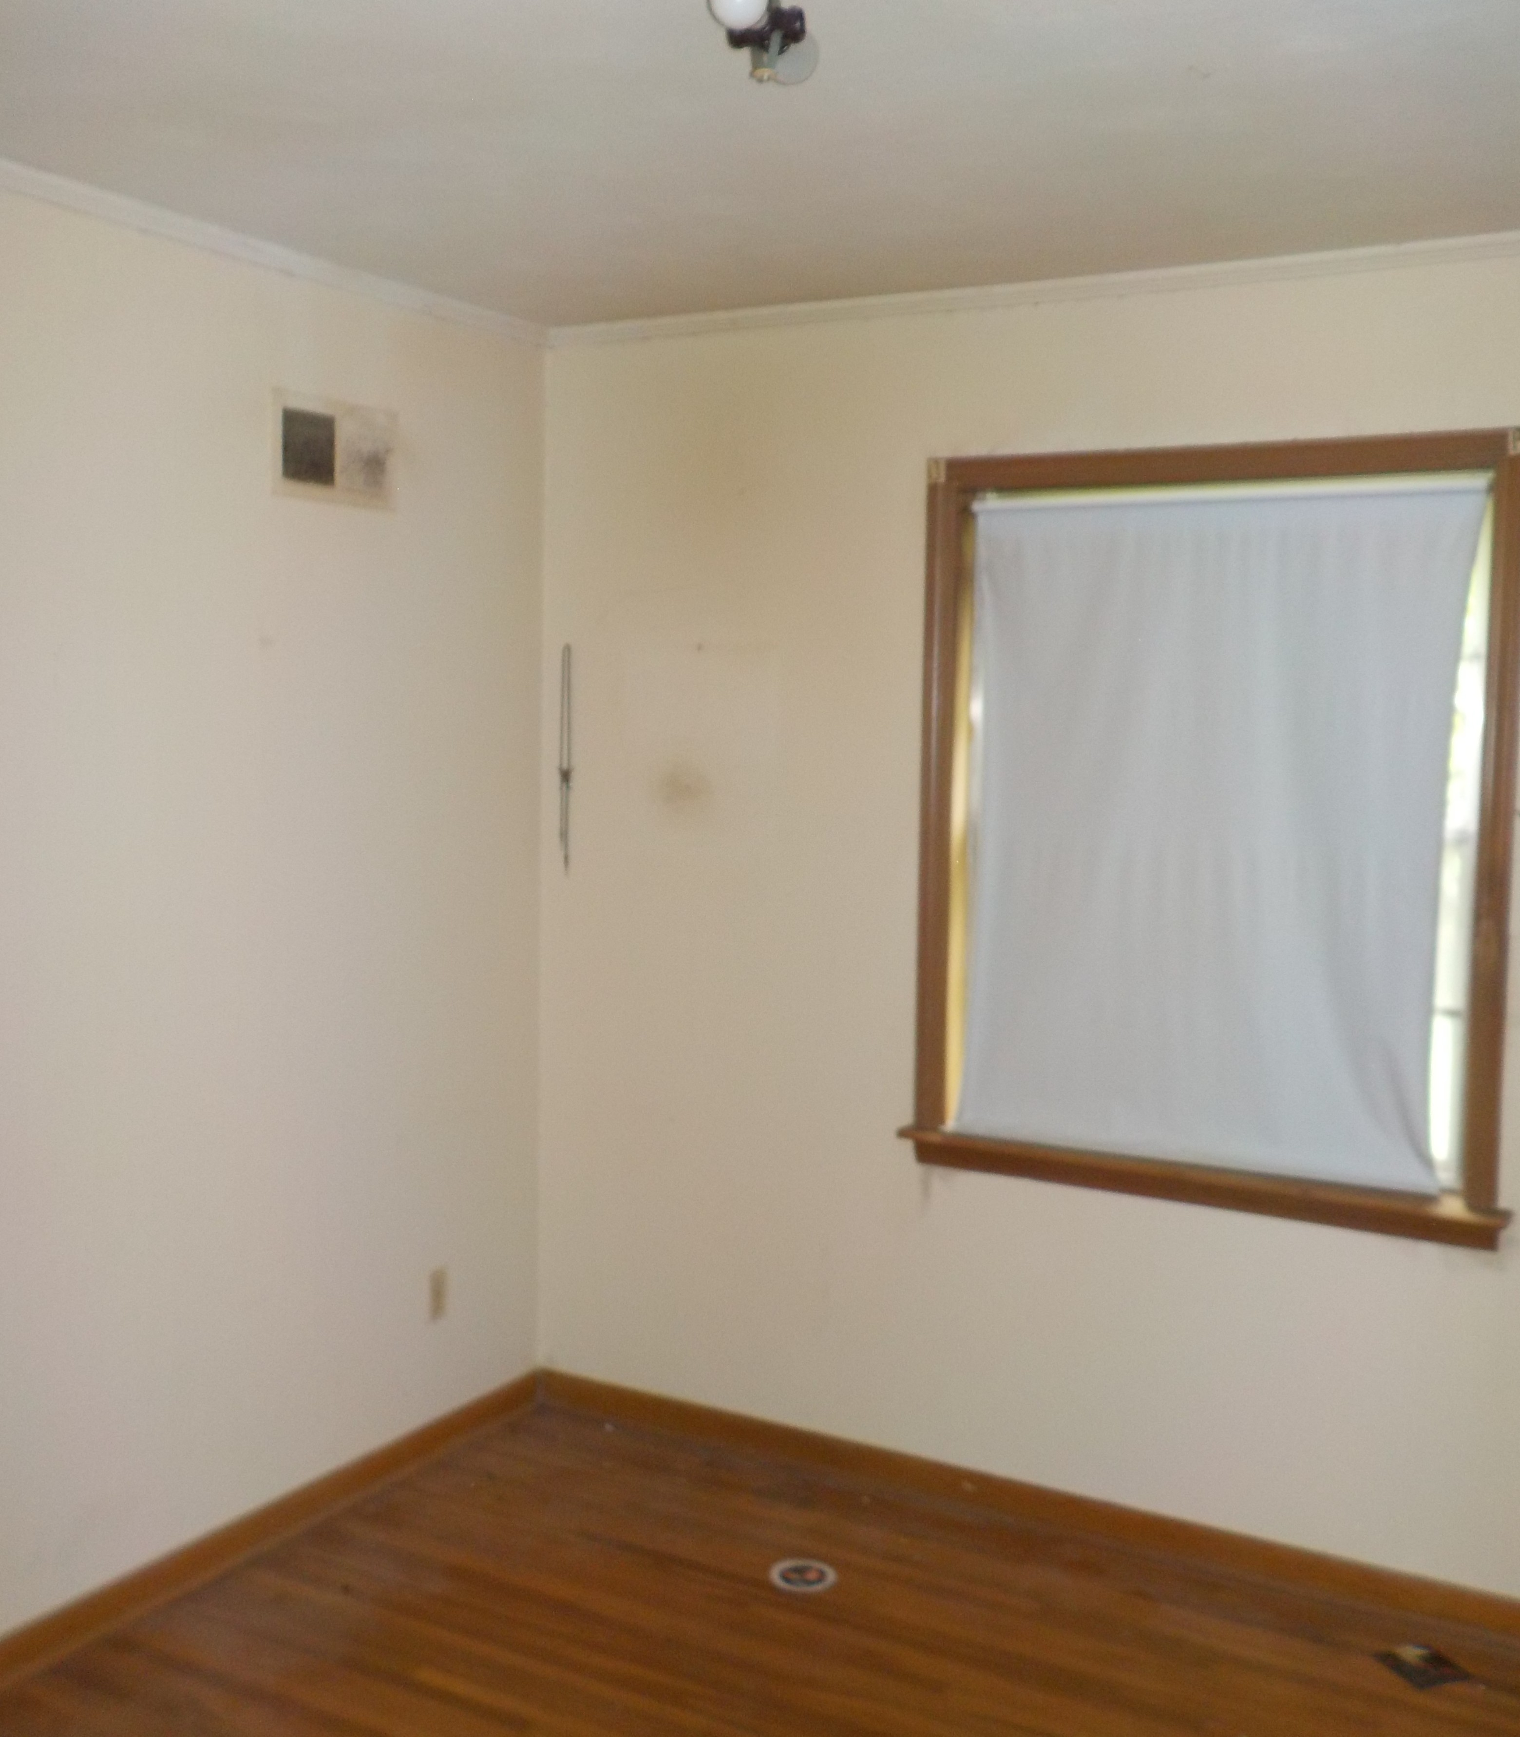
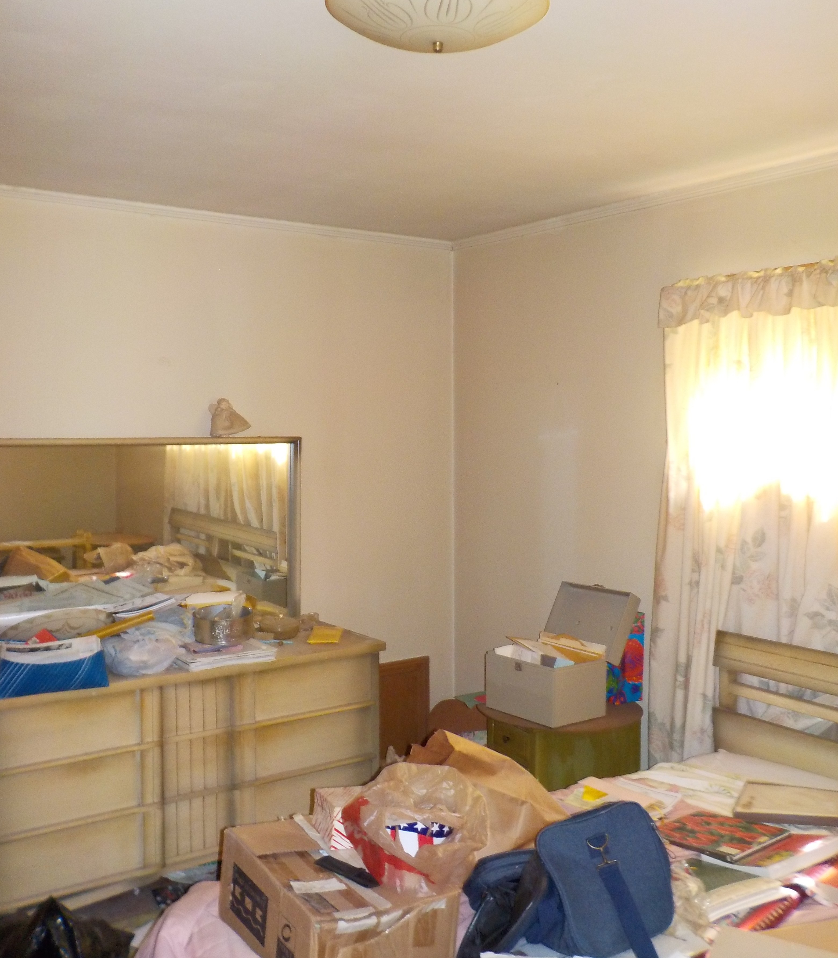
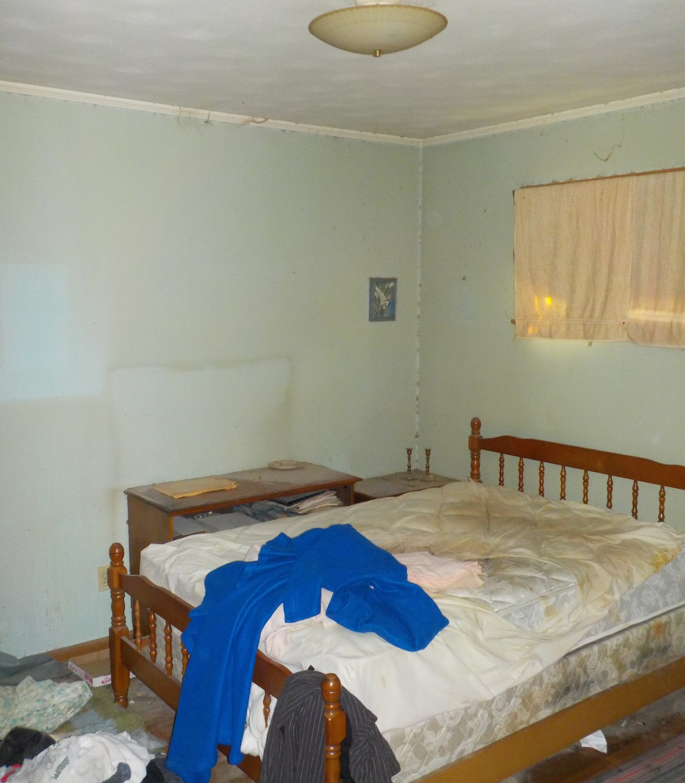
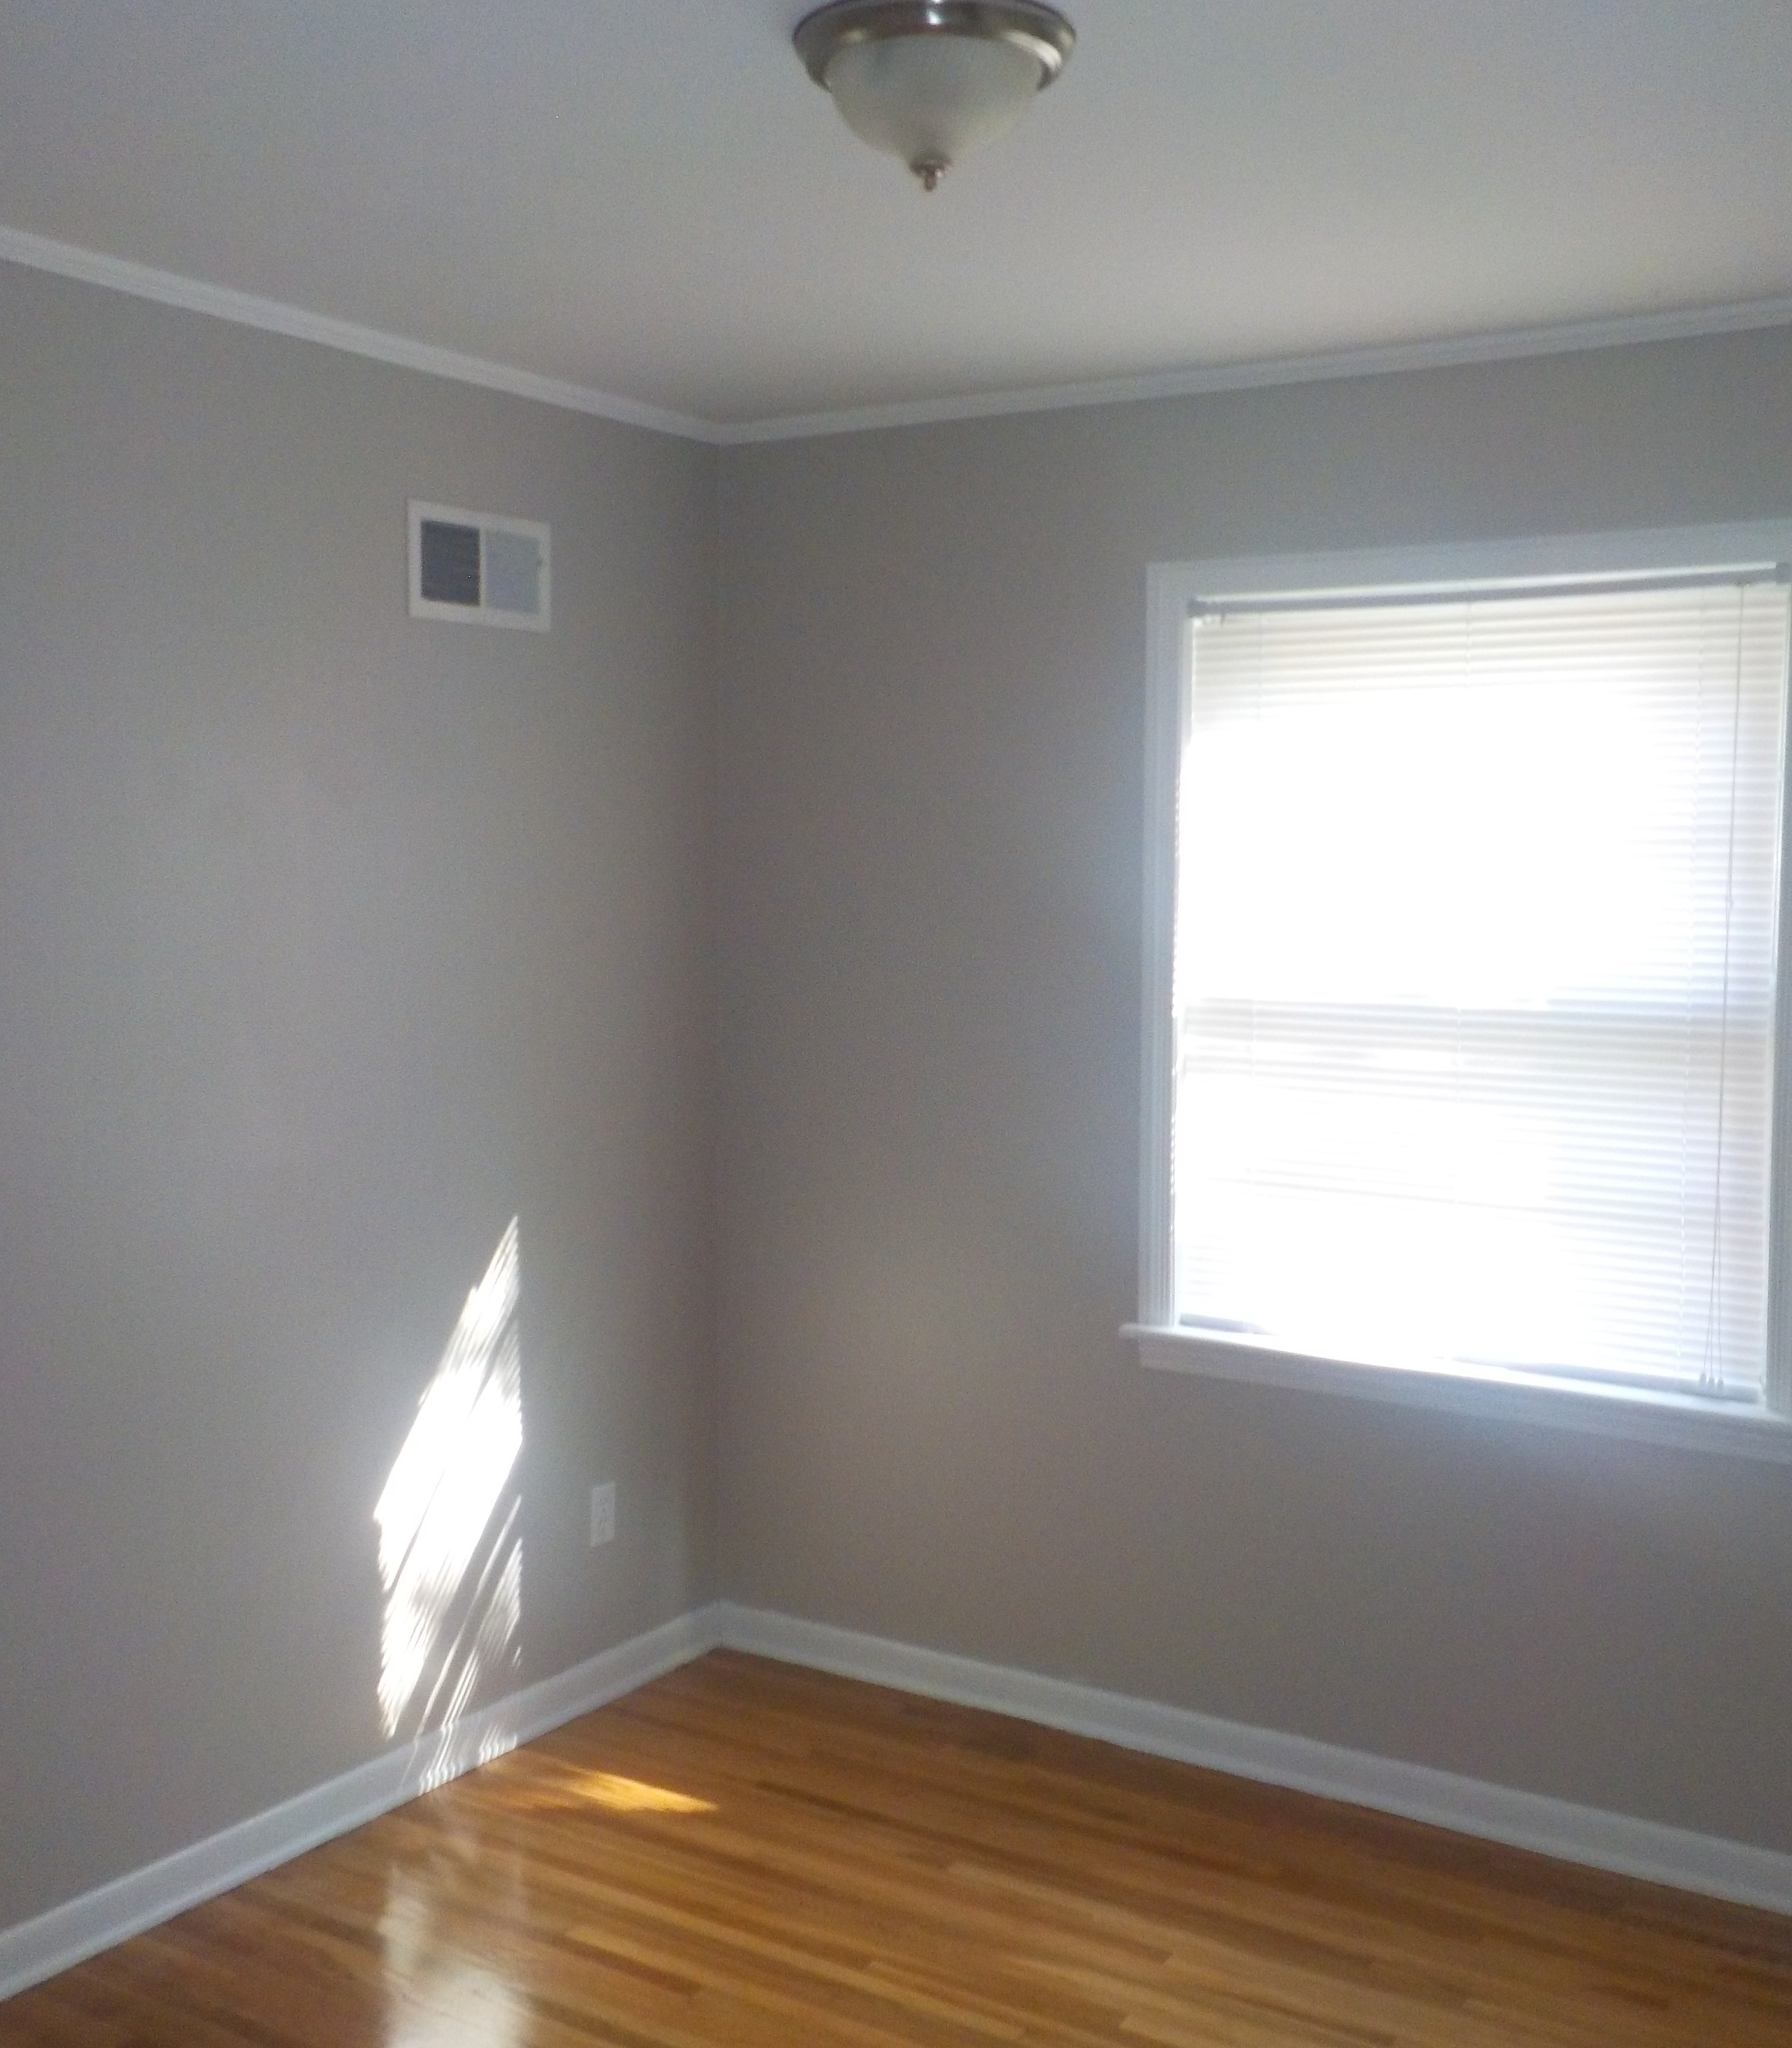
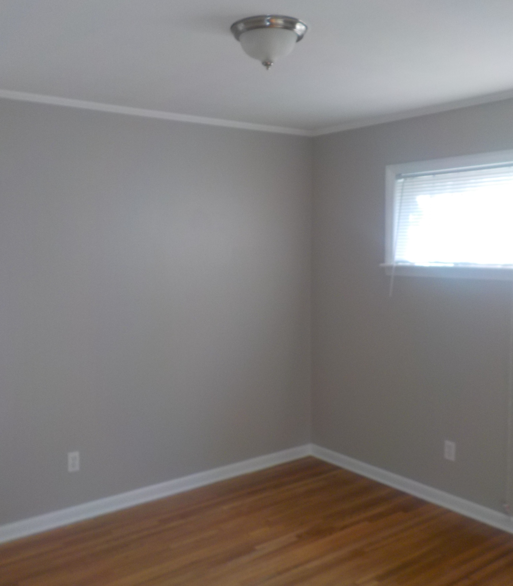
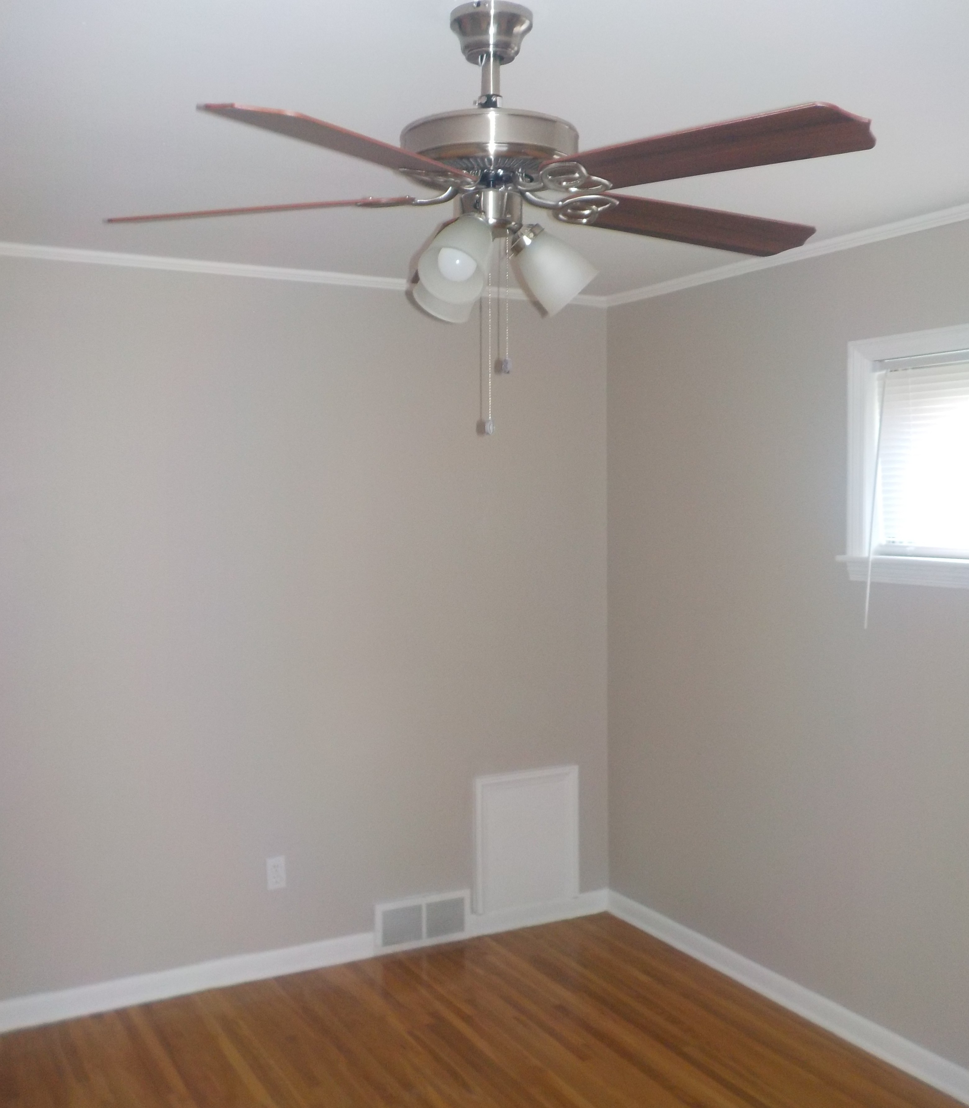
BEFORE BEFORE BEFORE
AFTER
AFTER
AFTER
Page Bedrooms

Slide 15
Work Performed On The Home’s Bedrooms
Bedroom 1:
install new support bracket for closet bar
1 new two-bulb brushed nickel light fixture(s)
Bedroom 2:
install new support bracket for closet bar
1 new two-bulb brushed nickel light fixture(s)
Master Bedroom:
install new support bracket for closet bar
new ceiling fan with light

Slide 16
Additional Work Performed:
Additional Items Entrance:
new tile floor
new metal exterior door crescent window
1 new light fixture(s)
Den:
new tile floor
new ceiling fan with light
Hallway:
install new support bracket for closet bar
remove all trash from attic
Laundry:
install new concrete backer board
new tile floor
1 new light fixture(s)
paint cabinets inside and out
new hardware on cabinets
new dryer vent with exterior cover
Dining Room:
remove door to Kitchen
1 new light fixture(s)
Additional Items:
rekey all locks
install security door(s) on: front
mow yard/landscaping
plumbing repairs as recommended by a licensed plumbing contractor
install new water heater
HVAC repairs as recommended by a licensed HVAC contractor
install new furnace
install new AC
electrical repairs as recommended by a licensed electrical contractor
update electrical panel
refinish all hardwoods
chemically clean roof
install new dishwasher
cleaning at completion of renovation

Slide 17
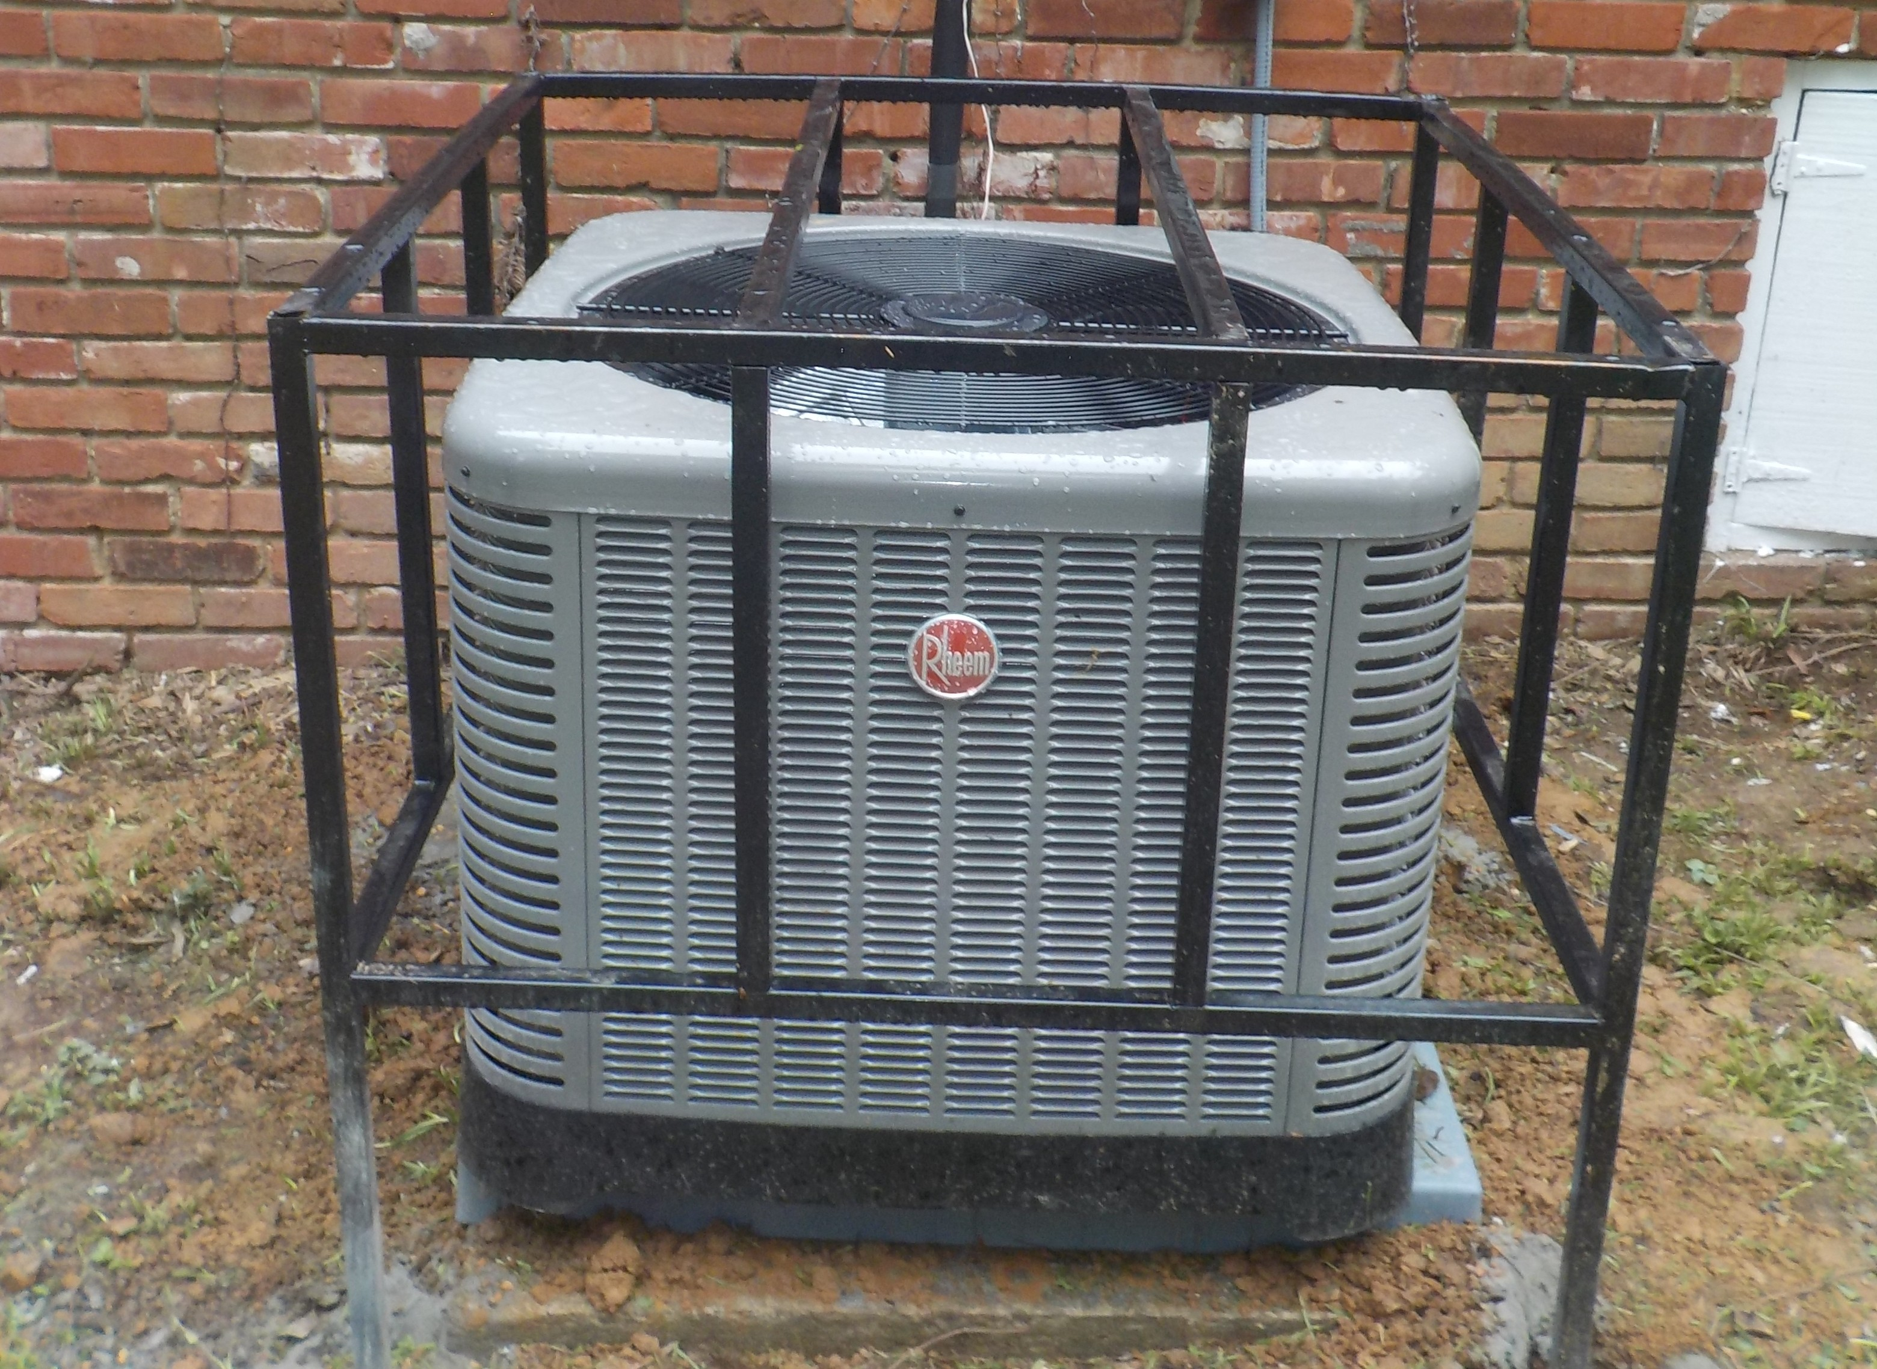
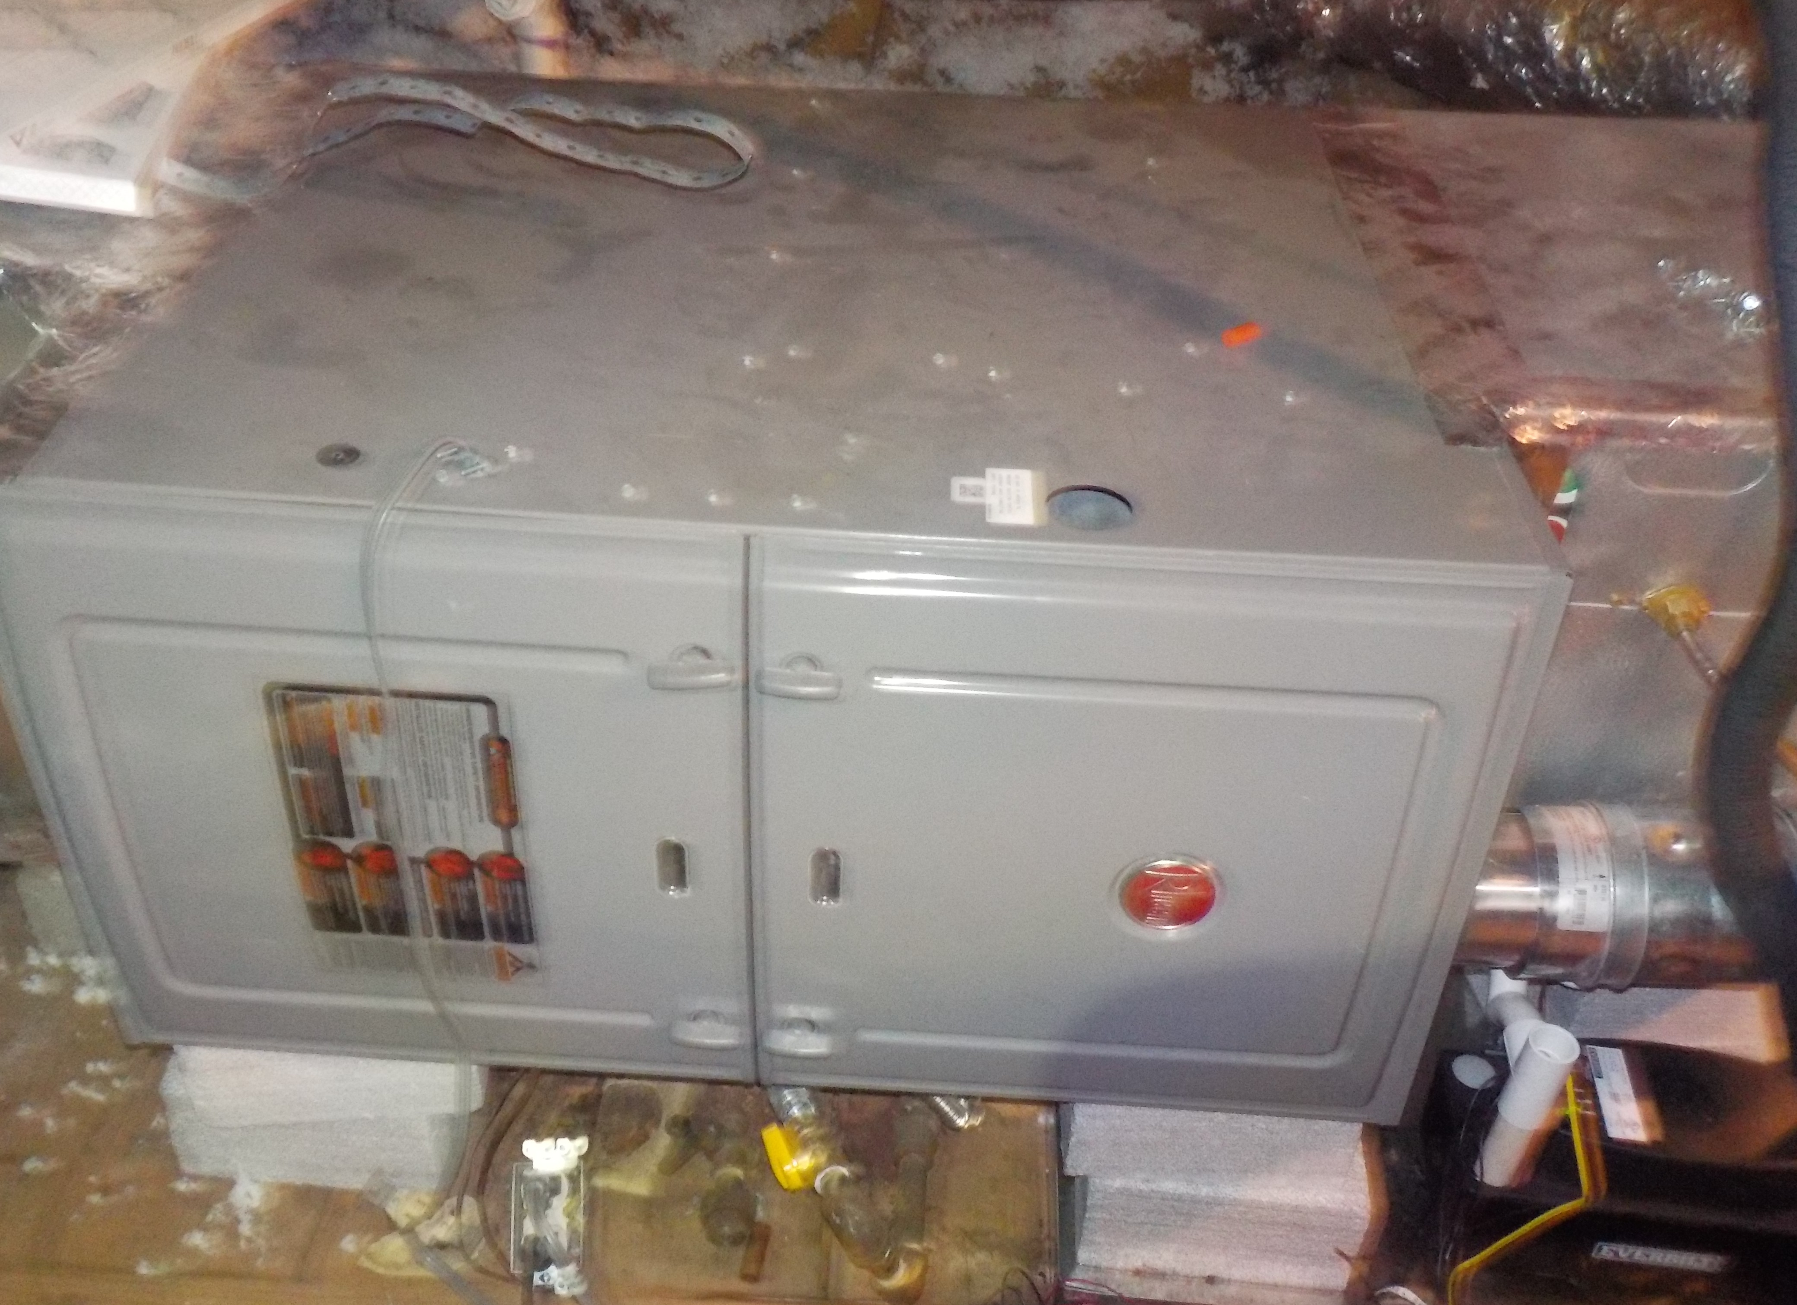
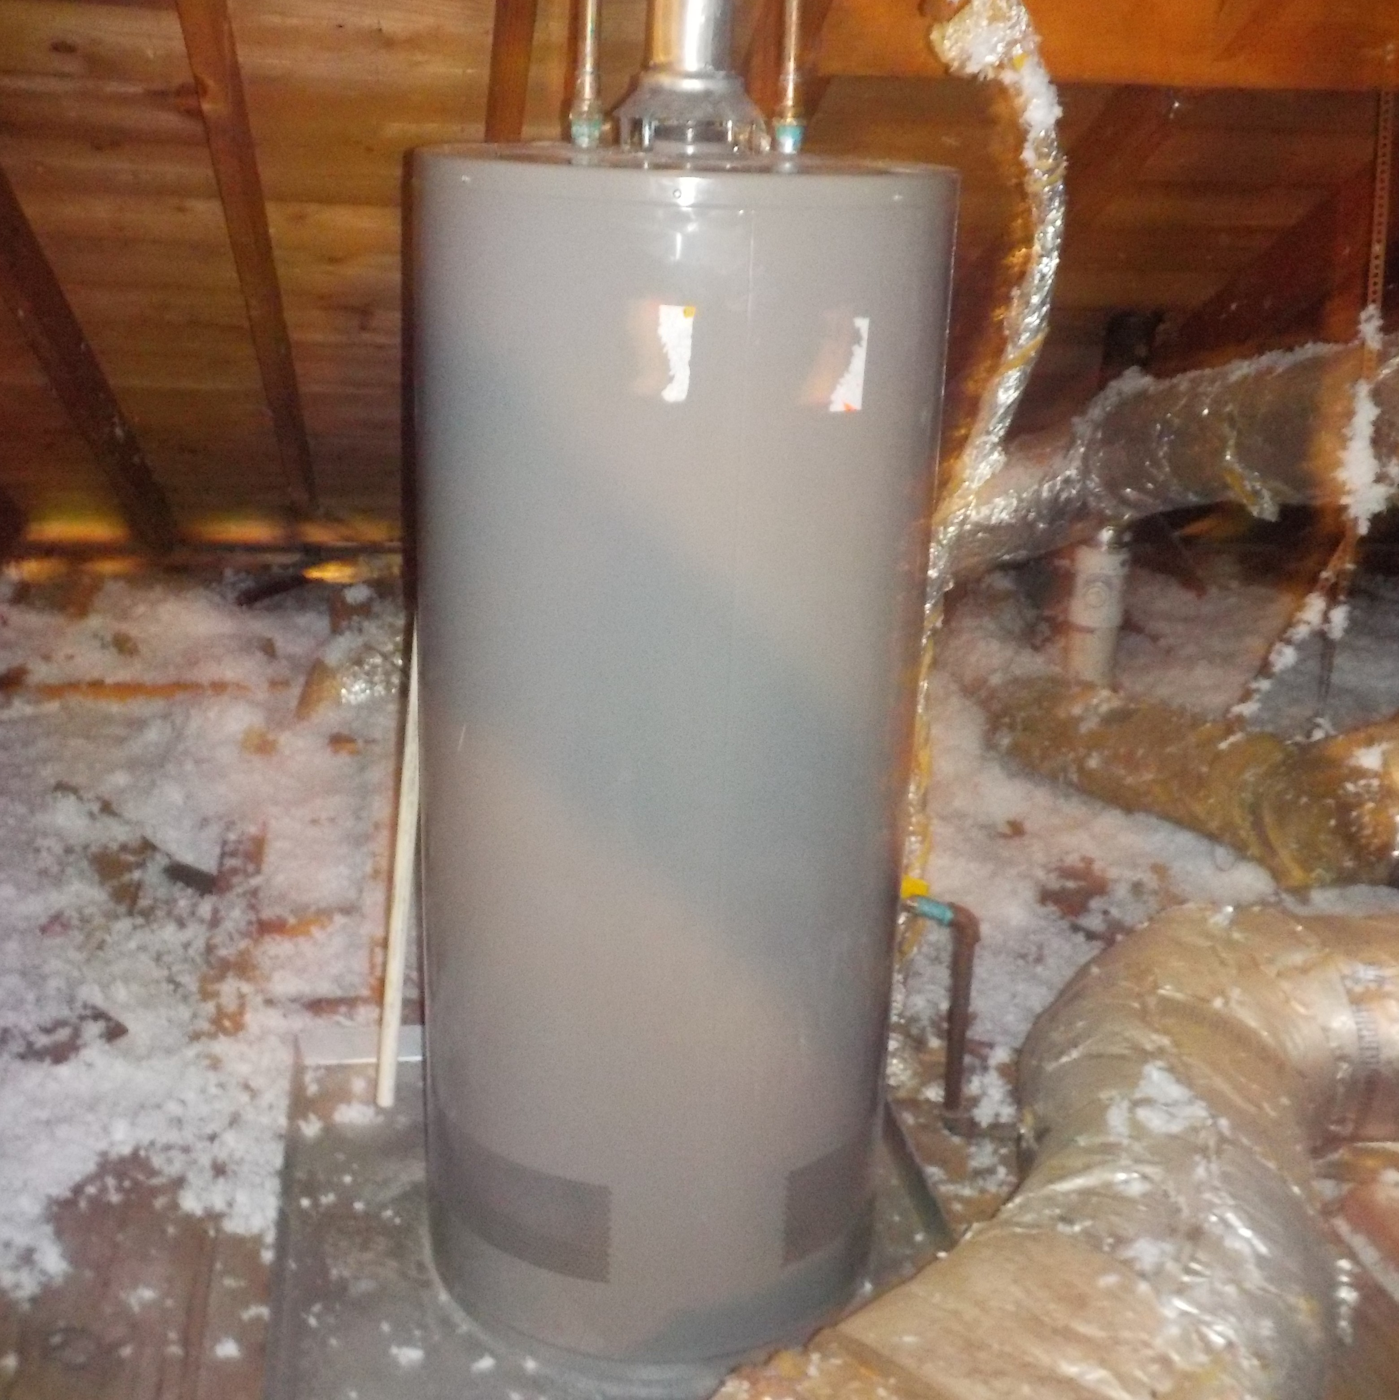
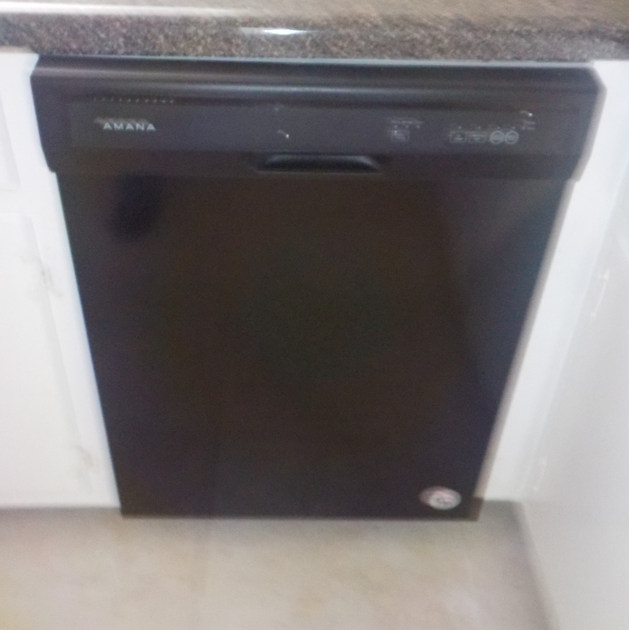
Page Mechanicals

