Slide 1
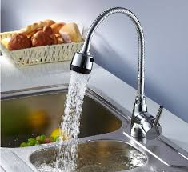
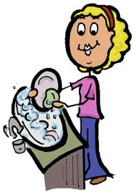
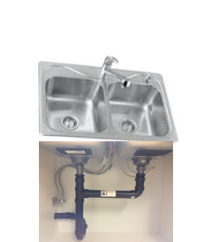

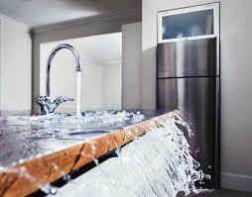
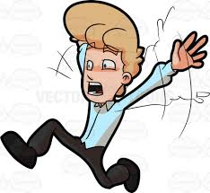
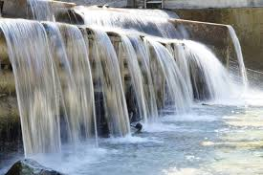

People doing dishes
Running water down the stack
Kitchen sink
Stack
pipe
^{4th} floor
People doing dishes
Running water down the stack
^{3rd} floor
People doing dishes
Running water down the stack
^{2nd} floor
1St floor
Bottom neighbour flooding and freaking out
Bottom of the stack clogged by bacon fat
Apartment building sewer main Pipe

