Slide 1
CROSSMATCH
Introduction
November 16, 2018

Slide 2
2019 Proposed Acquisition Roadmap
Business Systems
Infrastructure
User Experience
Support
2019 Jan | Feb | Mar | Apr | May | Jun | Jul | Aug | Sep | Oct | Nov | Dec
Apr 9
Impro
Apr 9
Identitag
Jul 9
IAI
Oct 8
Mercury
Islog
Full Discovery
Configuration
Training
Apr 2020
All Sites Together
Finalize Requirements
Remote Global Training
Crossmatch
US
EMEA
APAC
SALESFORCE CATCHUP
Quantum
Secre
SFDC Consultant
Peake
SFDC Consultant
CID
SFDC Consultant

Slide 3
IT Acquisition Integration – Guiding Principles
Protect the value of the acquired company – Do No Harm
Involve IT early in the acquisition lifecycle to detect potential risks, identify costs, and leverage synergies
Communicate IT support services to enable acquired employees to acclimate to HID quickly
Deploy HID standard IT infrastructure
  Secure, reliable infrastructure is mandatory to meet our business goals
  Centrally managed infrastructure reduces support costs and downtime
  Shared communications tools (email, Skype) allow for better team collaboration
Leverage HID Enterprise Systems – Oracle, SalesForce, and Agile (other 3rd party as needed)
  Central financial and sales applications support corporate reporting requirements
  IT Applications Integration Roadmap requires advance prioritization and planning
Leverage HID data centers and migrate legacy systems from on-site and 3rd party locations, where appropriate.

Slide 4
Application Migration Process
Requirements Gathering
Meet with Business to determine requirements and confirm / determine complexity
Design and Instance Build
Build and configure test instances
CRP
Initial testing with manually entered / converted data
Begin manual entry of data for testing
Super User / SME training
UAT
Final testing in fully integrated environment
Full data available for complete testing and validation
Train all end users
Roles and Responsibility setups complete
Production
Go Live in Production Environment
All data entered prior to go live with open transaction sets
Confirm data completeness and integrity
Train using specific acquisition configuration
Confirm out facing document changes
RICE required
Review customizations / localizations
Segregation of Duties review
Reconciliation with Legacy / New system and archive decommission

Slide 5
HID Applications Platform
Quoting
Approval Workflow
Partner Tier Pricing
Product Configurator
Quote Output
CPQ
Quote to Order Automation
M&S Pricing
SFDC
CRM
Accounts(Bill-To)
Opportunities
Leads
Contacts
Activities
Axiom Sls Training
Advantage Partner Program
PAF
Accounts(Ship-to, End User)
Quote Prototype (SFDC Order)
Order Status/History
Install Base / Service Contracts Data
Partner Community
Agile
PPM
PQM
PCM
PC
PG&C
MDM
Product Hub
Customer Hub
Supplier Hub
Service Contracts
Install Base
Costing
Billing
Adv. Collections
iReceivables
Master Data Management
HID Technology Platform
HID Application Platform
Projects
Oracle
RTR
AP
AR
Fixed Assets
GL
Cash Management
Sub Ledger Accounting
Vertex / EBTax
PTPd
Manufacturing
Intercompany
MRP
Shop Floor
Material Mgmt
Cost Acct
OTC
Order Management
Sales Agreement
Advanced Pricing
Returns Processing
EDI
PTPy
Requisition
Purchasing
Supplier Management
Projects
iSupplier
Discoverer
Oracle to Safenet
Safenet to Oracle
Quote to Order Automation
Vertical Market to DWH
Available Credit Limit to SFDC
Oracle to DW
Sales
AR/AP
GL
Fixed Asset
CRSD
Inventory
Purchasing
Integrations
Supply Demand
Agile to DW
Agile to Oracle
Agile to Marcom
Legend
Oracle to SFDC
Bill to Address to SFDC
Spend Data to SFDC
Pricing to SFDC/CPQ
Products to SFDC/CPQ
Ship to Address to SFDC
Oracle to 3rd Party
Cubeware
Safenet
Implemented
Concur
In Progress
3rd Party
KOFAX/ KTM
CIC/IIC
Web Order Status
Akami
Future
SIS
Steelwedge
CSOD/ MyHID
Marketo

Slide 6
Functional Process Areas or ‘tracks’
Process Area | Sample of How ERP Enables Benefits
Plan to Produce (PTPd) | Real-time, integrated access to manufacturing, supply chain & financial data Automation of transactional tasks associated with planning, scheduling & inventory management A platform for the integration of shop floor, quality, & supply chain (ERP) data Centralization of supply chain master data (materials, vendors, customers)
Procure to Pay (PTPy) | Consistent, integrated spend analysis -> facilitating vendor evaluation Automated enforcement of process & policy requirements Consignment / Vendor Managed Inventory
Record to Report (RTR) | Minimization of manual interventions and point-to-point reconciliations Streamlined Chart of Accounts and simplified/reconfigured hierarchies Data integration from Sub-ledgers to G/L and Consolidations “Drill-down” capabilities for analysis
Order to Cash (OTC) | Accurate and real-time inventory visibility Flexibility to handle complex delivery and shipping requirements Automatic billing to reduce manual interventions and improve cycle time Electronic funds transfer (EFT) / direct debit to collect payments and improve receipt processing

Slide 7
Functional Process Areas or ‘tracks’
Process Area | Sample of How ERP Enables Benefits
Product Lifecycle Management (Agile) | Improved quality of knowledge/data transfer Greater visibility into portfolio and project performance Unify product quality data in one record Closed loop quality processes Increased collaboration
CRM (Salesforce, CPQ) | Closed-loop visibility to customer behaviors and interactions throughout the entire customer lifecycle Provides the information you need to interact with your customers based on their needs
Datawarehouse and Business Intelligence | Consolidate common reports and report generation Automation and simplification of data analysis Self-service reporting Enforce clean consistent data

Slide 8

Roles and Responsibilities:
Project Footprint
Role | Key Responsibilities
Steering Committee 15% | Provide overall program quality assurance Resolve issues, as necessary Adoption to all levels of the organization Decision making body
Steering Committee / Sponsors
Biz
IT
Program Management Office (PMO)
Biz
IT
Business Acquisition Teams &
Lead Transformation Owners
Role | Key Responsibilities
Lead Transformation Owners As Needed | Participate in overall project from a business perspective Assist with project escalations where needed Ensure all deliverables meet acceptance criteria Ensure that the solution meets the company’s business needs and is harmonized across the enterprise
Biz
IT
Agile
Order to Cash / PTPy
CRM
Plan to Produce
Record to Report
Recurring Billing / Svc. Contract
Projects
Core Project Team
SMEs / Super Users
Role | Key Responsibilities
Core Team Member 30% | Represent business to design and implement leading practice Represent business to adopt new, leading practices Prioritize requirements Participate in design, data cleanup, data migration and testing Participate in developing test scripts Actively participate in CRP's and User Acceptance Testing (UAT) Working member of IT project team using PMP process and templates Participate in coordination of training efforts
Subject Matter Expert (SME) / Super Users 15% | Represent users to adopt new leading practices Provide expertise in specific functional areas Define future processes and configuration Participate in testing and training as needed
Technical
IT Technical / Functional Team
Integration approach is to have Business representatives involved in ALL aspects of the project, from sponsorship to participation to decision making to support.
Integration also considers IT participation paramount to success, therefore a similar approach for involvement will be followed. However, it is important to understand this is NOT an IT project…
8

Slide 9
KEY SUCCESS FACTORS
Establish clear roles and responsibilities for the whole team, and hold resources accountable for their deliverables
Focus on global business processes in requirements
Establish good communication plan
Implement and follow project management methodology
Establish change management process
Active involvement of the users in the requirements and design phases
Ensure timely resolution of issues and good issue tracking process
Ensure testing is well planned and executed successfully covering all scenarios

Slide 10
Sample Project Team
PMO
Steering Committee
IT Council | Stakeholders
Stefan Widing Laura Crumley Rodney Glass Mike Fitzgerald | Harm Radstak Susan Kosiba Stephanie Moore Mary Procyk Audrey Bielawa Dave Stewart
Lead Transformation Owners
Stanley Therneau – Program Manager Bruce Kamph – GQ&O Integration Mary Procyk – Acquisition Finance Dave Stewart – Operational Excellence TBD – Sales Operations
Core Team
Finance (Record to Record) | Eng/ Doc Control (Agile) | Projects | CRM | Order Mgmt (Order to Cash) /Pricing | Supply Chain (Procure to Pay) | (Plan to Produce)
10

Slide 11
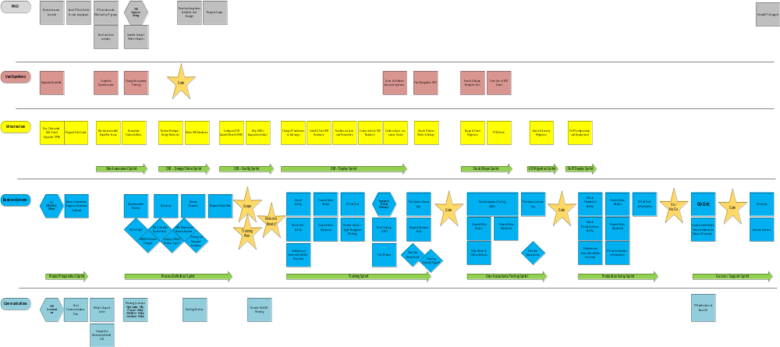
Project / Gate Process

Slide 12
Preliminary schedule – no discovery completed
Task Name | Nov | Dec | Jan | Feb | Mar | Apr | May | Jun | Jul | Aug | Sep | Oct | Nov | Dec
Crossmatch
Discovery |  |  |  | Discovery
Infrastructure
Site Assessment |  |  |  |  |  | Assess
OIB - Design/Order |  |  |  |  |  |  | O-Design
OIB - Config |  |  |  |  |  |  |  |  | O-Config
OIB - Deploy |  |  |  |  |  |  |  |  |  | O-Deploy
Email/Skype |  |  |  |  |  |  |  |  |  |  | Email | Email
AD Migration |  |  |  |  |  |  |  |  |  |  | Telecom | Telecom
Telecom |  |  |  |  |  |  |  |  |  |  |  | AD | AD
Business Systems Integration
Project Preparation |  |  |  |  | Demos | Data | Prep
Process Definition |  |  |  |  |  |  |  | Process | Process
Configuration |  |  |  |  |  |  |  |  |  | Config | Config
Training (US) |  |  |  |  |  |  |  |  |  |  |  | Train
Training (EMEA/APAC) |  |  |  |  |  |  |  |  |  |  |  |  | Train
Testing (UAT) |  |  |  |  |  |  |  |  |  |  |  |  |  | UAT
Go Live / Support

