Slide 1
Astral Maths design
Design Brief:
To design the front and back of a set of cards to be used for practicing numeracy skills. For use at home and in school.
Target Group:
Age 5-13
Specifications
Back of the card: Character, company name and background
Front of the card: Example of design to show a ’12’ card (example included below)

Slide 2
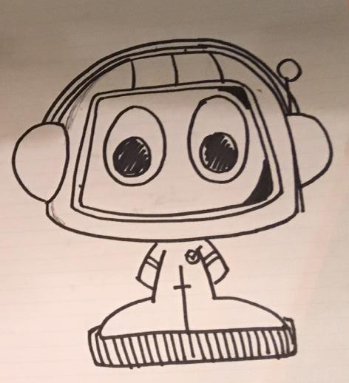
Character design
This is a drawing of our character design idea: a cute and humorous astronaut, appealing to children across the 5-13 year age range.
The character should be free from gender and ethnicity.
We are looking for a small improvement upon this.
It needs to have an orange colour theme with a badge on the uniform (see next two pages).

Slide 3
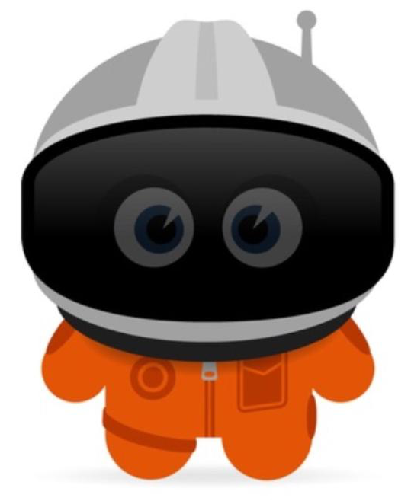
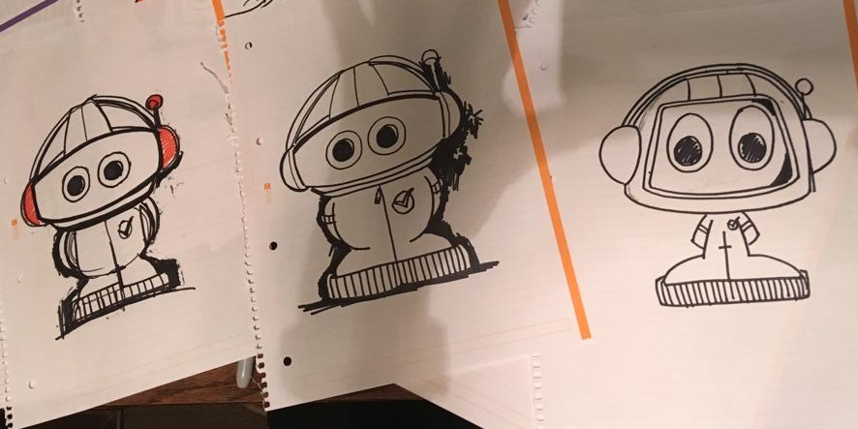
We took inspiration from this picture.
These drawings show how we arrived at our idea.

Slide 4
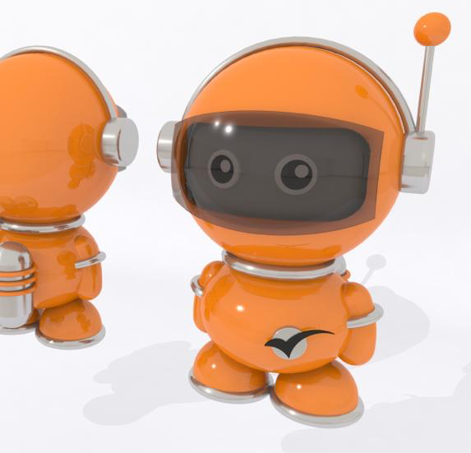
This is our initial idea of the design that we commissioned.
We experimented with 3D but we felt that this looked too childish for older children, as it looks like a plastic children’s toy.
We like the character’s badge and we would like it to be included on the astronaut’s uniform.

Slide 5
Background and Company Name
Retro style (see pictures on the mood board)
May include rocket, planets, stars,…
Need a clear, visible font for the brand name, Astral Maths

Slide 6

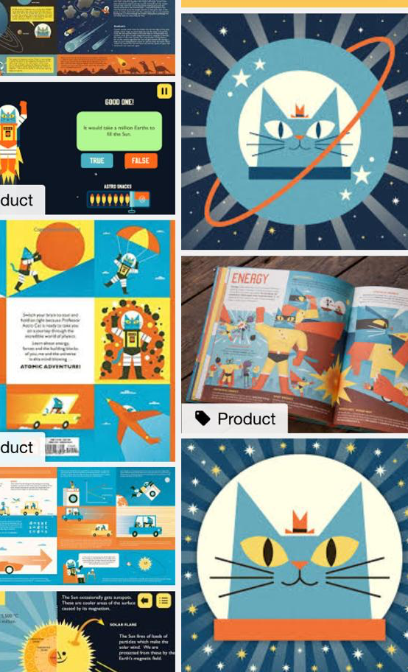
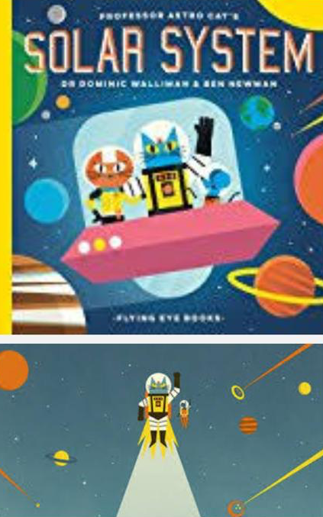

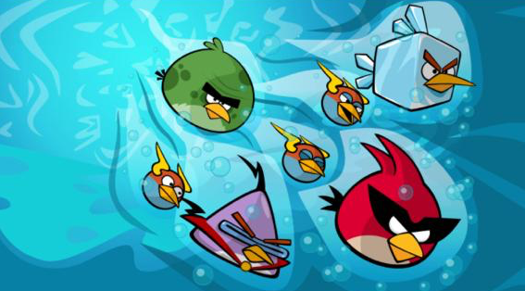
Mood board for background

Slide 7
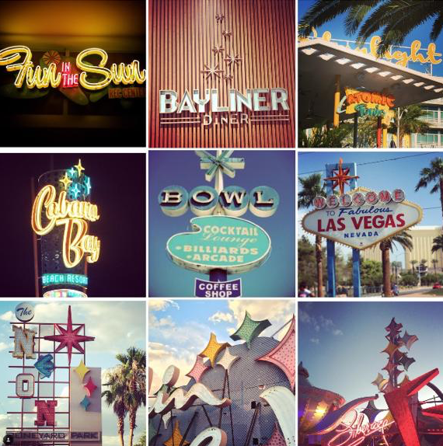
Styles ideas for font

Slide 8
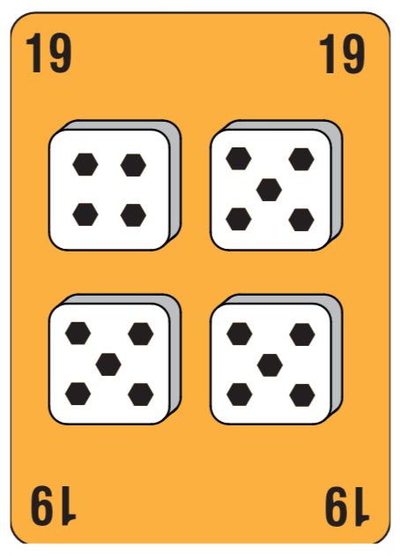
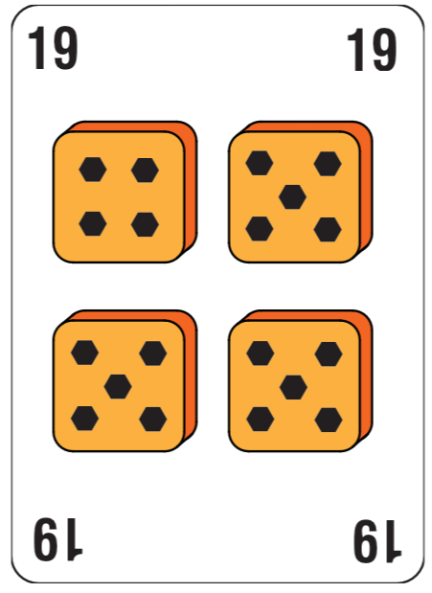
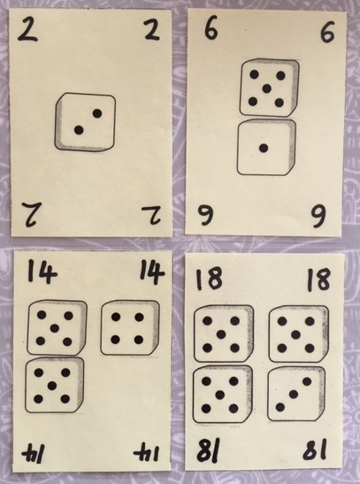
The front of the card
The design for the front of the card should be based on this design, with circles instead of hexagons on the dice faces.
Some colour may be included.
Exemplary sketches for how different numbers will be represented using dice patterns on the front of each card.

