Slide 1


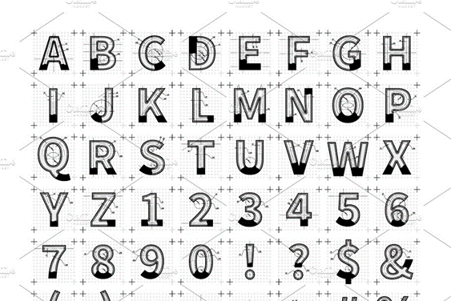
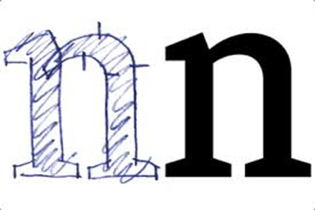
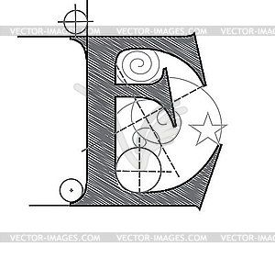
My consulting process
1. My Clients Starting point- trapped in a “thinking maze” with seemingly no way out
2. Break down the situation to first principles / outline design sketch
3. Sharpen up the design – grey line to right shown as hollow with drafting guide lines
4. The end goal – change perspectives – think your way out of the Maze along solid new lines – pls include end grey arrow in this version in addition to the original
New variant 1
New variant 2
Styles I like:

Slide 2
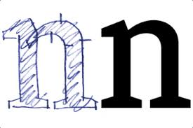
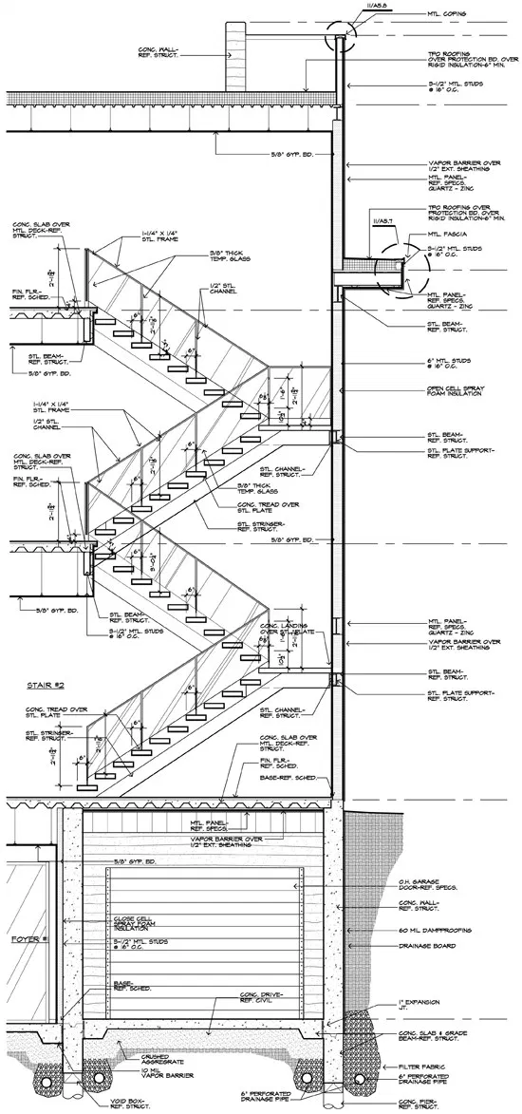

Hand drawn / rougher drafting style
Grid background with guide crosses
Letters are hollow, not filled.
Guide lines – have arrows on ends point out to represent options/ choices in which way to turn
Designers / Architects style

