Slide 1

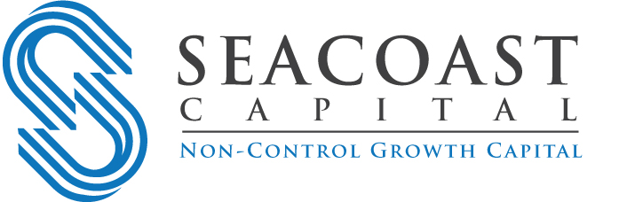
Introduction to Non-Control Capital
The Lower Middle Market Private Company Strategy for Raising Capital
While Maintaining Business Control
Fall 2018

Slide 2
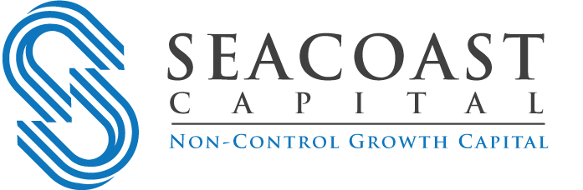
Introduction
Private company owners have traditionally considered two capital raising options:
  Borrow from a local bank, or
  Sell most or all of the company to a change-of-control investor (aka Buyout firm)
An alternative most have not considered is the raising of Non-Control Capital, or capital that is invested into the business yet allows those same owners to retain controlling interest in their company
Non-Control Capital is not appropriate for every private company owner but neither is a Change-of-Control sale
The key is to determine what the business and owners require, and then partner with an investor best aligned with those needs so that long-term company growth, and personal goals, can both be achieved

Slide 3
What is Non-Control Capital?
Non-Control Capital is an investment which is primarily used for the ongoing operation and/or growth of a business but also allows the current owners to retain:
  Control of the business economics
  Control of the business operations
  Control of strategy and key decision making
  Control of the Board of Directors
Requires the alignment of management incentives with ownership
In essence, a company receives the capital it needs to implement its business plans but owners continue to retain ultimate control

Slide 4
When is a Non-Control Transaction Appropriate?
The company has opportunities to expand but requires capital to do so
At least one active owner is not close to retirement
The company is not in a turnaround situation
Family members may work in the business and want to continue
Owners care about keeping the business in their family name (legacy)
Liquidity (dividend) is not the major use of the invested capital
Owners are sensitive to utilizing too much debt
Companies require more than just capital:
  They may also need operational, marketing, financial, and/or technology counsel

Slide 5
“Our company had several business opportunities but I needed outside capital to take advantage of them. Why would I cede control of my business when we were at the exact point when raising outside capital would allow me to accelerate growth and achieve my life-long business and personal goals?!”
--John Wilson, CEO; The VMS Group

Slide 6
The 12 Primary Uses of Non-Control Capital
Growth Capital used to organically expand a business: introduce new products, build a new factory, hire additional management or employees, enter new markets, or for general working capital purposes | Acquisitions Capital used to acquire one or more competitors or to allow for further vertical or horizontal integration | Partner or Shareholder Buy-Out Capital used to buy-out an inactive or retiring partner or shareholder | Management Buy-Out (MBO) When the incumbent management team buys most or all of the ownership of an inactive founder or executive
Management Buy-In (MBI) When an external, experienced executive buys a business from one or more inactive owners and needs additional capital to affect the purchase | Family Ownership & Wealth Transfer When junior generations of a family acquire most or all of the ownership interests of more senior generations allowing the business to remain in the family name | Balance Sheet Recapitalization Changes the debt and equity mixture of a Company’s finances to a more optimal capital structure | Refinancing Replacing one form or type of debt with another with better terms, conditions, and flexibility
Family Office Support Allows a Family Office to affect an investment in a Company by allowing a junior capital provider to invest alongside them | Senior Lender Enhancement or Transition When a Company has grown beyond the means or interest of its senior bank but needs additional capital to support its continuing growth | De-Lever Balance Sheet When a Company has taken on too much debt (typically senior debt) and replaces some of it with either equity or other junior capital to provide operating flexibility | Owner Dividend (Liquidity) When one or more owners take a non-life changing cash distribution, typically used to diversify their net worth

Slide 7
Seacoast Provides Junior Capital
Balance Sheet Seniority / Capital Stack Hierarchy
Senior Debt | Senior Debt Capital Providers Paid back first, plays more of a lender than partner role, less value-added, less equity dilutive, less expensive capital, but not strategically focused
Revolver
Asset-Based Loan
Senior Term Loan
Combination
Unitranche
Junior Capital | What Seacoast Invests Sits junior to all other capital (taking on more risk), plays a partner role, more value-added services provided, more expensive than senior debt, but supplies an engine for continuous improvement and growth
Subordinated Debt
Preferred Stock
Common Stock

Slide 8
A Balance Sheet: Seacoast’s Position in the Capital Stack
Assets |  | Liabilities
Cash |  | Accounts Payable
Marketable Securities |  | Taxes Payable
Accounts Receivable |  | Revolver
Inventory |  | Senior Term Loan
PP&E |  | Unitranche Debt
Intangible Assets |  | Subordinated Debt*
Other Assets |  | Equity
 |  | Owners’ Equity
 |  | Preferred Stock
 |  | Common Stock
*Key: Where Seacoast Participates

Slide 9
Firm Overview

Slide 10
Seacoast Capital Introduction
Seacoast invests Non-Control Capital direct with management
  Owners retain control of their business after we invest
  Without a traditional Change-of-Control private equity sponsor
One of the longest-standing junior capital funds targeting the lower middle market
Since 1994, Seacoast has completed 74 (and counting) Non-Control Capital investments and managed over $600 million
Our interests are aligned with management or we don’t invest
“Consultants with Capital”
  We partner with companies that seek capital and our assistance to improve and/or grow the business

Slide 11
OVERVIEW
We have over 140 years of combined principal investing experience.
Offices in Boston and San Francisco with 12 investment professionals fully dedicated to Non-Control Capital investing
Invest combinations of equity and subordinated debt securities
Currently investing $260MM fourth fund
  9 Fund IV investments made to date (as of November 1, 2018)
  Over $120MM of “dry powder” available for new investments

Slide 12
WHAT WE DO / AND WHY
Non-Control Capital transactions only
Companies looking for a partner to help them grow, not sellers looking to exit
Management’s personal wealth directly tied to the performance of the investment
Situational investors with a generalist approach
Our heritage reflects decades of Non-Control Capital investing—it’s all we do

Slide 13
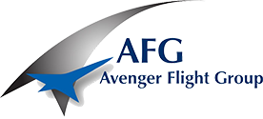




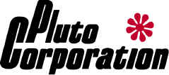
Seacoast Representative Non-Control Capital Investments
Growth Capital Management Buy-Out (MBO)
Acquisition Finance Balance Sheet Recapitalization
Family Ownership & Wealth Transfer Family Office Support
♦ Operates dedicated commercial airline pilot training facilities throughout the U.S. and Mexico. Centers are complete with classrooms; integrated procedures trainers; flight training devices; and Level D, full-motion flight simulators.
♦ Seacoast’s capital was used to fund the Company’s near to intermediate-term growth. Seacoast also assisted the Company in the recruitment of additional management personnel and the opening of a new Dallas office.
♦ Provider of audit compliance software and consulting services for hospitals and physician practices.
♦ Seacoast’s capital was used to assist the active CEO in acquiring the business from its inactive founder. Seacoast also assisted in the significant investment into the Company’s core revenue integrity software platform, developing it into the premier risk-based product in its sector.
♦ Manufacturer of vibration isolation, seismic control, and shock protection products. The Company’s products are designed to limit the transmission of vibration, impact, seismic, and wind forces to protect larger systems that are at risk of damage from these events. .
♦ Seacoast’s capital was used to acquire two attractive tuck-in companies (a testing lab and an on-line component distributor) that improved VMC’s competitive position. Three years later, the Company set an all-time sales record.
♦ Provider of third-party vehicle maintenance services for private, public, and for-hire fleet-based businesses nationwide.
♦ Seacoast’s capital was used to support Amerit’s accelerating growth which exceeded their current lender’s capacity. Seacoast provided both subordinated debt and preferred stock, altered the debt and equity mix of the business, and the Company was able to grow significantly over the next three years.
♦ Provider of fire and security alarm design, installation, service, and monitoring services for commercial and residential end-markets.
♦ Seacoast’s capital allowed for enough cash breathing room for the CEO to think strategically about the business, focus on the growth of the Company, and build family wealth. Five years later, after the Company and Seacoast were successful in substantially growing the business, Mountain Alarm bought out Seacoast’s ownership position entirely with senior debt—as a result, the CEO (father), COO (son), and key management team were back to owning 100% of the Company. The son had a significantly larger stake in the business than five years earlier and the father had the flexibility to work through his family estate plans.
♦ Provides comprehensive and custom packaging for the liquid home cleaning products sector, and has the ability to safely process volatile liquids, such as bleach and hydrogen peroxide.
♦ Seacoast’s capital was used to assist a New York-based family office in acquiring the Company as part of their business outsourcing growth strategy thesis.

Slide 14
INVESTMENT CRITERIA
Seacoast invests in established, lower middle market companies.
Revenues of $10MM to $150MM
EBITDA of at least $2MM
Seacoast investment size of $5MM to $25MM
Experienced, committed, and incented management
Limited leverage (aka debt) “ahead” of Seacoast
Niche market leader with differentiated services or products
Focused on value-added execution, not proof of concept

Slide 15
CONSULTANTS WITH CAPITAL
We help portfolio Companies create greater value.
Facilitate strategy development
Improve financial reporting and information systems
Assist with key hires, such as CFOs and COOs, if needed
Source, evaluate, finance, close, and integrate acquisitions
Invest additional capital
Annual Executive Summit focused on professional development and networking
Most importantly, act as a sounding board to help solve problems, identify new opportunities, and create value
We personally invest in every transaction
These options are made available to our portfolio companies, if needed, and not forced upon them

Slide 16
SEACOAST IMPACT - BY THE NUMBERS
During Seacoast’s average investment term, our impact has been noteworthy
Impact Category | Actual Impact | Min/Max* Removed
Average Revenue Growth | 113% | 91%
Average EBITDA Growth | 75% | 78%
Average Employee Growth | 213% | 49%
*Note: Actual Impact figures based on 55 exited investments from 1994 to 2017. Min/Max removed from each of 3 fully invested funds.

Slide 17
In Summary
There is an alternative to giving up control of your company through an infusion of Non-Control Capital
All investors are not created equal
Non-Control Capital investing is a specialty:
  Choose only an investor with decades of Non-Control heritage, experience, and focus (see Questionnaire in the Epilogue section of this presentation)
It means more than just capital:
  Team up with an accomplished investor who can bring demonstrated growth abilities, not simply write a check
Chemistry between company management and the investor is critical:
  If Seacoast’s interests are not aligned with management, we don’t invest

Slide 18
Epilogue

Slide 19
The Critical Questions to Ask of Any Prospective Non-Control Investor
Non-Control Capital Questionnaire
Non-Control Capital is a specialty, so only those firms with deep experience investing it as a team should be considered
Question #1: How many years has the firm been investing Non-Control Capital?
  Best Answer: 5+ years investing as a team within the current firm
  Indicates comfort and experience evaluating and making NCC investments with each other and increases likelihood of close
Question #2: How may fully-invested Non-Control Capital funds in the firm’s history?
  Best Answer: 2+ fully-invested funds
  Indicates experience and ability to close deals with the current regime—those firms without it may only be testing the waters and not have a long-term commitment to NCC investing
Question #3: What percentage of the firm’s voting investment committee are full-time Non-Control Capital investors?
  Best Answer: Super-majority
  Indicates commitment, experience, and focus on NCC and overcomes dependency on buyout heritage, if any
Question #4: What is the number of Non-Control Capital investments made with the current firm and team?
  Best Answer: 20+
  Indicates long-term experience and comfort with current team, investment committee, and NCC investment assessment
Question #5: What percentage of portfolio investments made are “sponsorless” (those without a change-of-control investor)?:
  Best Answer: 80%+ of all investments closed in the last 5 years (assumes current transaction is also sponsorless)
  Indicates ability to add-value as a sole minority investor and not simply as a back-up to another sponsor
Question #6: Can the investor show quantifiable proof of their ability to assist portfolio companies with growth and improvement (assumes more than 20 exited Non-Control investments)?:
  Best Answer: Yes (company owners should evaluate investors on actual historical revenue, EBITDA, and employee growth impact and the results should exceed what the current management has achieved on their own over the past 3 years)
  Indicates true value-added ability to help owners grow their businesses. Those without proof of their impact, or who are unwilling to disclose it, should be excluded

Slide 20
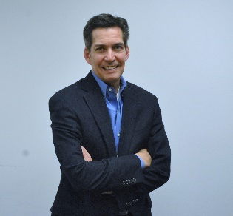
CONTACT
Philip S. Curatilo
Principal
83 Wooster Heights Road, Suite 125
Danbury, CT 06810
Direct: (978) 750-1319
pcuratilo@seacoastcapital.com
Boston Office
55 Ferncroft Road, Suite 110
Danvers, MA 01923
(978) 750-1300
San Francisco Office
One Bush Street, Suite 650
San Francisco, CA 94104
(415) 956-1400
seacoastcapital.com
Copyright © 2018 ♦ Seacoast Capital Partners ♦ All Rights Reserved

