Slide 1
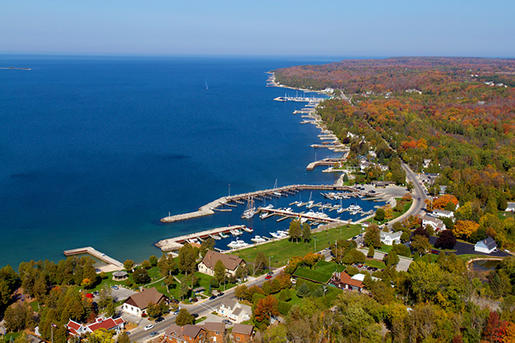
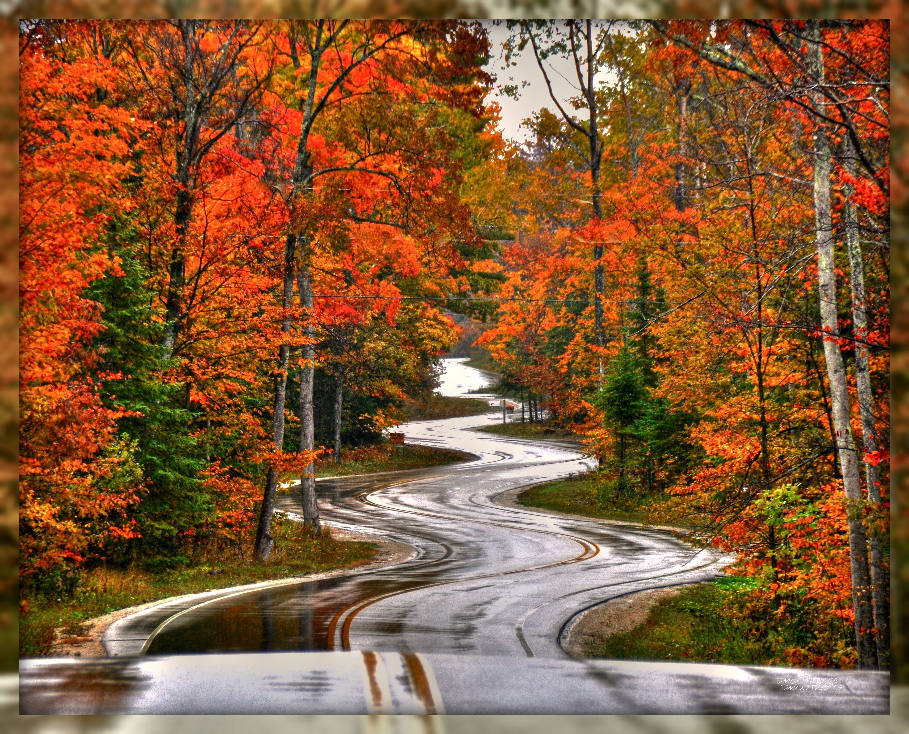
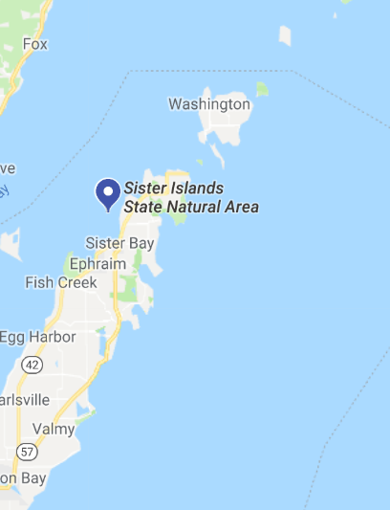
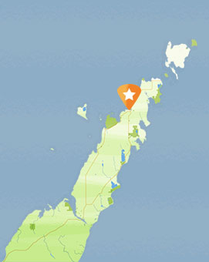
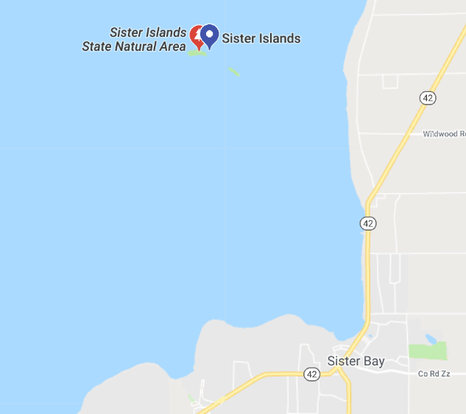
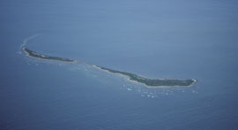
I don’t want blue colors like a lake. I like warm, earthy tones.
Oranges – teals – etc.
Name: Sister Bay Marketing Co.
Sales – Marketing – Brand Building
This is just for inspiration:
Sister bay is named that because there are two islands called ‘sister islands’ that flank the bay.
its in th

