Slide 1
Organic Dough Co – Authentic Pizza Dough
www.organicdough.co.nz

Slide 2
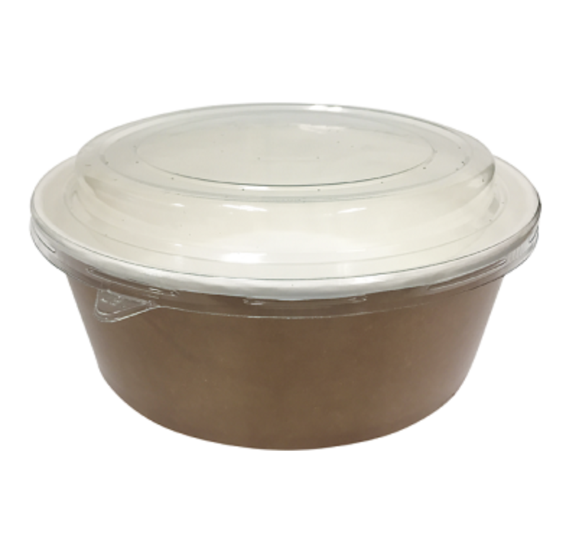
Logo Design for Market Samples
A simple logo with the company i.e. Organic Dough Co and the product name description i.e. Authentic Pizza Dough, required for marketing samples, to be made into stickers to go on the lid of a pack format as shown.

Slide 3

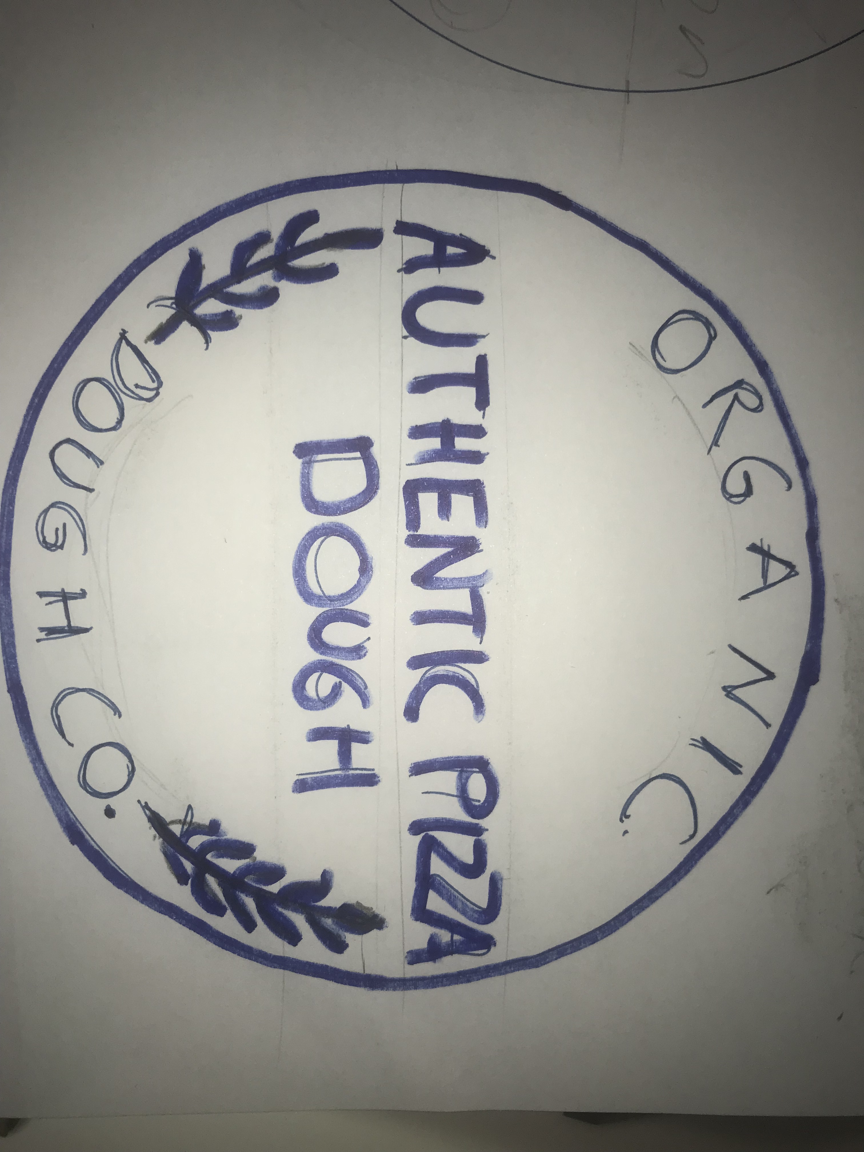
Basic Visual Guide Line
https://www.iconfinder.com/icons/508062/agriculture_farm_grain_wheat_icon

Slide 4
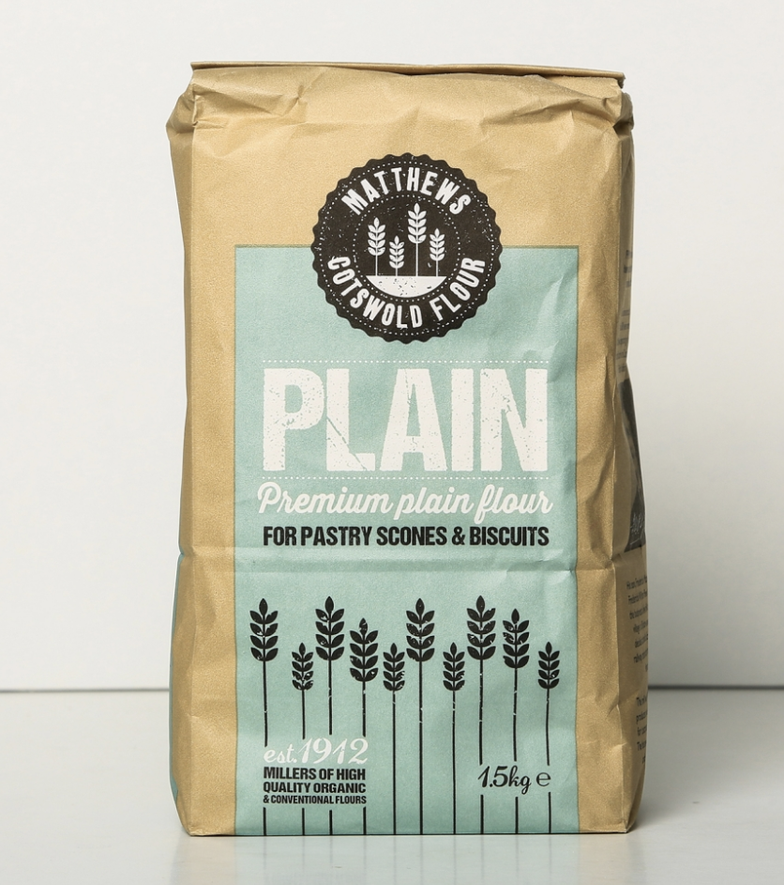
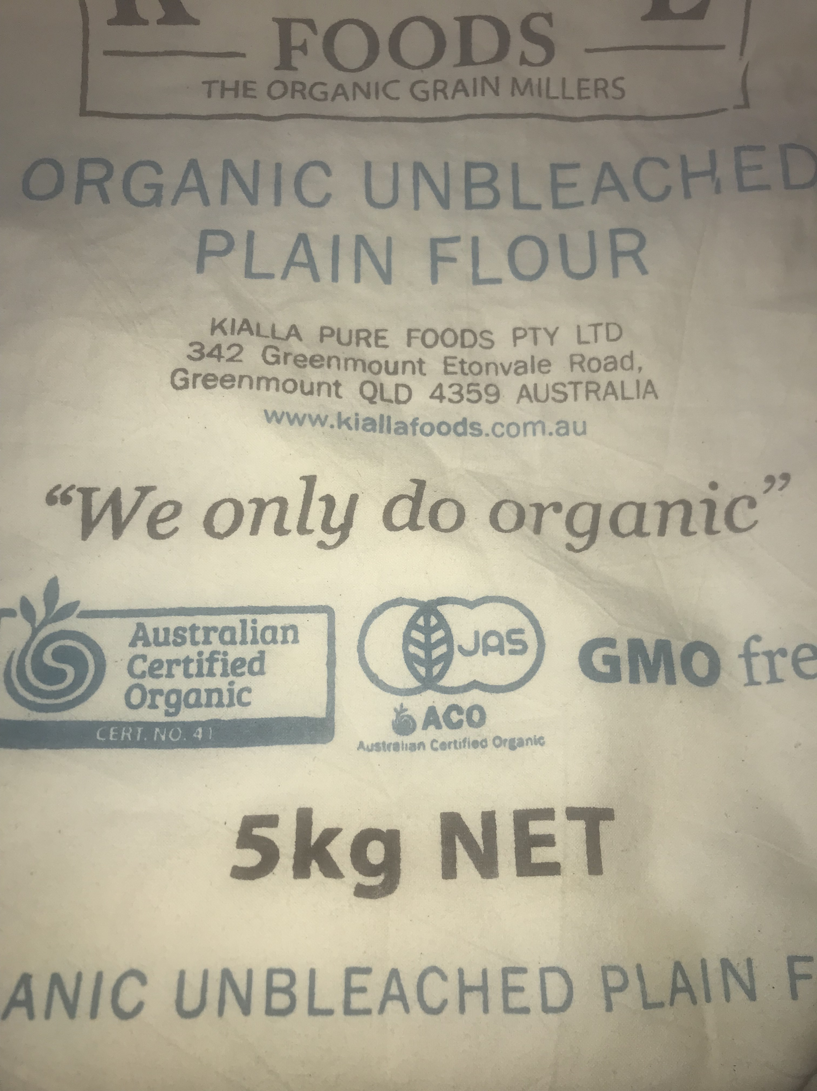
Colour Palette /Styling
Blues and browns, earthy and organic, rustic screen printed look on linen or brown recycled paper not trying to be clinical like Apple iPhone, but simple, tidy and natural. The ingredients all 100% Organic and Natural
https://www.fwpmatthews.co.uk/product/cotswold-plain-flour/

