Slide 1
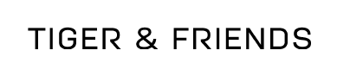
Current text logo:

Slide 2
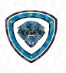
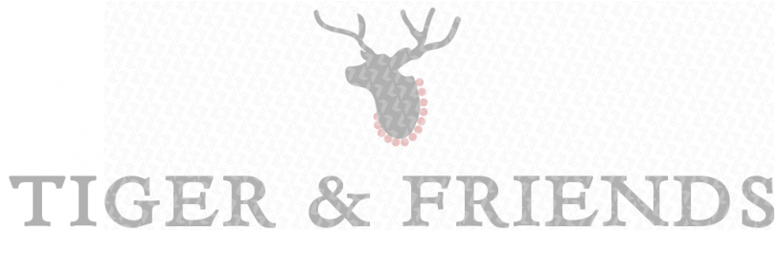
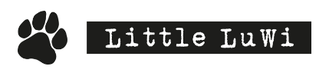

1. We need an illustration to use with the text logo, see examples below

Slide 3
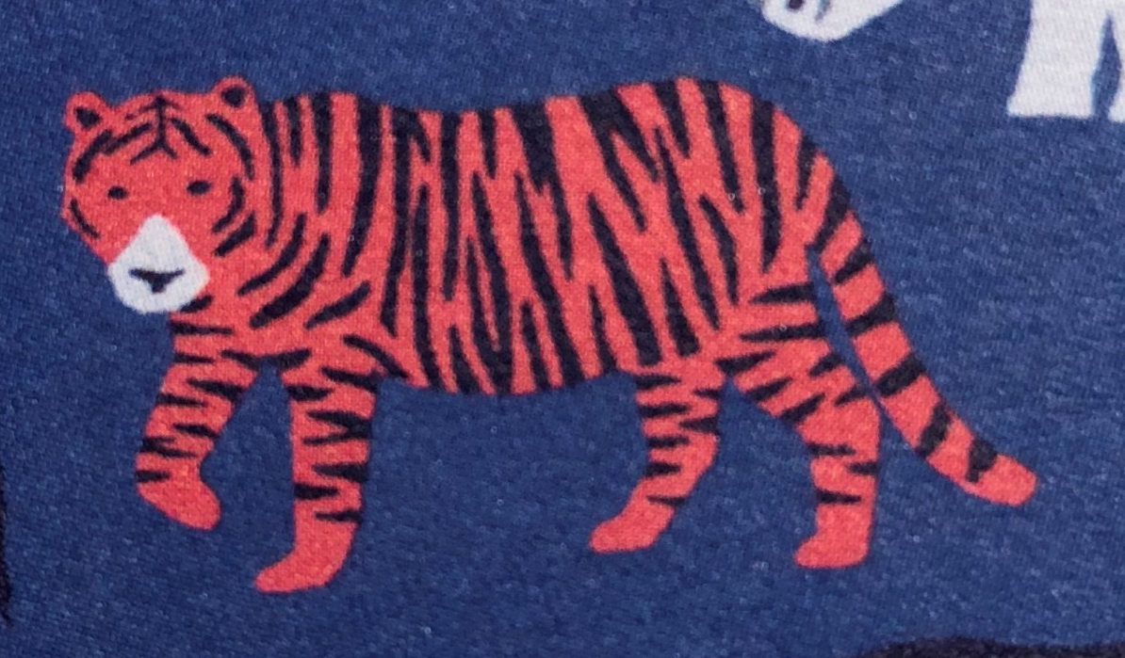




2. We need a simple animal (preferably a tiger) to use on clothes, labels etc as a "second" logo (see examples below)

Slide 4

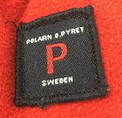



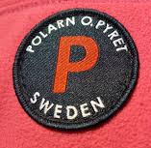
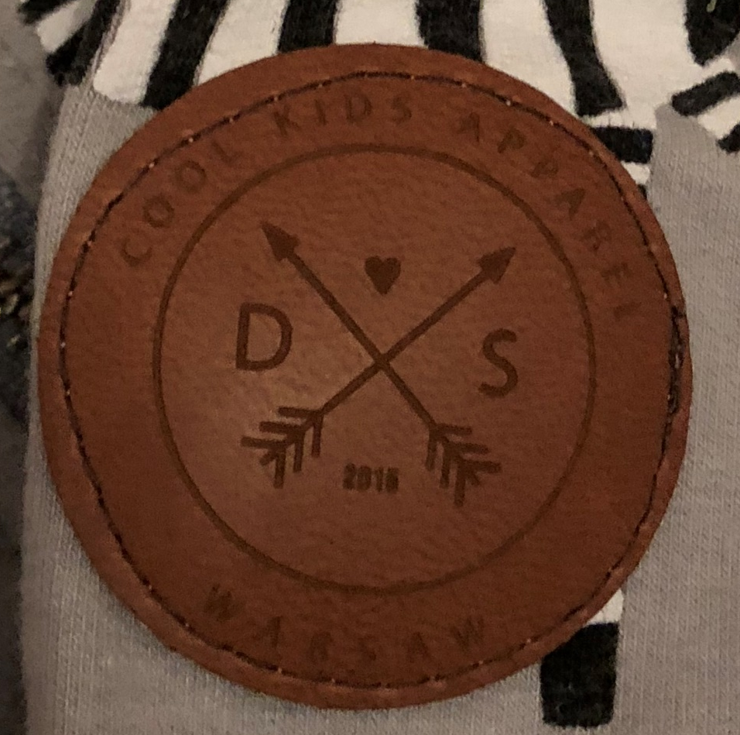

3. We need a design to use on cloths, labels etc with a symbol (see examples below).

