Slide 1




Home from Home &
Work from Work.
The price of failed leadership is already too high for us not to attend to the process through which we can develop and support our key players.
Individual Houses Available
PA can stay; family visits; staff meetings; chef prepares meals
Technical Staff on site setting up secure data, video and audio links – unlimited bandwidth
Extremely discrete and private
24/7 security
Site Features
3 beds in each private house
1 master en-suite per house
Private clinical and medical staff monitoring progress
HIPAA compliant network
Bass fishing; kayaking; skiing; pleasure boating; private BBQ facilities
Client’s tablet allows immediate and constant access to all amenities and staff
Tablet is retained on departure and used to access the Clinical and Medical staff 24/7
Meals prepared and served in house
Family pets welcome within reason
You are with your own peer group
Contact Us:
Today is your Tomorrow
We Can Make it Happen
Psychological, social, and Cultural functions of leadership form the cornerstone of our research and development when assisting our clients.
Phone: 205 287 5951 [24hrs]
Cell: 205 222 6298
Info@ccchealth.care
CCC is a registered and Licensed State of Alabama Mental Health Facility

Slide 2










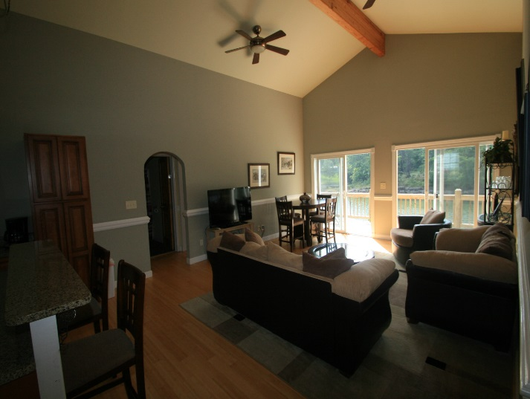

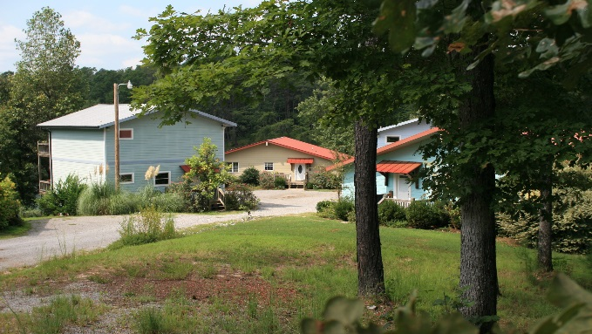
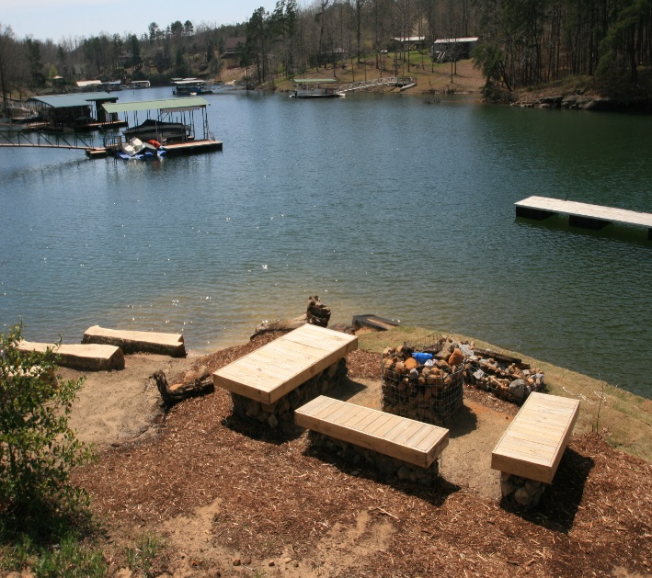

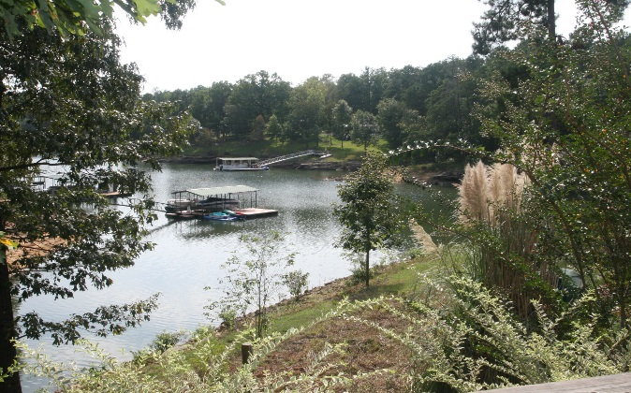
Lakeside Treatment; Lakeside Living; Lakeside Wellbeing
Grindstone
Overwork - in hours and also emotional energy invested in one’s job – is a huge problem in today’s corporate culture. As we are urged to have an intimate bonding relationship with work, we should not be surprised that it threatens our families, our productivity, and our health. The triggers for stress keep coming thick and fast and externalizes in mood swings; outbursts; lack of tolerance and many other personal characteristics.
They are approaching a point where intervention is a preferred route to alleviate their crisis.
Mindful, Effective, and Responsible Leaders
Competent and trustworthy leaders are the most valuable assets that any company strives to locate, nurture and protect. We encourage the performance of these key staff purposefully for the benefit of the individuals, their extended family and society at large.
Loyalty and advancement are the true hallmarks of virtue and success within an organisation.
18 executive Rooms; Six Stunning Homes with a private chef; 4 Acres of private land; Medical, Clinical and Psychiatric Staffing on Site; lakeside sports and activities in abundance; HIPAA compliant Site-Wide Digital Overlay accessed through client’s Clientweave Tablet.
Unlimited data from AT&T enables an ultra secure site-wide 200Mbit wireless intranet and internet access. Never leave the office behind.
Cloud Managed Wireless

