Slide 1
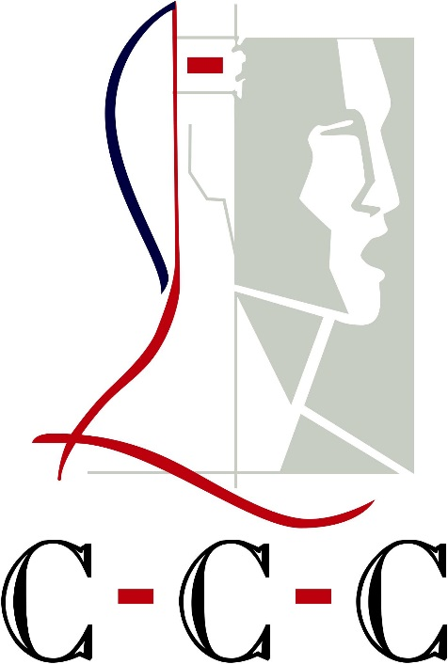


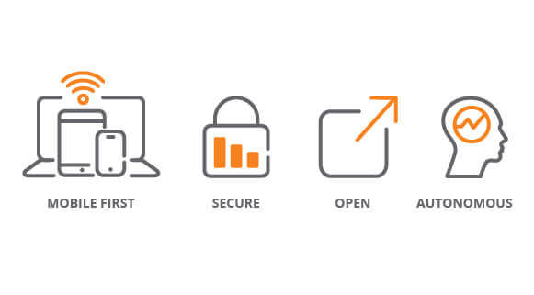
Home from Home &
One on One Treatment.
Technology, when applied to substance and PTSD issues, opens avenues of treatment previously untapped resulting in more dynamic and effective treatment.
Bespoke Treatment Plans
Clinical/Medical staff create bespoke treatment plan
Plan Implemented by extremely qualified clinical/medical staff – NOT ex-addicts
One client per bedroom
Family involvement with plenty of planned visits
Family involvement over secure video links – HIPAA compliant
Technical Staff on site setting up secure data, video and audio links – unlimited bandwidth
Extremely discrete and private
24/7 security
Site Features
3 private bedrooms [1x bed] in each lake house
1 master en-suite per house
Private clinical and medical staff monitoring progress
Bass fishing; kayaking; skiing; pleasure boating; private BBQ facilities
Client’s tablet allows immediate and constant access to all amenities and staff
Tablet is retained on departure and used to access the Clinical and Medical staff 24/7 [Audio; Video and Data]
Meals prepared by on-site
Family pets welcome within reason
You are with your own peer group
Planet Fitness Membership
Contact Us:
Today is your Tomorrow
We Can Make it Happen
ClientWeave allows our clients to maintain a presence at their workplace through secure Data; Audio and Video Links and once they depart.
Phone: 205 287 5951 [24hrs]
Cell: 205 222 6298
Info@ccchealth.care
CCC is a registered and Licensed State of Alabama Mental Health Facility

Slide 2
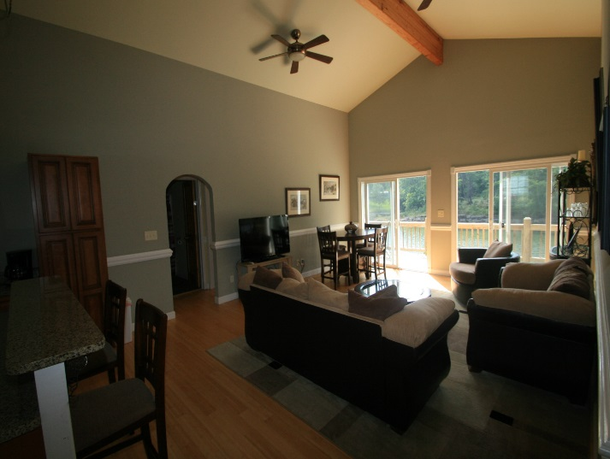
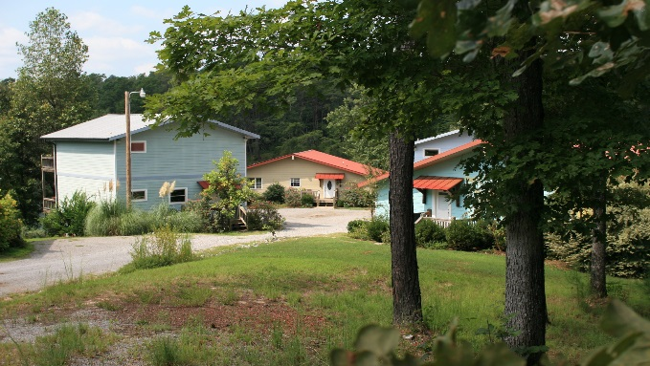
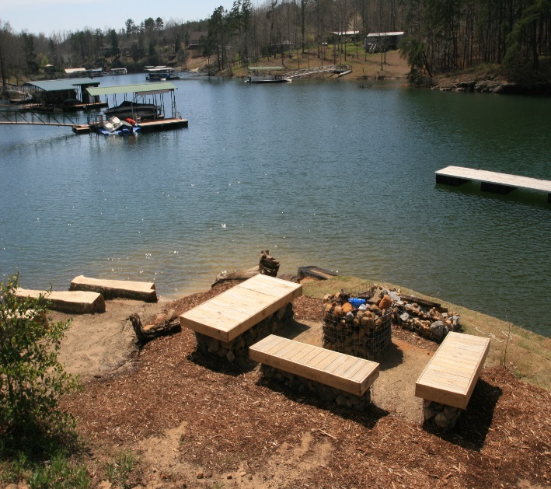

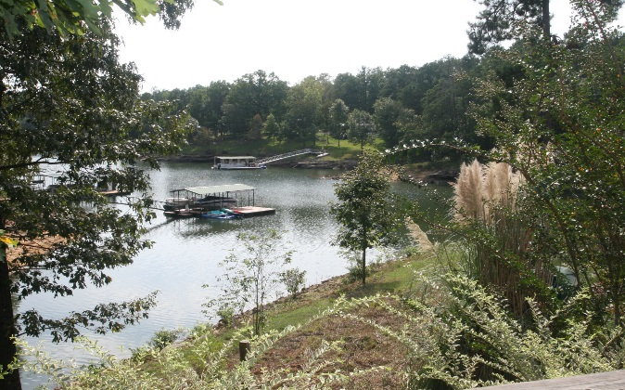
Lakeside Treatment; Lakeside Living; Lakeside Wellbeing
ClientWeave Overview
The judiciary module is basically a ‘pleading’ system between the CCC Behavioral Health facility and the disparate courts in Alabama and the adjoining States.
A ClientWeave tablet connects through to CCC from the court or court chambers. Court papers are transferred to CCC over a HIPAA compliant secure data, video and audio link established between the court and the CCC Clinical and/or Medical staff. The client is given a choice, after passing protocol checks, of attending therapy at CCC or not.
Effective and Bespoke Treatment The issue that the courts in general have is that conventional treatment open to the courts simply do not seem to establish a treatment pattern that results in a high success rate. That is, the resistivity of the client to issues that caused the initial downfall has not improved post treatment resulting in a 'repeat offender' label being applied.
We anticipate an improvement from this circa 5% success rate through intense treatment plans bespoke to each a client; a low ratio of clients to clinical & medical staff; an environment conducive to treatment and recovery and a peer group that facilitates the divesting of the stigmata associated with their experience.
Weekly reports, are sent back into the court from CCC on the clients improvements as therapy is applied. These are in the form of video, audio and data.
18 private Rooms; Six Stunning Homes with a private chef; 4 Acres of private land; Medical, Clinical and Psychiatric Staffing on Site; lakeside sports and activities in abundance; Site-Wide Digital Overlay accessed through the client’s personal ClientWeave Tablet.
Networking underpins our
ClientWeave strategy and functionality
Unlimited data enables an ultra secure site-wide 200Mbit wireless intranet and internet access. Never leave work or family behind.

