Slide 1



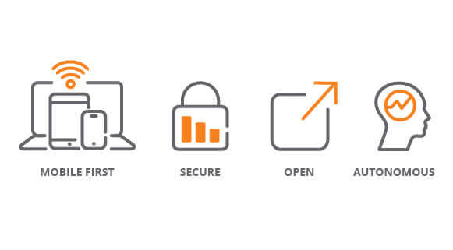
- Home from Home &
One on One Treatment -
The price of failed adolescence is already too high for us not to attend to the process through which we can develop and support our future players.
Bespoke Treatment Plans
Medical& Clinical staff create treatment plan
Plan Implemented by extremely qualified clinical staff
One client per bedroom
Intense Family involvement with plenty of planned visits
Optional and secure video links – HIPAA compliant
Technical Staff on site setting up secure data, video and audio links – unlimited bandwidth
Extremely discrete and private
24/7 security
Site Features
3 private bedrooms in each lake house
1 master en-suite per house
Clinical and medical staff monitor progress
Bass fishing; kayaking; skiing; pleasure boating; BBQ facilities; Planet Fitness
Client’s tablet allows immediate and constant access to all amenities and staff
Clentweave tablet is retained on departure and used to access the Clinical and Medical staff 24/7 [Audio; Video and Data]
Chef prepared meals, cooked and served in house
Family pets welcome within reason
You are with your own peer group
Contact Us:
Today is your Tomorrow
We Can Make it Happen
Psychological, social, and cultural functions of adolescence form the cornerstone of our research and development when assisting our young clients.
Phone: 205 287 5951 [24hrs]
Cell: 205 222 6298
Info@ccchealth.care
CCC is a registered and Licensed State of Alabama Mental Health Facility

Slide 2
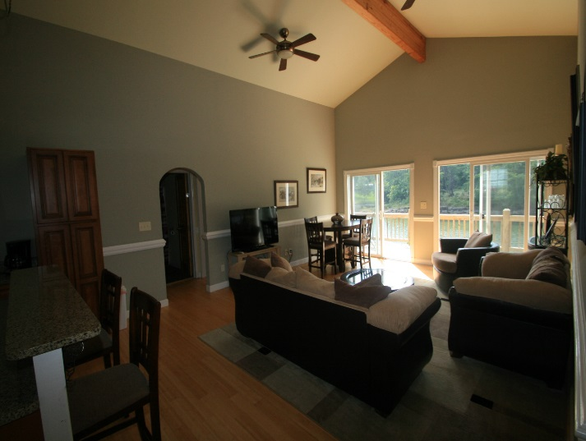
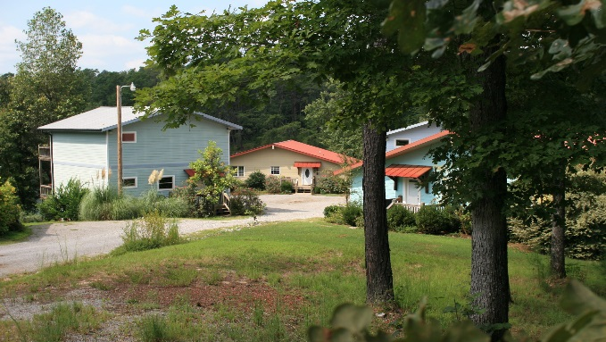
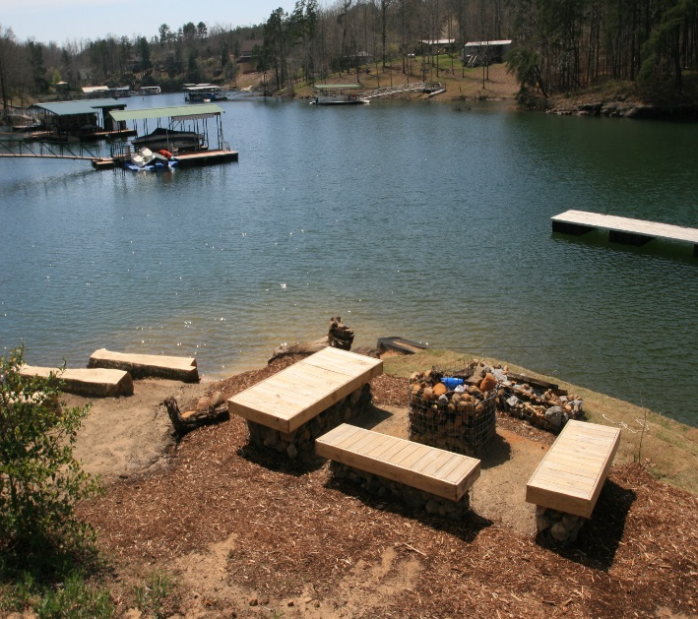
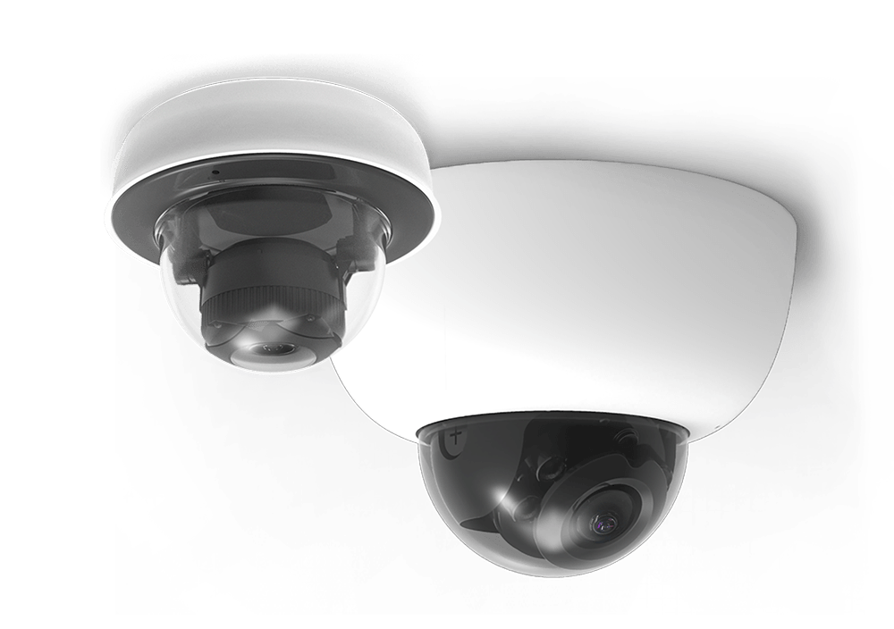
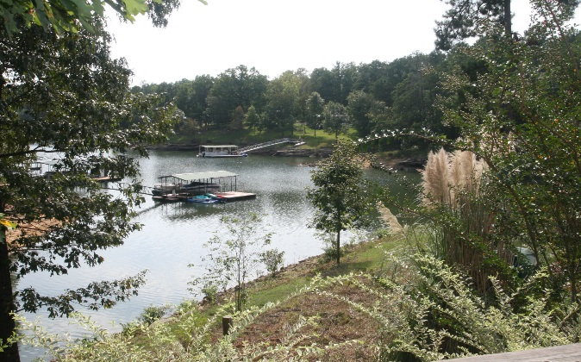
Lakeside Treatment; Lakeside Living; Lakeside Wellbeing
Your Brain is being Damaged
Substance use during adolescence has been associated with alterations in brain structure, function, and neurocognition. In short – your brain is suffering more than you can imagine.
Cognitive deficits resulting from these alcohol and drug related neural insults have potentially harmful implications for subsequent academic, occupational, and social functioning extending into adulthood. Therefore it’s important that adolescents realise that a moment on the lips can lead to a lifetime of mental suffering.
Our treatment tools are designed to deliver engaging and effective health monitoring and health behavior interventions and to collectively lead to transformations in the delivery of science-based health care.
Intervention is a preferred route to alleviate their future crisis.
Mindful, Effective, and Responsible Leaders
Competent and trustworthy adolescents are the most valuable assets that any community strives to locate, nurture and protect. We encourage the performance of our future parents; the social fabric of our future family and society at large.
Our future lies with healthy and responsible adolescents.
18 private Rooms; Six Stunning Homes with a private chef; 4 Acres of private land; Medical, Clinical and Psychiatric Staffing on Site; lakeside sports and activities in abundance; site-wide Digital blanket accessed through your own CCC Tablet.
Networking underpins our
ClientWeave strategy and functionality
Unlimited data from AT&T enables an ultra secure site-wide 200Mbit wireless intranet and internet access. Never leave the family behind.

