Slide 1
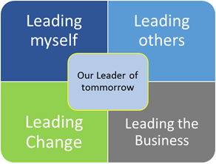

Managers/Leaders
Development
Shopfloor Development
Development Enablers
Training & qualification for key positions
Onboarding
Core competencies matrix model implementation
Global programmes from engagement
Internal Trainer network
External partners
Coaching Academy
Lean Academy programs
E-learning modules
Digital enablers
Communication standards
Core competencies matrix model
Product Supply «Learn&Grow» Academy
Notes:
Comments :
Use a customer-centric approach
Think about certifications and qualifications
Budgetwise : link to the issue with our legacy and focus on the operators upscaling need
Training matrix (ex Lars)
Simple basic manufacturing practices
Solid / aseptic
QC discipline
Know products of their respective site

