Slide 1
Our values
Be TRUSTED by our team and clients, so that our opinions are sought and our recommendations valued.
Have a tight knit relationship with our clients, so we are seen as a PARTNER and not just supplier.
Be focused on return-on-investment, but predominantly, always deliver GREAT VALUE.
DEVELOP & INVEST IN our own people to continually stay one step ahead.
Work relentlessly to deliver results for our clients, but ensure we collectively ENJOY THE JOURNEY.
Take SOCIAL RESPONSIBILITY seriously by supporting other worthwhile organisations.

Slide 2
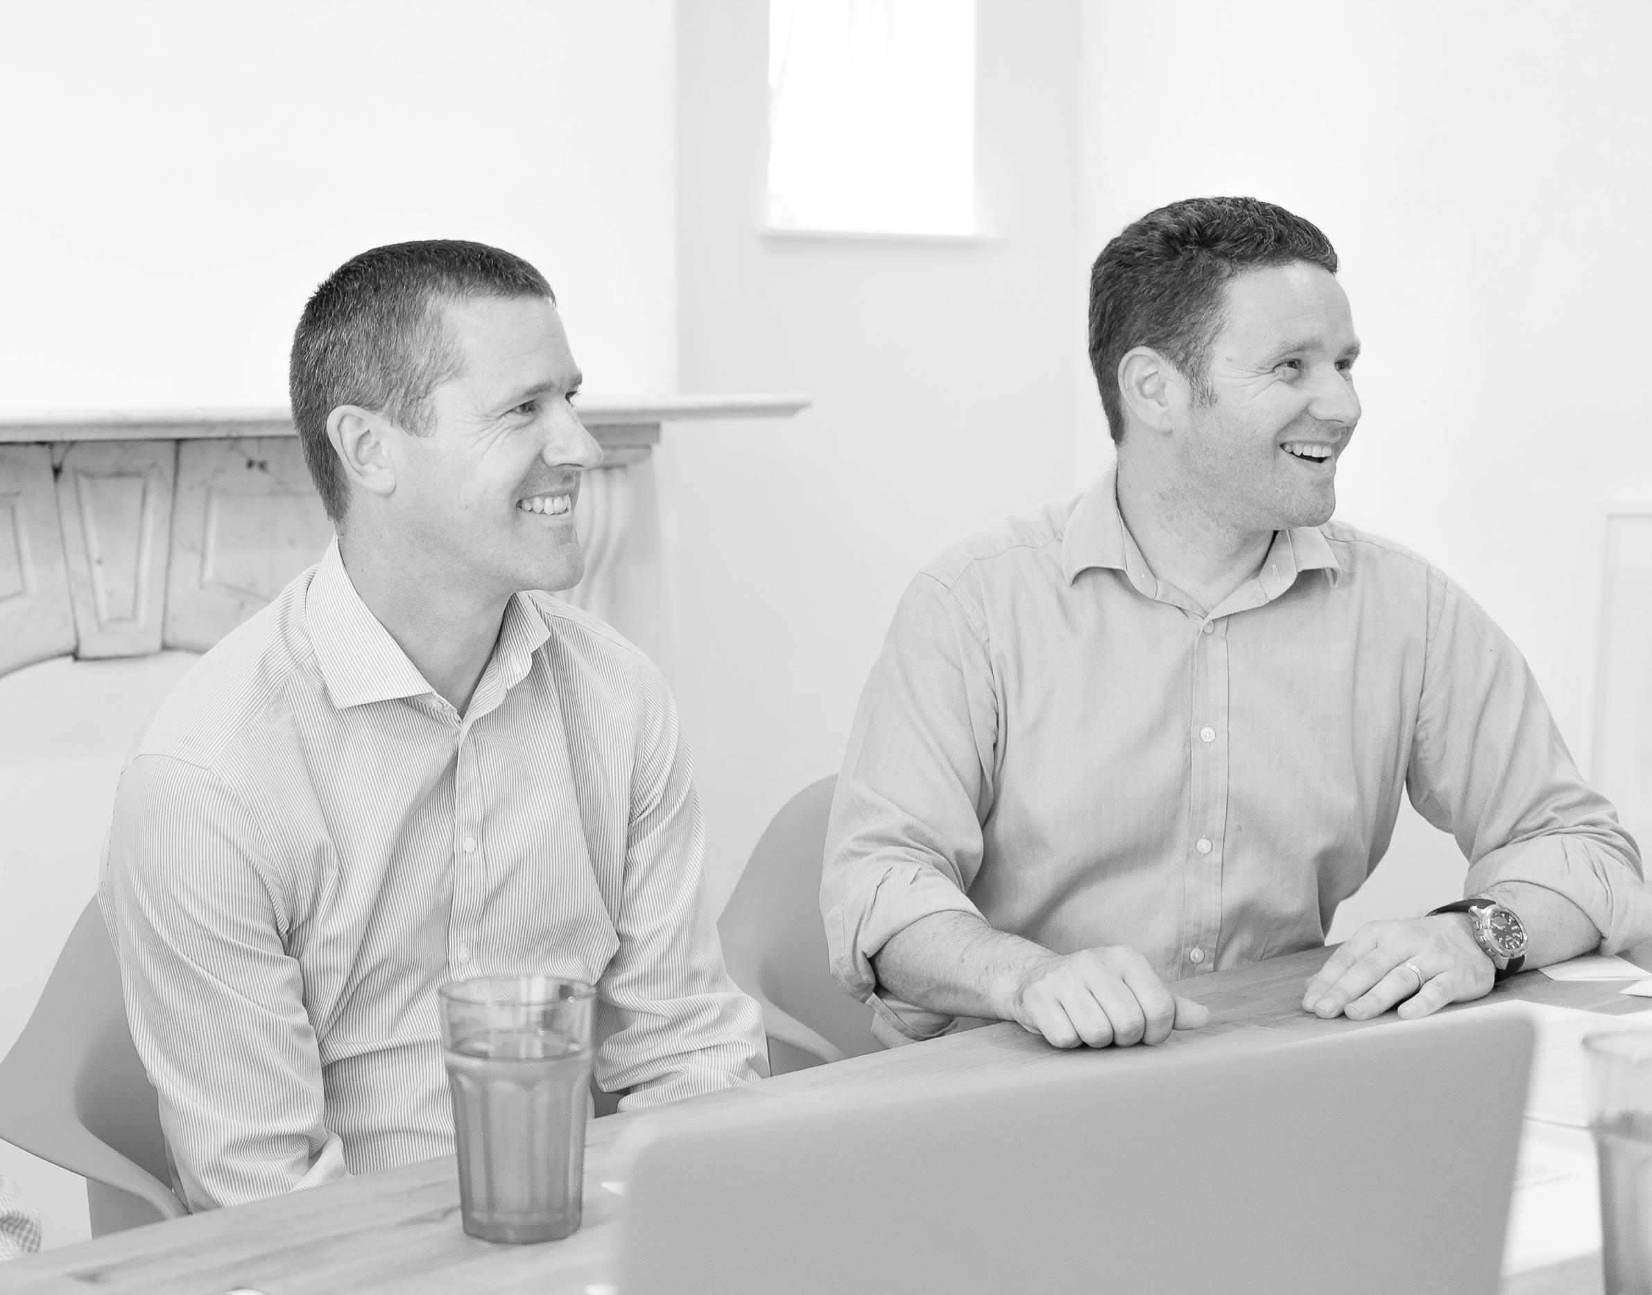
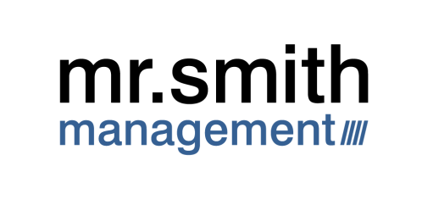
About us
At MSM we constantly strive to deliver the best possible value for our clients. Importantly we recognize, it’s our clients that define value, not us.
Mark Smith
Partner
Signature
Paul Crabtree
Partner
Signature
We bring together our expertise from Toyota and our experience of working with multiple organisations to help our clients deliver results against their own individual goals.

Slide 3
Our Regions
APAC

Slide 4
Our People
All of our team at MSM started their careers in operational roles. This means we understand what it’s like to be in your shoes. Blending this understanding with our years of experience and skills we are able to work in partnership with you and your teams to deliver great results, together. Simply put, our team has some of the best people in the industry.
We also recognise no single person knows everything, so within the team we have experts in their own fields. They are able to bring their specialised skills and experience, at the right time and in the best way possible.
Our team also understand the importance of engagement. Everyone in your team will get to know us on first name terms, because we take the time to listen to everyone, from shop floor to senior management

Slide 5
Quotes
MSM have achieved excellent engagement throughout the entire organisation with significant measurable successes.
Director of Operations
SIS
With the team from MSM we have been able to embed an improvement approach across the entire organisation.
Chief Operations Officer
NHS Hospital
You have definitely made our lives easier knowing that you are taking care of our British colleagues. If we have future needs, we will definitely be straight back to you.
Chief Operations Officer
Invictus Games
The team from MSM have been invaluable with helping implement our lean programme. They’ve helped break down what seemed very complicated at the start, into logical and simple steps.
Managing Director
Staples
MSM have been able offer us support across a range of topics based on their in-depth knowledge of lean and Toyota systems
Continuous Improvement Manager
Daimler

Slide 6
Our services
New Product Introduction
Logistics and planning
leadership coaching & mentoring
Facility Design
Process design
Programme Management & PMO
Business Improvement
Programme Management
Organisational Readiness
Senior leadership development
Equipment design
Quality systems
Personal Development
Business Assessment
Strategy Development
Helping your organisation perform at it’s best
Organisational design
Supply chain development
Separation & Mergers
Optimisation
New Product Introduction
Growth
I.T. System Introduction
Merger
Managing programmes through to successful delivery
Getting your business ready for it’s future
Customer Accreditation
Separation
Facility Relocation
Acquisition
New Equipment
Major Events
ISO
Cost Improvement Programmes
Sale
Three blended offerings, tailored to your organisation.
A blended approach, tailored to each organisation, across 3 core offerings

Slide 7
Our services (to go with graphic)
We recognise every organisation we work with is different; the products or services provided, the culture and the readiness for change but most importantly the ‘wants and needs’ are always unique. The skills, knowledge and experience across our team means we are able to offer an extensive range of services which are tailored to meet your specific needs.

Slide 8
Organisational readiness
Business Improvement
Programme management
Potential layout for our services (centerfold)

Slide 9
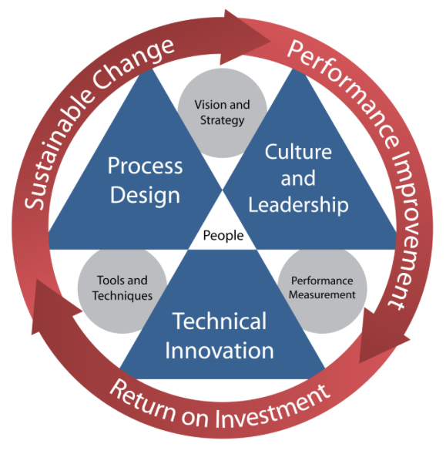
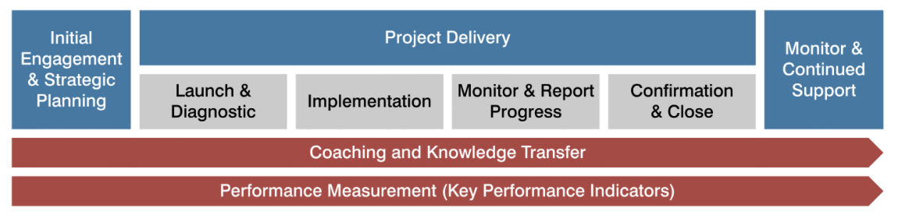
Our Approach
Before everything else, our approach is collaborative. This key principle means we develop programmes of work and an approach to suit your needs.
Throughout our engagements we employ an effective, yet simple set of tools and techniques to ensure we keep on track to guarantee delivery and achieve results. However, our view is that if we just deliver a great set of results we have only partly succeeded, real success has to include the development of your team and leaving them with a set of skills and know-how gained from working alongside us. Our sleeves rolled up style gets things done through showing, not just telling.
For both the below models we would like to have them redesigned as they look very dull. The content should remain the same.

Slide 10
Our Sectors
  Health & care
  Manufacturing
  Hospitality
  Infrastructure
  Global events
  Charities
  FMCG
  Environment
  Retail
  Food
  Financial
  Construction

Slide 11
Contact us
MSM Limited
Riverside Chambers
Full Street
Derby
DE1 3AF
Tel: +44 (0) 1332 408051
enquiries@mrsmithgroup.com
www.mrsmithgroup.com

Slide 12
Suggested page layout
Front cover
Our values
About us & regions
Our people
Quotes
Our Services
Our Services
Our approach
Our approach
Sectors
Contact Us
Back cover

